Slide 1

Creative English
Lesson One: What is a monologue?

Slide 2
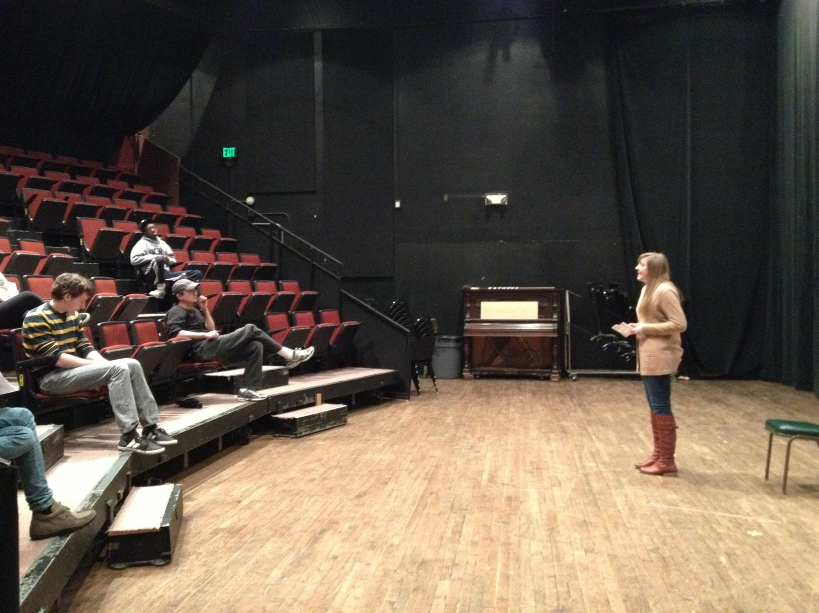
What is a monologue?
A monologue is a speech delivered by one person, who exposes inner thoughts and provides insights into his or her character.
The character/person speaks out their thoughts about a specific event or situation and tells us how they are feeling at that particular time.
Monologues are always written in first person (I think/I feel).
The Greek root word monologos translates to “speaking alone,” and that's a monologue: one person doing all the talking.

Slide 3
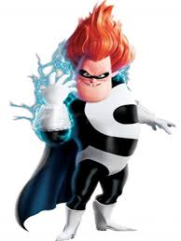
What do you notice about how this character is speaking?
Click on Syndrome to watch him speak in a series of monologues to Mr. Incredible
Listen for:
his attitude (tone)
his use of long and short sentences
Listen for punctuation.
(! ? … --)

Slide 4
Syndrome’s Monologue
WHO is he speaking to?
WHAT is it that he wants?
What is he FEELING at this point?
See? Now you respect me, because I’m a threat. That’s the way it works. Turns out, there are a lot of people, whole countries, who want respect, and they will pay through the nose to get it. How do you think I got rich? I invented weapons, and now I have a weapon that only I can defeat, and when I unleash it, I’ll get… You sly dog! You got me monologuing! I can’t believe it. It’s cool, huh? Zero-point energy. I save the best inventions for myself. Am I good enough now? Who’s super now? I’m Syndrome, your nemesis and…Oh, brilliant.

Slide 5
Syndrome’s Monologue
See? Now you respect me, because I’m a threat. That’s the way it works. Turns out, there are a lot of people, whole countries, who want respect, and they will pay through the nose to get it. How do you think I got rich? I invented weapons, and now I have a weapon that only I can defeat, and when I unleash it, I’ll get… You sly dog! You got me monologuing! I can’t believe it. It’s cool, huh? Zero-point energy. I save the best inventions for myself. Am I good enough now? Who’s super now? I’m Syndrome, your nemesis and…Oh, brilliant.
Underline a question.
Circle the punctuation that tells you his stream-of-thought has been interrupted.
Highlight a sentence that tells you he is feeling vengeful.*
*vengeful=seeking revenge and/or to harm someone because of a past injury

Slide 6
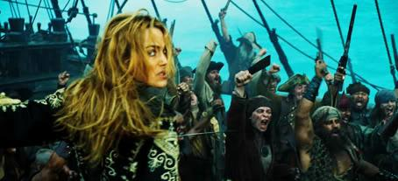
Let’s look at another…
As you have noticed, a monologue occurs when a character is feeling passionate about a situation or an idea. We say this is when “the stakes are high.” When a character feels they have something to lose or win, their emotions grow much stronger.
In this monologue from “Pirates of the Caribbean 3,” Elisabeth must rouse the pirates, who are about to give up, into fighting an impossible enemy.

Slide 7
But wait...
The best way to understand a monologue is to determine its CONTEXT. This will help us understand what they are saying and why.
CHARACTER: Who is speaking?
AUDIENCE: Who are they speaking to?
SETTING: Where are they?
GOAL: What do they want to see
happen?
Glossary
context: the circumstances surrounding a situation (the facts)

Slide 8
Elisabeth’s Monologue
Then, what shall we die for? You will listen to me! Listen! (stares into their eyes) The Brethren will still be looking here, to us, to the Black Pearl, to lead. And what will they see? Frightened bilge rats aboard a derelict ship? No. No, they will see free men and freedom! And what the enemy will see is the flash of our cannons. They will hear the ring of our swords, and they will know what we can do. By the sweat of our brows and the strength of our backs, and the courage of our hearts. Gentlemen. Hoist the colors!
CHARACTER: Who is speaking?
AUDIENCE: Who is she speaking to?
SETTING: Where are they?
GOAL: What does she want to see happen?

Slide 9
Ingredients of a Dramatic Monologue
After you have established:
Character
Setting
Audience
Goal
There are five elements you must include when writing your own monologues:
Stage Directions
Repetition
Imagery and metaphor
Pause and silence
Changes of tone (attitude)

Slide 10
Elisabeth’s Monologue
Then, what shall we die for? You will listen to me! Listen! (stares into their eyes) The Brethren will still be looking here, to us, to the Black Pearl, to lead. And what will they see? Frightened bilge rats aboard a derelict ship? No. No, they will see free men and freedom! And what the enemy will see is the flash of our cannons. They will hear the ring of our swords, and they will know what we can do. By the sweat of our brows and the strength of our backs, and the courage of our hearts. Gentlemen. Hoist the colors!
Highlight the phrase or sentence that
matches each of the following:
Stage Directions
Repetition
Imagery and metaphor
Pause and silence
Changes of tone (attitude)

Slide 11
Elisabeth’s Monologue
Then, what shall we die for? You will listen to me! Listen! (stares into their eyes) The Brethren will still be looking here, to us, to the Black Pearl, to lead. (Pause) And what will they see? Frightened bilge rats aboard a derelict ship? No. No, they will see free men and freedom! And what the enemy will see is the flash of our cannons. They will hear the ring of our swords, and they will know what we can do. By the sweat of our brows and the strength of our backs, and the courage of our hearts. Gentlemen. Hoist the colors!
Highlight the phrase or sentence that
matches each of the following:
Stage Directions
Repetition
Imagery and metaphor
Pause and silence
Changes of tone (attitude)

Slide 12
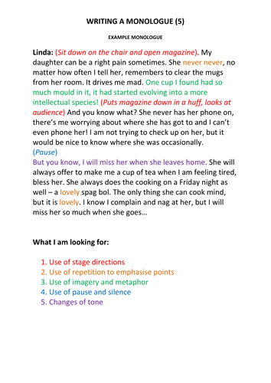
Let’s look at a longer example.
WHO is speaking?
Who are they speaking TO?
WHAT is the character feeling? (at the beginning and the end)

