Slide 1
The Importance of Bar Models

Slide 2
Session Contents
What are ‘bar models’?
How can bar models be used?
How can bar models be introduced?
What do bar models look like across key stages?

Slide 3
Discussion
What do bar models look like?
Why are bar models used?

Slide 4
What Are Bar Models?
16
9
7
9
16
7
0
1
2
3
4
5
6
7
8

Slide 5


A Consistent Picture
2 of 20 = ?
Share 20 in the ratio 2:3
5
4 + 11 = ?
5 x 4 = ?
11
20
0
4
?
:
4
4
4
4
4

Slide 6
A Consistent Picture
4 + 11 = ?
15 - 4 = ?
?
15
4
11
4
?
5 x 4 = ?
20 ÷ 5 = ?
?
20
4
4
4
4
4
?
?
?
?
?
2 of 20 = ?
Share 20 in the ratio 2:3
5
20
20
?
?
?

Slide 7
Discussion
What are the positives and negatives of using bar models?

Slide 8
The importance of bar modelling
“Instead of relying on superficial and unreliable clues like key words, the simple visual diagrams help children understand why the appropriate operations make sense.”
Beckmann 2014
“When children have experience and exposure to many concrete materials, they are able to develop the ability to visualise”
Ban Har 2016
“Although bar models will not always help children carry out required calculations, they are clearly designed to help children decide which operations to use.”
Beckmann 2014
“Model drawing trains children to think analytically, providing an important transition between the concrete and the abstract.”
Forsten 2014
“Bar models are a tool to help children visualise stories”
Ban Har 2016

Slide 9
Introducing Bar Models

Slide 10


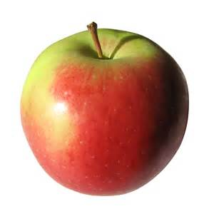
Introducing Bar Models in EYFS

Slide 11
Show me…
There are six glasses of apple juice
Hannah has more than five friends
Sam has more conkers than Tom

Slide 12
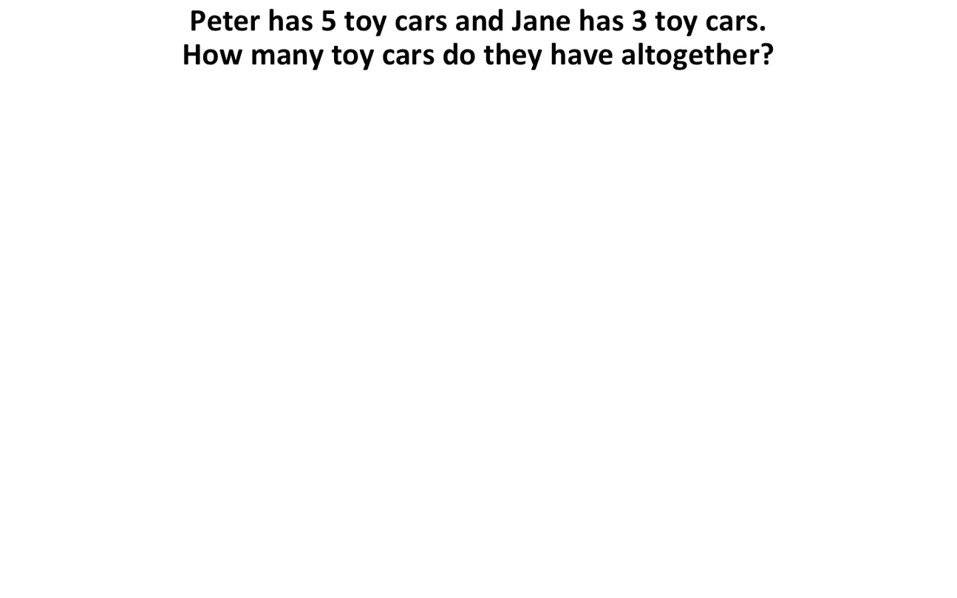
KS1 bar modelling

Slide 13


KS1 Bar Modelling
Tim has 4 sweets and Ben has 2 sweets.
How many sweets do they have altogether?
6
6
6
6
6
4
4
2
Tim
Ben
Tim
Ben
Tim
Ben
Tim
Ben
Tim
Ben

Slide 14
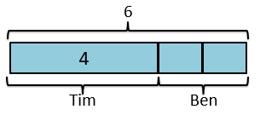
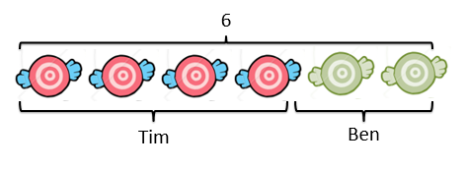
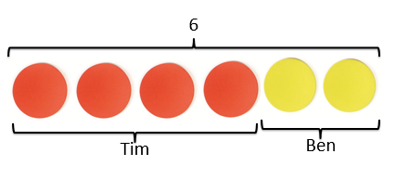
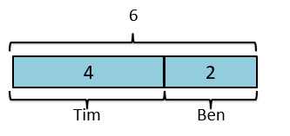
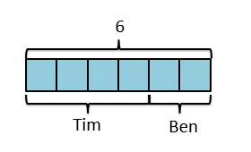
Small steps
4 + 2 = 6

Slide 15
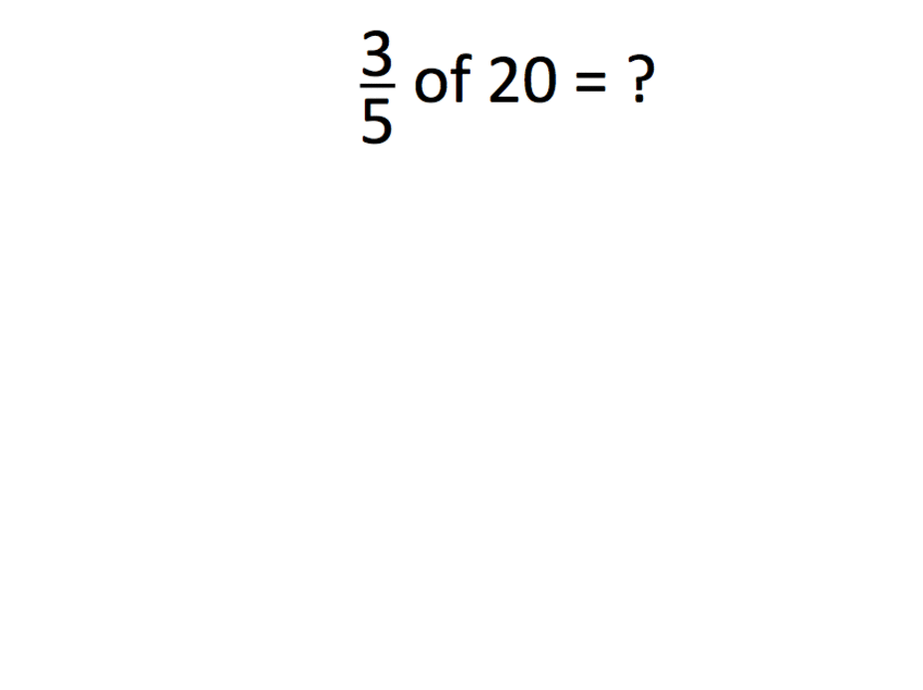
KS2 barmodelling

Slide 16
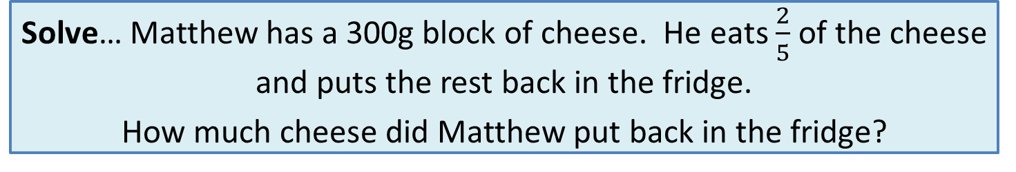
KS2 Bar Modelling
Solve… Matthew has a 300g block of cheese. He eats $\frac{2}{5}$ of the cheese and puts the rest back in the fridge.
How much cheese did Matthew put back in the fridge?
Model
Calculations
300g
300 ÷ 5 =
60
60
60
60
60
60
3 x 60 = 180
Eats
Put back
?
180

Slide 17
KS3 Bar Modelling
3a + 4 = a + 8
Model
Calculations
3a
+ 4
=
a + 8
a
a
a
4
-a
-a
2a + 4 = 8
a
8
-4 -4
4
2a = 4
÷2 ÷2
a = 2

Slide 18
KS3 Bar Modelling
Solve 2a + 3 = a + 7
2a + 3 = a + 7
a
a
3
-a
-a
a + 3 = 7
-3
-3
a
7
4
a = 4

Slide 19
Word problem
Raju had 3 times as much money as Gopal. After Raju spent $60 and Gopal spent $10, they each had equal amount of money.
How much money did Raju have at first?
Model
Calculations
$10
$50
$75
50 ÷ 2 = 25
?
Raju
$25
$25
$25
3 x 25 = 75
$60
Gopal
$10
Primary Mathematics volume 6B

Slide 20


