Slide 1

Annelies-Marie (Anne) frank

Slide 2
Anne Frank,
Born in Frankfurt, Germany she lived most of her life in or near Amsterdam, Netherlands. She moved there with her family at the age of four and a half when the Nazis gained control over Germany. She was born on the 12th of June 1929, the second daughter of Otto Frank and Edith Frank-Holländer. Margot Frank was Anne’s older sister.
The reason the franks were singled out was because they were Jews, the Germans didn’t like Jewish people or anyone who was different. For the first 5 years of her life, Anne lived with her parents and older sister, Margot, in an apartment on the outskirts of Frankfurt. After the Nazi gained power in 1933, Otto Frank and his family fled to Amsterdam in the Netherlands because Otto hade buisnes connections there. The rest of the Frank family followed Otto, with Anne being the last of the family to arrive in February 1934 after staying with her grandparents in Aachen.

Slide 3
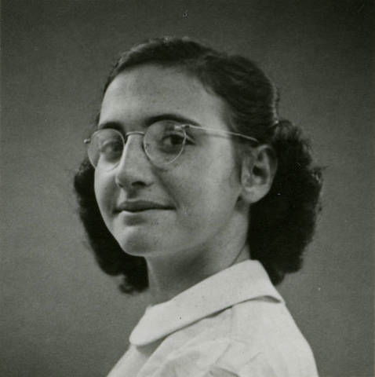
Margot
Margot, born in Febuary 16th 1926 was the older sister of Anne Frank. According to the diary of her younger sister, Anne, Margot kept a diary of her own, but no trace of Margot's diary has ever been found. She attended the Ludwig-Richter School in Frankfurt until Adolf Hitler wanted all of the Jews out of his country on January 30, 1933. Margot and her mother left Germany to join Otto Frank on December 5, 1933, then Anne followed in February 1934. At the age of 19 She died in Bergen-Belsen concentration camp on the 27th of march 1945. Margot passed away in Bergen-Belsen because of typhus.
Typhus- also known as typhus fever, is a group of infectious diseases that include epidemic typhus, scrub typhus, and murine typhus. Common symptoms include fever, headache, and a rash

Slide 4
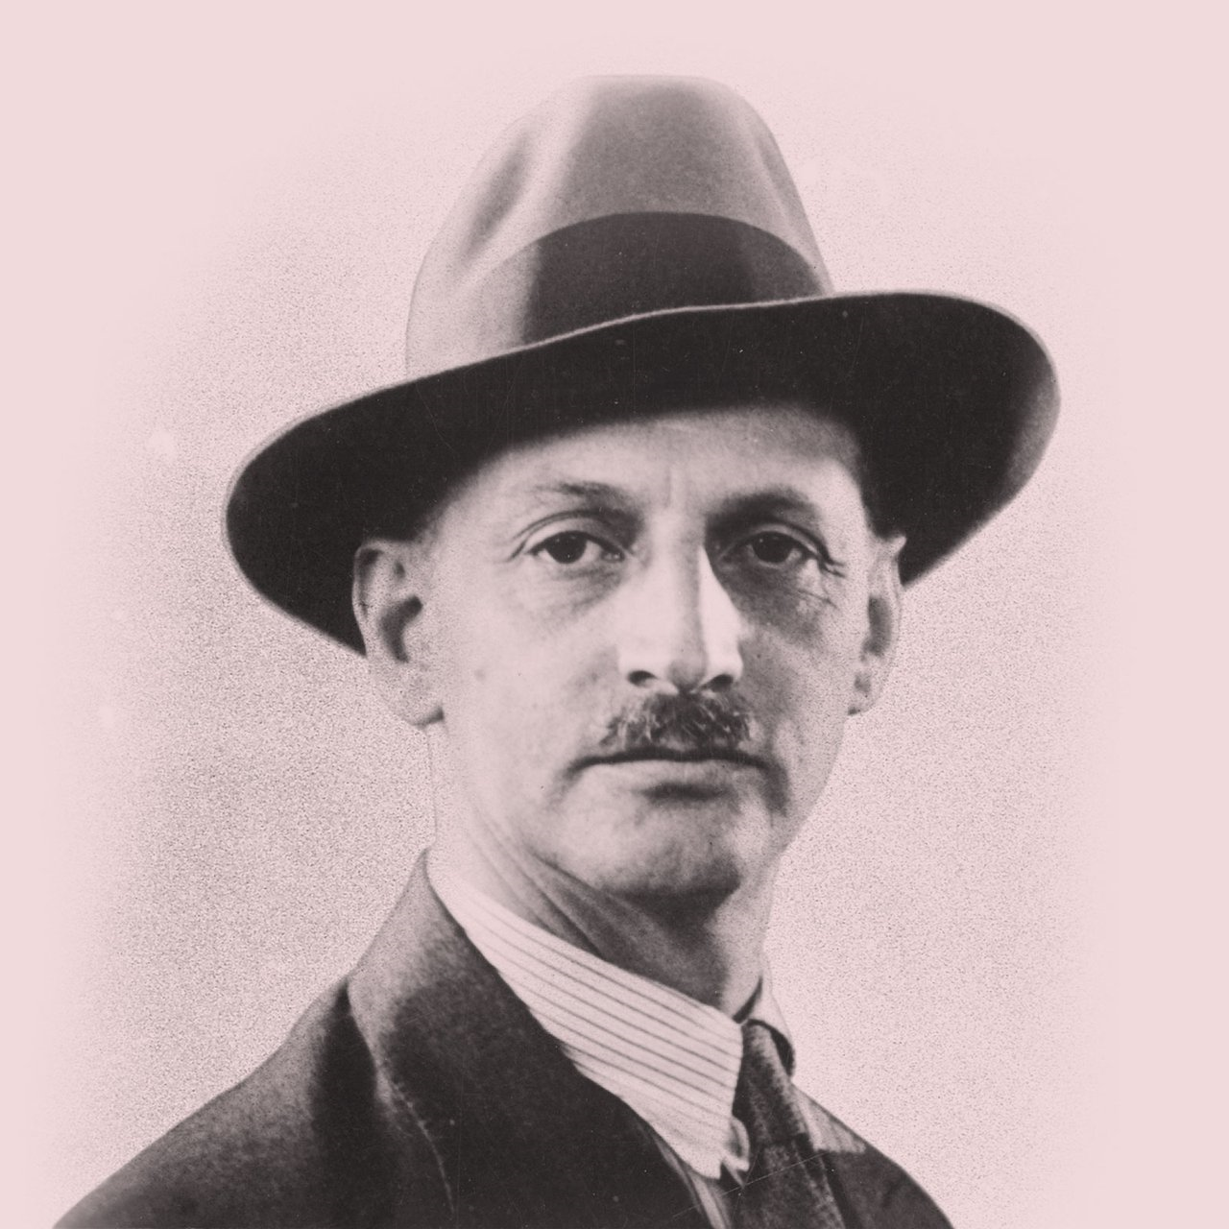
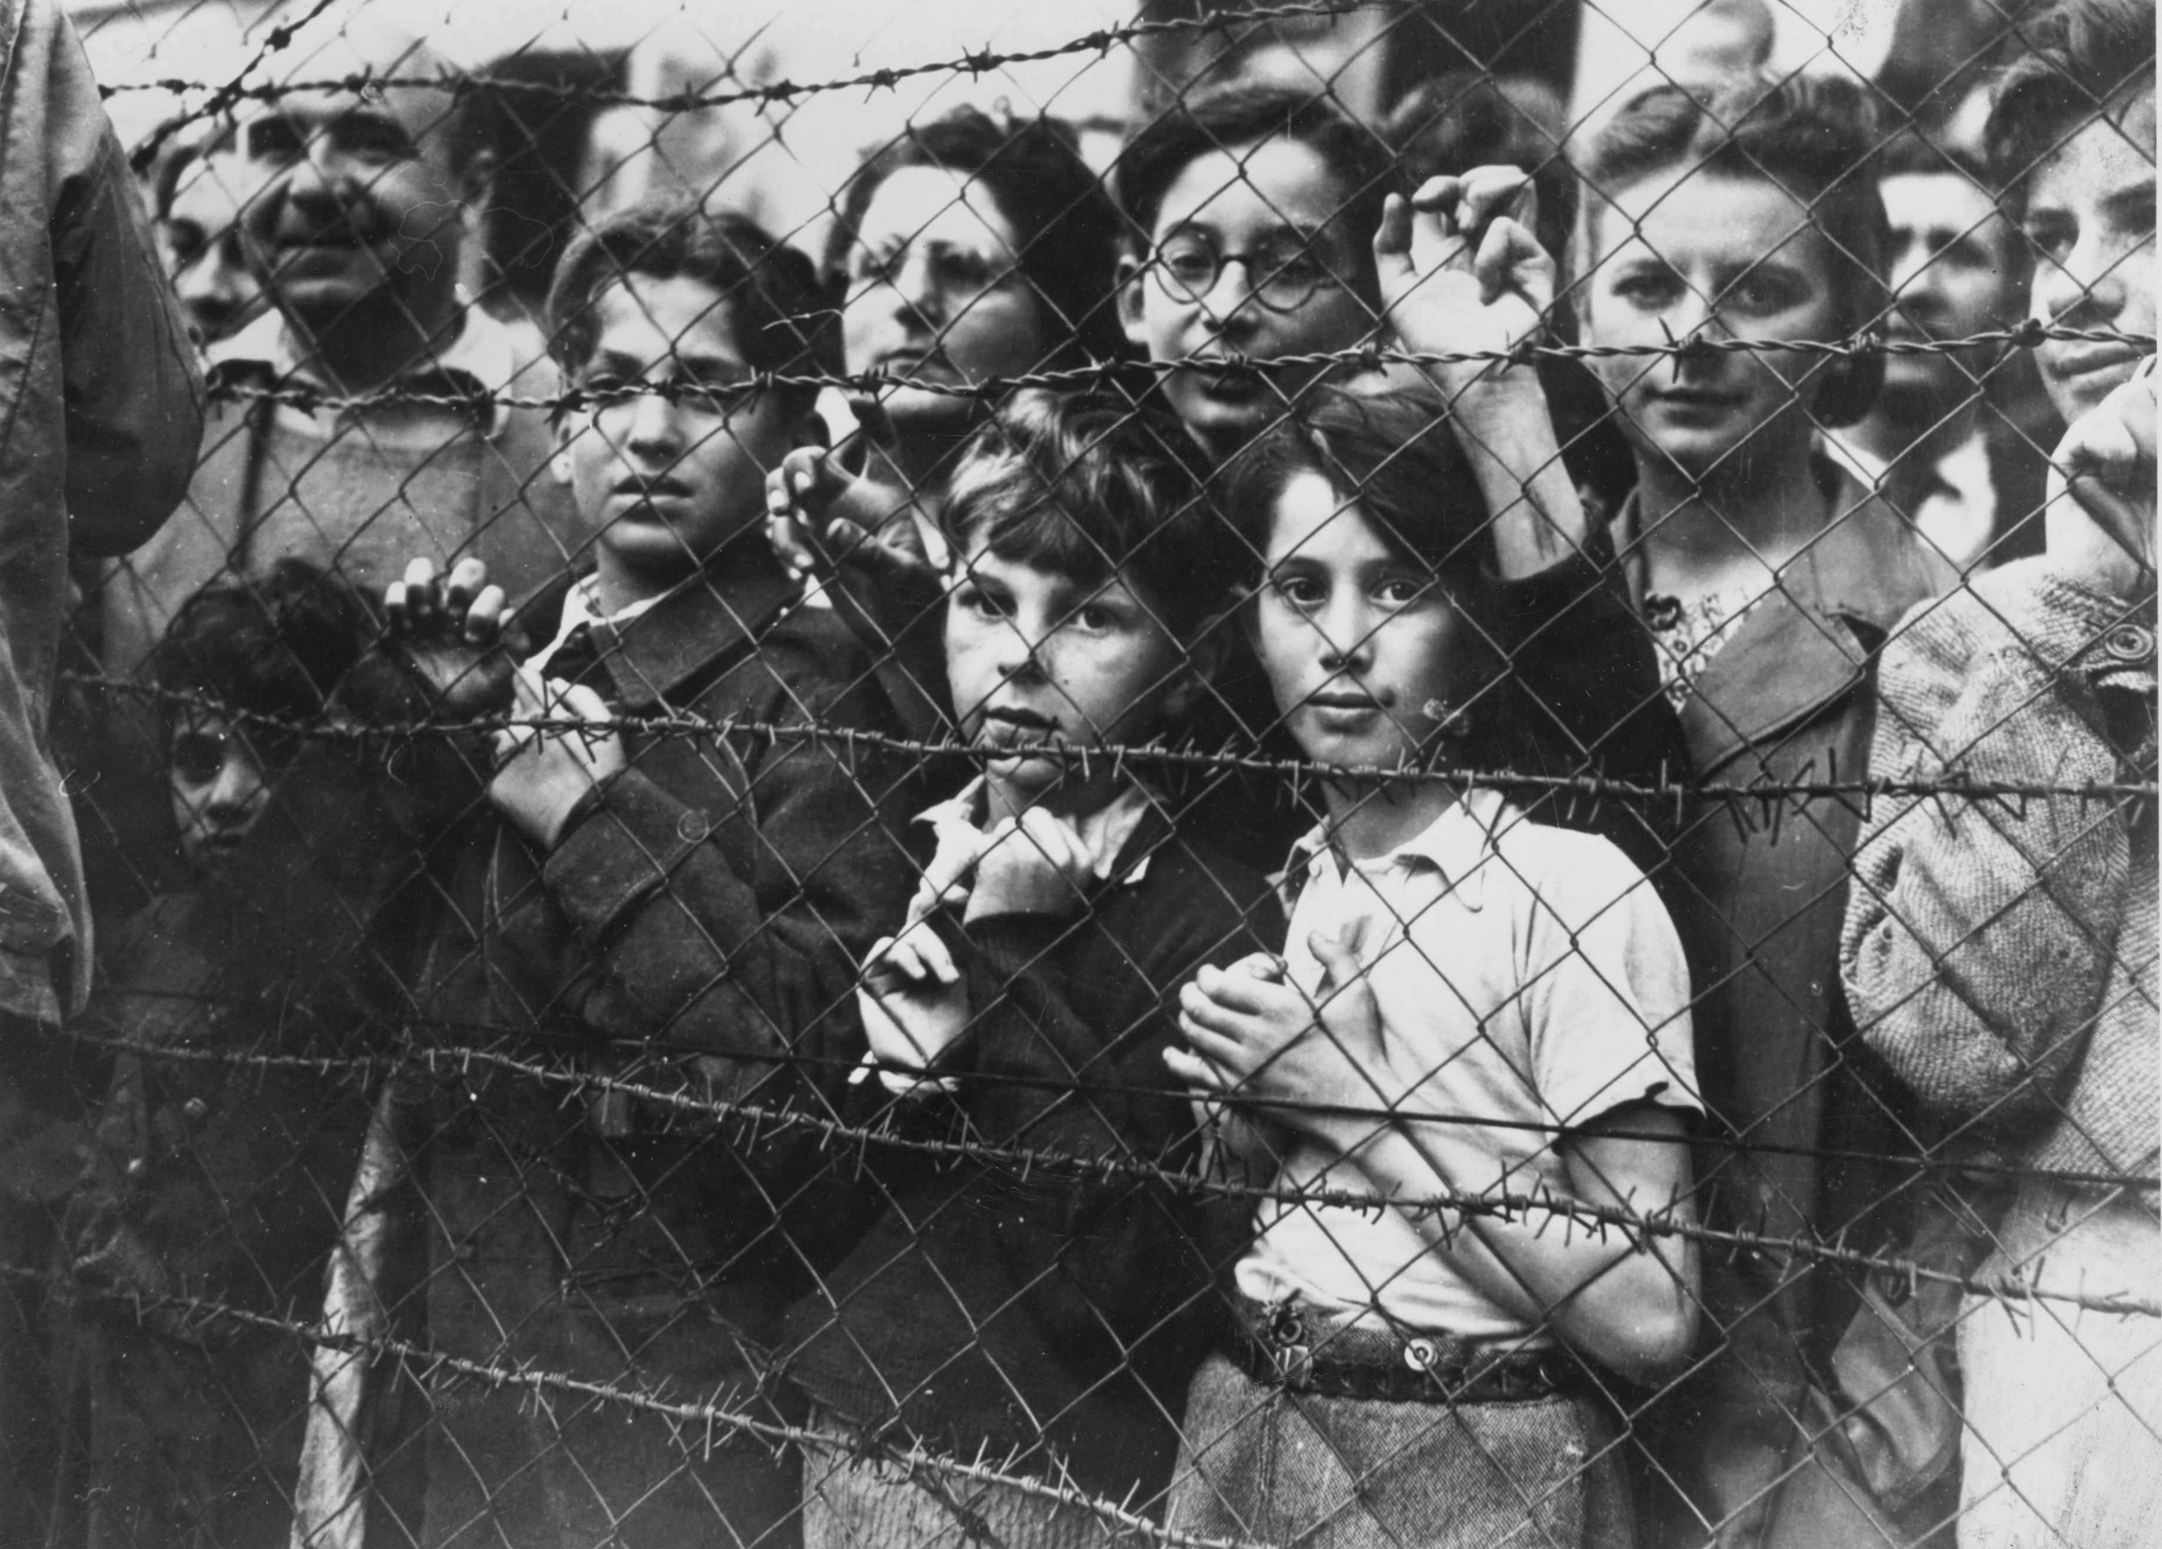
Otto Frank
Was a German businessman who later became a resident of the Netherlands and Switzerland. He was the father of Anne and Margot Frank and husband of Edith Frank-Holländer, as the sole member of his family to survive the Holocaust. After Anne’s death Otto was given all of her manuscripts, letters and stories which he then published as ‘The diary of a young girl’ in 1947. Otto Frank was born to a liberal Jewish family on May 12, 1889, in Frankfurt am Main, Germany.Frank had three siblings.
Holocaust-
The Holocaust, also known as the Shoah, was a genocide of the European Jews during World War II. Between 1941 and 1945, across German occupied Europe, Nazi Germany and its collaborators systematically murdered some six million Jews, around two-thirds of Europe's Jewish population.

Slide 5
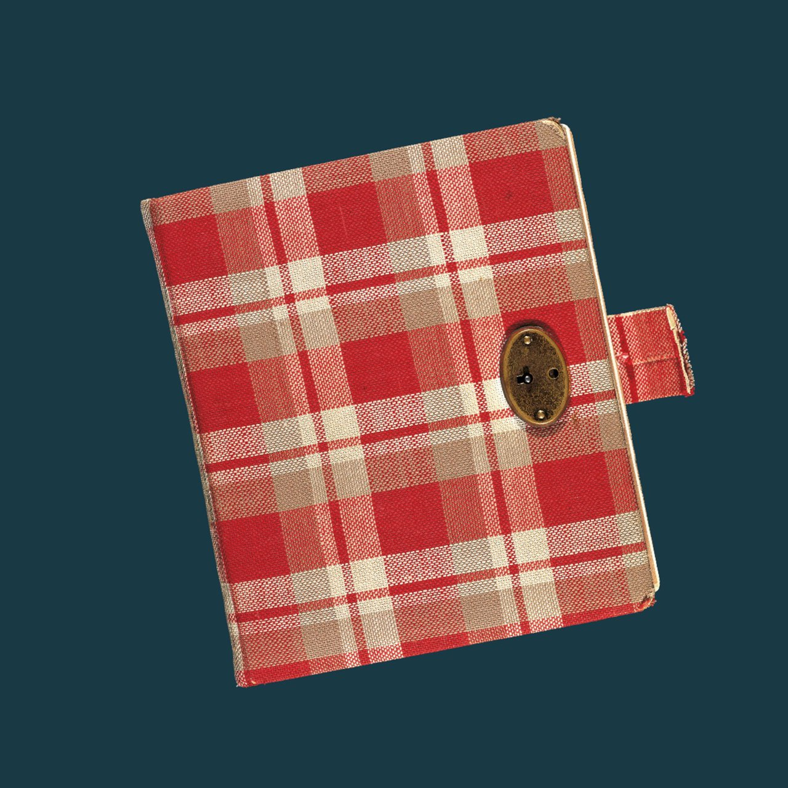
Anne wrote in Dutch. On occasion, she used German or English words.
Anne’s diary
The diary Anne receives for her 13th birthday.
Photo collection: Anne Frank Stichting, Amsterdam.
Who was kitty?
Kitty was the fictional character Anne eventually addressed all her diary letters to. The name Kitty came from a series of books Anne had read, by Dutch author Cissy van Marxveldt. These books were about Joop, a girl who had all kinds of adventures with her group of friends.Anne’s
What is the date of Anne’s last entry?
Anne's last diary letter is dated 1 August 1944, three days before the arrest.
When did
Anne stat wrighting?
Anne got the diary as a birthday but ,the actual writing started two days after her birthday, on 14 June 1942.
imagination was very lifelike. She had preferences for some of the characters and Kitty rose to first place straight away: ‘Dear Kitty...I like writing to you most, you know that don’t you, and I hope the feeling is mutual.

Slide 6
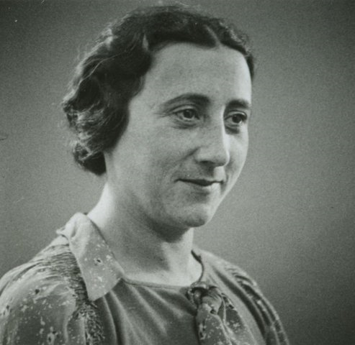
Edith Frank
Edith Frank (born on 16th January 1900 and died 6th January 1945) was the mother of and Anne frank and her older sister Margot frank. She was a prisoner during the Holocaust at Auschwitz-Birkenau concentration camp, where she died from starvation.
DID YOU KNOW?
Edith was the youngest out of her four siblings

Slide 7





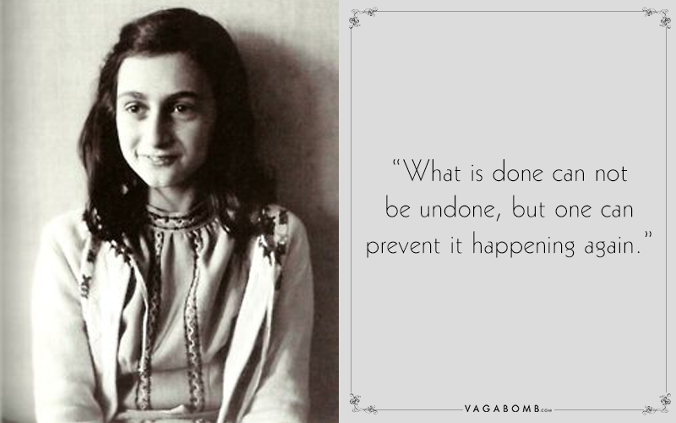
In Anne’s writing and letters she had quite a few inspirational quotes, here are a few.
[my favorite]

