Slide 1
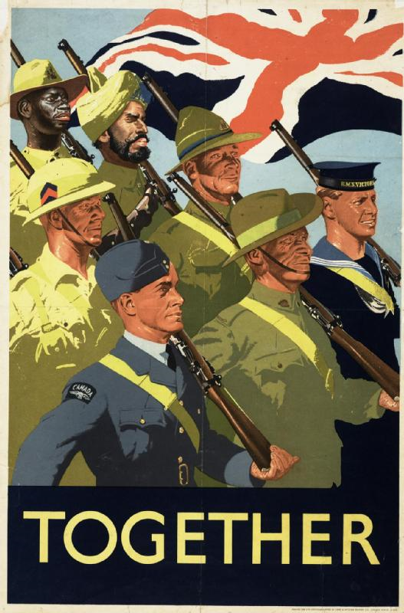
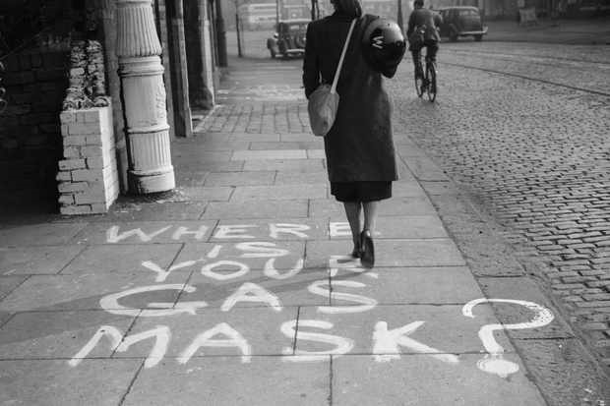
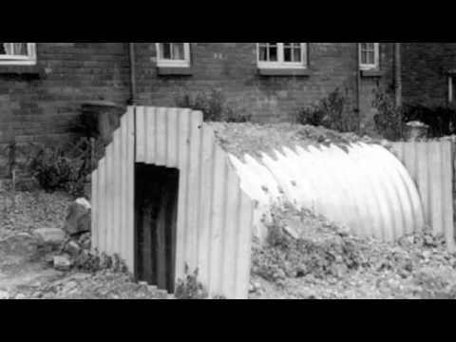
Anderson shelters
This power point is about Anderson shelters and what happened in World war II.

Slide 2
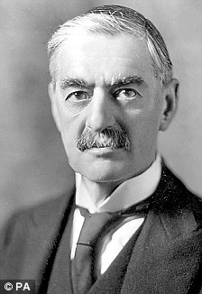
Neville Chamberlain
Neville chamberlain became prime minster In May 1937.
Neville Chamberlain was born on 18th of March 1869 in , Birmingham. He became a member of parliament when he was of 49 in 1918.

Slide 3
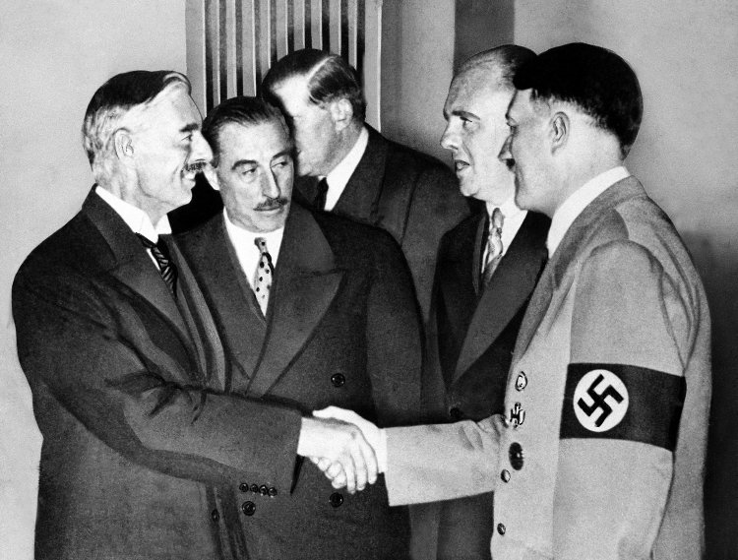
How the war started The British, German, French and Italian leaders all signed the Munich Agreement in 1938 so that Hitler could have Sudetenland (a part of Czechoslovakia). However Hitler broke the terms of this agreement the following year and invaded Poland on September 1st 1939, Britain and France reacted and two days later at 11am on the 3rd September, Neville Chamberlain announced we were at war.

Slide 4
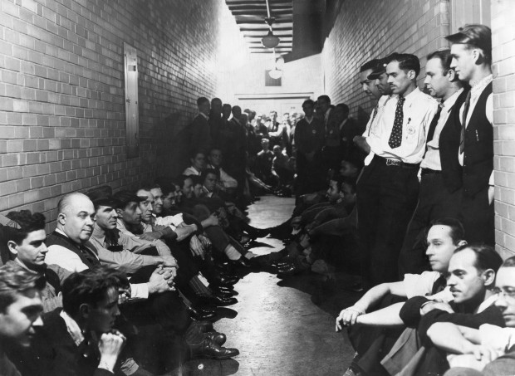

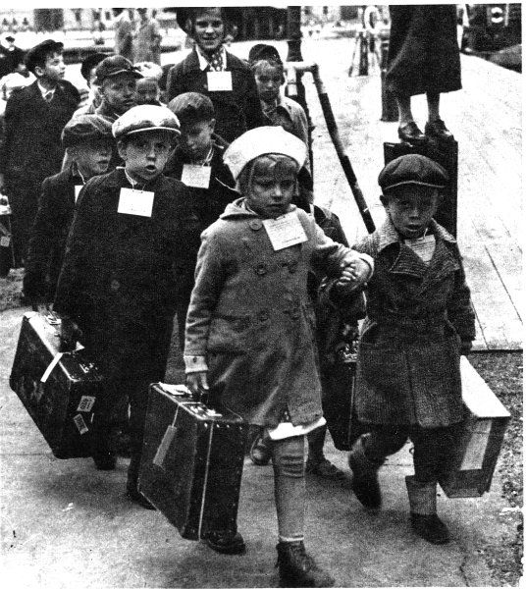
Advice for the blitz
~go into the air raid shelter
~do blackout procedures
~send the children away to live in the country side

Slide 5
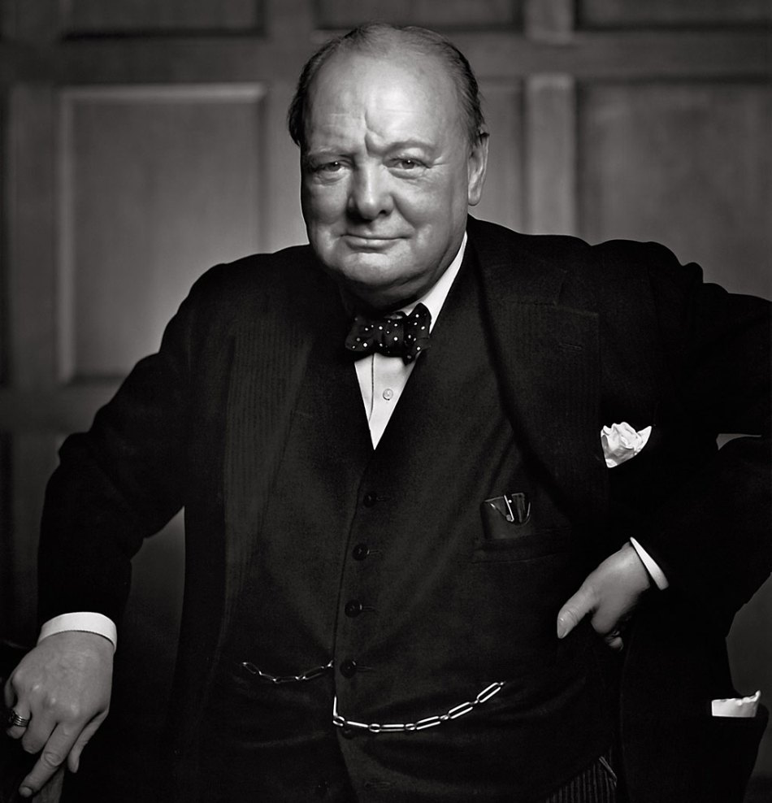
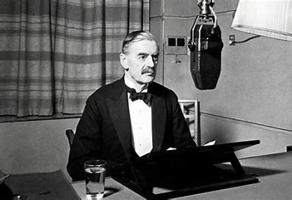
Winston Churchill and Neville Chamberlain
Winston Churchill became prime minster in 1940 after Neville resigned.
Neville was prime minster for three years before he resigned on the 10th of May 1940

Slide 6
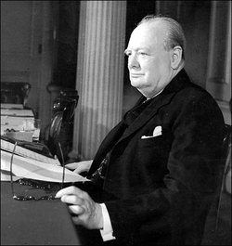
Winston Churchill
Winston Churchill is most known for leading Britain successfully during the Second World War. He lost the elections after the war, however, Churchill did serve as prime minster for a second time. He lead the United Kingdom from 1951 till 1955.
Winston was born in 1874 – 1965
Winston
Churchill being elected

Slide 7
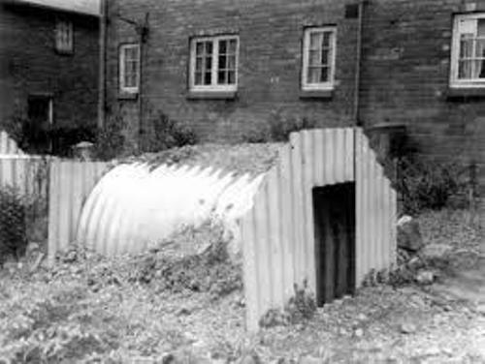
Anderson shelters
Anderson shelters were half buried in the ground with earth heaped on top to protect people from bomb blasts during World War II.
They were made from six corrugated iron sheets bolted together at the top, with steel plates at either end

Slide 8
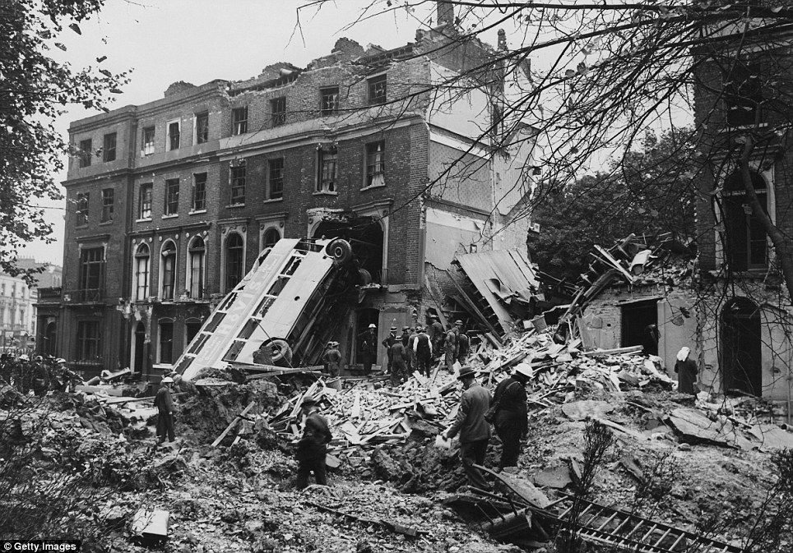
Aftermath of the Blitz
In the end, approximately 43,000 British citizens were killed or wounded.
Over 3,500,000 homes were flattened and all that was left of most cities was broken walls and debris.

Slide 9
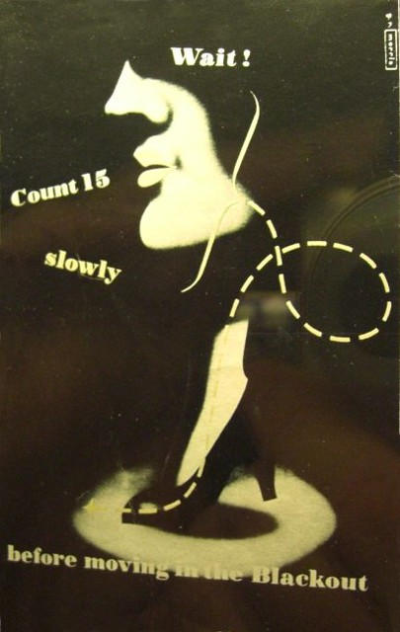
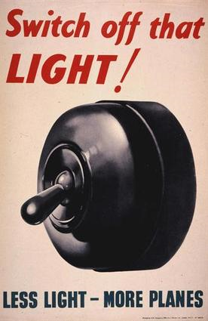
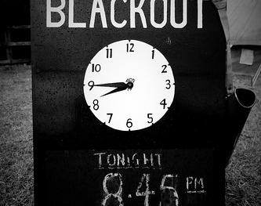
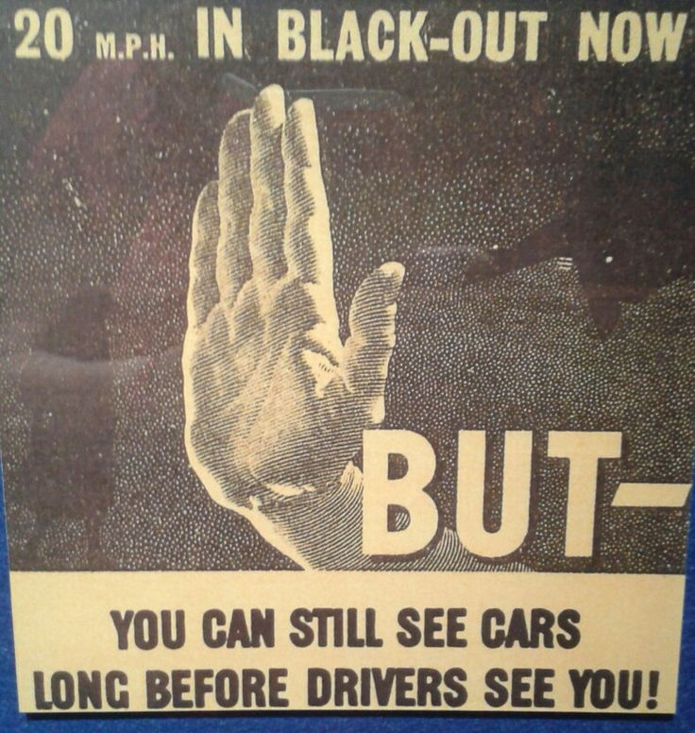
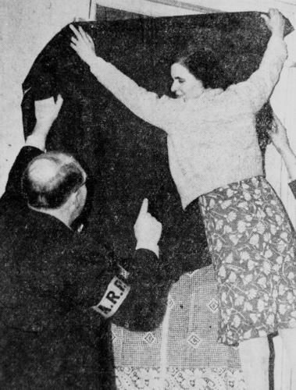
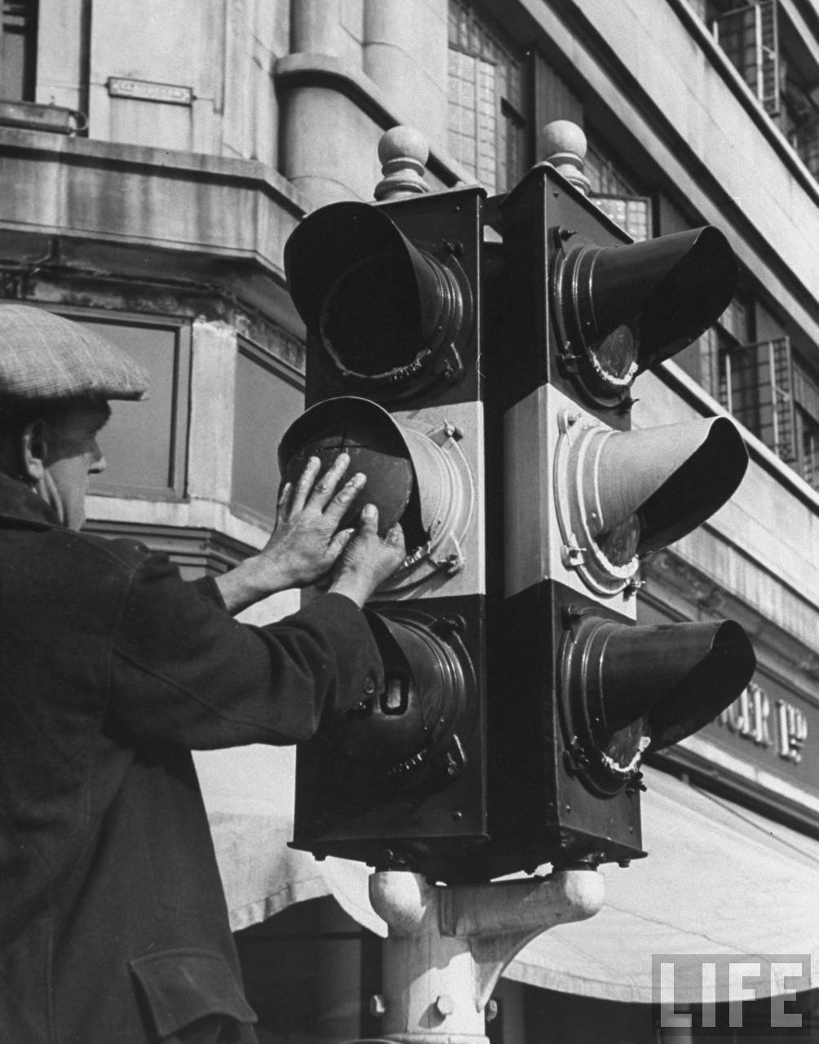
Blackout
During World War 2, the blackout was a nationwide effort to turn off all the lights in towns and cities. This was so they couldn’t be spotted by bomber planes flying overhead.
Everyone covered their windows with thick black sheets so no light could shine through, just like this woman.
WAIT – count to 15 slowly!
They also had to wait 15 seconds till they could move around the house again incase the Germans were outside they also waited 15 seconds because they didn’t want to make any noise.

Slide 10



British Allies
France
Britain
Poland

Slide 11


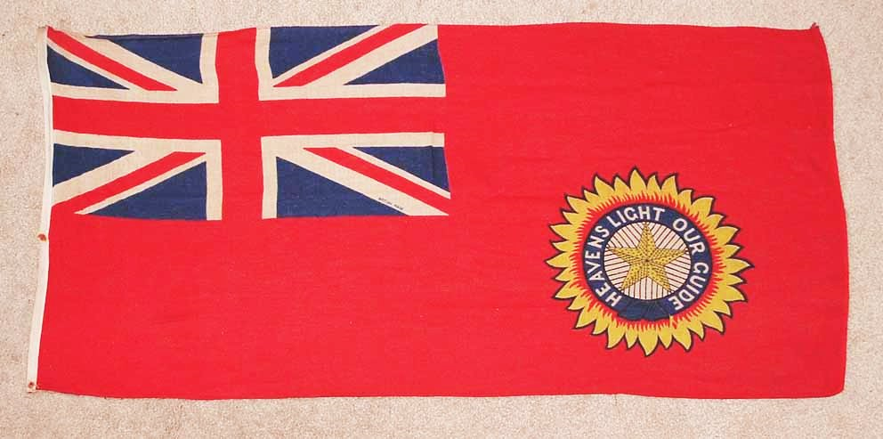
Other Allies
Netherlands
British India
Yugoslavia

Slide 12
By Chloe Saunders Redwings, Year 5
15.5.2020

