Slide 1




YOU ARE AWESOME

Slide 2
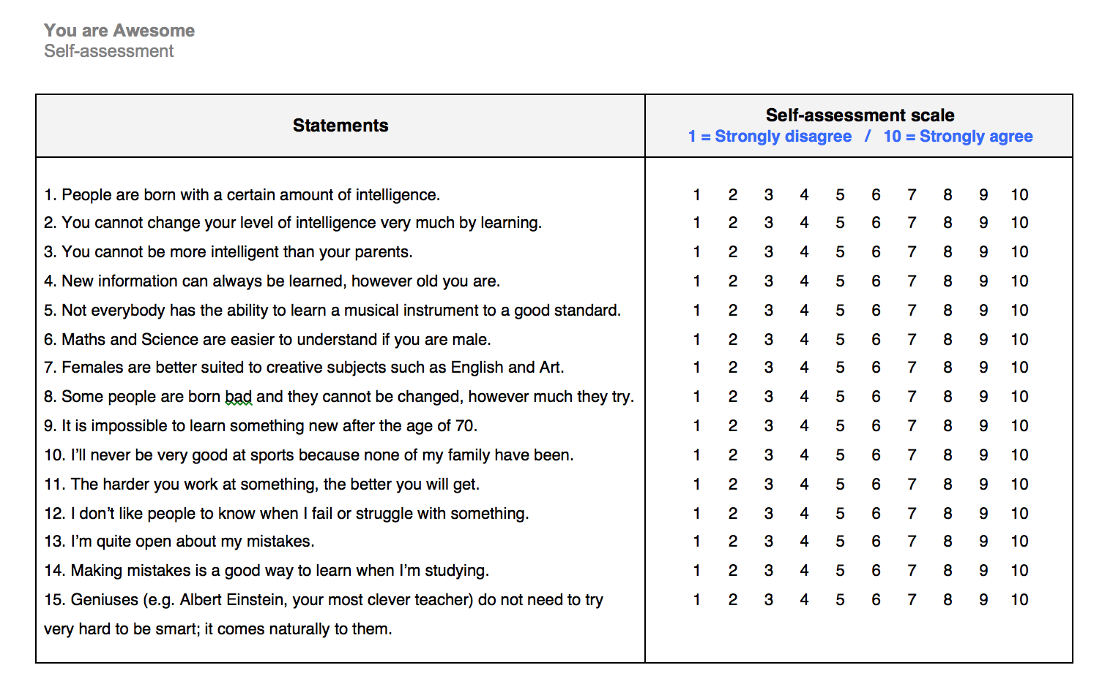
Have your responses to any of these statements changed? How? Why?

Slide 3

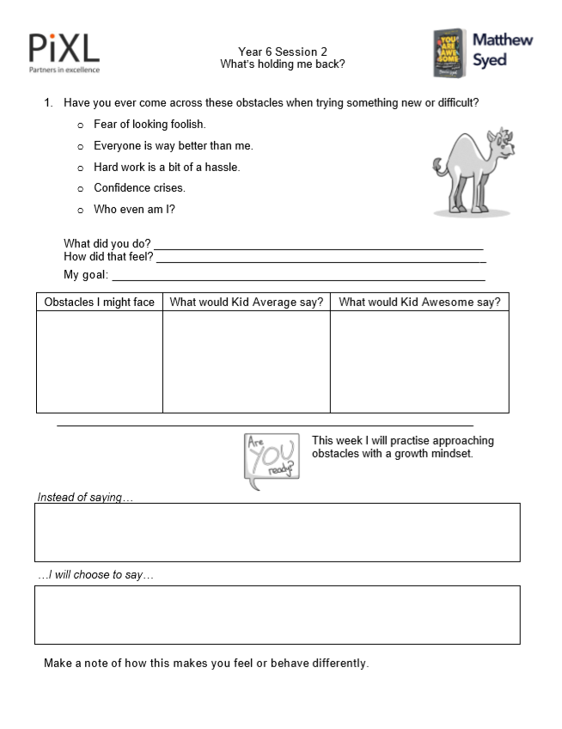
TODAY’S SESSION
YOU WILL NEED

Slide 4

Read Chapter 2 of ‘You Are Awesome’.

Slide 5


The world around us is changing so fast. It’s no wonder that we sometimes feel anxious about how we fit into it. We question whether we are smart enough. We get a bit scared to have a go (in case we look stupid). And sometimes it’s tempting to quit before we’ve even tried something. Lots of anxieties and worries can hold us back. So let’s take a look and see how we can overcome them. Because it’s good to be READY. PREPPED. CONFIDENT. On fire! We need to find our confidence to deal with all the changes and challenges that life can bring.
page 35
Notes:
Page 138

Slide 6

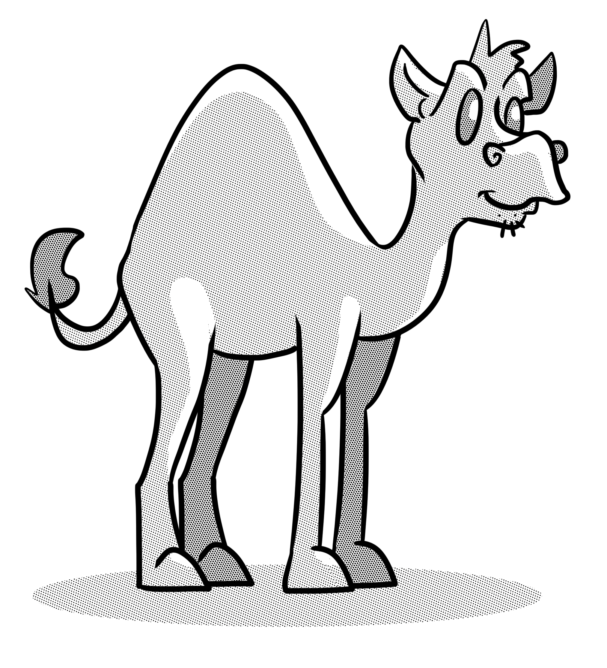
Discuss
Matthew came up against these obstacles on his path to success. Which of these have you encountered?
Fear of looking foolish.
Everyone is way better than me.
Hard work is a bit of a hassle.
Confidence crises.
Who even am I?

Slide 7

What is an obstacle?
Obstacle (noun): something that blocks your way or prevents progress.
Fixed mindset: I’ll give up because there are too many obstacles.
Growth mindset: I’ll find a way around the obstacles because I really want to succeed.

Slide 8

Reflection
During Session 1 you wrote down a goal for your lifetime.
What obstacles could you face in working towards this?
b) What would each of the below say when faced with these obstacles?
What would Kid Average say?
What would Kid Awesome say?

Slide 9
Focus on the solution
Who can help me?
What resources do I need?
How can I change my actions?
How can I maintain resilience?

Slide 10

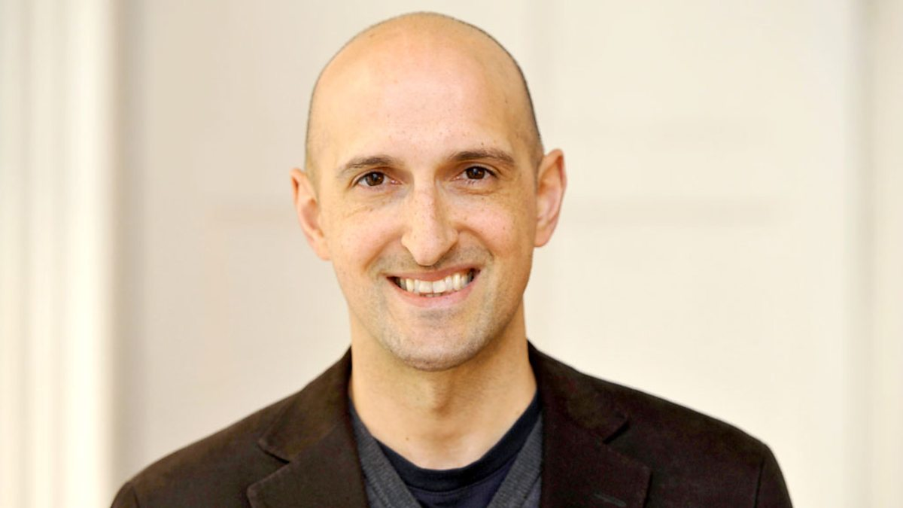
Matthew Syed

Slide 11

1. Write down what you might usually say when faced with an obstacle in your daily life. 2. Now change what you have written to approach the obstacle with a growth mindset. Practise saying this aloud during the week. How does it make you feel different?

Slide 12

NEXT SESSION

Slide 13
YOU ARE AWESOME

Slide 14
© Year 2018 The PiXL Club Ltd and Author Matthew Syed. All rights reserved.
If this resource has been provided under The PiXL Club Ltd school membership agreement, it is strictly for the use of member schools for as long as they remain members of The PiXL Club. It may not be copied, sold, or transferred to a third party or used by the school after membership ceases. Until such time it may be freely used within the member school.
The Author Matthew Syed has the right to sell this teaching guide. It may not be copied, sold, or transferred to or by a third party. Matthew Syed takes full responsibility for all commercial activity thereof.
All opinions and contributions are those of the author. The contents of this resource are not connected with, or endorsed by, any other company, organisation or institution. Any additional images are from getty.co.uk , unless otherwise stated. 'You Are Awesome' illustrations copyright © Toby Triumph. ​
Endeavours have been made to trace and contact copyright owners. If there are any inadvertent omissions or errors in the acknowledgements or usage, this is unintended and PiXL will be remedy these on written notification.

