Slide 1




YOU ARE AWESOME

Slide 2
How did you respond to the following statements in your self-assessment?
2. You cannot change your level of intelligence very much by learning.
11. The harder you work at something, the better you will get.
Do you think it is important to practise new skills? Why?

Slide 3
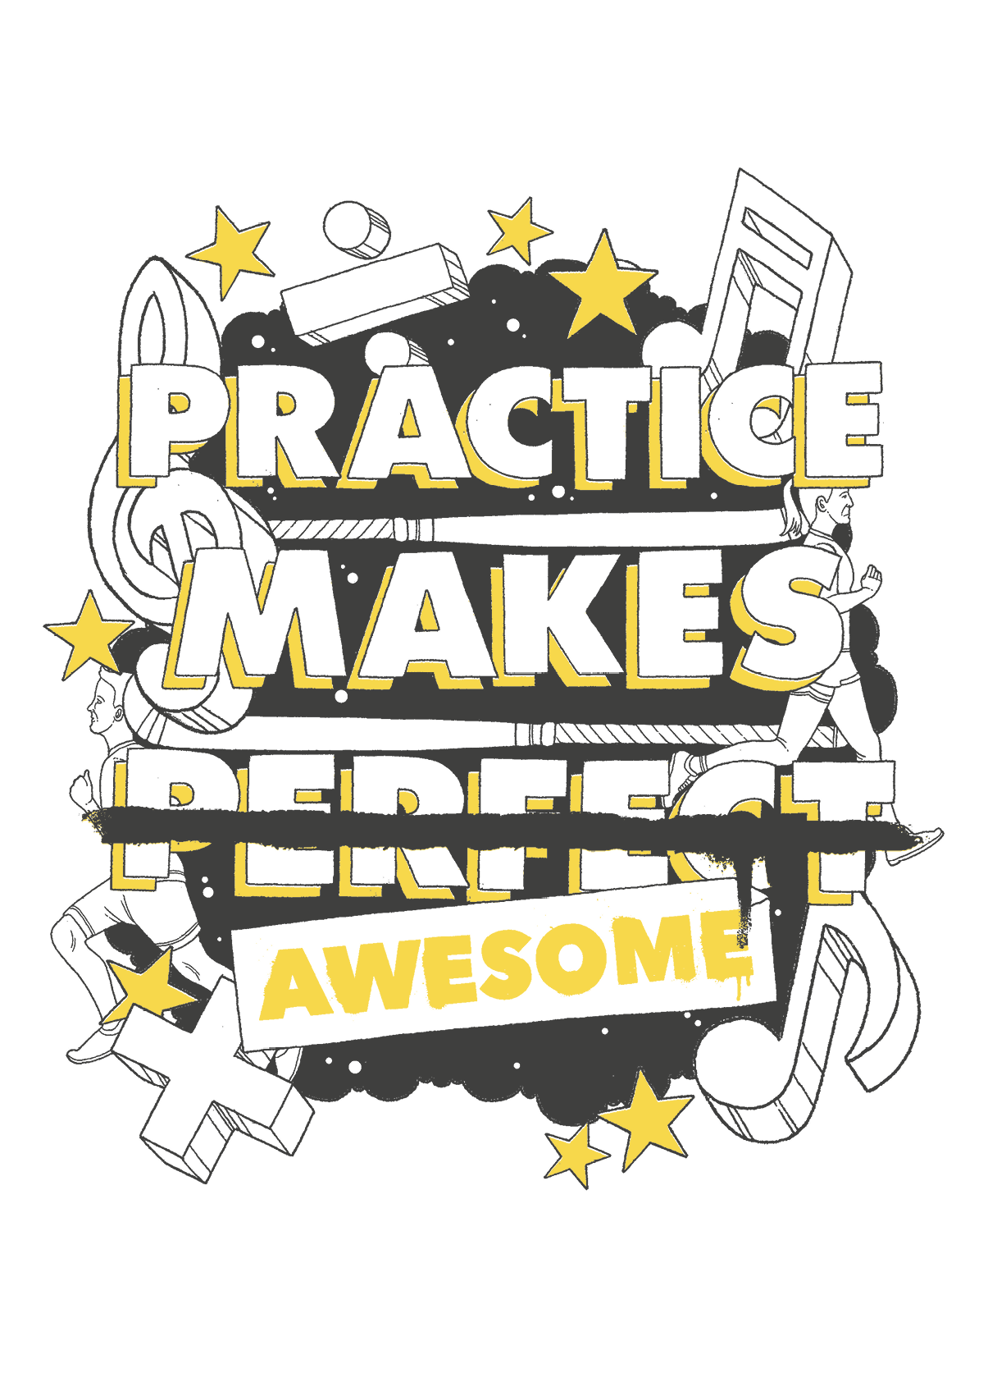
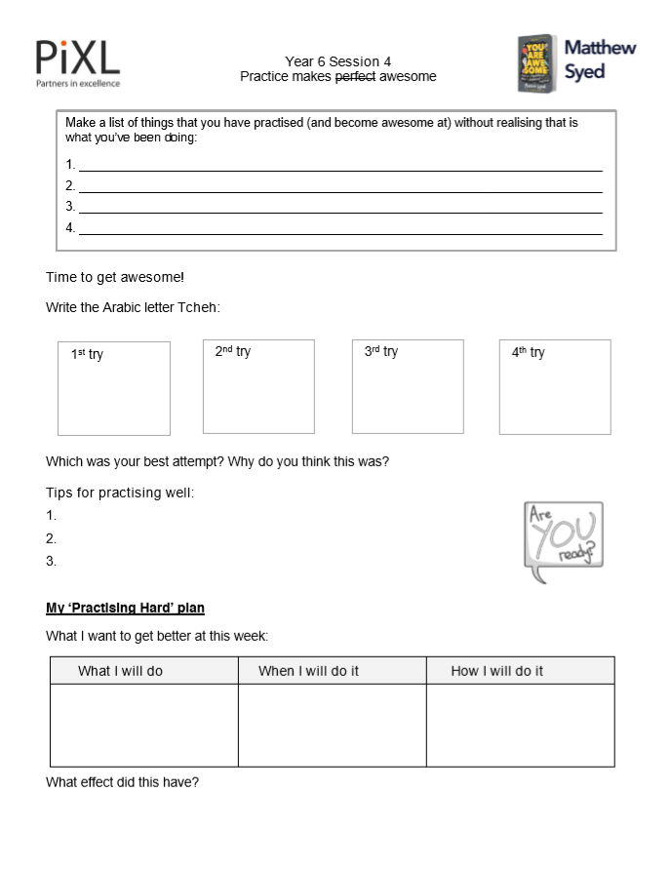
TODAY’S SESSION
YOU WILL NEED

Slide 4
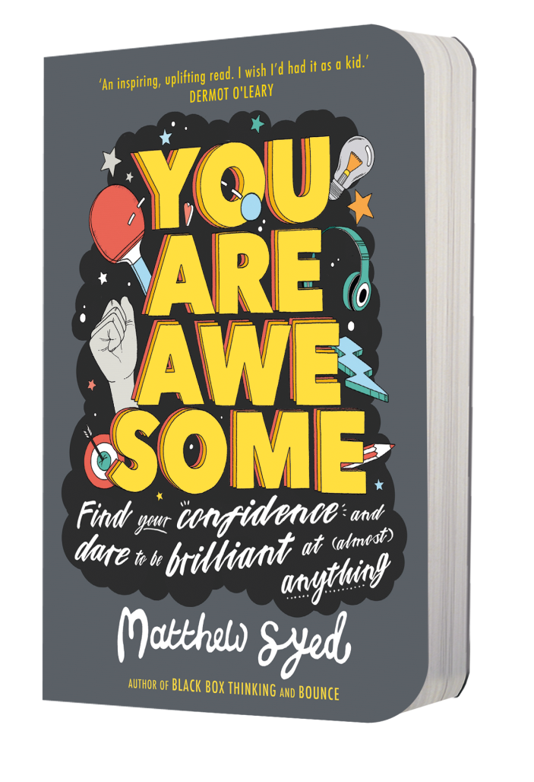
Read Chapter 4 of ‘You Are Awesome’.

Slide 5

Can you read this?
It deosn’t mttaer waht odrer the ltteers in a wrod are, the olny iprmoatnt tihng is taht the frist and lsat ltteers are in the rghit pclae.

Slide 6


Without realising it you’ve probably spent hundreds of hours practising reading. It is a hugely complex skill. But doesn’t it make you think – if you can master this reading business, with practice, why can’t you master that violin piece you’ve been putting off learning? Or nail that science topic that you think is way beyond you?
The truth is, there is absolutely no reason why.
page 79
Notes:
Page 138

Slide 7
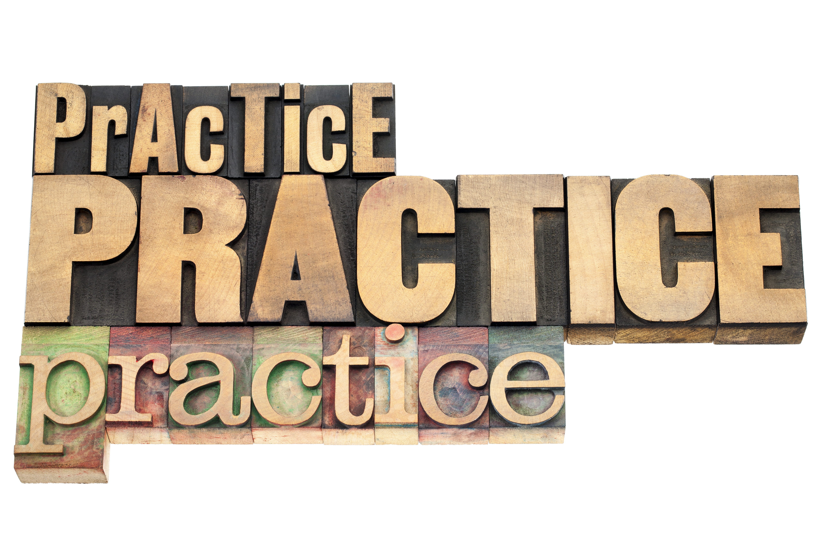
Accidental practice
Make a list of things that you have practised (and become awesome at) without realising that is what you’ve been doing:
1.
2.
3.
4.
5.
6.

Slide 8
Can you write the Arabic letter Tcheh?
Time to get awesome!

Slide 9
Instructed/ imitated
Procedural
Automatic
The phases of learning
ﭻ
Copy this Arabic letter. I’ll read you some instructions to help you get started.
Arabic letter Tcheh

Slide 10
Instructed/ imitated
Procedural
Automatic
The phases of learning
ﭻ
Now follow the instructions yourself.
1. Start at the top left hand side.
2. Draw a short horizontal line, then a curve similar to a capital C.
3. At the top of the letter C shape, draw a small L shape.
4. Add three dots in a group in the middle of the C shape.
Arabic letter Tcheh

Slide 11
Instructed/ imitated
Procedural
Automatic
The phases of learning
ﭻ
Now have a go on your own. Because you have practised, you should find this easier than when we started.
Once you don’t need the instructions anymore, then you know it has become automatic. Practice makes awesome!
Arabic letter Tcheh

Slide 12
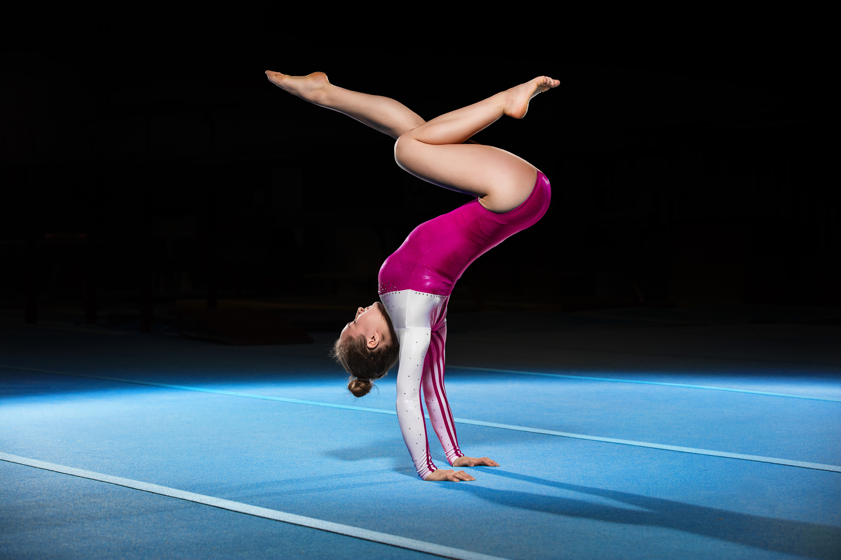
Anything is possible
The reality is, with a growth mindset, anything is possible. But practice can be hard, particularly if you are doing it well! What tips would you give someone for ‘practising hard’? Use these words in your responses:
Resilience
Challenge
Focus

Slide 13

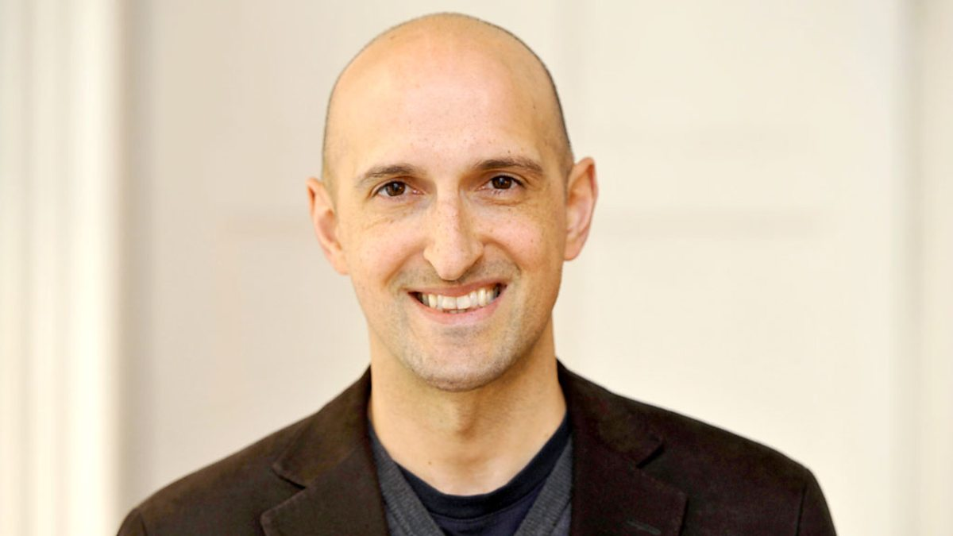
Matthew Syed

Slide 14

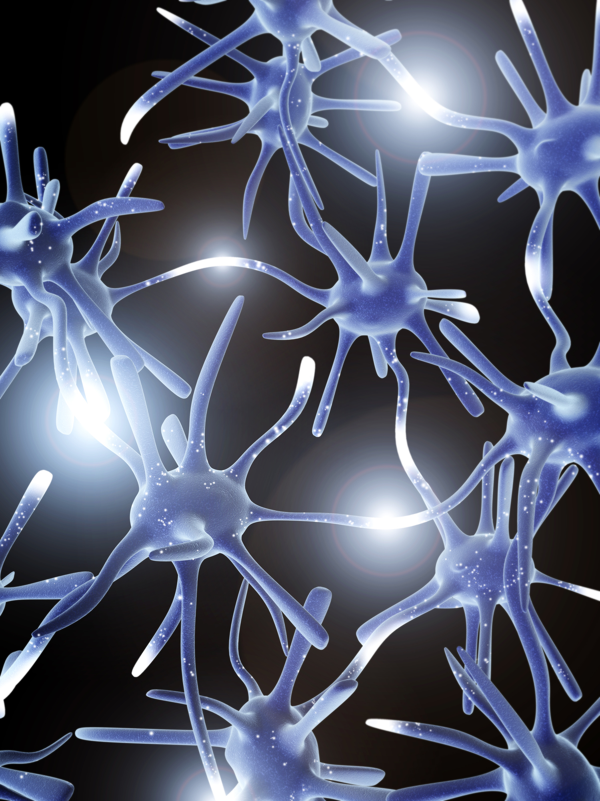
Creating neural pathways
Choose one thing that you want to get better at this week. It might be a specific concept in a subject (division in Maths, for example) or something outside school (your backhand in squash, for example). Make a ‘Practising Hard’ plan. What will you do? When will you do it? How will you do it? What effect did this ‘practising hard’ have?

Slide 15

NEXT SESSION

Slide 16
YOU ARE AWESOME

Slide 17
© Year 2018 The PiXL Club Ltd and Author Matthew Syed. All rights reserved.
If this resource has been provided under The PiXL Club Ltd school membership agreement, it is strictly for the use of member schools for as long as they remain members of The PiXL Club. It may not be copied, sold, or transferred to a third party or used by the school after membership ceases. Until such time it may be freely used within the member school.
The Author Matthew Syed has the right to sell this teaching guide. It may not be copied, sold, or transferred to or by a third party. Matthew Syed takes full responsibility for all commercial activity thereof.
All opinions and contributions are those of the author. The contents of this resource are not connected with, or endorsed by, any other company, organisation or institution. Any additional images are from getty.co.uk , unless otherwise stated. 'You are Awesome' Illustrations copyright © Toby Triumph.
Endeavours have been made to trace and contact copyright owners. If there are any inadvertent omissions or errors in the acknowledgements or usage, this is unintended and PiXL will be remedy these on written notification.

