Slide 1


KS1 Therapy: Y2 Writing
Commissioned by The PiXL Club Ltd.
February 2018
This resource is strictly for the use of The PiXL Club Ltd member schools during the life of the membership only. It may NOT be copied, sold, or transferred or made available by whatever means to a third party non-member during or after membership. Until such time it may be freely used within the PiXL member school by their teachers and authorized staff and any other use or sale thereof is strictly prohibited.
All opinions and contributions are those of the authors. The contents of this resource are not connected with, or endorsed by, any other company, organisation or institution. Images from getty.co.uk unless otherwise stated.
PiXL Club Ltd endeavour to trace and contact copyright owners. If there are any inadvertent omissions or errors in the acknowledgements or usage, this is unintended and PiXL will remedy these on written notification.
© Copyright The PiXL Club Limited, 2018

Slide 2

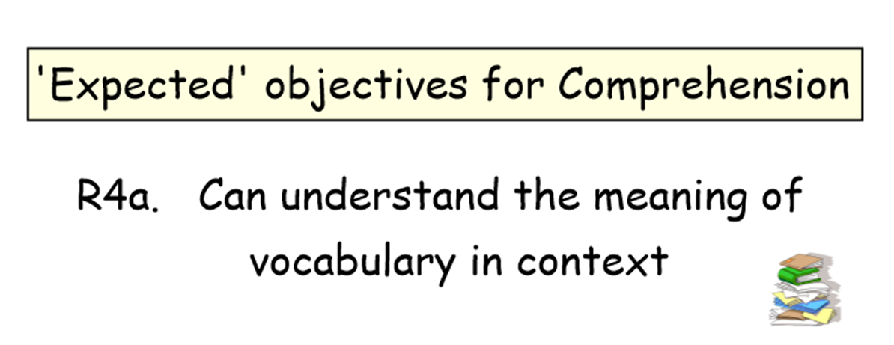
W3b. Can use capital letters at start of most sentences
= teacher notes

Slide 3
Teacher information
This resource should be used to support Key Marginal pupils for whom you have completed a PLC. It is designed to be delivered as a teaching activity to a small group or individual in order to fill a gap in their understanding.
Use of this resource should form part of normal, day-to-day teaching, as you would do with a guided teaching group. This teaching resource is based on the National Curriculum expectations for Key Stage 1, with a focus on the laser-sharp statements from the PiXL PLC.

Slide 4
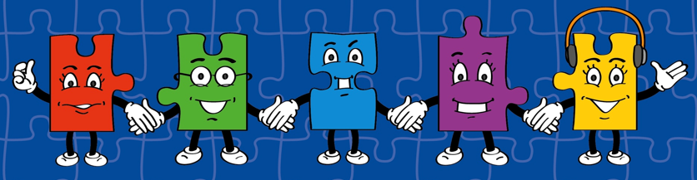
LORIC
Our Primary Edge attributes help us to become better learners and today is no exception. Before you start this activity, here are some ideas for how you will need your Olly Organisation skills today:
Command Words:
Plan Prepare
Create Organise Design Compile Support Assist
Organising your resources.
Working as a team.
Making sure your capital letter are in proportion to your lower case letters.

Slide 5

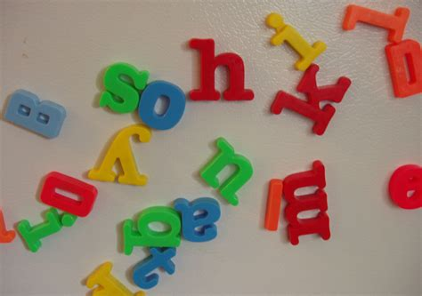
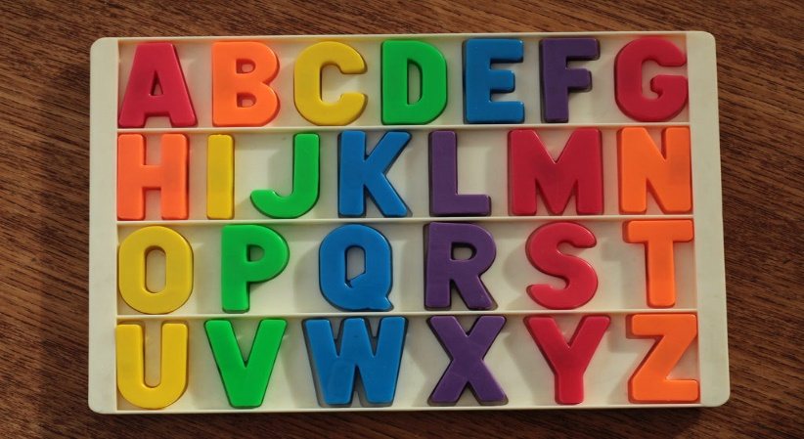
Developing Organisation Skills
Use this activities to help children develop their organisation skills before you begin the therapy.
Give children a pile of mixed upper case and lower case magnetic letters and ask them to sort them. Then ask them to find a specific case letter. Ask if the way they sorted them helped to find the letter quicker. Now ask them to sort the letters in a different way, perhaps all the capital letters in alphabetical order. Ask them to find a capital Z. Discuss how by organising the letters it makes finding the right letter easier.

Slide 6
What I Will Be Looking For Today
You will have lots of chances to demonstrate your organisation skills today. Here’s what I’ll be looking for:
Working together as a team.
Planning what resources you will need.
Forming your capital letters correctly and in proportion to your lower case letters.

Slide 7
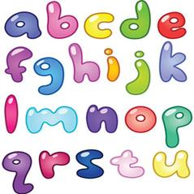
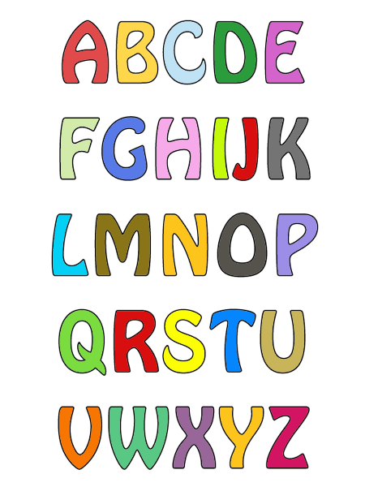
Capital Letters
Every sentence will always start with a capital letter.
Which picture shows the capital letter?
Can you find the capital letter for h, r and f?

Slide 8
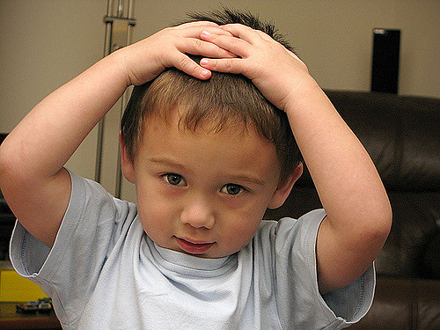
Capital Letters
Read a passage from a story book. Ask the children to put their hands on their head whenever they think there is a capital letter as they listen. Then discuss why they thought there should be a capital letter at that point.

Slide 9
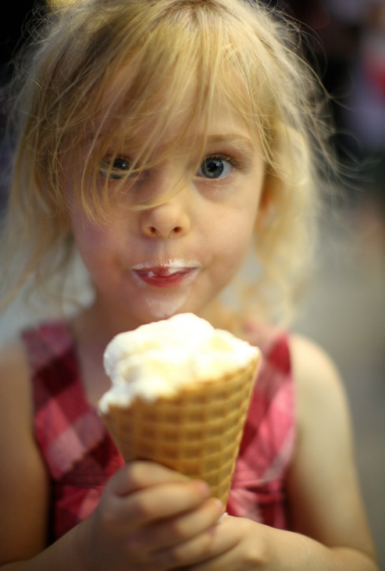
Capital Letters
What is missing in these sentences? Can you show me how you can correct the sentence?
a little girl went to the beach.
she bought an ice-cream.
before long, soon her mouth was very sticky.
her mummy need to wipe her face clean.

Slide 10
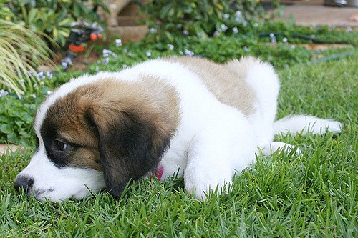
Practise
Read the paragraph below. What is missing?
in a messy garden, a puppy was destroying a rose bush. there were petals and leaves everywhere. before long his owners came home. the puppy darted behind the shed to hide. he knew he was going to be in big trouble.

Slide 11
Capital Letters
Did you spot them all?
The full stops can help you because a new sentence starts after a full stop and we know every sentence has to start with a capital letter.
In a messy garden, a puppy was destroying a rose bush. There were petals and leaves everywhere. Before long his owners came home. The puppy darted behind the shed to hide. He knew he was going to be in big trouble.

Slide 12
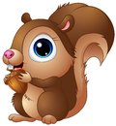
Practise
Which sentence can you make, without making any changes, using the blocks below?
Naughty squirrels stole acorns from the birds.
or
Squirrels stole acorns from the naughty birds.
stole
from
Naughty
squirrels
.
acorns
the
birds

Slide 13
Practise
It was the first option as the word ‘squirrels’ doesn’t have a capital letter and so cannot be the word to start the sentence.
Naughty squirrels stole acorns from the garden.

Slide 14
Capital Letters in Speech
Sentences where inverted commas have been used to show someone is speaking also need to start with a capital letter.
“Please help me find my fluffy slippers?” pleaded Kamil.
“My favourite vegetable are carrots and peas,” announced Tim proudly.

Slide 15
Practise
Is the capital letter in the right place in these sentences? Explain your answers.
“who wants to go on this scary Ride first?” asked the park keeper.
nobody understood why the elephant started to charge But they knew they had to run away.
“Flowers are the prettiest thing in the garden,” exclaimed the groundsman.

Slide 16
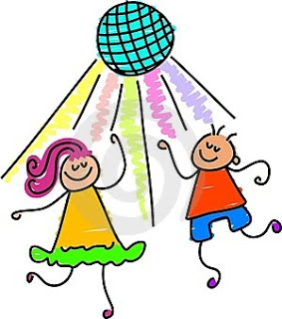
Practise
It’s the school disco! Write a paragraph about the what you and your friends do at the school disco. Remember how you need to start each sentence.

Slide 17
Review
Swap your paragraph with your partner. Put a big tick above each capital letter they used at the start of a sentence. Did they miss any? Help explain to them how they can correct it.

Slide 18
Teacher information
Show Me Tasks
Once the therapy has been delivered you can use Show Me Tasks to demonstrate that the skill is now secure. They are not intended to be completed all at once and ideally should be done in intervals of a few days after the therapy has been delivered. The challenge in the tasks is progressive.

Slide 19


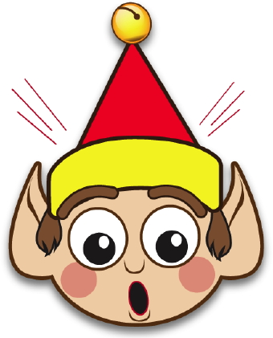
There are 5 missing capital letters, can you circle where they should be?
Show Me Tasks
W3b. Can Use Capital Letters at Start of Most Sentences
it was a calm day at sea. the pirates were getting very bored. they had run out of supplies and thought they were a long way from land. suddenly a seagull glided above the ship. “ land must be near if birds are flying near us,” the captain muttered with great relief.
Commissioned by The PiXL Club Ltd.
February 2018
This resource is strictly for the use of member schools for as long as they remain members of The PiXL Club. It may not be copied, sold nor transferred to a third party or used by the school after membership ceases. Until such time it may be freely used within the member school. All opinions and contributions are those of the authors. The contents of this resource are not connected with nor endorsed by any other company, organisation or institution.
© Copyright The PiXL Club Limited, 2018
I made sentence using the blocks below, without making any changes to them. How do you know which is the sentence I created?
Write a paragraph to explain why this elf is so surprised. Don’t forget to use capital letter where needed.
hanging
trees
Colourful
the
CHALLENGE
Can you include one sentence to show someone is speaking?
lights
on
were
Colourful lights were hanging on the trees.
Lights were hanging on the colourful trees.

