Slide 1


KS1 Therapy: Y2 Writing
Commissioned by The PiXL Club Ltd.
January 2018
This resource is strictly for the use of The PiXL Club Ltd member schools during the life of the membership only. It may NOT be copied, sold, or transferred or made available by whatever means to a third party non-member during or after membership. Until such time it may be freely used within the PiXL member school by their teachers and authorized staff and any other use or sale thereof is strictly prohibited.
All opinions and contributions are those of the authors. The contents of this resource are not connected with, or endorsed by, any other company, organisation or institution. Images from getty.co.uk unless otherwise stated.
PiXL Club Ltd endeavour to trace and contact copyright owners. If there are any inadvertent omissions or errors in the acknowledgements or usage, this is unintended and PiXL will remedy these on written notification.
© Copyright The PiXL Club Limited, 2018

Slide 2

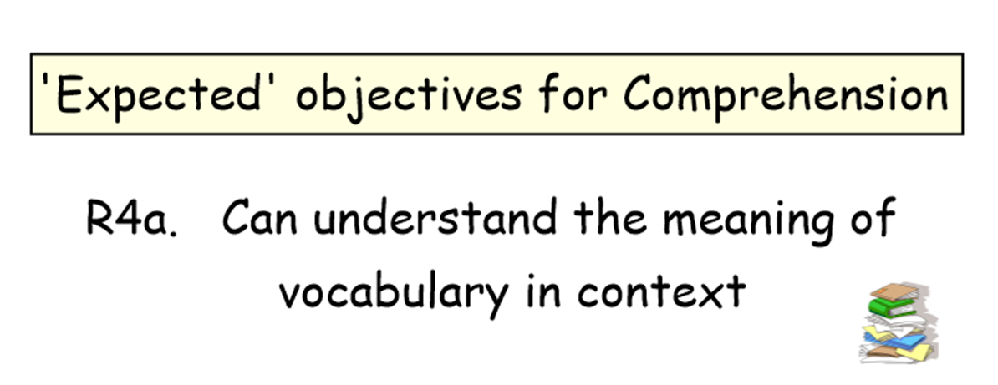
W3c. Uses capital letters for names (proper nouns).
= teacher notes

Slide 3
Teacher information
This resource should be used to support Key Marginal pupils for whom you have completed a PLC. It is designed to be delivered as a teaching activity to a small group or individual in order to fill a gap in their understanding.
Use of this resource should form part of normal, day-to-day teaching, as you would do with a guided teaching group. This teaching resource is based on the National Curriculum expectations for Key Stage 1, with a focus on the laser-sharp statements from the PiXL PLC.

Slide 4
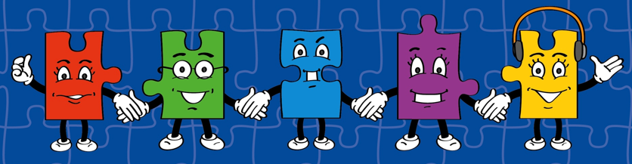
LORIC
Our Primary Edge attributes help us to become better learners and today is no exception. Before you start this activity, here are some ideas for how you will need your Laura Leadership skills today:
Command Words:
Take responsibility
Produce Lead Coach Direct Manage Undertake
Shows a good example to others.
Encourages others to do their best.
Works collaboratively and cooperates with others.

Slide 5

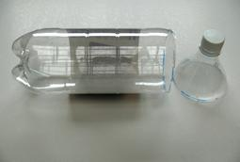
Developing Leadership Skills
Use these activities to help children develop their leadership skills before you begin the therapy.
Cut off top of plastic bottle and place a ping pong ball, or any object that will float, at the bottom. Make a few holes. Explain that they need to get retrieve the ball by making it float to the top. Once objective has been achieved discuss: good examples of collaboration and co-operation; who was a good example to others and who encouraged each other with specific examples.

Slide 6
What I Will Be Looking For Today
You will have lots of chances to demonstrate your leadership skills today. Here’s what I’ll be looking for:
Show a good example to others.
Encourage others to do their best.
Working as a group or pair to achieve the best outcome.

Slide 7
Capital Letters
A capital letter is an uppercase letter. Can you match the lower case letter to the upper case letter?
h
S
q
R
t
T
r
H
s
Q

Slide 8

Capital Letters for Names
We know that every sentence starts with a capital letter. Now we need to remember, all names (proper nouns) should also start with a capital letter.
Write down your name. Did you start with a capital letter?
Batman
Practise: Now write the names of other children in the class. Make sure each one starts with a capital letter.

Slide 9
Capital Letters for Names
All names (proper nouns) should start with a capital letter including: names of the week, months, places and events.
Write an answer for each of these questions.
What day is it?
What month is your birthday?
What do we celebrate on the 25th December?
Can you name a country?
Can you name a famous building?

Slide 10
Capital Letters for Names
The answers to all these questions were names (proper nouns). Did you use a capital letter for each answer?
Write answer for each of these questions.
What day is it? Tuesday
What month is your birthday? February
What do we celebrate on the 25th December? Christmas
Can you name a country? Australia
Can you name a famous building? Cardiff Castle

Slide 11
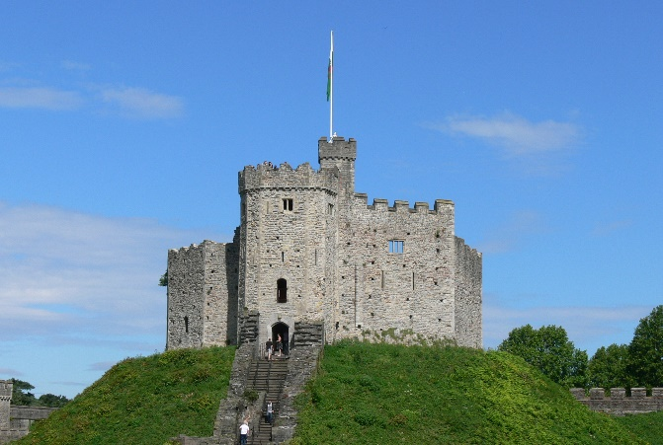
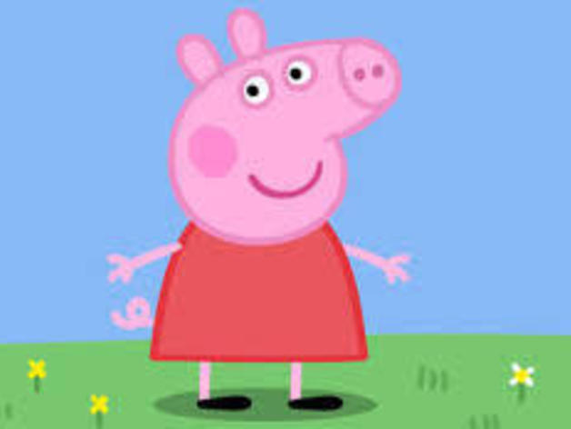
Capital Letters for Names
The picture below is of Cardiff Castle. If a name has more than one word, each word of the name needs a capital letter.
Cardiff Castle
Who is this?
Peppa Pig

Slide 12
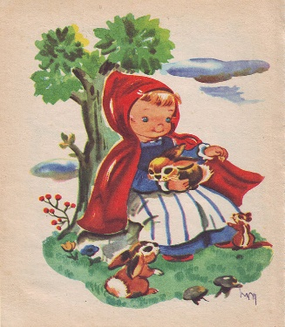
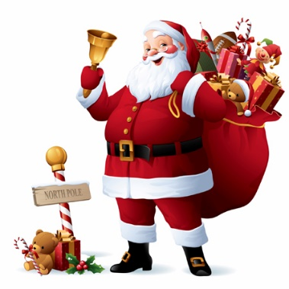
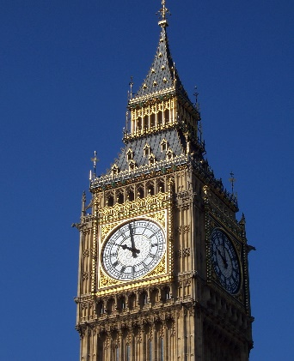
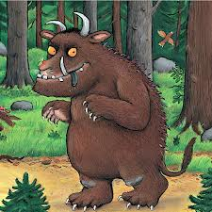
Practise
Write down these names (proper noun).
Little Red Riding Hood
Father Christmas
Big Ben
The Gruffalo

Slide 13
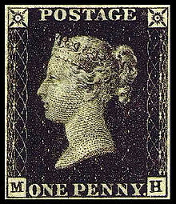
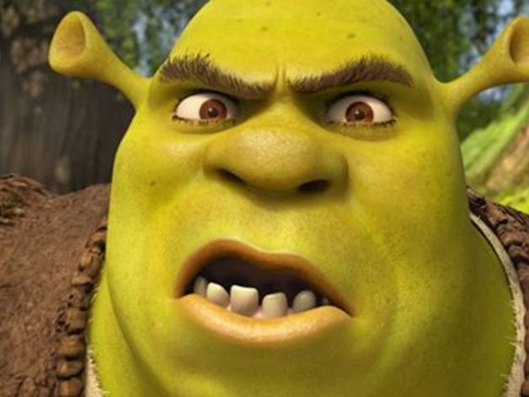
Capital Letters for Names
This letter needs to be sent to Shrek but the postman has asked for the punctuation to be corrected. Can you spot the names that need a capital letter?
mr shrek
4 swamp street
enchanted forest
far far away

Slide 14
Capital Letters for Names
Did you find them all? Now try write your own address, ask for help with the spelling if you need it.
Mr Shrek
4 Swamp Street
Enchanted Forest
Far Far Away

Slide 15
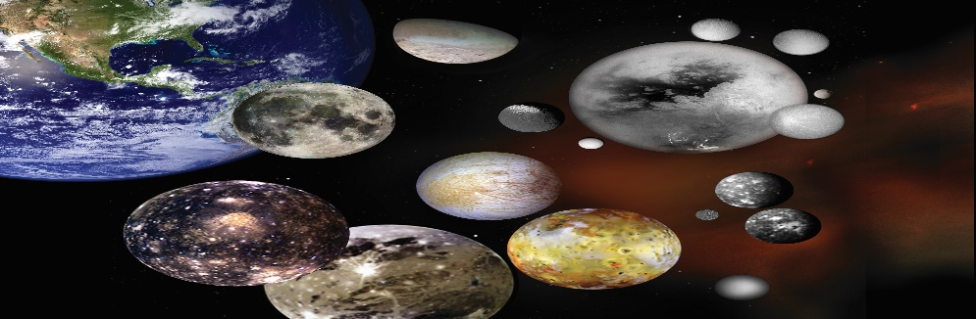
Capital letter for Names
Do these sentences use capital letters correctly?
These children are coming to my party, lucy, cameron, amit and lexie.
My teacher, mr gupta, thinks matt worked extremely hard today.
did you know these planets have more than one moon: saturn, jupiter, venus and uranus?

Slide 16
Capital letter for Names
Did you spot them all?
These children are coming to my party, Lucy, Cameron, Amit and Lexie.
My teacher, Mr Gupta, thinks Matt worked extremely hard today.
Did you know these planets have more than one moon: Saturn, Jupiter, Venus and Uranus?
Not all the missing capital letters were for proper nouns, did you notice the last sentence did not start with a capital letter? Well done if you found that one!

Slide 17
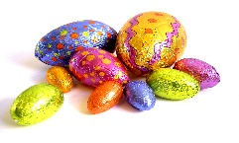
Missing Capital Letters
How about a bigger challenge? There are lots of missing capital letters in these sentences. Some for names, some at the start of sentence and some for ‘I’ (the personal pronoun). Can you find them all?
this easter i was determined to catch the easter bunny delivering his eggs. i asked my friends pete and tom to help me. patiently we waited up all night, hiding behind the long, heavy curtains in the lounge. just before it was light, we saw a ford van coming down church street. is this the moment we finally get to see the easter bunny?

Slide 18
Missing Capital Letters
How did you do?
This Easter I was determined to catch the Easter Bunny delivering his eggs. I asked my friends Pete and Tom to help me. Patiently we waited up all night, hiding behind the long, heavy curtains in the lounge. Just before it was light, we saw a Ford van coming down Church Street. Is this the moment we finally get to see the Easter Bunny?

Slide 19
Teacher information
Show Me Tasks
Once the therapy has been delivered you can use Show Me Tasks to demonstrate that the skill is now secure. They are not intended to be completed all at once and ideally should be done in intervals of a few days after the therapy has been delivered. The challenge in the tasks is progressive.

Slide 20



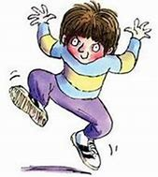
Which of these words need a capital letter? Why?
Show Me Tasks
W3c. Uses capital letters for names (proper nouns).
christmas
castle
peanuts
february
Commissioned by The PiXL Club Ltd.
January 2018
hamil
This resource is strictly for the use of member schools for as long as they remain members of The PiXL Club. It may not be copied, sold nor transferred to a third party or used by the school after membership ceases. Until such time it may be freely used within the member school. All opinions and contributions are those of the authors. The contents of this resource are not connected with nor endorsed by any other company, organisation or institution.
wednesday
manchester
© Copyright The PiXL Club Limited, 2017
cartoon
Can you correct the punctuation in this address?
Find the missing capital letters in this paragraph.
horrid henry is a famous character created by the author, francesca simon. he has a brother perfect peter and his enemy is moody margaret. Although many books have been written, horrid henry tricks the tooth fairy, remains a favourite with
many children.
queen elizabeth
buckingham palace
london
england
Explain the reason for any changes you make.

