Slide 1


Y6 Therapy
GPS
3c. Can recognise and use SUBORDINATING (e.g. when, if, that, because) and COORDINATING CONJUNCTIONS (e.g. or, and, but)
Commissioned by The PiXL Club Ltd.
August 2019
This resource is strictly for the use of member schools for as long as they remain members of The PiXL Club. It may not be copied, sold nor transferred to a third party or used by the school after membership ceases. Until such time it may be freely used within the member school.
All opinions and contributions are those of the authors. The contents of this resource are not connected with nor endorsed by any other company, organisation or institution.
PiXL Club Ltd endeavour to trace and contact copyright owners. If there are any inadvertent omissions or errors in the acknowledgements or usage, this is unintended and PiXL will remedy these on written notification.
© Copyright The PiXL Club Limited, 2019

Slide 2
Teacher Notes
There is a great deal of technical language which can be used when teaching clauses, phrases and conjunctions. This can sometimes be confusing, particularly for Key Marginals, so how much is actually introduced, especially when teaching different types of phrases, should be at the teacher’s discretion. We do all share high expectations for all pupils, but the aim is for pupils to have a solid understanding of the core concepts.
You may wish to use the GPS Recall Cards as a starter or supporting activity, as well as linking to the PiXL Writing Resources (W2c).

Slide 3
Vocabulary Task
Read it:
coordinating
Define it
Use it
Link it
synonym:
antonym
Deconstruct it
focus element: coordinate
meaning:

Slide 4

Conjunctions
A conjunction is a word that links words or connects ideas within a sentence.
We were all tired from our day’s activities, but we stayed up late round the campfire having fun.

Slide 5
Types of conjunction
There are two different types of conjunction: subordinating conjunctions and coordinating conjunctions.
Soon after that, the tiger crept through the trees as the monkey grabbed the fruit and ate it messily. The tiger spied on the monkey silently because she didn’t want to frighten it away.
because is a subordinating conjunction – it is linking words or groups of words that are less important than the rest of the sentence
and is a co-ordinating conjunction – it is linking words or ideas in the sentence which are of the same importance

Slide 6


Subordinating conjunctions
Subordinating conjunctions are words that link a main clause and a subordinate clause within a sentence and establish a relationship between them, for example that one depends on the other.
She couldn’t sleep although she was really tired.
It would be fantastic if you could come on holiday with us.
It snowed heavily while we were climbing in Scotland.

Slide 7
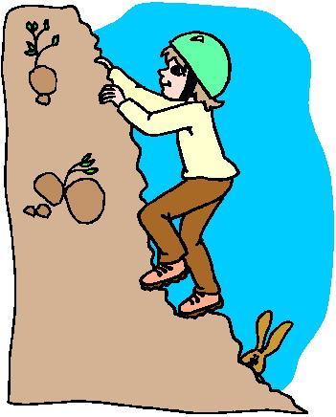
Subordinating conjunctions
Sometimes subordinating conjunctions are used at the beginning of a sentence. Remember – if the subordinate clause comes first in the sentence it needs a comma to separate it from the main clause.
Although she was really tired, she couldn’t sleep.
If you could come on holiday with us, it would be fantastic.
While we were climbing in Scotland, it snowed heavily.

Slide 8
Subordinating conjunctions
Here is a list of subordinating conjunctions:
Have a go at making up sentences that include some of these words.
after | although | as | as soon as | because | before
by the way | even though | every time | if | just in case | now that
once | only if | since | the first time | though | unless
until | when | whenever | whereas | whether | while

Slide 9
Your turn
Join these sentences together using a subordinating conjunction within the sentence.
I went swimming on Thursday. I needed to practise for the race.
He was a good swimmer. He didn’t like to swim in the sea.
You can stay at my house. Your mum and dad are going away.

Slide 10
Challenge
Now change them around so that the subordinating conjunction is at the start of the sentence.

Slide 11
Coordinating conjunctions
Coordinating conjunctions join words, phrases and clauses.
There are seven coordinating conjunctions:
for and nor but or yet so

Slide 12
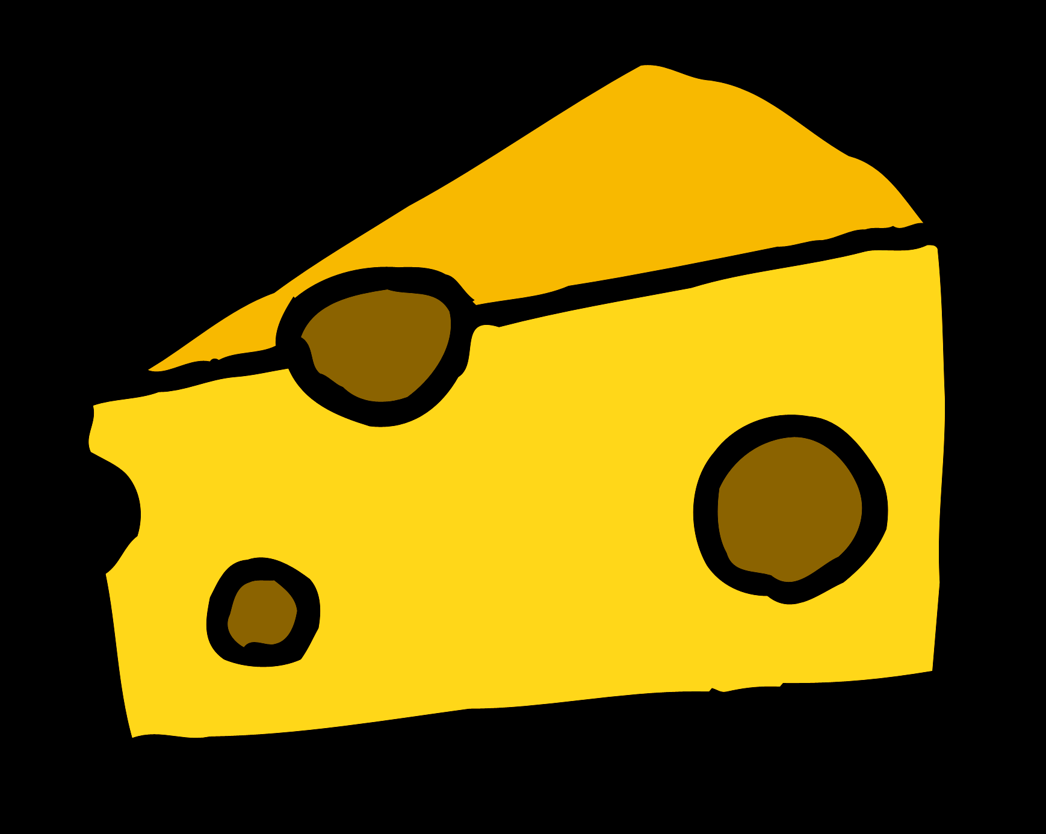

Coordinating conjunctions
Coordinating conjunctions can join things of equal importance together in a sentence. For example:
I like Cheddar cheese and I also enjoy cheese spread too.
The teacher enjoyed the art lesson, so did all the children in his class.
Dad spent all afternoon outside, for the snow had covered the drive.

Slide 13

Coordinating conjunctions
Coordinating conjunctions can also compare and give opposite ideas. For example:
Rosie likes to watch comedy videos but Ella likes to watch music videos.
She loves swimming in the pool yet she doesn’t enjoy swimming in the sea.
We could go to the cinema today or we could go to the park.

Slide 14

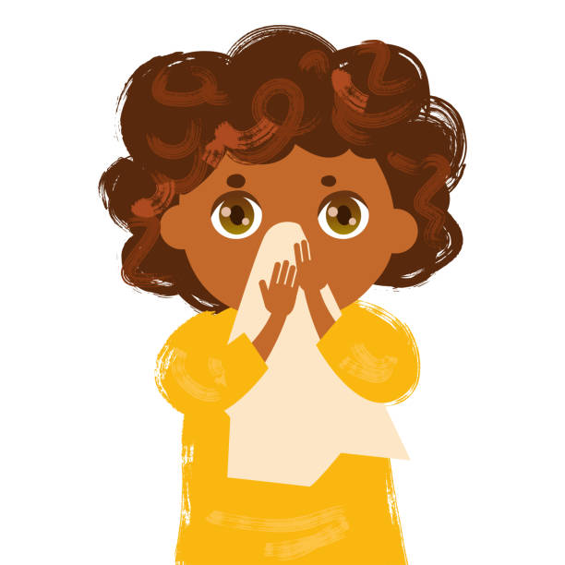
Using commas
When a coordinating conjunction connects two independent clauses, it is often accompanied by a comma. For example:
Shall we go swimming, or have you got a cold?

Slide 15
Your turn
Join these sentences together using different coordinating conjunctions.
She had plenty of money. She wouldn’t pay for her own food.
I like jam on my toast. My brother likes marmalade on his.
We enjoyed our trip away with the school. Our mum and step-dad enjoyed it too!

Slide 16
Summary
A conjunction is a word that links words or connects ideas within a sentence.
Subordinating conjunctions are words that link a main clause and a subordinate clause within a sentence and establish a relationship between them, for example that one depends on the other.
Coordinating conjunctions join words, phrases and clauses. They can join things of equal importance together in a sentence.

Slide 17


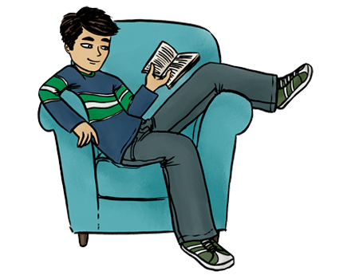
Reflection
You have learnt about subordinating and coordinating conjunctions.
See if you can spot some in your reading, and use them in your writing to make it more interesting and to add more detail.

