Slide 1
Wednesday 15th September 2021
L.I: to understand what individual liberty means and everyone’s right to individual liberty.

Slide 2

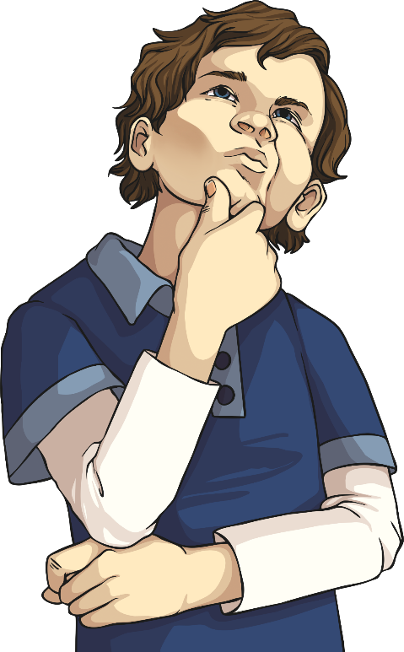
Individual Liberty
Liberty means being free from oppression or restrictions by the government or power.
What do we have the freedom to do?
Think about it

Slide 3
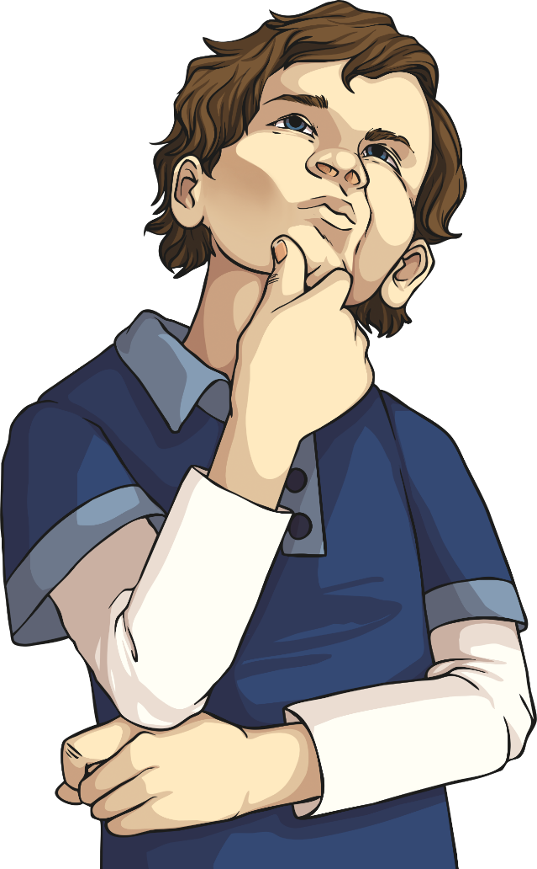

Everyone’s Individual Liberty
There may be times when we try to stop people having their individual liberty.
Think about a time you have tried to get someone to do something you wanted them to.
Think about it.

Slide 4
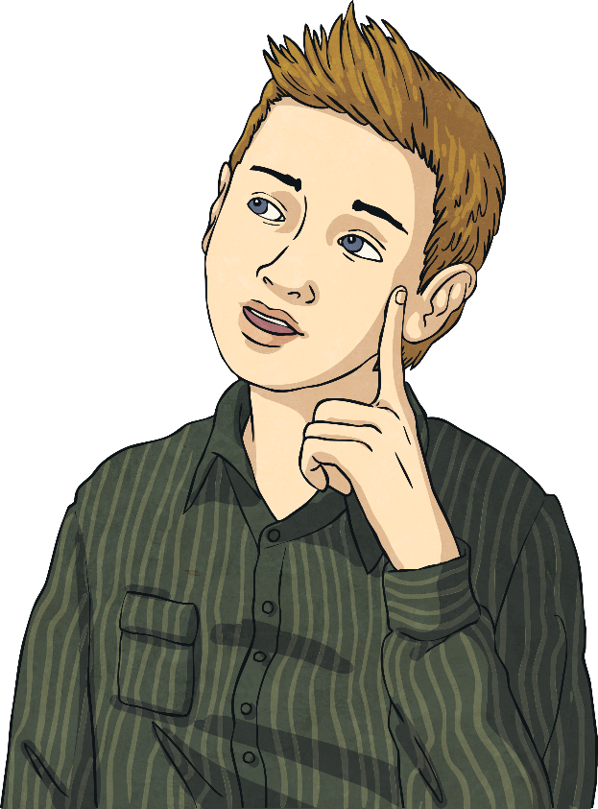
Everyone Should Have Their Individual Liberty
Just as no one should stop our individual liberty, we should not prevent any one else’s.
This means:
being more understanding of others;
thinking of others rather than ourselves;
trying to see things from other people’s point of view;
valuing everyone’s input and opinions.

Slide 5

Listen to this story:
Think about:
How have the Huey’s changed?
Is it for good or for worse?
What do you think the message from Oliver Jeffers is?
Do you think it’s important for everyone to be unique? Why?
https://www.youtube.com/watch?v=H7vAbyWV0Ec

Slide 6
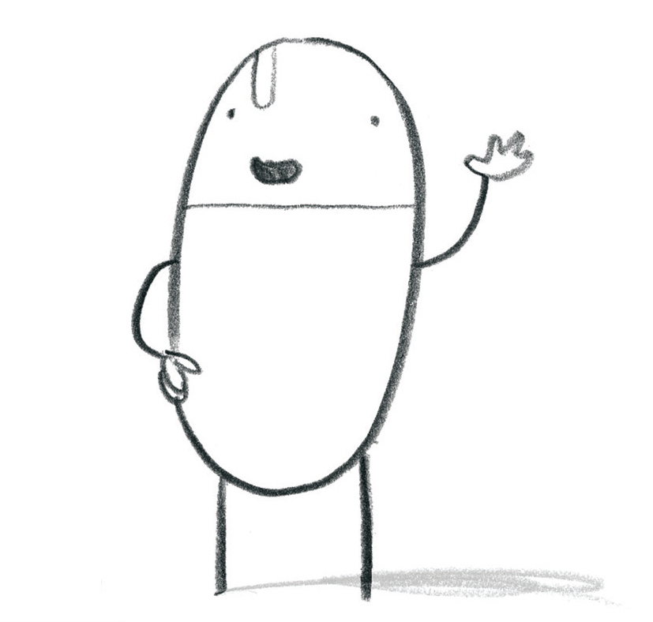
MAIN ACTIVITY
Design your own Huey character and include personal items. e.g. pets/ any hobbies to reflect our 5 school values- respect, aspiration, compassion, resilience and friendship.
Label your character and explain your choices. Finally, write a paragraph underneath about how your Huey character respects individual liberty.
See the next slide for an example

Slide 7







MAIN ACTIVITY- Example
I respect people and treat them how I would like to be treated .
I am resilient when work is tricky.
I have a great friendship group.
I show compassion when I care for my pet dog.
I have an aspiration to be a footballer.
I have the right to be happy. I am free to speak my opinion and keep myself healthy. I think of others before myself and do not prevent others from their individual liberty. I value other people’s opinions.

