Slide 1


W2a. Can describe settings and characters using adjectives
(including expanded noun phrases)
e.g. a fearsome, heinous dragon with sharp claws
Commissioned by The PiXL Club Ltd.
August 2018
This resource is strictly for the use of member schools for as long as they remain members of The PiXL Club. It may not be copied, sold nor transferred to a third party or used by the school after membership ceases. Until such time it may be freely used within the member school.
All opinions and contributions are those of the authors. The contents of this resource are not connected with nor endorsed by any other company, organisation or institution.
© Copyright The PiXL Club Limited, 2018

Slide 2
Teachers’ Notes
This therapy models how pupils can use adjectives to describe settings and characters.
Pupils are shown how adjectives can be used to modify nouns.
Pupils are given the opportunity to consider how adjectives can be carefully chosen to create atmosphere.
Pupils are shown how to build expanded noun phrases and use them to add detail to writing.
Throughout the therapy, pupils are provided with opportunities to practise what they have learned.

Slide 3
Using adjectives
The function of an adjective in a sentence is to modify (make a slight change to) the noun so that the description is clear to the reader. Identify the adjectives in the sentences below. How do they add clarity to the writing?
Dan ate the small pizza; Georgie ate the large pizza.
Using a serrated knife, slice the tomatoes thinly.
Fortunately, the grey clouds had passed quickly overhead.
Melt the brown sugar in a pan, before adding a splash of hot water.
Mega Monsters is the most exciting game I have ever played.

Slide 4
Adjectives for character
Adjectives can be used to create a clear picture of a character in the reader’s head. Appearance, personality and mood can all be conveyed using carefully chosen adjectives. Read the sentences below and decide what impression you get of each of the characters from the adjectives.
His shoulders were hunched as he stood staring into the distance.
As he glimpsed at her eyes, her steely, menacing stare made his blood freeze.
She had a tiny, rosebud mouth.
The teacher spoke with a low, droning voice.

Slide 5
Adjectives for character – your turn
Insert adjectives into the spaces below to create a clear image of the character in the reader’s head. If you add more than one adjective, remember to insert a comma to separate them. Have you conveyed their appearance, their personality or their mood?
Her _______ laugh echoed around the room.
As he appeared before her, she could see his _______ coat.
His ________ beard gave him a ________ look.

Slide 6
Adjectives for character – your turn
Look at the possibilities below which demonstrate how you can create different appearances, personalities and moods with your choice of adjective. How did you do? What does each of the choices tell you about the character?
Her excited laugh echoed around the room.
Her demonic laugh echoed around the room.
As he appeared before her, she could see his worn, scruffy coat.
As he appeared before her, she could see his smart, tailored coat.
His trimmed beard gave him a distinguished look.
His grimy, tangled beard gave him an unkempt look.

Slide 7
Adjectives for setting
Adjectives can also be used to create a detailed picture of the setting for the reader. With clever choices, writers can also create atmosphere using adjectives. Look at the two setting descriptions below – how have the adjectives been used to create different atmospheres?
The rotten floorboards were covered with torn rugs. Old tapestries covered the crumbling walls. On the ceiling, a broken chandelier hung.
The polished floorboards were covered with elegant rugs. Intricate tapestries covered the smooth walls. On the ceiling, a crystal chandelier hung.

Slide 8
Adjectives for setting – your turn
Insert adjectives into the spaces below to create a detailed picture of the setting in the reader’s head. Complete the task twice: choose adjectives to create a positive mood and then choose adjectives to create a negative mood.
The ________ trees towered above him. All around, he could hear the ________ wind in the branches and ________ birds overhead. Beneath his feet, the ________ path stretched out ahead of him. Out of the corner of his eye, he glimpsed a ________ dwelling and set off towards it.

Slide 9
Adjectives for setting – your turn
Read the two examples below – what are the two different atmospheres that have been created? How did you do?
The twisted trees towered above him. All around, he could hear the ghostly wind in the branches and screeching birds overhead. Beneath his feet, the shadowy path stretched out ahead of him. Out of the corner of his eye, he glimpsed a tumbledown dwelling and set off towards it.
The majestic trees towered above him. All around, he could hear the welcome wind in the branches and chattering birds overhead. Beneath his feet, the bluebell-lined path stretched out ahead of him. Out of the corner of his eye, he glimpsed a cosy dwelling and set off towards it.

Slide 10
Expanded noun phrases
Adjectives are an essential part of expanded noun phrases which can be used to create a precise mood or image by adding detail to the noun. They can be made by adding detail both before and after the noun.
Through the air, came two fearsome dragons with sharp talons.
We call the section that comes before the noun a pre-modifier and the section after a post-modifier. In the example above, the post-modifier is a prepositional phrase but we can also use a relative clause.
There were two giant, fearsome dragons who had wings of gold.
determiner
adjective
noun
prepositional phrase
pre-modifier
post-modifier – relative clause

Slide 11
Expanded noun phrases – your turn
Insert pre-modifiers (determiners and adjectives) and post-modifiers (prepositional phrases or relative clauses) into the spaces below to create some expanded noun phrases of your own. Make sure that your language choices match the mood of the sentence.
In the park, ________ tree _______ swayed gently in the wind.
The ________ teacher ________ marched down the corridor.
Hurriedly, ________ children _______ found shelter from the rain.

Slide 12
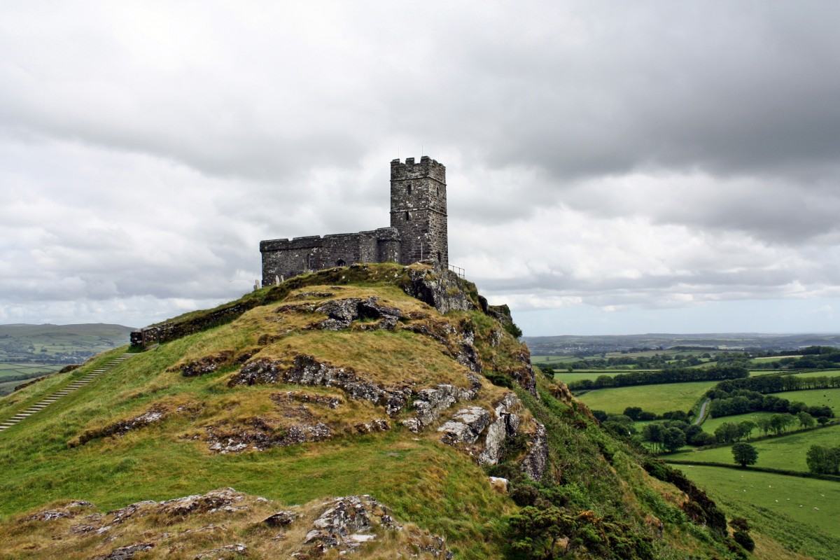
Putting it all together – your turn
Using the picture below, create a short descriptive passage which uses adjectives and expanded noun phrases to convey the atmosphere. Remember that you must choose language which works together to create one mood – either positive (e.g magical, happy) or negative (e.g. threatening, dangerous).

