Slide 1


Y2 A2 Writing
Commissioned by The PiXL Club Ltd.
November 2019
This resource is strictly for the use of The PiXL Club Ltd member schools during the life of the membership only. It may NOT be copied, sold, or transferred or made available by whatever means to a third party non-member during or after membership. Until such time it may be freely used within the PiXL member school by their teachers and authorized staff and any other use or sale thereof is strictly prohibited.
All opinions and contributions are those of the authors. The contents of this resource are not connected with, or endorsed by, any other company, organisation or institution. Images from getty.co.uk unless otherwise stated.
PiXL Club Ltd endeavour to trace and contact copyright owners. If there are any inadvertent omissions or errors in the acknowledgements or usage, this is unintended and PiXL will remedy these on written notification.
© Copyright The PiXL Club Limited, 2019

Slide 2

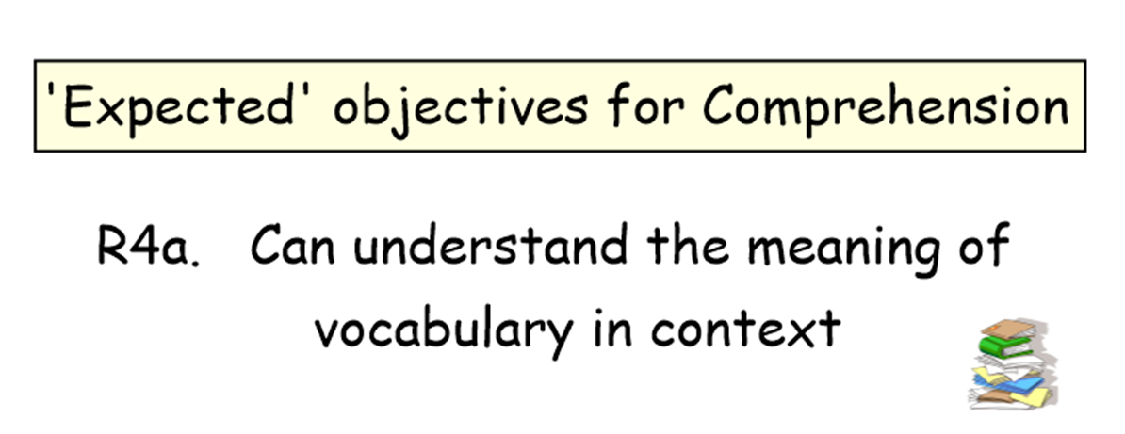
Y2 A2 W2a. Imagination is shown by the inclusion of further details e.g. description of setting and characters, twist to known story, suspense
= teacher notes

Slide 3

Teacher Information
The A2 version of this therapy is intended to support teachers in ensuring that a pupil is secure within the Expected Standard for Year 2, as well as providing additional challenge (Think It) to move pupils towards Above Expected Standard.
The component parts are:
Expected Standard therapy
Expected Standard Show Me tasks
Think It questions
Above Expected Show Me tasks (within this therapy)
Above Expected therapy test (separate resource)
N.B. Teachers will need to gather together a few objects that children can describe and discuss.

Slide 4
How to use this resource
The A2 resources are flexible in their use. However, some suggestions are:
a) If needed, the Expected Standard therapy could be delivered, followed by the Show Me tasks. If a pupil demonstrates security, they could move on to the Think It section in the next session.
b) Deliver only the Expected Standard Show Me tasks to check on security then move straight on to the Think It section (should pupils be able to perform the taught skill independently and consistently).
c) Should there already be sufficient evidence of security within the Expected Standard, it may be appropriate to move straight to the Think It section.

Slide 5
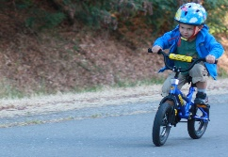
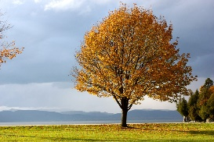
Details make a difference
Writers need to make sure that their readers can imagine what they are talking about. To do this, writers need to give their readers descriptions.
What are three simple things we could say to describe this picture?
Your turn
What are three simple things you could say to describe this picture?
It is a cloudy day.
There is a tree.
Its leaves are red, orange and brown.

Slide 6
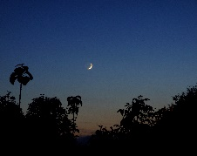
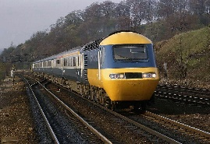

Details make a difference
Good writers give their readers more than simple descriptions. They provide details so readers can really imagine the scene in their head.
List three details you notice about this picture.
Your turn
There is a train carrying passengers.
The engine is yellow and blue.
Describe the picture in full sentences using as much detail as possible.
It’s going past a grassy bank, topped with trees.

Slide 7

Details make a difference
Provide a selection of different objects. Give one object to a member of the group and ask them to say three things about it, without saying what it is.
Repeat with the other children.
Say three things about the object you have been given. Make sure you speak clearly and use detailed descriptions, but don’t tell the others what it is! Can they guess?

Slide 8
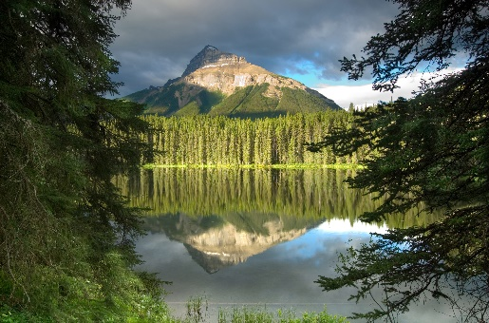
Details make a difference
Now you know how to add detail, where should you put it? A good place to start is the setting. When the reader doesn’t have a picture to look at, the writer needs to paint the picture with words.
Spot the difference
She saw a mountain.
Through the trees, she glimpsed a majestic, snow-capped mountain, skirted by a dense forest
and reflected in a
smooth, still lake.

Slide 9
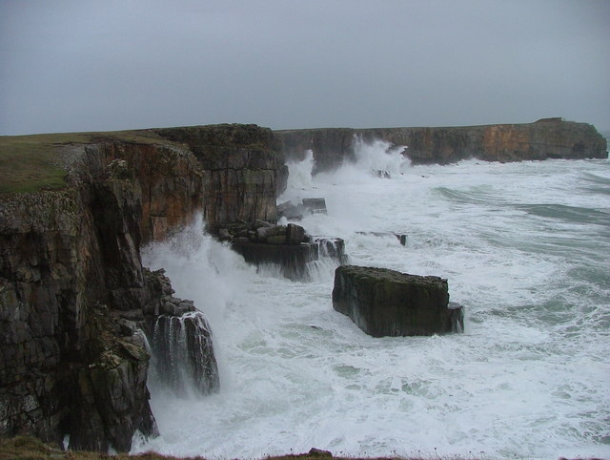

Describing a setting
Describing a setting effectively means giving the reader enough detail to know what is there, while making sure it is clear and interesting to read.
Your turn – have a go at describing this setting.
Remember to speak clearly, use detailed descriptions and try to speak in full sentences.

Slide 10
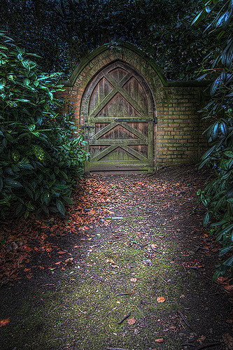
Describing a setting
Describing a setting effectively means giving the reader enough detail to know what is there, while making sure it is clear and interesting to read.
Your turn – now try describing this setting.
Remember to speak clearly, use detailed descriptions and try to speak in full sentences.

Slide 11
Describing a setting
Now for something a little more challenging!
Can you describe a setting without having a picture to help you?
Take it in turns to close your eyes and describe your favourite place. Try to speak in full sentences and remember to add detail.

Slide 12
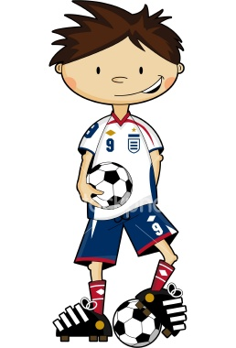
Describing characters
It’s not just settings that need to be described in detail. You also need to give the reader a clear idea of what your characters are like.
Compare this description…
With this description…
Stan is a football-crazy, eight year-old
boy with brown
spiky hair, a
white tee-shirt
and blue shorts.
Stan is a boy.

Slide 13
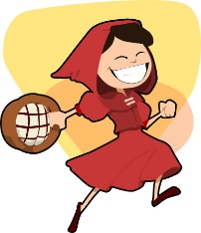
Describing characters
Just like with settings, describing characters means giving the reader enough detail to know what they are like. This is not just about what they look like – how they behave is often more interesting.
Take turns to describe a character from a story.
For example:
Little Red Riding Hood is a kind, brave
girl who cares for her granny. However,
she is also a little silly to leave the path
when she walks through the woods.

Slide 14
Describing characters
Remember, describing characters is not just about what they look like – how they behave is often more interesting.
Now take turns to describe someone else in the group. Make sure you only say positive things!
Remember to speak clearly, use good descriptions and try to speak in full sentences.

Slide 15
Including a twist for interest
Sometimes it helps to keep your reader interested by including a ‘twist’ – something a little unexpected – especially when you are writing a story.
Let’s look at an example.
Traditional version:
Improved version – with a twist:
When she opened her eyes, Goldilocks saw the three bears leaning over her. Screaming with fear, she jumped out of bed and ran away.
When she opened her eyes, Goldilocks saw the three bears leaning over her. “Don’t just stand there,” she snarled. “Bring me my breakfast. Now!” Horrified by her rudeness, the bears ran away screaming from the spoilt girl.

Slide 16

Including a twist for interest
Sometimes it helps to keep your reader interested by including a ‘twist’ – something a little unexpected – especially when you are writing a story.
Your turn – read this traditional version of The Gingerbread Man:
Now discuss how you could put your own interesting twist on the end of the story!
Halfway across the river, the fox said “Climb onto my nose.” But when the Gingerbread man did so, the fox flipped him high into the air and swallowed him with one gulp.

Slide 17
Teacher information
Show Me Tasks
Once the therapy has been delivered you can use Show Me Tasks to demonstrate that the skill is now secure. They are not intended to be completed all at once and ideally should be done in intervals of a few days after the therapy has been delivered.
For these tasks, please provide children with writing materials to enable them to demonstrate their understanding.

Slide 18


Imagine an enchanted forest. Now write as many words as you can to describe what it is like.
__________________________________
__________________________________
__________________________________
__________________________________
Show Me Tasks
A2 W2a. Imagination is shown by the inclusion of some details e.g. description of setting and characters, twist to known story
Commissioned by The PiXL Club Ltd.
November 2019
This resource is strictly for the use of member schools for as long as they remain members of The PiXL Club. It may not be copied, sold nor transferred to a third party or used by the school after membership ceases. Until such time it may be freely used within the member school. All opinions and contributions are those of the authors. The contents of this resource are not connected with nor endorsed by any other company, organisation or institution. PiXL Club Ltd endeavour to trace and contact copyright owners. If there are any inadvertent omissions or errors in the acknowledgements or usage, this is unintended and PiXL will remedy these on written notification.
© Copyright The PiXL Club Limited, 2018
Write two or three sentences to create a new twist to the end of a famous story you know.
__________________________________
__________________________________
__________________________________
__________________________________
Write two or three sentences about a character from a famous film or story without saying who it is. See if your partner can guess.
_________________________________
_________________________________
_________________________________
_________________________________

Slide 19


Teacher Guidance
The intention of the Think It section of this resource is to provide greater challenge for pupils who have demonstrated security within the Expected Standard. It is suggested that the Think It questions are best delivered as part of a guided group. In this way, pupils’ verbalisation of their reasoning can provide valuable assessment information, as well as providing a context for probing questions and additional challenge.

Slide 20
Teacher Guidance
Having worked on the Think It questions, the expectation is that the pupil completes the two Show Me tasks independently. The additional A2 therapy test (separate to this resource) is intended to provide a bridge to the Year 3 therapy test format and move pupils towards greater independence. Additional PiXL resources designed to demonstrate a deeper understanding within subjects are:
The PiXL Progression Ladders
The PiXL Knowledge Mats – Think It

Slide 21
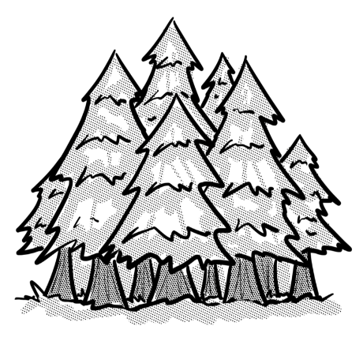
In writing, suspense is when the author leaves the reader unsure about what might happen next – especially when there is a hint that something bad is coming. How could you alter this story extract to create more suspense?
They were walking through the forest when suddenly a bear came crashing out through the undergrowth.
They thought they had heard a snuffling and the
breaking of twigs. It seemed to have been
following them for a while. Now, they knew
what had been making that noise.

Slide 22
This session has focused on showing imagination by including more detail.
Shane knows he has to add more detail to his writing but he is beginning to wonder whether it is possible to have too much detail. What do you think? Give examples to support your ideas.

Slide 23
Show Me Tasks – Task 1
Y2 A2 W2a. Imagination is shown by the inclusion of some details e.g. description of setting and characters, twist to known story
Rewrite this extract to create more suspense.
He could see the spider crawling down towards him. He had been lying in his bed, looking up, when something caught his eye. At first he didn’t know what it was but then he realised it must be a spider and it was moving his way.
________________________________________________
________________________________________________
________________________________________________
________________________________________________

Slide 24
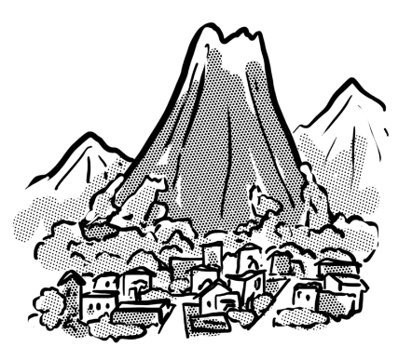
Show Me Tasks – Task 2
Y2 A2 W2a. Imagination is shown by the inclusion of some details e.g. description of setting and characters, twist to known story
Sometimes you can add too much detail. Cross out the parts of this extract that you think are not necessary.
They lived in a comfortable house in a small town at the bottom of the volcano. It had streets, shops and a park. The volcano had been quiet for many years but now there were signs of it coming back to life. Smoke rose from it almost every day, now. Sometimes it
went straight up and sometimes it was blown sideways
by the wind. Every now and then, the whole town was
shaken by a worryingly loud rumble. Mrs Rossi from next
door was often away so she usually missed the rumbles.

