Slide 1


W5f. Is beginning to develop characterisation through describing how characters look, react, talk or behave.
Commissioned by The PiXL Club Ltd.
Example 2017
This resource is strictly for the use of member schools for as long as they remain members of The PiXL Club. It may not be copied, sold nor transferred to a third party or used by the school after membership ceases. Until such time it may be freely used within the member school.
All opinions and contributions are those of the authors. The contents of this resource are not connected with nor endorsed by any other company, organisation or institution.
© Copyright The PiXL Club Limited, 2017

Slide 2
Teachers’ Notes
This therapy begins by exploring how to describe the appearance of a character. Two levels of difficulty are exemplified.
It moves on to model how a character’s actions and reactions can inform the reader about their personality. It isn’t necessary to directly tell the reader that, for instance, a character is nervous. It can be implied through their actions.
This is followed by examining how dialogue can reveal information about a person – both what they say and how they say it.
Throughout the therapy there are opportunities to practise and apply the taught skills.

Slide 3

What do you KNOW about this character?
What might you INFER (work out) about this character?
What DON’T you know about this character?

Slide 4
A picture or photograph can quickly tells us a great deal about a character. When we write, we need to communicate this information through words.
How do we find out about a character in a story?
from what they say or how they say it
from what the author tells us directly
from what they do (their actions)
from what others say about them

Slide 5
The most obvious starting point for a character is their APPEARANCE. Our reader needs to be able to picture the character.
Discussion
How would you describe this woman to your partner?
The key features which stand out are:
her smile
her eyes
she is listening to something
With these features in mind, we can write a description.

Slide 6
The woman had a dazzling smile and her eyes sparkled. She had wavy, black hair and she was wearing a pair of blue headphones. She had a blue jacket on.
Your turn: compare these two descriptions. Which one is better? Give reasons for your answer.
As I arrived on the train, I noticed a striking woman in front of me. She had a dazzling smile and her eyes sparkled. On her wavy, black hair, sat a pair of headphones. Perhaps what she was listening to was making her smile? Interestingly, her blue headphones matched the blue jacket she was wearing.

Slide 7
What did you think?
The woman had a dazzling smile and her eyes sparkled. She had tousled black hair and she was wearing a pair of blue headphones. She had a blue jacket on.
This version is a clear description of the features we decided to focus on. However, it is a bit like a list. Most of the sentences begin with ‘She had…’

Slide 8
As I arrived on the train, I noticed a striking woman in front of me. She had a dazzling smile and her eyes sparkled. On her tousled, black hair, sat a pair of headphones. Perhaps what she was listening to was making her smile? Interestingly, her blue headphones matched the blue jacket she was wearing.
This also includes all of the key features but they are linked together in a more natural way. A mixture of adverbials and prepositions at the beginning of the sentences makes the writing flow, because the ideas are linked.

Slide 9
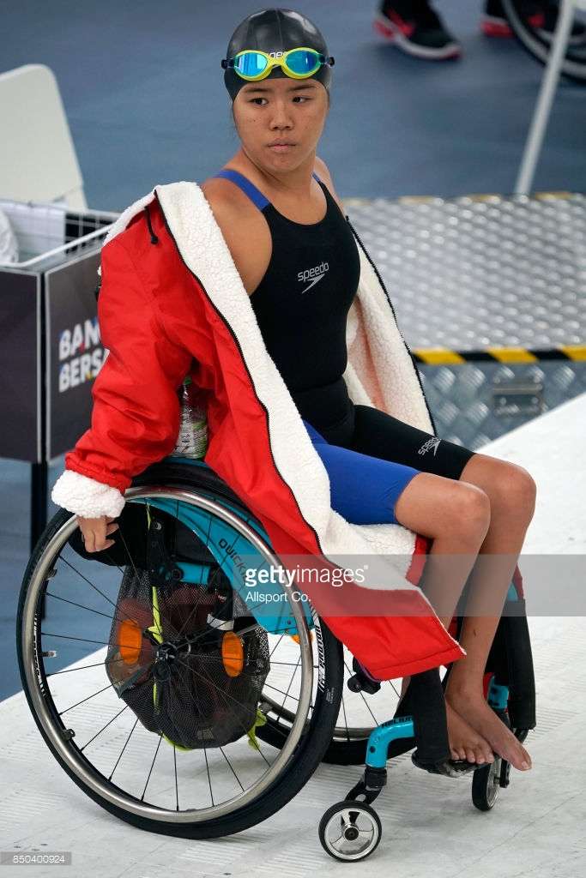
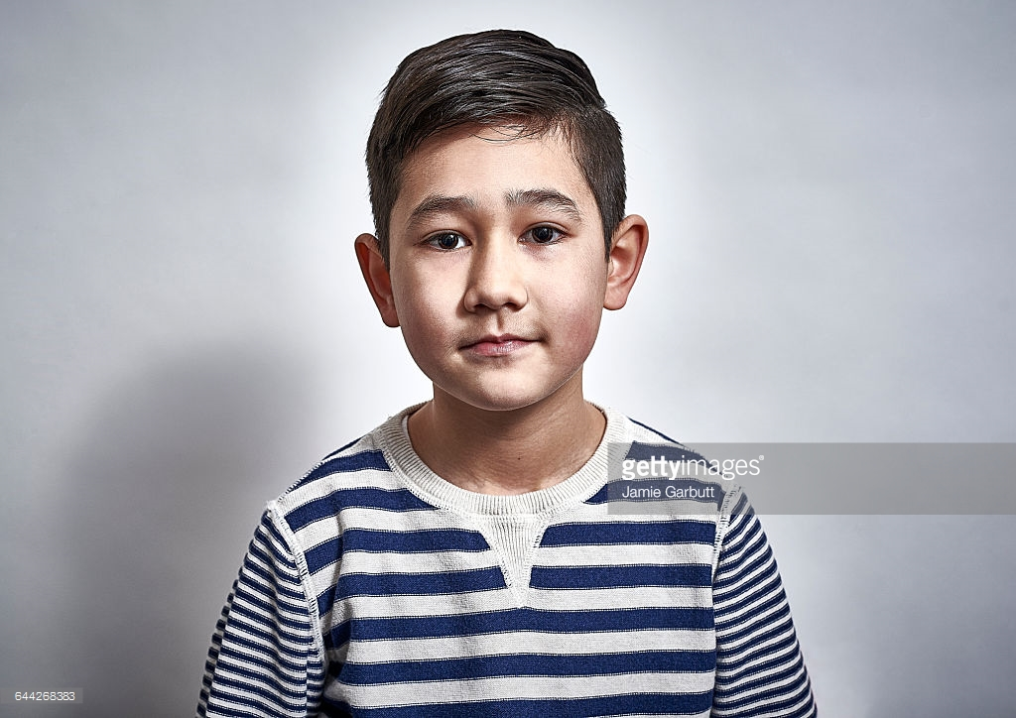
Your turn: choose one of the characters below. Decide on three features to focus on and write a description of them based on what you can SEE.
Easier version – in the style of the first example (like a list).
Harder version – in the style of the second example. Try to use adverbials and prepositions. For example, ‘On her head ...’

Slide 10
If we are good writers, we can show the personality of our characters by the way they act and react. We don’t have to TELL our reader what they are like.
When Tim heard the news he was sad.
Discussion
How do we react when we are sad?
We cry.
Our eyes water.
Our head goes down.
We wipe our eyes.
So, it would be much more interesting to write:
When Tim heard the news, he burst into tears.
When Tim heard the news, his eyes began to water and his head drooped.
We don’t have to TELL our reader how the character is feeling, we can suggest it by describing our character acting or reacting in a certain way.

Slide 11
Your turn: match the action to the emotion.
He raised his arms up in triumph.
puzzled
Jane’s hands went to her mouth and her eyes widened.
excited
Moheen frowned and stared hard at the maths problem.
nervous
Alison tiptoed down the stairs, biting her finger nails as she went.
shocked

Slide 12
Read this extract. What do we know about Kate from this?
Kate settled down to watch her favourite programme on television. Everyone was out and she had the whole house to herself. Great! She folded her long legs underneath her and snuggled up on the cushions. Her blonde, curly hair, as usual, seemed to have a life of its own!
Just as she had settled down, she heard a strange noise upstairs. She listened carefully, thinking she had imagined it. There seemed to be some odd scratching noises on the floorboards above her. What could it be?
“Is anyone there?” she shouted. There was no answer so she decided to go upstairs and investigate. Climbing up the stairs, she could feel her heart beating loudly in her chest. Should she call someone rather than going up? No. She was determined to sort it out herself.
As she reached the landing, she burst out laughing. Sitting outside her bedroom door was next door’s cat!

Slide 13
Kate settled down to watch her favourite programme on television. Everyone was out and she had the whole house to herself. Great! She folded her long legs underneath her and snuggled up on the cushions. Her blonde, curly hair, as usual, seemed to have a life of its own!
Just as she had settled down, she heard a strange noise upstairs. She listened carefully, thinking she had imagined it. There seemed to be some odd scratching noises on the floor boards above her. What could it be?
“Is anyone there?” she shouted. There was no answer so she decided to go upstairs and investigate. Climbing up the stairs, she could feel her heart beating loudly in her chest. Should she call someone rather than going up? No. She was determined to sort it out herself.
As she reached the landing, she burst out laughing. Sitting outside her bedroom door was next door’s cat!
We are told by the author that Kate has:
Long legs
Blonde, curly hair
However, we can be reading detectives and work out what we think Kate is like by her ACTIONS and REACTIONS.
Answer: she appears to be brave.
Evidence: she went upstairs, even though she thought there might be an intruder.
Answer: she is independent.
Evidence: she seems happy to be in the house on her own.

Slide 14
Your turn. Choose one of the emotions from the list below and write a short paragraph about a character who is feeling like this. Can your partner guess the emotion from how the character ACTS?
frightened
worried
pleased
excited

Slide 15
We can also find out about characters from what they SAY and HOW they say it.
Discussion
What do you think this character is like? What is your evidence?
“Go away Warren! You’re always pestering us!” shouted Kim, giving him a shove.
Answer: Kim doesn’t appear to be very kind.
Evidence: she has told Warren to go away and she has pushed him. Also, she shouted at him, which seems aggressive.
We haven’t written the sentence ‘Kim was unkind.’ Instead, we have suggested it by what she has said and how she has said it.

Slide 16
Your turn: what do you think these characters are like? What is your evidence?
“Did you see that James only got three out of ten in his spelling test?” sneered Tess as she nudged Chloe.
“Would you like to join in our game?” asked Colin gently.
“Just follow me. Don’t worry. I’ve been here loads of times!” said Mr Caxton calmly.

Slide 17
So, the best writers create interesting characters by:
*Telling us some information (usually about their appearance)
*Suggesting it through their actions and reactions
*Suggesting it by what they say and how they say it
Your turn: use the ideas we have explored to write a short extract from a story where two characters are trapped in a cave. Try not to tell us about their personality. Instead, suggest it by what they do and say.
Hint: try to make your two characters completely different. For example, one could be brave and confident while the other is much quieter and nervous. Perhaps the brave, confident one got them into trouble in the first place and the quiet, confident one saves them!

