Slide 1


.
Y5 M3g Can interpret remainders in context as fractions, decimals or by rounding
Commissioned by The PiXL Club Ltd.
June 2019
This resource is strictly for the use of member schools for as long as they remain members of The PiXL Club. It may not be copied, sold nor transferred to a third party or used by the school after membership ceases. Until such time it may be freely used within the member school.
All opinions and contributions are those of the authors. The contents of this resource are not connected with nor endorsed by any other company, organisation or institution.
PiXL Club Ltd endeavour to trace and contact copyright owners. If there are any inadvertent omissions or errors in the acknowledgements or usage, this is unintended and PiXL will remedy these on written notification.
© Copyright The PiXL Club Limited, 2019

Slide 2
Teachers’ Notes
The PiXL therapies can be taught to a whole class or a target group. Year 3-5 therapies are designed to take approximately 30-40 minutes. However, this is flexible: it may be that only part of the therapy is taught or it could, of course, be adapted or extended.
Each therapy begins with a LORIC activity to develop relevant learning behaviours.
This is followed by a vocabulary task, which uses the PiXL 5-phase approach to teach key mathematical vocabulary. Further resources to develop vocabulary can be found in the Whole School area.
Each therapy adopts the ‘Teach, model and apply’ process with opportunities for pupils to demonstrate the taught skill independently.
Problem solving and reasoning activities are an integral part of each therapy.

Slide 3
Progress across amber – the 4-stage model
The three therapy tests which accompany this resource can be used to revisit the taught skill to check that the pupil is able to perform it independently and consistently.
A
A child has successfully completed a therapy test independently, following a set of therapy sessions.
A child has successfully completed a therapy test independently, a period after the relevant therapy sessions – we would advise about 2 weeks.
A child has successfully applied their knowledge or skill in an unfamiliar context. This may be application across the curriculum or in a problem.
A pupil has successfully re-visited the skills at a later point, and applies these in an unfamiliar context or problem, or across the curriculum.
A
DA
G

Slide 4
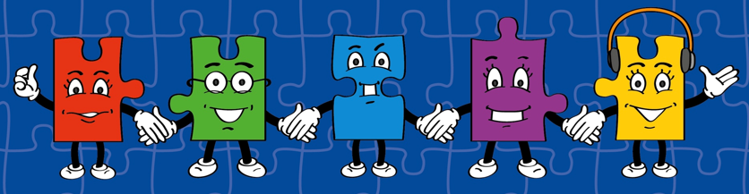
LORIC task
Today the LORIC task will focus on your Raj Resilience skills:
Do not be put off by a difficult task.
Keep going – persevere.
Think about ways you can help yourself and others.

Slide 5

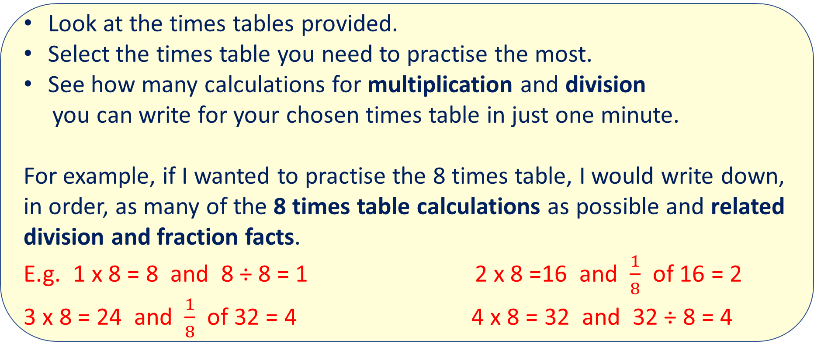
LORIC task
Look at the times tables provided.
Select the times table you need to practise the most.
See how many calculations for multiplication and division
you can write for your chosen times table in just one minute.
For example, if I wanted to practise the 8 times table, I would write down, in order, as many of the 8 times table calculations as possible and related division and fraction facts.
E.g. 1 x 8 = 8 and 8 ÷ 8 = 1 2 x 8 =16 and $\frac{1}{8}$ of 16 = 2
3 x 8 = 24 and $\frac{1}{8}$ of 32 = 4 4 x 8 = 32 and 32 ÷ 8 = 4
Notes:
May need to recap on fractions and decimals before moving on. If children need further support with fractions and decimals, look at the other PLCs available that purely focus on this.

Slide 6
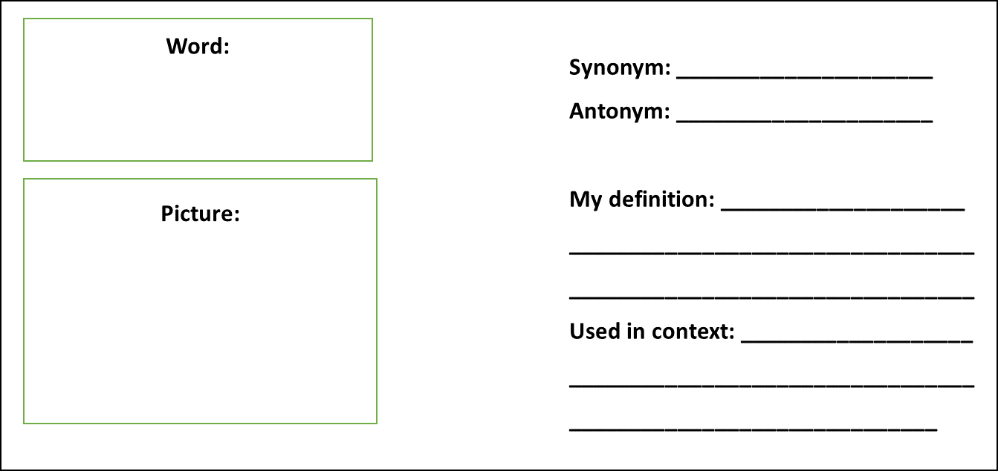
Vocabulary activity
remainder fraction
decimal
rounding
DEFINE IT / USE IT

Slide 7
Teach
Sometimes we cannot share equally. This means that there are some left over which means the groups are not equal. This is when we have remainders.
For example, 21 ÷ 4 = 5r1
When we divide numbers, we normally share into equal groups.
For example, 42 ÷ 7 = 6
Notes:
May need to recap on fractions and decimals before moving on to this part.

Slide 8
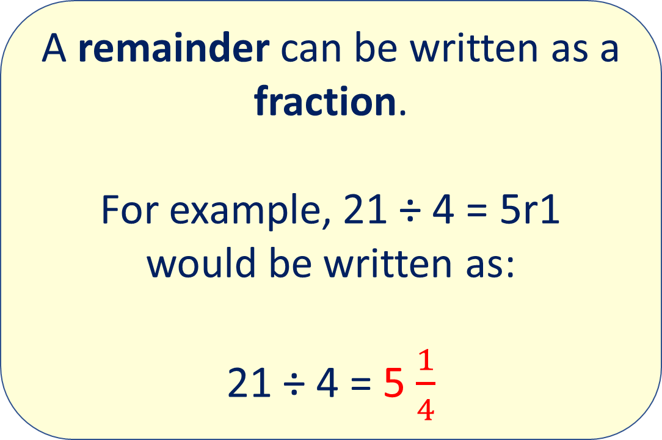
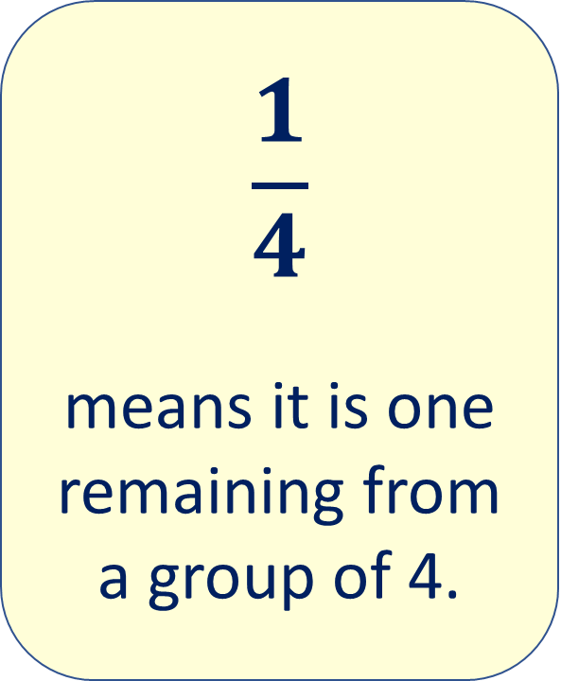
Teach
A remainder can be written as a fraction.
For example, 21 ÷ 4 = 5r1
would be written as:
21 ÷ 4 = 5 $\frac{1}{4}$
$$\frac{1}{4}$$
means it is one remaining from a group of 4.

Slide 9
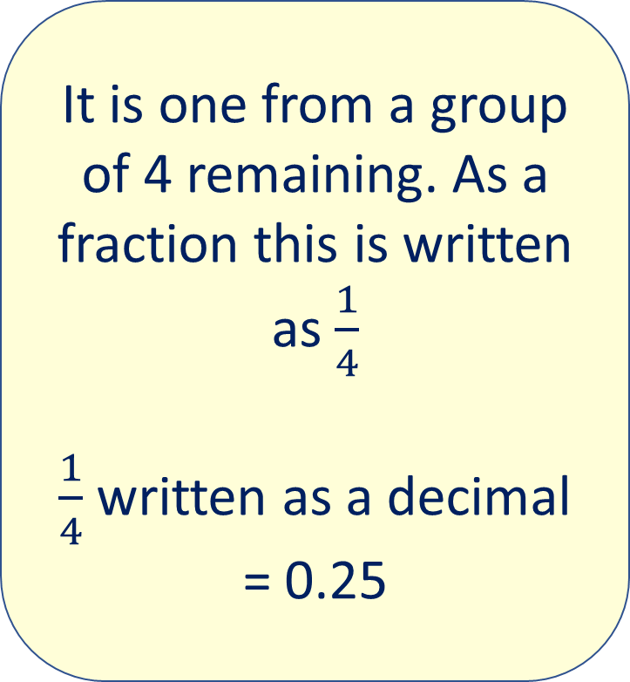
Teach
A remainder can be written as a decimal.
For example, 21 ÷ 4 = 5r1
would be written as:
21 ÷ 4 = 5.25
It is one from a group of 4 remaining. As a fraction this is written as $\frac{1}{4}$
$\frac{1}{4}$ written as a decimal = 0.25

Slide 10
Teach
A remainder can also be rounded too. So, if the statement was put into the following context, the answer could be rounded:
Sam needs to buy 21 boxes of cereal. They are sold in packs of 4. How many boxes will Sam need?
ANSWER: 5 boxes will not be enough (because of the remainder) so he will have to buy 6 boxes.
Sometimes we cannot share equally. This means that there are some left over which means the groups are not equal. This is when we have remainders.
For example,
21 ÷ 4 = 5r1

Slide 11
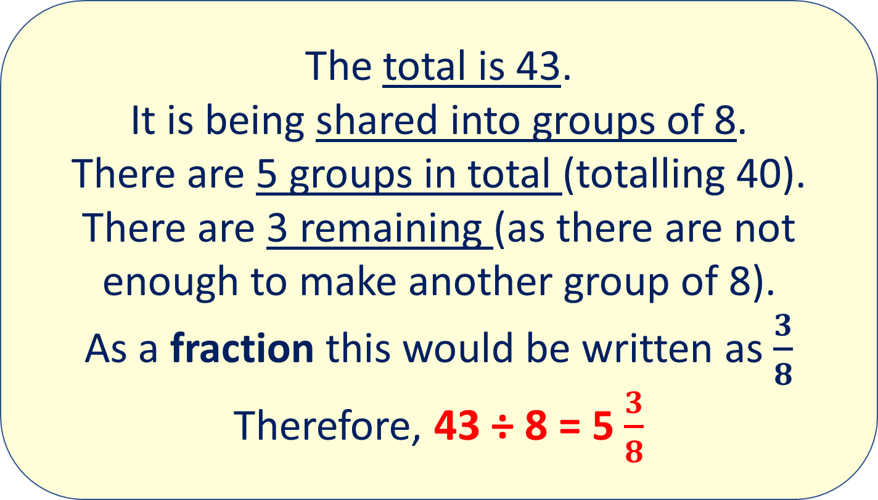
Model
The total is 43.
It is being shared into groups of 8.
There are 5 groups in total (totalling 40).
There are 3 remaining (as there are not enough to make another group of 8).
As a fraction this would be written as $\frac{3}{8}$
Therefore, 43 ÷ 8 = 5 $\frac{3}{8}$
We can change a remainder into a fraction. Let’s use the example of 43 ÷ 8 = 5r3

Slide 12
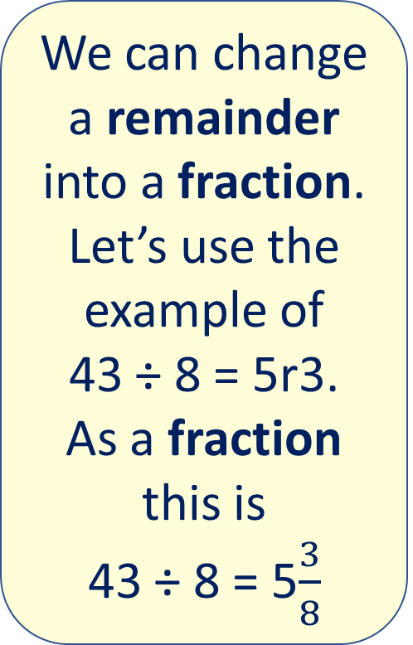
Apply
We can change a remainder into a fraction. Let’s use the example of
43 ÷ 8 = 5r3.
As a fraction this is
43 ÷ 8 = 5$\frac{3}{8}$
Work out these calculations and write the remainder as a fraction:
40 ÷ 7 =
35 ÷ 8 =
29 ÷ 3 =
67 ÷ 9 =
45 ÷ 6 =

Slide 13
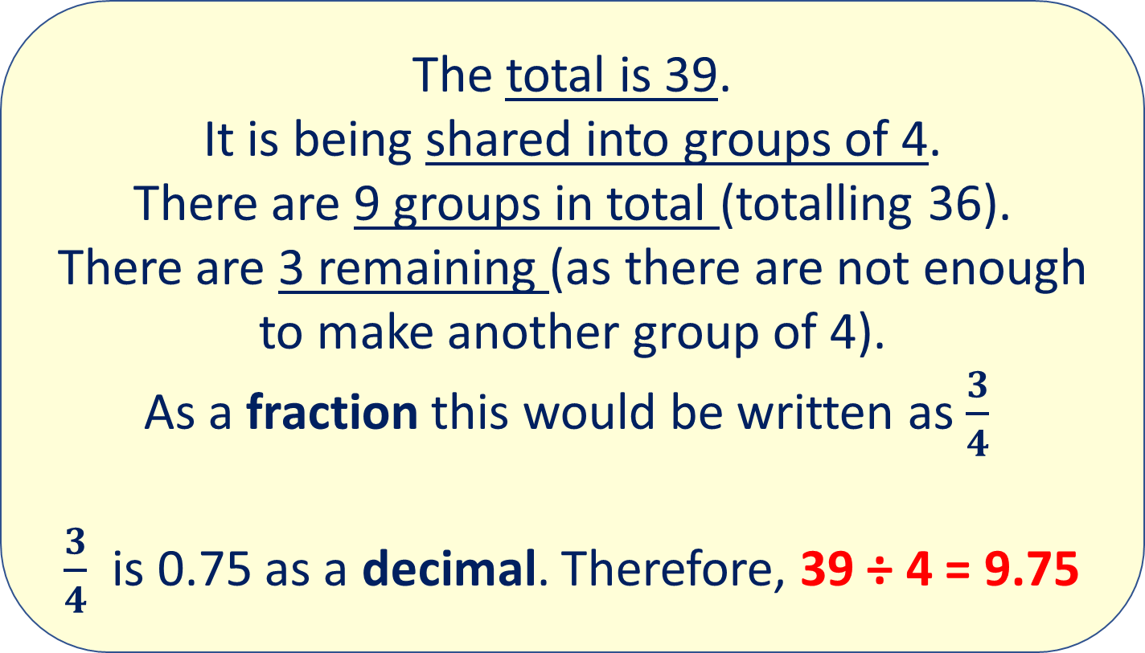
Model
The total is 39.
It is being shared into groups of 4.
There are 9 groups in total (totalling 36).
There are 3 remaining (as there are not enough to make another group of 4).
As a fraction this would be written as $\frac{3}{4}$
$\frac{3}{4}$ is 0.75 as a decimal. Therefore, 39 ÷ 4 = 9.75
We can change a remainder into a decimal. Let’s use the example of 39 ÷ 4 = 4r3

Slide 14
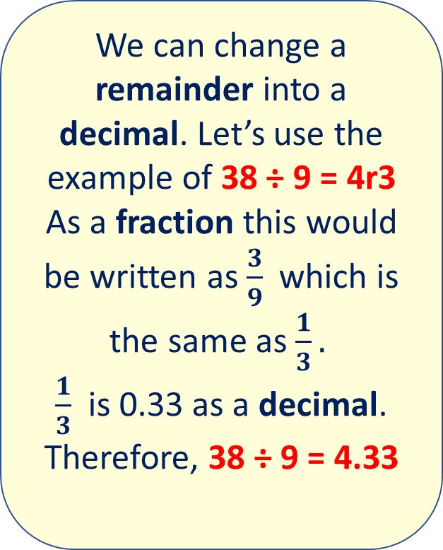
Apply
We can change a remainder into a decimal. Let’s use the example of 38 ÷ 9 = 4r3
As a fraction this would be written as $\frac{3}{9}$ which is the same as $\frac{1}{3}.$
$\frac{1}{3}$ is 0.33 as a decimal. Therefore, 38 ÷ 9 = 4.33
Work out these calculations and write the remainder as a decimal:
42 ÷ 5 =
35 ÷ 4 =
29 ÷ 10 =
67 ÷ 2 =
41 ÷ 3 =

Slide 15
Model
37 people are going to a party and they need to book taxis to get there. Each taxi can fit 5 people into it. How many taxis will they need in total?
As there is a remainder of 2, a whole extra taxi will be needed, meaning the answer is 8.
We can change a remainder by rounding – it all depends on the context of the question.
Let’s use the example of
37 ÷ 7 = 5r2

Slide 16
Apply
We can change a remainder by rounding – it all depends on the context of the question.
Work out these calculations and round to the next whole number:
82 ÷ 5 =
65 ÷ 4 =
39 ÷ 8 =
73 ÷ 4 =
41 ÷ 7 =

Slide 17
Apply – Problem Solving
Solve this problem.
Round the remainder.
Challenge: Can you also show the remainder as a fraction? As a decimal?
How many 4cm pieces of string can John cut if he has 39cm of string in total?

Slide 18
Apply – Problem Solving
Solve this problem.
Round the remainder.
Challenge: Can you also show the remainder as a fraction? As a decimal?
June has 237 pages of her book left to read. She reads 5 pages per day. How many days will it take her to finish her book?

Slide 19
Apply – Reasoning Problem
Remember that remainders can be shown in different ways. Can you show more than one way?
Explain the error in this calculation:
53 ÷ 4 = 12.1
Write the correct remainder.

