Slide 1


Writing
Y5 W7c. Can proof read to check for spelling errors
.
Commissioned by The PiXL Club Ltd.
October 2019
This resource is strictly for the use of member schools for as long as they remain members of The PiXL Club. It may not be copied, sold nor transferred to a third party or used by the school after membership ceases. Until such time it may be freely used within the member school.
All opinions and contributions are those of the authors. The contents of this resource are not connected with nor endorsed by any other company, organisation or institution.
PiXL Club Ltd endeavour to trace and contact copyright owners. If there are any inadvertent omissions or errors in the acknowledgements or usage, this is unintended and PiXL will remedy these on written notification.
© Copyright The PiXL Club Limited, 2019

Slide 2
Teachers’ Notes
The PiXL therapies can be taught to a whole class or a target group. Each therapy is editable so that it can be adapted or extended.
Each therapy begins with a LORIC activity to develop relevant character attributes.
This is followed by a vocabulary task, which uses the PiXL 5-phase approach to teach key vocabulary. Further resources to develop vocabulary can be found in the Whole School area under the PiXL Unlock strategy.
Each therapy adopts the ‘Teach, model and apply’ process with plenty of opportunities for pupils to demonstrate the taught skill.
A range of question types are included to promote pupils’ developing security by testing the same skill in different ways.
In this therapy it may be useful for the group to have a copy of the practise sections of the therapy.

Slide 3
Progress across amber – the 4-stage model
The three therapy tests which accompany this resource can be used to revisit the taught skill to check that the pupil is able to perform it independently and consistently.
A
A child has successfully completed a therapy test independently, following a set of therapy sessions.
A child has successfully completed a therapy test independently, a period after the relevant therapy sessions – we would advise about 2 weeks.
A child has successfully applied their knowledge or skill in an unfamiliar context. This may be application across the curriculum or in a problem.
A pupil has successfully re-visited the skills at a later point, and applies these in an unfamiliar context or problem, or across the curriculum.
A
DA
G

Slide 4
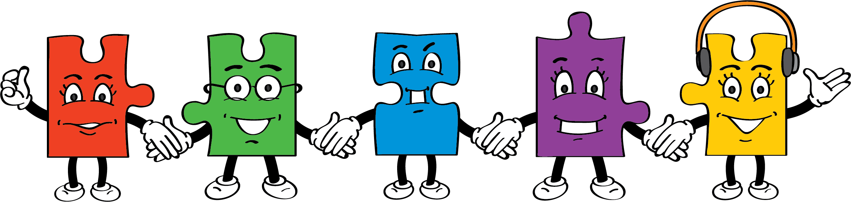

LORIC Task
Our Primary Edge attributes help us to become better learners and today is no exception. Before you start this activity, here are some ideas for how you will need your Raj Resilience skills today:
Understand the need to persevere to
complete an activity.
Ask for help when you need it.
Use a set amount of time allocated to
a task.
Command Words:
persevere overcome learn

Slide 5

Form a circle while holding hands but, before the last pair connect, place a hula-hoop over one child’s arm. Without letting each other’s hands go, the challenge is to get the hula-hoop to move around the circle. You will have to work together to move the hoop and support each other so that you don’t fall over. At the end, talk about what made it difficult and any ideas you came up with to solve problems.
Did you persevere and not give up?
Did you ask for help from a friend or adult?
Did you complete the task in the time you were given?
LORIC Task

Slide 6
Vocabulary activity
DEFINE IT/USE IT
The words are: proof read | Meaning: _________________ _________________ _________________ _________________ _________________
Image/graphic: | In context: _________________ _________________ _________________ _________________ _________________
Complete the four square grid for the words proof read.
Challenge
What do we mean when we say proof read your writing?

Slide 7
Tips for proof reading
Read each paragraph of your writing one at a time.
Read somewhere quiet.
Read your work out loud.
Look for words or phrases that do not make sense or do not look right.
Underline or highlight any mistakes that you have made first, before correcting them.

Slide 8
Proof reading strategies
Finding spelling mistakes in your writing can be hard to spot, especially if you are not sure what you are looking for.
Look for common spelling mistakes or your ‘usual’ errors. These are ones that your teacher has given you feedback about before.
Look for homophones. These are words that sound the same but have different meanings. Example: aloud/allowed
Look for the spelling rules for suffixes that you have learnt or are learning. Example: tious/cious or cial/tial

Slide 9
Common spelling errors
Words with double consonants can be a common spelling error. These include words such as:
happen
brilliant
difficult
beginning
happily
stopping
Words ending in –ly can also be a common spelling error.
These include words such as:
angrily
quietly
quickly
suddenly
eventually
finally

Slide 10

Your turn
Can you identify the common spelling errors in these sentences?
During our science experiment, we had to wait for something to hapen. Sudenly, the two chemicals had a reaction. Finaly, we took a photo to stick in our books.

Slide 11
How did you do?
Can you identify the common spelling errors in these sentences?
During our science experiment, we had to wait for something to happen. Suddenly, the two chemicals had a reaction. Finally, we took a photo to stick in our books.

Slide 12
Quick fire Spelling Rule: -cious or -tious
If the root word ends in ce, remove the e and replace with –ious. For example, space – spacious; malice – malicious.
If the root word can have the ending tion in its noun form, the ending should be –tious. For example, nutrition – nutritious; caution – cautious.
There are some exceptions to the above rules. For example, delicious, fictitious, anxious.

Slide 13
Your turn
Can you choose the correct ending for these incorrectly spelt words?
nutrishun
delishus
caushon
feroshus
ambishon
vicshus
infectshon
-tion or -cious

Slide 14

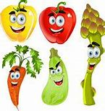
How did you do?
nutrition
delicious
caution
ferocious
ambition
vicious
infection

Slide 15

Homophones
Homophones are words that sound the same but have different meanings, for example ‘I’ and ‘eye’. These are words which are often tricky to spot when we are proof reading our writing.
Some examples of common errors that we should proof read for include:
past / passed witch/which
herd / heard they’re/their/there
desert / dessert are/our
lead / led hear/here

Slide 16
Your turn
Can you choose the correct homophone for each sentence?
I was not allowed / aloud to go out to play without my coat on.
I could not decide witch/which coat to wear to the party.
The general of the army led/ lead his troops to victory.
I walked past/ passed the staff room without making a sound.

Slide 17
How did you do?
Can you choose the correct homophone for each sentence?
I was not allowed / aloud to go out to play without my coat on.
I could not decide witch/which coat to wear to the party.
The general of the army led/ lead his troops to victory.
I walked past/ passed the staff room without making a sound.

Slide 18
Your turn
Can you correct the sentences below by choosing the correct homophone and spelling it correctly?
My teacher often gives me ……………… on how to improve my work.
The roof tiles were made of solid, black ……………… .
The ……………… sticks together when it migrates across the plains.
herd / heard
advice / advise
lead / led

Slide 19
How did you do?
Can you correct the sentences below by choosing the correct homophone and spelling it correctly?
My teacher often gives me advice on how to improve my work.
The roof tiles were made of solid, black lead.
The herd sticks together when it migrates across the plains.
herd / heard
advice / advise
lead / led

Slide 20

Quick fire spelling rule: -cial or -tial?
Spelling rule: If the stem of the word ends in a vowel, use suffix –cial to make it an adjective.
If the stem of the word ends in a consonant, use suffix –tial to make it an adjective.
Some Year 5 examples include:
confidential essential
influential partial
official initial
special artificial

Slide 21
Your turn
Can you choose the correct ending for these words?
offishal
benefishal
substanshal
soshal
fashal
-cial or –tial

Slide 22
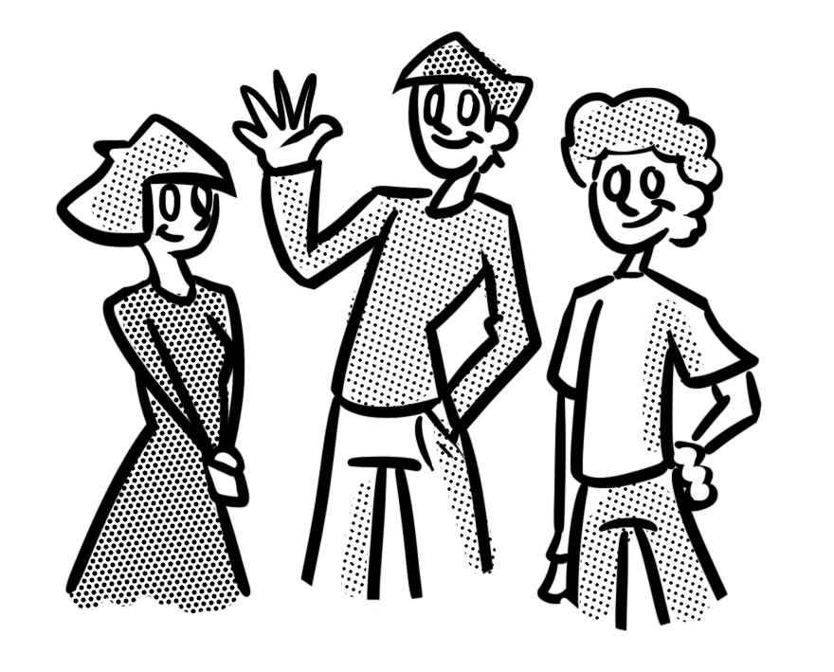
How did you do?
official
beneficial
substantial
social
facial

Slide 23

Your turn
Correct the text on the following slides using what you have practised today. Remember to use the strategies given to you.
Underline the spelling mistakes FIRST. Then, correct them.

Slide 24
Strategies to use
Look for your ‘usual’ spelling mistakes. These are the ones that your teacher has given you feedback about before.
Look for common spelling errors such as words with a double consonant or –ly endings.
Look for homophones. These are words that sound the same but have different meanings e.g aloud/allowed.
Look for the spelling rules that you have learnt or are learning. For example -tious/-cious or -cial/-tial.

Slide 25
Your turn
Dear Mrs Pearson,
I am writing to you to express my outrage at the fact that you are going to close our school playground. My frends and I think that this is an awfol idea and I will explain why.
Firstly, if we are not aloud to play outside we will not get enuf exercise each day – you know that fresh air and exercise is vital to children’s learning. Secondly, missing our playtime outside will effect our learning. Fresh air is benefitial to our concentration; I am shure we will be able to concentrate better after a play outside. This is the advise we have been given by other teachers at the school.

Slide 26
How did you do?
Dear Mrs Pearson,
I am writing to you to express my outrage at the fact that you are going to close our school playground. My frends and I think that this is an awfol idea and I will explain why.
Firstly, if we are not aloud to play outside we will not get enuf exercise each day – you know that fresh air and exercise is vital to children’s learning. Secondly, missing our playtime outside will effect our learning. Fresh air is benefitial to our concentration; I am shure we will be able to concentrate better after a play outside. This is the advise we have been given by other teachers at the school.

Slide 27
How did you do?
Dear Mrs Pearson,
I am writing to you to express my outrage at the fact that you are going to close our school playground. My friends and I think that this is an awful idea and I will explain why.
Firstly, if we are not allowed to play outside we will not get enough exercise each day – you know that fresh air and exercise is vital to children’s learning. Secondly, missing our play time outside will affect our learning. Fresh air is beneficial to our concentration; I am sure we will be able to concentrate better after a play outside. This is the advice we have been given by other teachers at the school.

Slide 28
Your turn
Now try this one on the next slide. Remember to use the strategies that you have practised today.
Look for your ‘usual’ spelling mistakes. These are the ones that your teacher has given you feedback about before.
Look for common spelling errors such as words with a double consonant or an –ly ending.
Look for homophones. These are words that sound the same but have different meanings, for example aloud/allowed.
Look for the spelling rules that you have learnt or are learning, for example -tious/-cious or -cial/-tial.

Slide 29
Your turn
She gazed up at the windows; they where all dark. Her heart was beating like a drum. She didn’t even want to walk passed the house but it was like her feet had a mind of their own – they urged her on. Claire was terrably frightened.
She came to a steal gate and on it was a tiger, no, a seal perhaps. It was painted black but the paint had run, making it look like a different speshies. Suddenly, the door flung open and a voice hissed in the murky darkness. Immediataly, Claire spun around, every bit of her shakking in terror. This time her quoriosity had got the better of her.

Slide 30
How did you do?
She gazed up at the windows; they where all dark. Her heart was beating like a drum. She didn’t even want to walk passed the house but it was like her feet had a mind of their own – they urged her on. Claire was terrably frightened.
She came to a steal gate and on it was a tiger, no, a seal perhaps. It was painted black but the paint had run, making it look like a different speshies. Suddenly, the door flung open and a voice hissed in the murky darkness. Immediataly, Claire spun around, every bit of her shakking in terror. This time her quoriosity had got the better of her.

Slide 31
How did you do?
She gazed up at the windows; they were all dark. Her heart was beating like a drum. She didn’t even want to walk past the house but it was like her feet had a mind of their own – they urged her on. Claire was terribly frightened.
She came to a steel gate and on it was a tiger, no, a seal perhaps. It was painted black but the paint had run, making it look like a different species. Suddenly, the door flung open and a voice hissed in the murky darkness. Immediately, Claire spun around, every bit of her shaking in terror. This time her curiosity had got the better of her.

Slide 32
Review
Look for your ‘usual’ spelling mistakes. These are the ones that your teacher has given you feedback about before.
Look for common spelling errors such as words with a double consonant or an –ly ending.
Look for homophones. These are words that sound the same but have different meanings. Example: aloud/allowed
Look for the spelling rules for suffixes that you have learnt or are learning. Example: -tious/-cious or -cial/-tial

