Slide 2
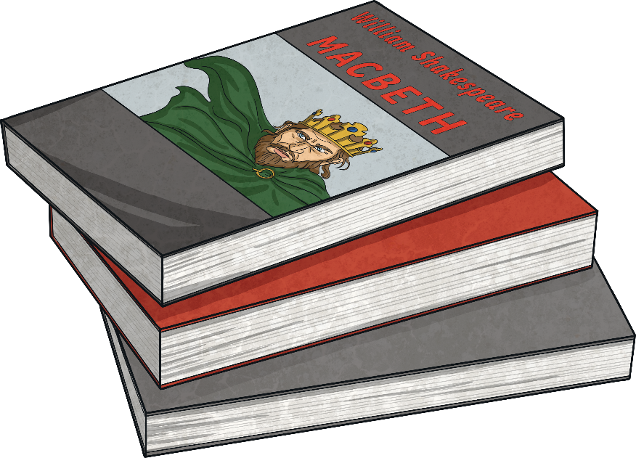
Point of View
A story can be told from different points of view.
It can be written in the first, second or third person.
I was going to the funfair today. I was so excited!
Have you ever wondered what life would be like as a superhero?
The boys ran from the house screaming. Riley was terrified.

Slide 3
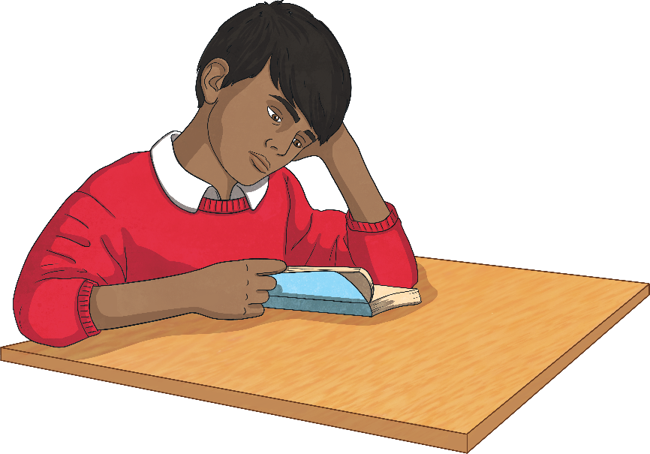
First Person
If writing a story in the first person, write as though you are a character inside the story.
Other pronouns used in the first person:
my
me
mine
we
our
ours
us
Describe how you feel and what you are doing or have done.
Use the pronoun ‘I’
For example:
Last year, I went to Spain with my family. I loved it!

Slide 4

Second Person
If writing in the second person, talk to the reader directly.
Other pronouns used in the second person:
your
yours
Use the pronoun ‘you’.
The second person is used a lot non-fiction as well as in fiction texts.
For example:
Before you begin, make sure that you have all of the tools listed above.

Slide 5
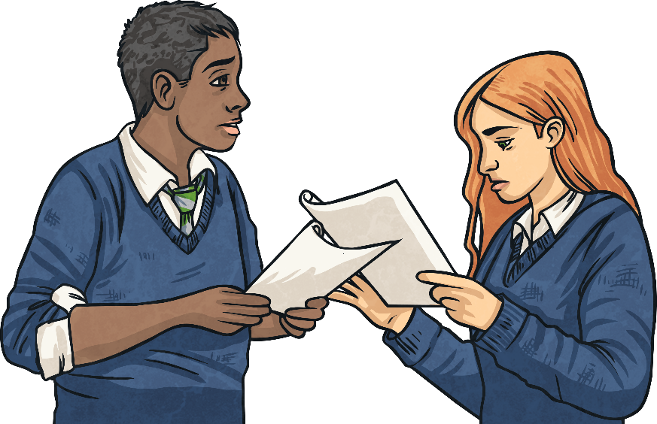
Third Person
If you are writing in the third person, you write about other people or characters.
Other pronouns used in the third person:
her/hers
his
theirs
You use the character’s name or pronouns such as ‘he’, ‘she’ and ‘they’.
For example:
Michelle sped off at top speed and was soon in first place. She couldn’t believe that she was going to win!

Slide 6
First, Second or Third Person?
Decide if the following sentences are in the first, second or third person.
Sophie was going to the cinema to meet her friends.
Third person
I couldn’t believe what I was seeing – it was incredible!
First person
“Where shall we go now?” wondered Tim and Holly as they sat in their car.
Third person
Do you believe in ghosts? Well after reading this story, you will!
Second person
As I walked into my new school, my stomach churned and my hands began to shake.
First person
Are you an early bird or are you a night owl?
Second person

Slide 7
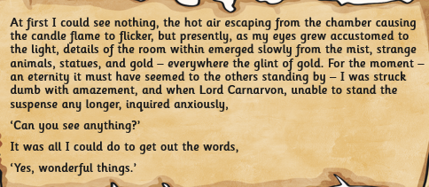
A Diary is a good example of first person writing.
This is part of Howard Carter’s Diary about the discovery of Tutankhamen’s tomb.
Can you find examples of first person sentences in the diary?

Slide 8
First to Third
Change this passage from the first to the third person by changing the pronouns.
Mr Craver looked at me and said, “Who’s picking you up from school Sarah?”
“I’m not sure,” I replied nervously. I was worried that mum would be late and that I would have to stay behind with HIM. “But if my mum is late, she said I can just walk home instead.” I tried to not look into Mr Craver’s eyes in case he could tell that I was lying.
“I think it would be best if you stay here with me,” Mr Craver replied. I knew that he was mentally preparing a list of work for me to do; I had to get out of school. But how? I needed a plan and fast.
Mr Craver looked at Sarah and said, “Who’s picking you up from school Sarah?”
“I’m not sure,” Sarah replied nervously. She was worried that her mum would be late and that she would have to stay behind with HIM. “But if my mum is late, she said I can just walk home instead.” Sarah tried to not look into Mr Craver’s eyes in case he could tell that she was lying.
“I think it would be best if you stay here with me,” Mr Craver replied. Sarah knew that he was mentally preparing a list of work for her to do; she had to get out of school. But how? She needed a plan and fast.

Slide 9
Third to First
Change this passage from the third to the first person by changing the pronouns.
Rupert and his friends decided to go to the park after school. As soon as the bell went, they grabbed their bags, sped out of school and sprinted to the football pitches at St John’s park. Rupert scored a goal and celebrated by cartwheeling five times and finishing with a roly-poly. He knew his gymnastics lessons would pay off one day! As the boys were playing, three older boys from Merryfield’s Academy walked on to the pitch. Rupert’s heart sank as he knew who the boys were and he knew that they didn’t want to play football. Rupert and his friends were in big trouble.
My friends and I decided to go to the park after school. As soon as the bell went, we grabbed our bags, sped out of school and sprinted to the football pitches at St John’s park. I scored a goal and celebrated by cartwheeling five times and finishing with a roly-poly. I knew my gymnastics lessons would pay off one day! As we were playing, three older boys from Merryfield’s Academy walked on to the pitch. My heart sank as I knew who the boys were and I knew that they didn’t want to play football. My friends and I were in big trouble.

