Slide 2
Aim
I can describe and understand how the UK has changed over time.
Success Criteria
I can explain some reasons a place may change.
I can describe how the UK population has changed over time.
I can tell you where some immigrants to the UK came from.
I can identify similarities and differences between my daily routine and that of a child from another historical period.

Slide 3







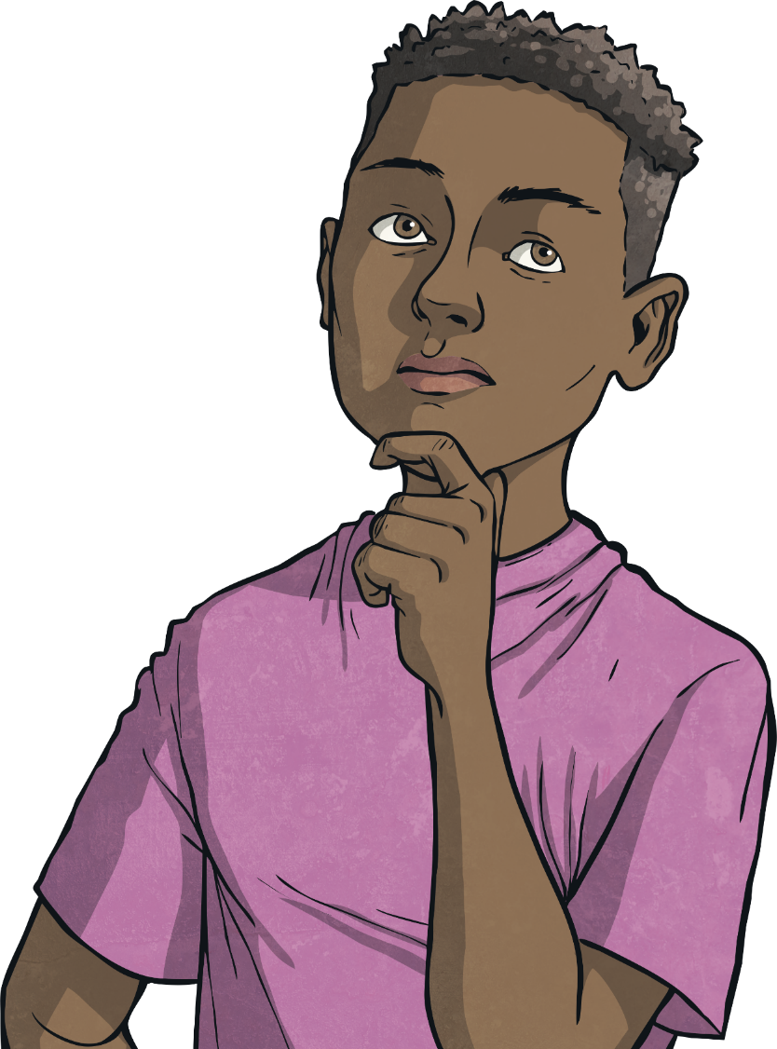



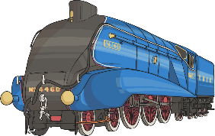
What Can Change a Place?
?
Why might a city, town, or village change?
Think about:
natural disasters;
new buildings;
a large employer closing down;
transport links;
war.

Slide 4
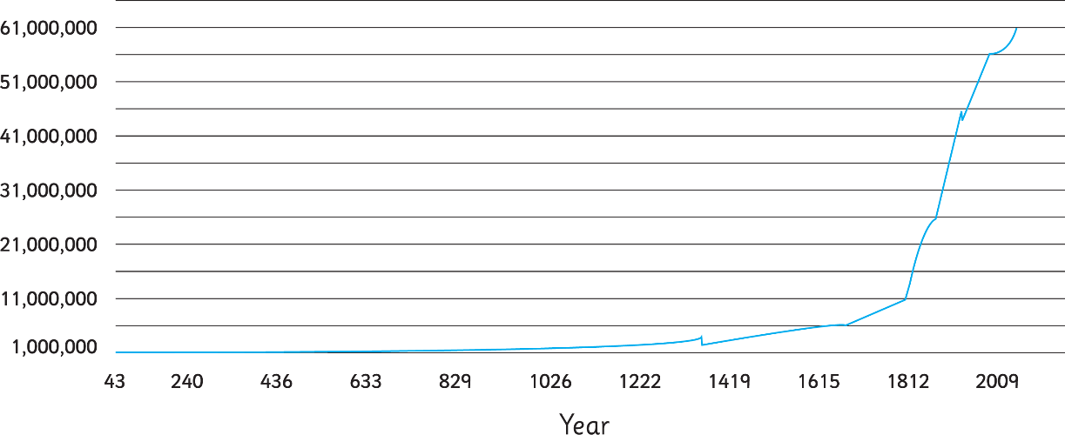
How Has the Population
of the UK Changed?
?
What story does the graph tell us?
AD1642-9
The Black Death
AD1801 – AD1901
Many people came to work in the UK from the growing British Empire
AD1911 – AD1921
Many British soldiers died in the First World War
AD1921 – AD1970
People from different parts of the world came to the UK after the Second World War
Look at the dates. Do any of them fit with events you have learnt about?
?

Slide 5
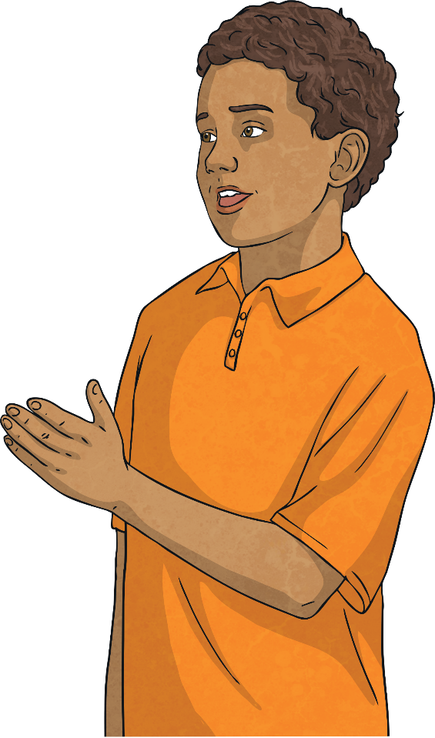
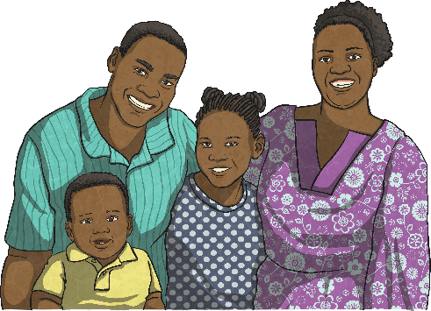




What is Immigration?
?
Have you heard of immigration before? What do you think it is?
Immigration is when someone moves from one country to live
permanently in a foreign country.
People move to other countries for all kinds of reasons. Can you think of any?
To be near family
For work
For a different lifestyle

Slide 6
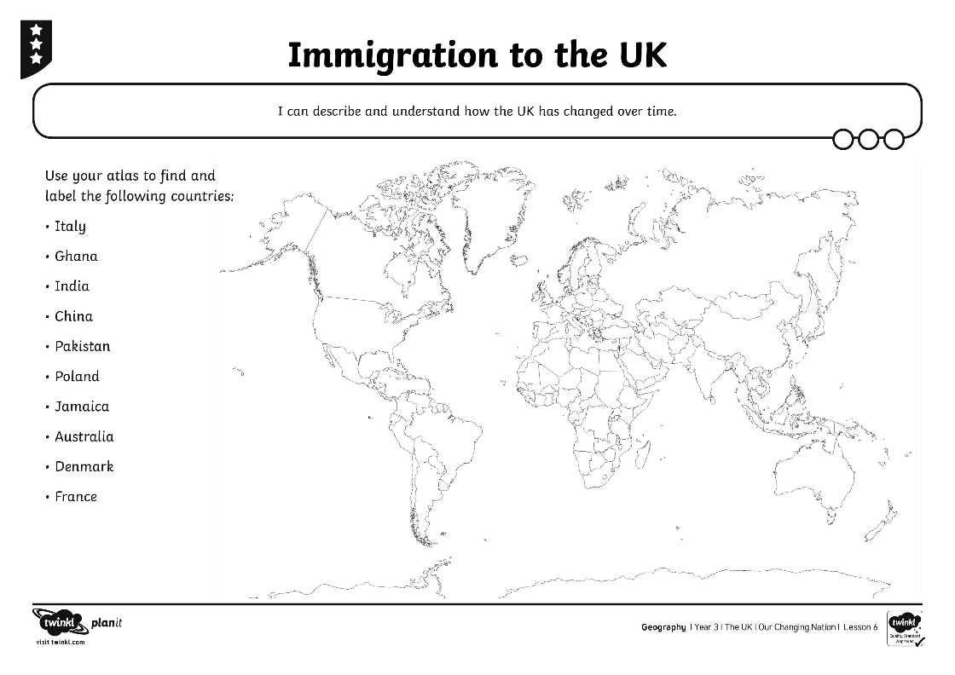
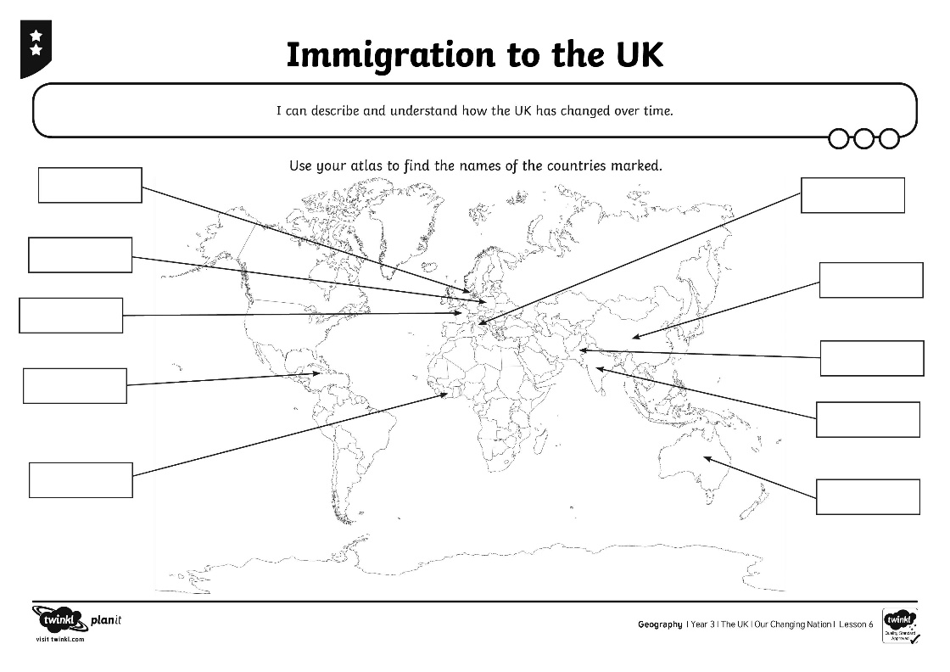
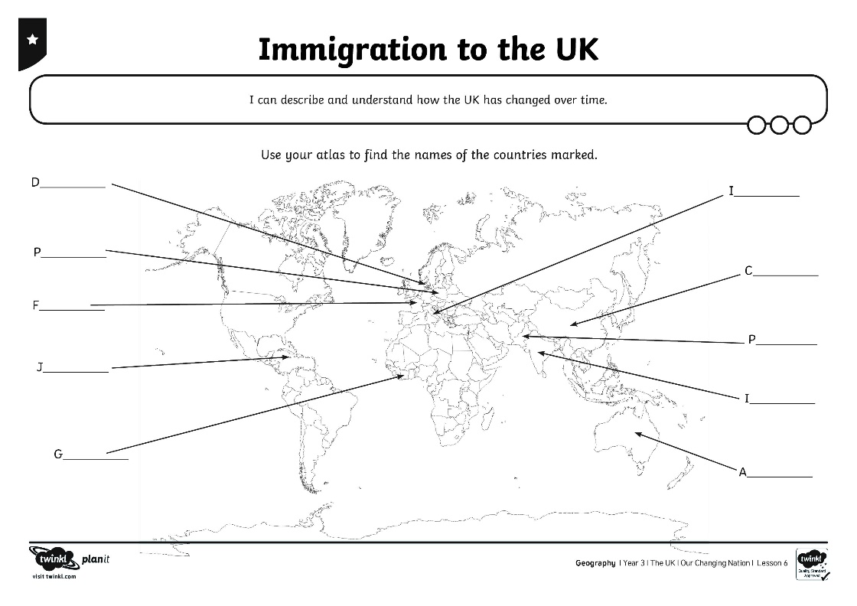
Where Did Immigrants
Come From?
Use your atlas to find and label the countries that immigrants travelled to the UK from.

Slide 7
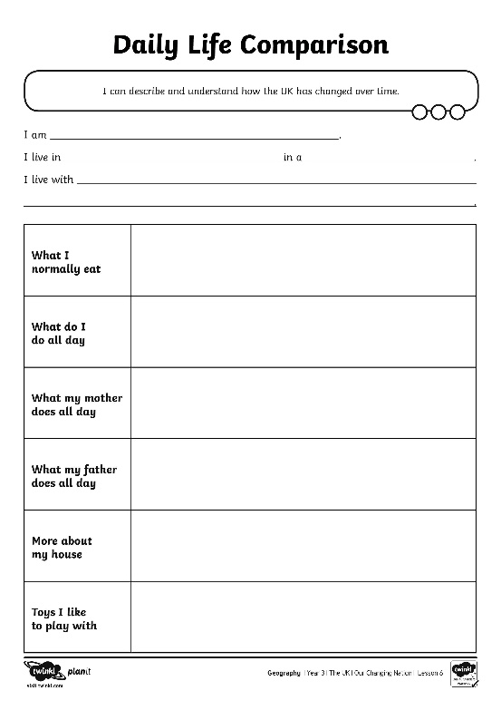
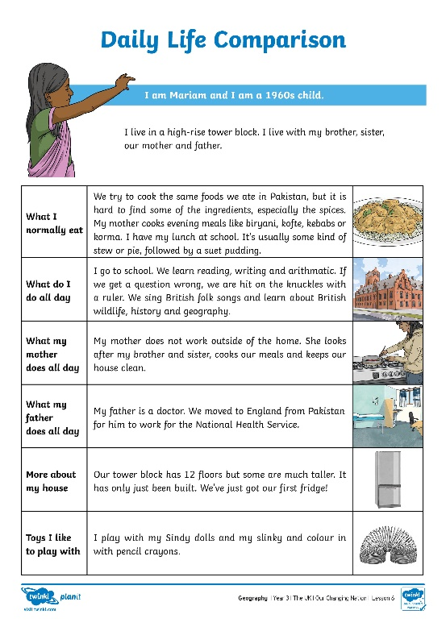
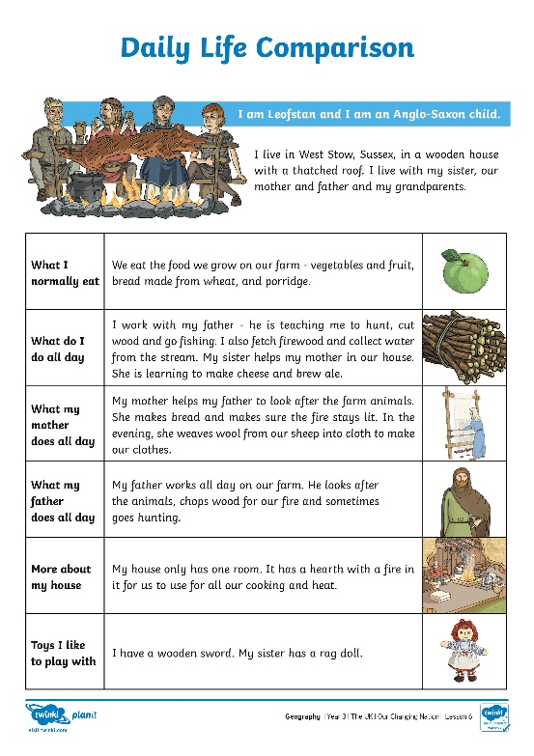
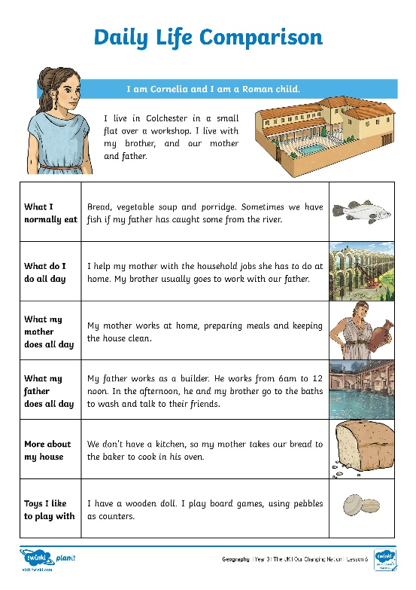
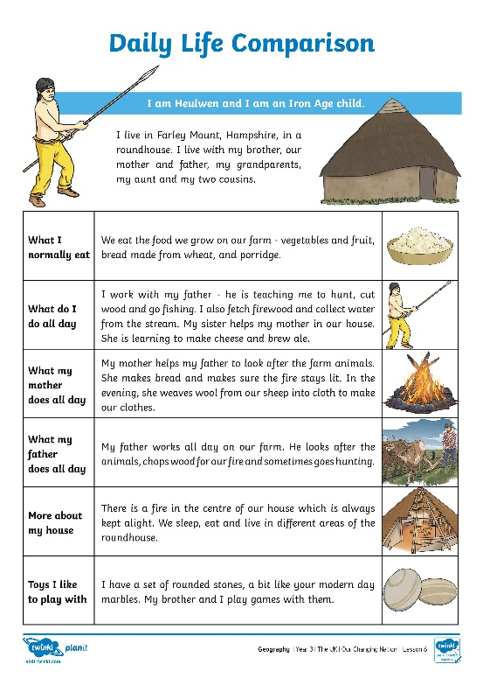
How Has Daily Life Changed
for People in Britain?
Read through the description of your character’s daily life. Fill in the details about your daily life.

Slide 8
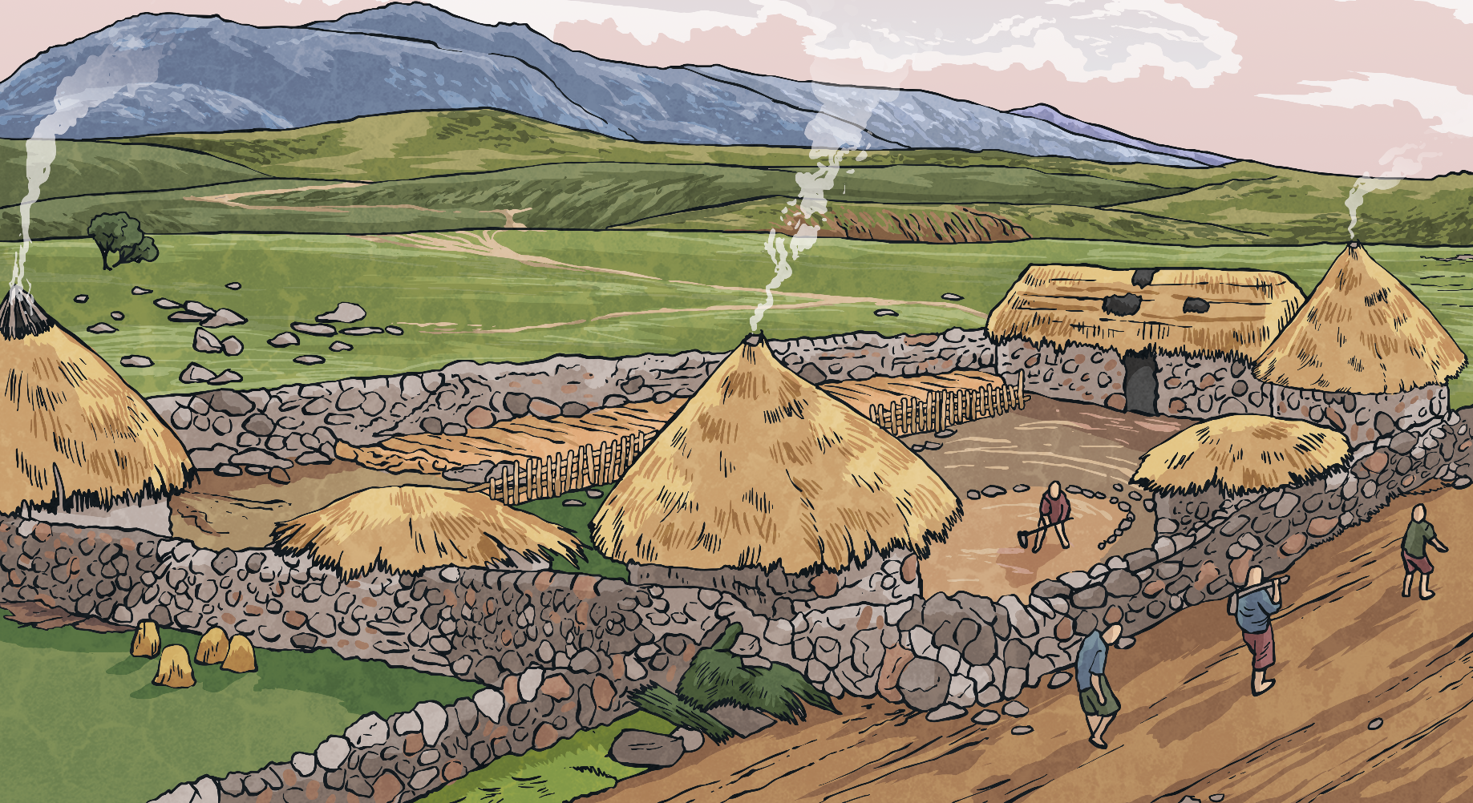
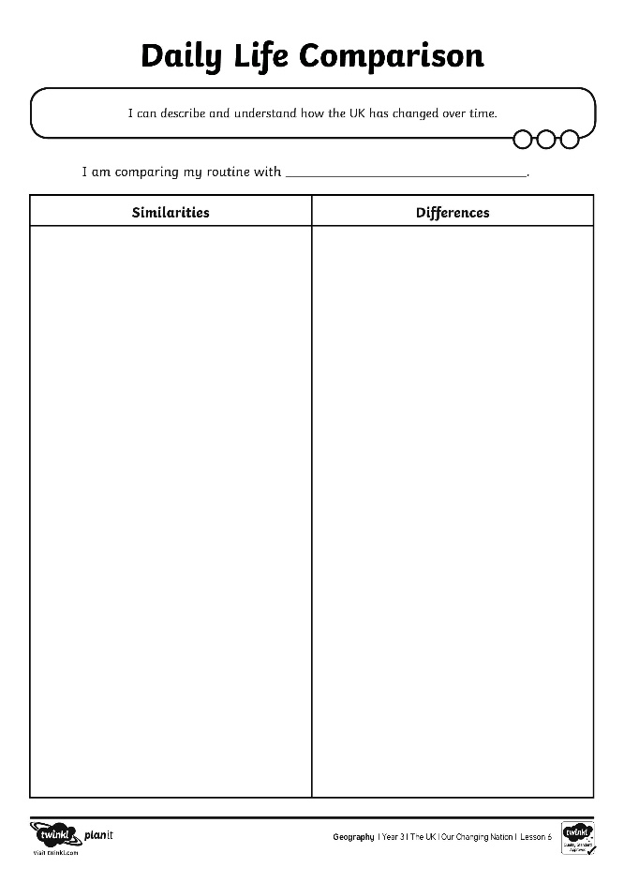
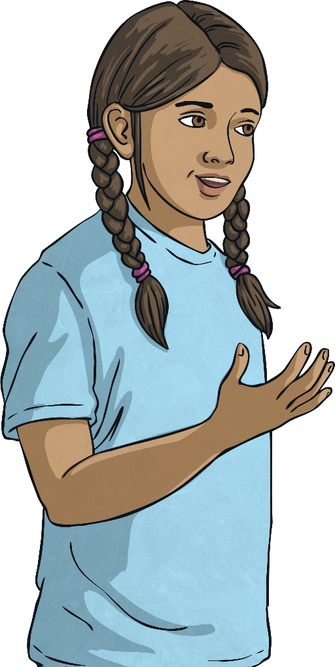
How Has Daily Life Changed
for People in Britain?
Use the comparison table to note similarities and differences between you and the character from the past.

Slide 9
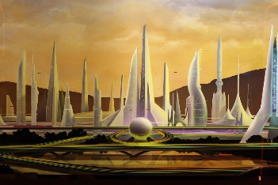
How Might the UK Change
in the Future?
Can you remember some of the events that changed the population of the UK?
New links with other countries
New jobs in growing industries
Illness
War
Which events might happen again and what effect would they have on the population?
?
Photo courtesy of Sam Howzit (@flickr.com) - granted under creative commons licence

Slide 10
Aim
I can describe and understand how the UK has changed over time.
Success Criteria
I can explain some reasons a place may change.
I can describe how the UK population has changed over time.
I can tell you where some immigrants to the UK came from.
I can identify similarities and differences between my daily routine and that of a child from another historical period.

