Slide 2
Aim
I can name and locate areas of high ground in the UK.
I can use a map or atlas to locate areas of high ground in the UK.
Success Criteria
I can tell you the names of some areas of high ground in the UK.
I can find areas of high ground on a map of the UK.
I can use a legend to find areas of high ground on a map.
I can find the height of a peak on a map.

Slide 3







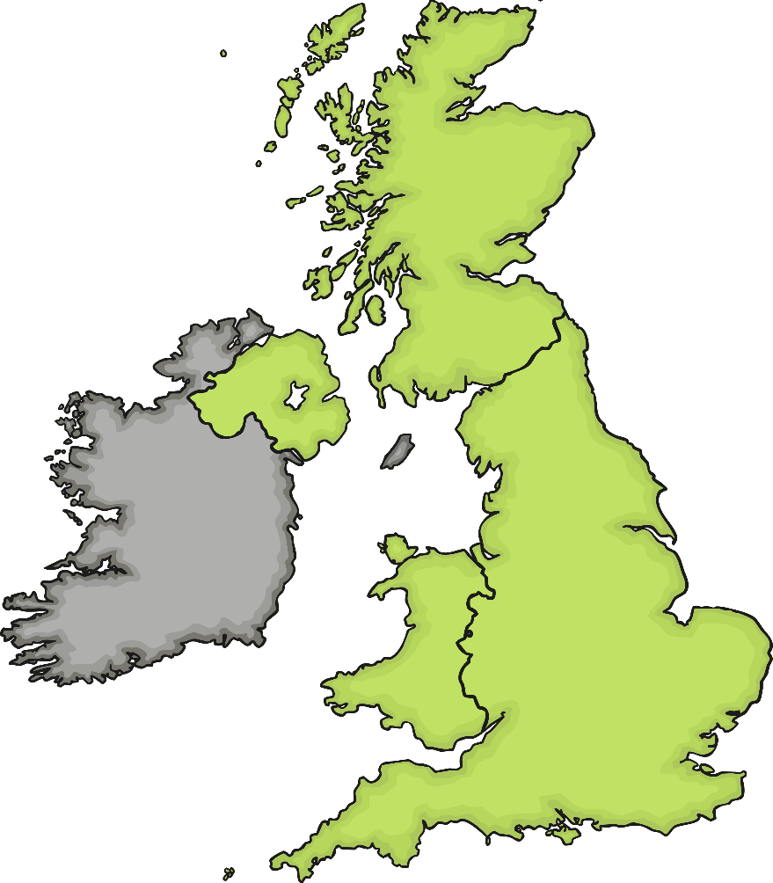
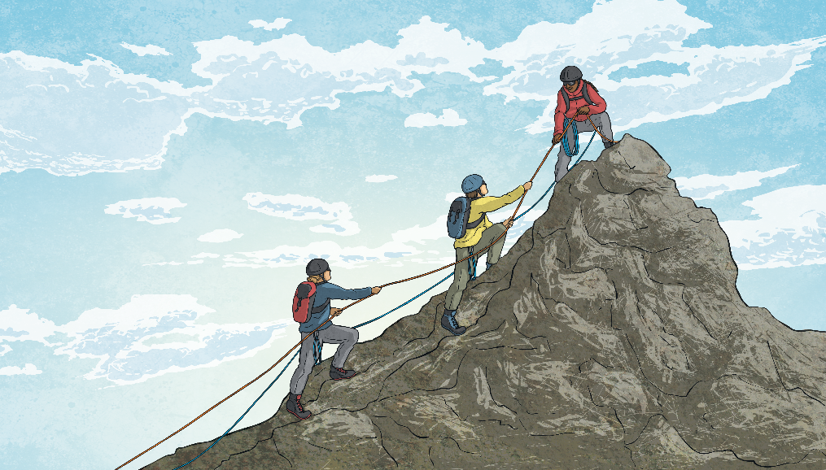
What Are the Hills
and Mountains?
Do you know any areas of hills or mountains?
?
?
Where do you think they might be?

Slide 4
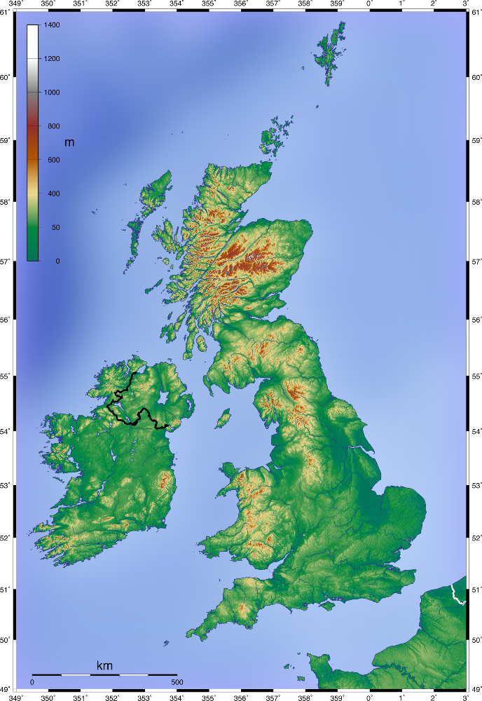
What Are the Hills and Mountains?
This is a topographical map.
What do the colours in the legend tell you?
?
Answer: The colours show the different heights of the ground above sea level. Green areas are the lowest and red areas are the highest.
Where are the highest and lowest areas of ground in the UK?
?

Slide 5
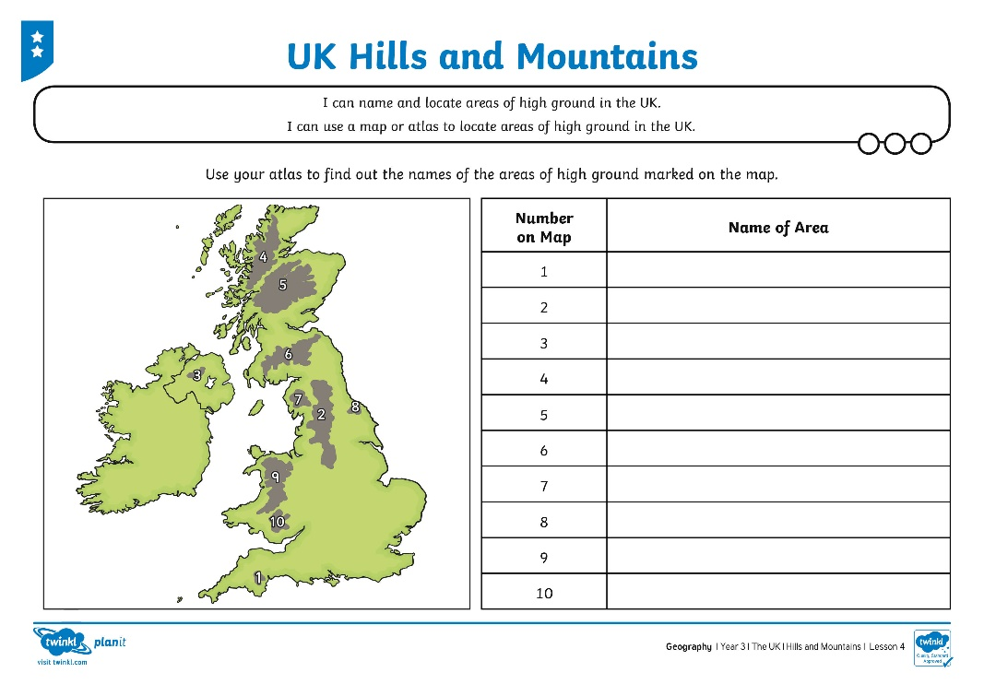
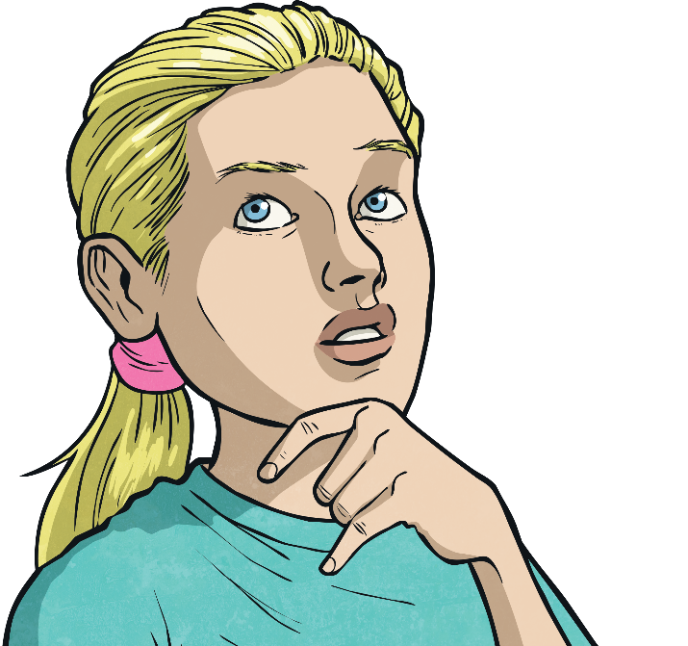
What Are the Hills and
Mountains Called?
Use your atlas to find out the names of the areas of hills and mountains marked on your map.
!
Extra Challenge: Which area is closest to where you live?

Slide 6
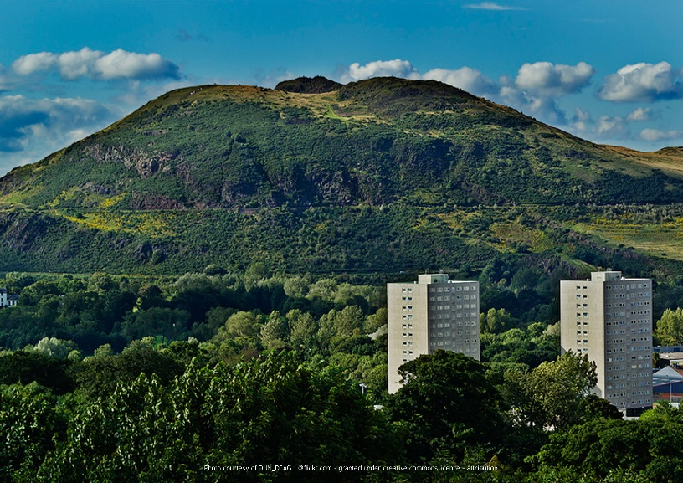
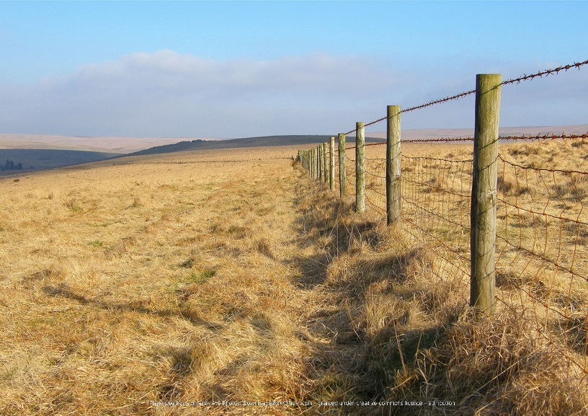
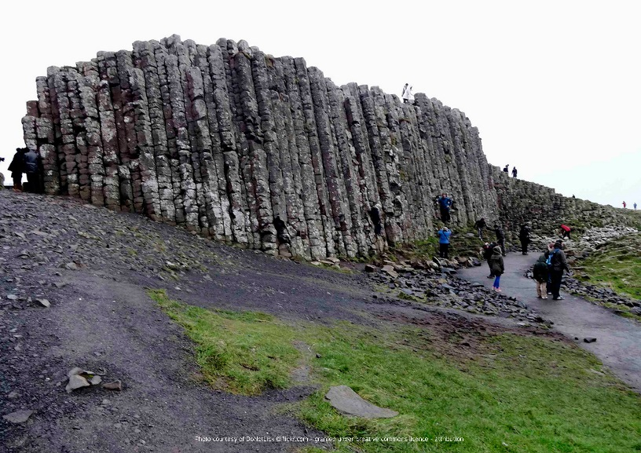
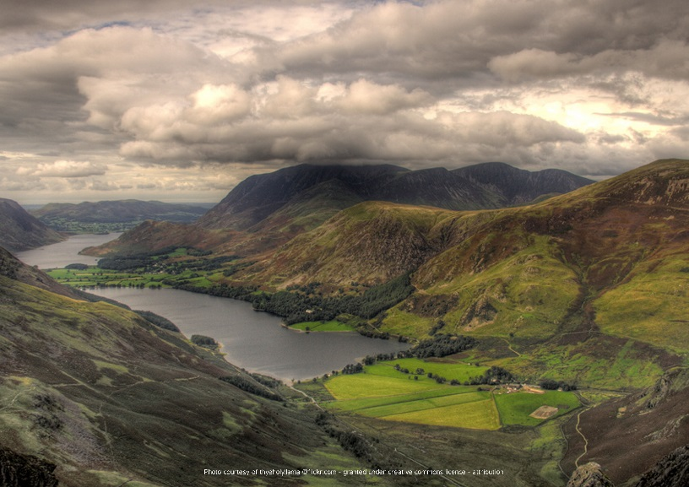
What Is It Like in the Hills?
Look at the image you’ve been given.
?
What is the weather like?
What do you think it would feel like if you were on this hill?
?

Slide 7
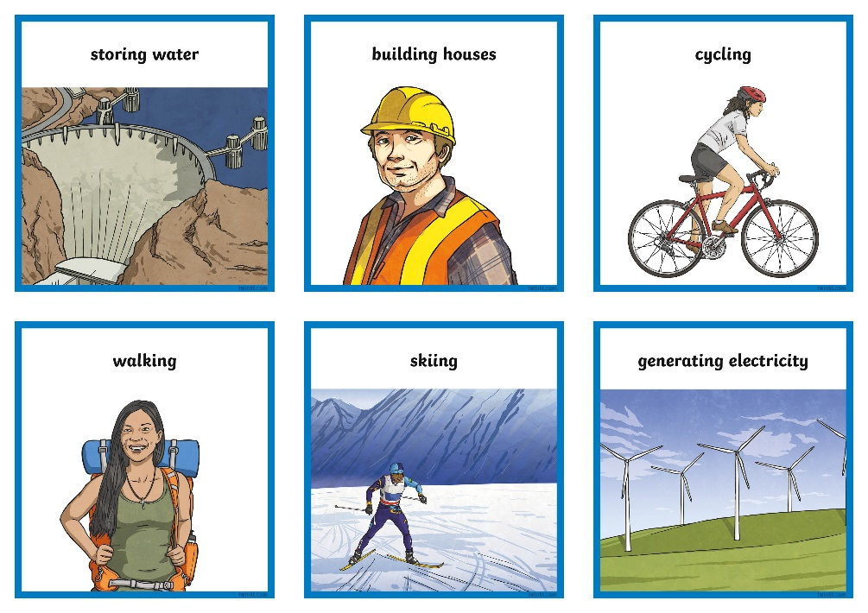
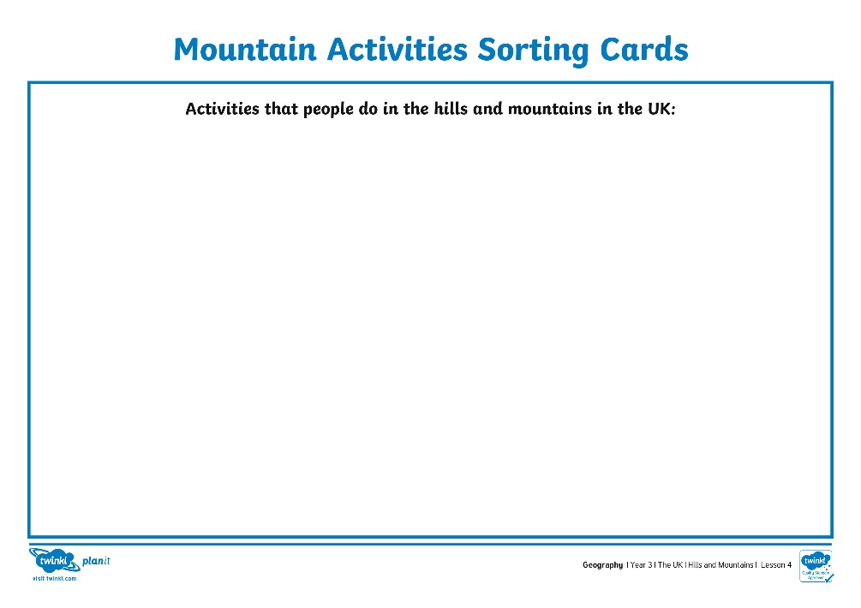
What Do People Do in the
Hills and Mountains?
Look at the activities that people do in the hills and mountains in the UK.
Make three piles:
Activities that people do in the hills and mountains in the UK.
Activities that people do in the hills and mountains but not in the UK.
Activities that people don’t do in the hills and mountains.

Slide 8
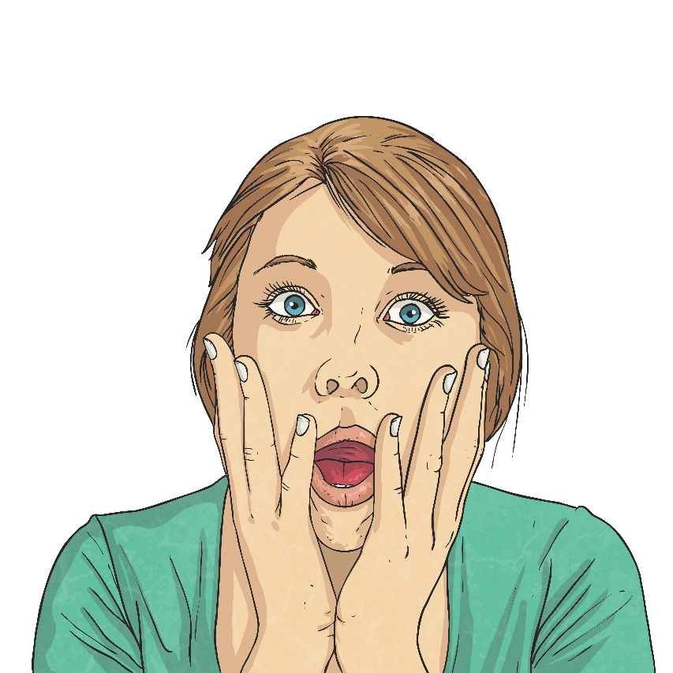
What Do People Do in the
Hills and Mountains?
?
How do your answers compare?
Activities that people do in the hills and mountains in the UK. | Activities that people do in the hills and mountains but not in the UK. | Activities that people don’t do in the hills and mountains.
Skiing Rearing livestock Climbing Walking Camping Growing Trees Cycling Generating electricity Storing water Building houses Gliding | Growing crops
Can you think of any other activities people might do in the hills or mountains?
Did any of the answers surprise you?

Slide 9
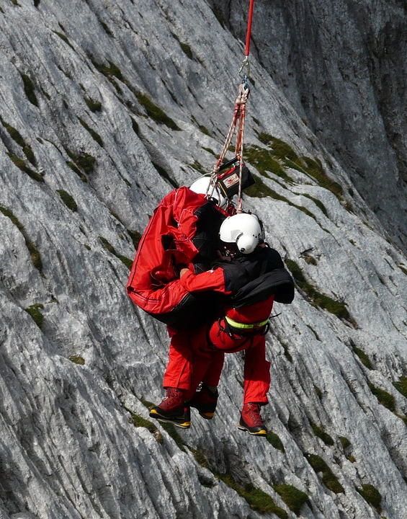
Mountain Rescue
?
Who are these people?
?
What are they doing?
Why do you think their job might be dangerous?
?

