Slide 1


Geography
The UK
Year One
Geography | Year 3 | The UK | Rivers and Seas | Lesson 2

Slide 3
Aim
I can name and locate the main rivers and seas of the UK.
I can identify rivers and seas using an atlas or map.
Success Criteria
I can name the seas surrounding the UK.
I can name some of the UK’s main rivers.
I can name the seas some rivers flow into.
I can find the names of seas on a map.
I can find the names of rivers on a map.
I can follow a river on a map to find where it starts and ends.

Slide 4







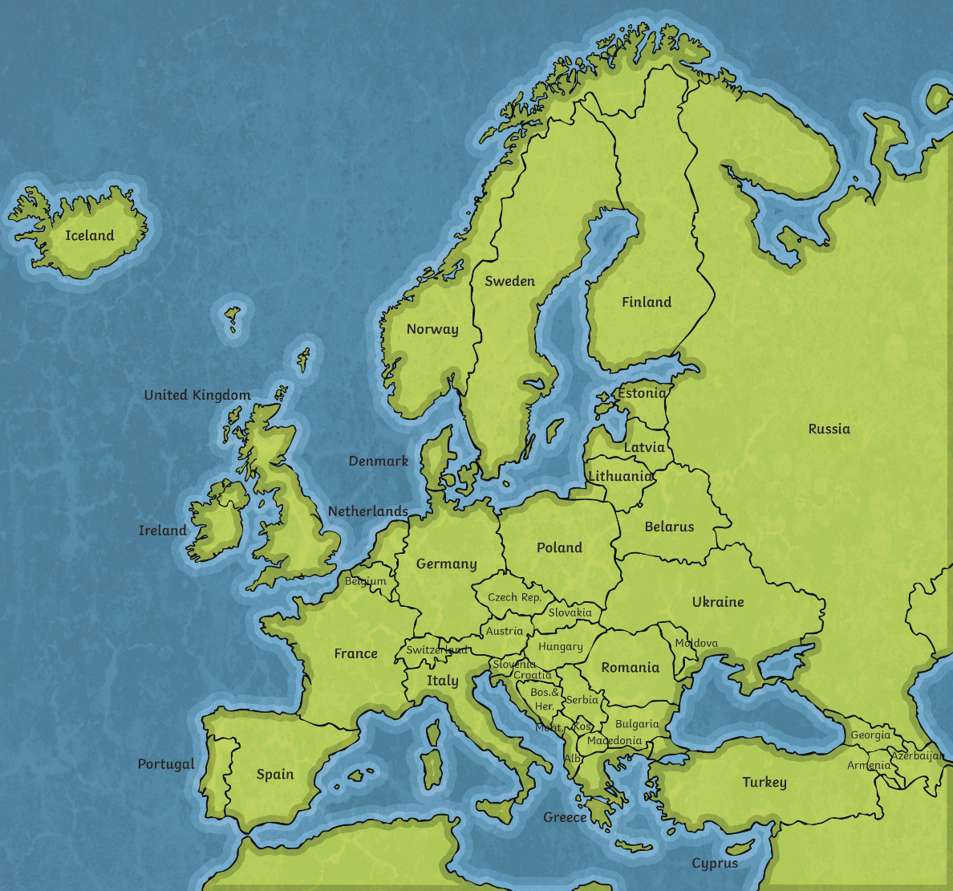
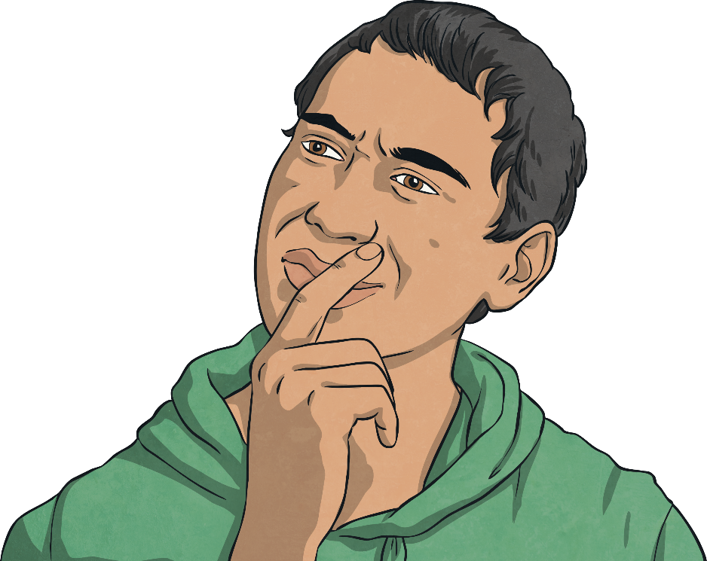
What Surrounds Us?
?
Where is the UK?
?
Can you find Austria?
On the map, how is the UK different to Austria?
?

Slide 5
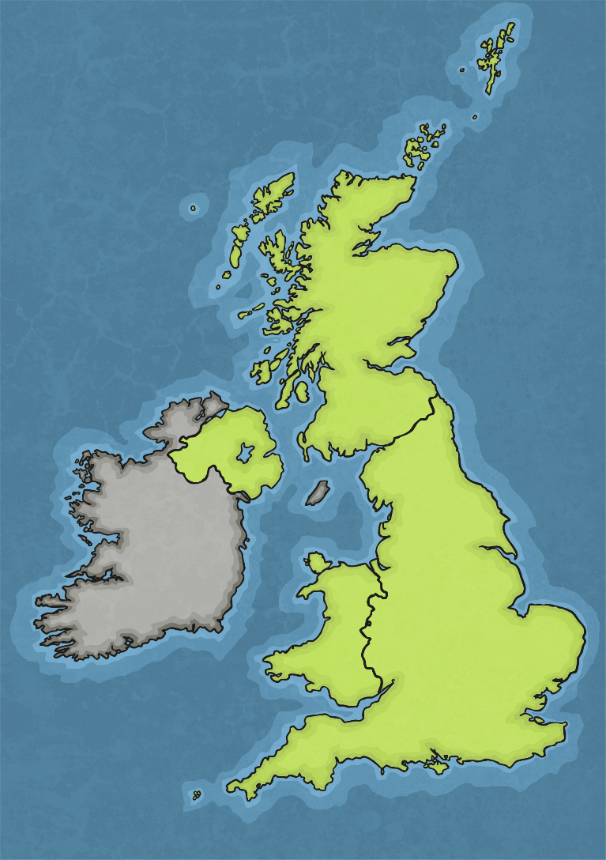
The Seas Around Us
Do you know where each label should go?
?
?
What clues might help us?
Irish Sea
English Channel
North Sea
Atlantic Ocean

Slide 6
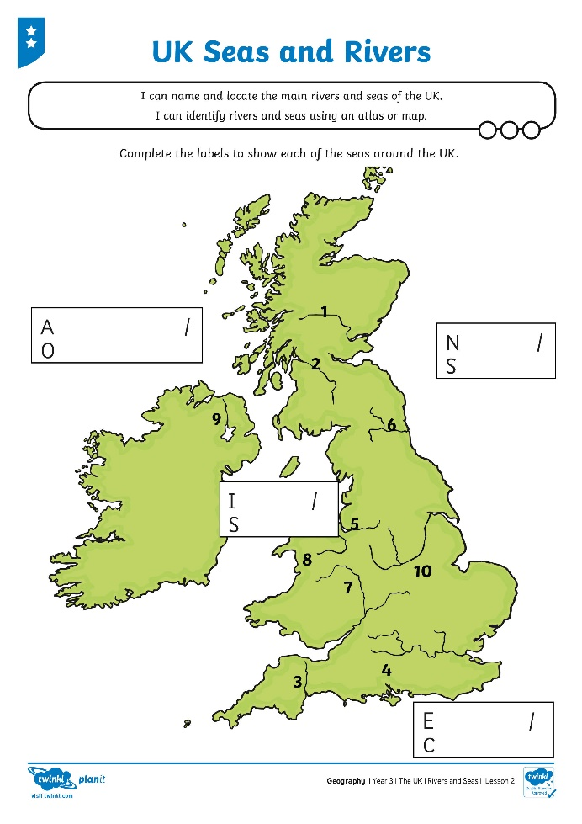
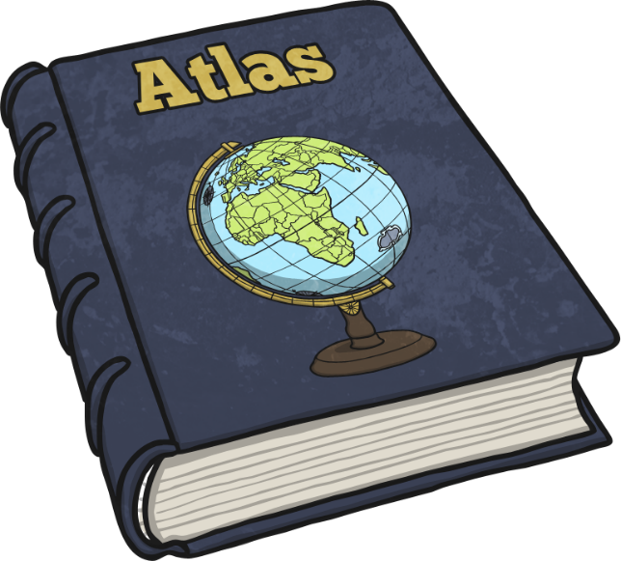
Seas Around the UK
Use your atlas to find the names of the seas around the UK. Label your map carefully.

Slide 7
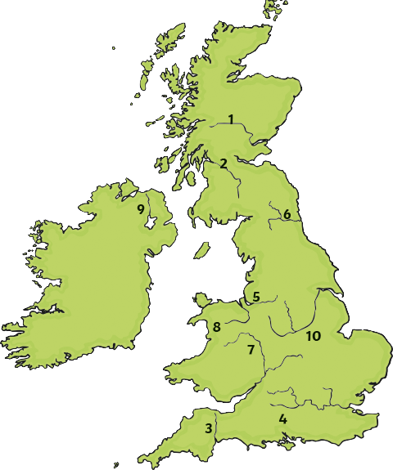
Rivers of the UK
Find out the names of the rivers labelled on your map of the UK.
?
Which seas do they flow into?

Slide 8
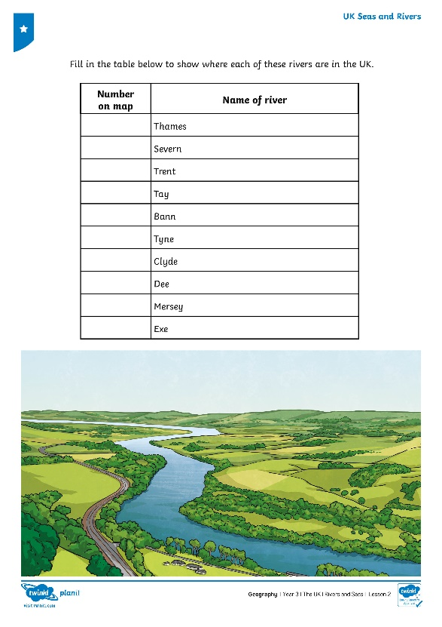
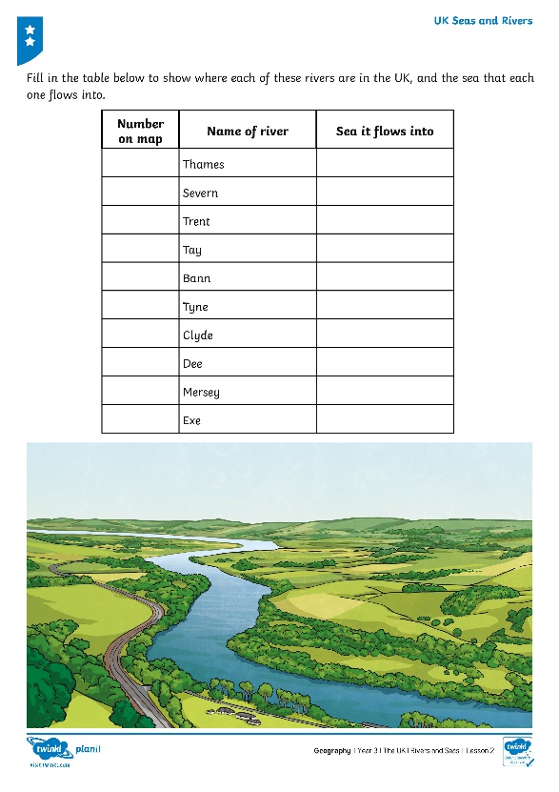
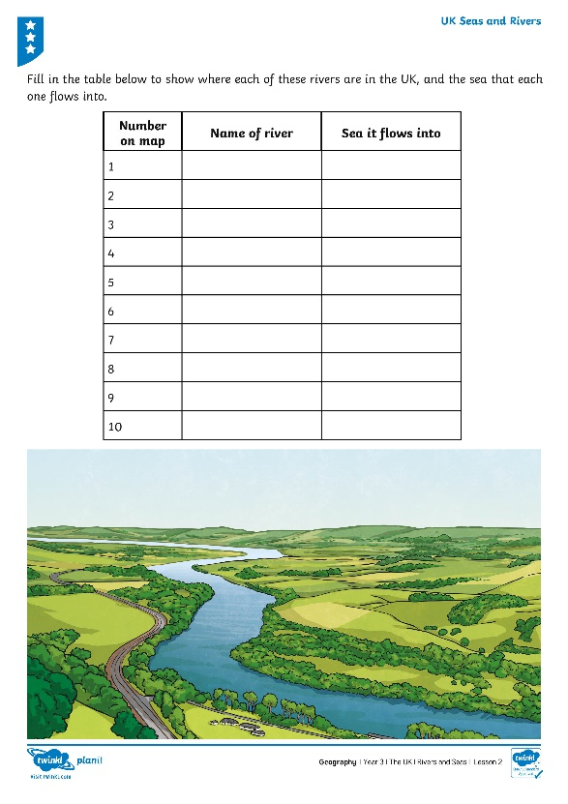
Rivers of the UK
Find out the names of the rivers labelled on your map of the UK.
!
Fill in the table to show where each of the rivers are in the UK.

Slide 9
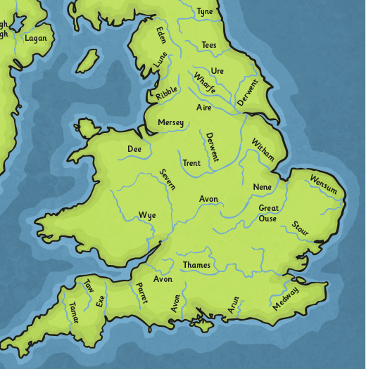

Where Do Rivers Go?
Can you find the River Thames?
?
?
Where does it start?
?
Where does it end?
What do you notice about where the rivers start and end?

Slide 10
Aim
I can name and locate the main rivers and seas of the UK.
I can identify rivers and seas using an atlas or map.
Success Criteria
I can name the seas surrounding the UK.
I can name some of the UK’s main rivers.
I can name the seas some rivers flow into.
I can find the names of seas on a map.
I can find the names of rivers on a map.
I can follow a river on a map to find where it starts and ends.

