Slide 1


Geography
The UK
Year One
Geography | Year 3 | The UK | Around the Counties | Lesson 3

Slide 3
Aim
I can name and locate some of the counties of the UK.
I can use a map to locate some of the counties of the UK.
Success Criteria
I can explain what a county is.
I can name some counties local to my area.
I can find my county on a map.
I can identify some counties local to my area on a map.

Slide 4







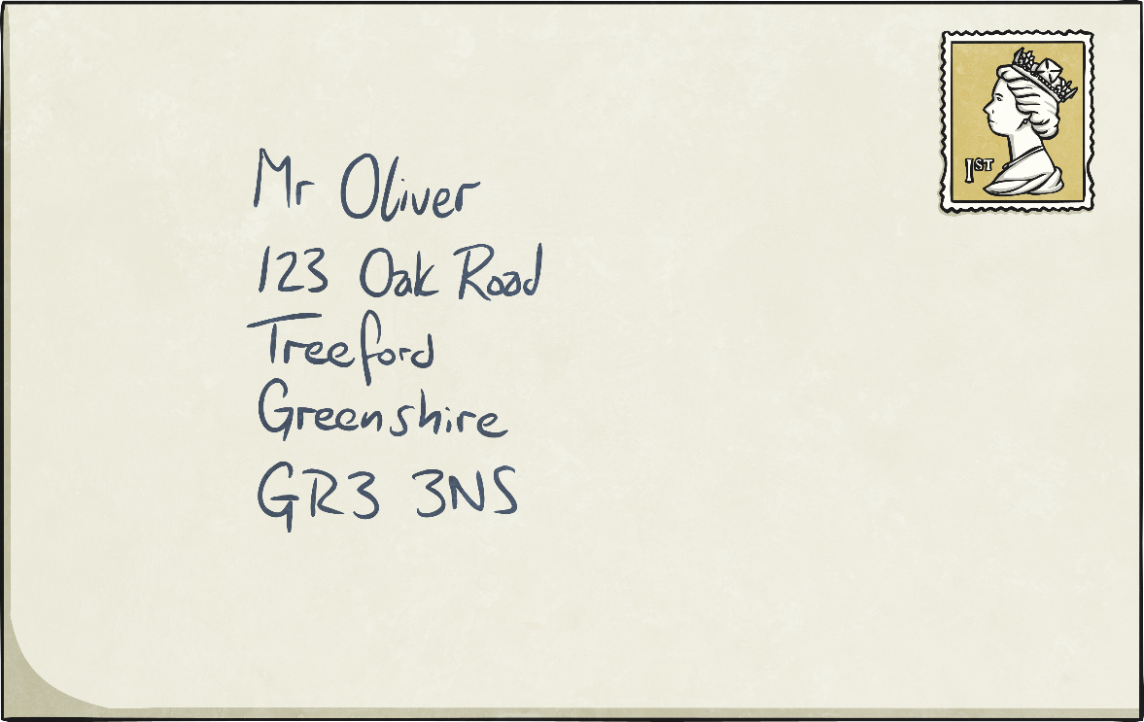
UK Addresses
?
What does each part of the address tell the Post Office?
Person the letter is for
House number and road
Town
County
Postcode
?
What is a county and why do we have counties?

Slide 5
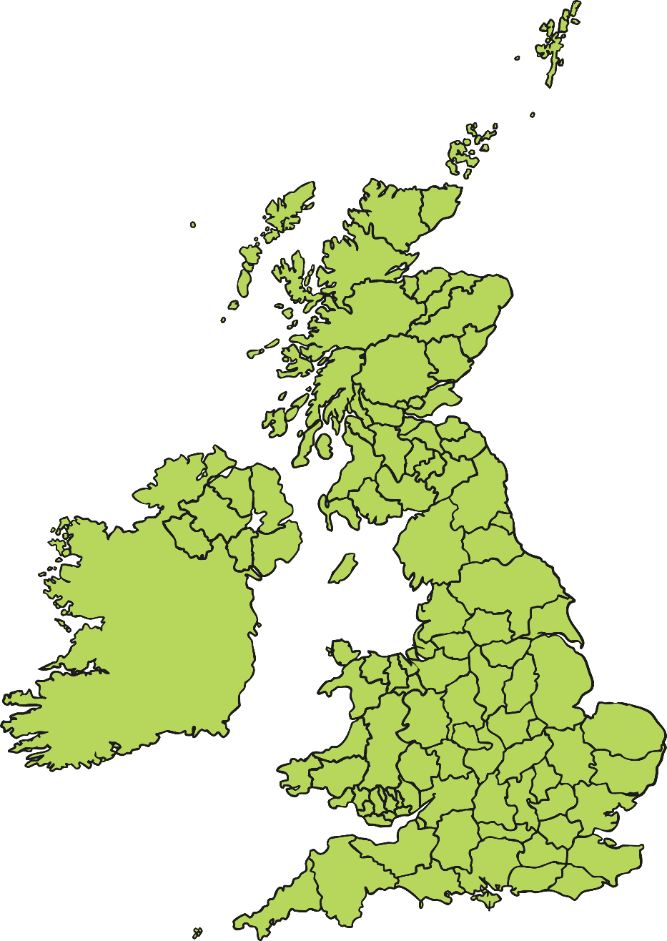
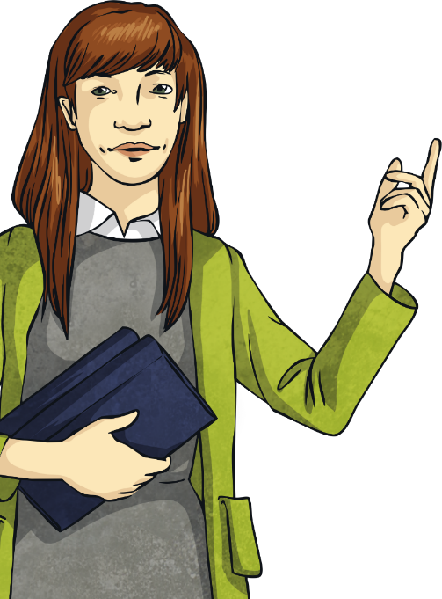
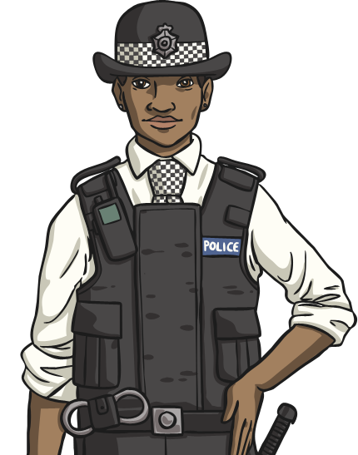
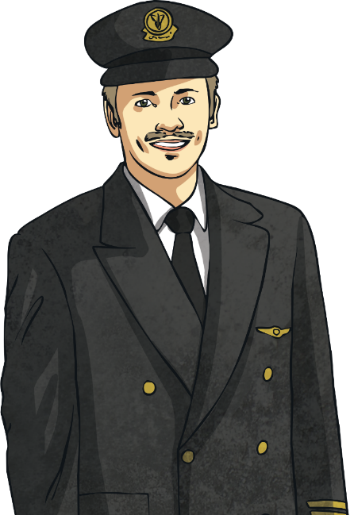
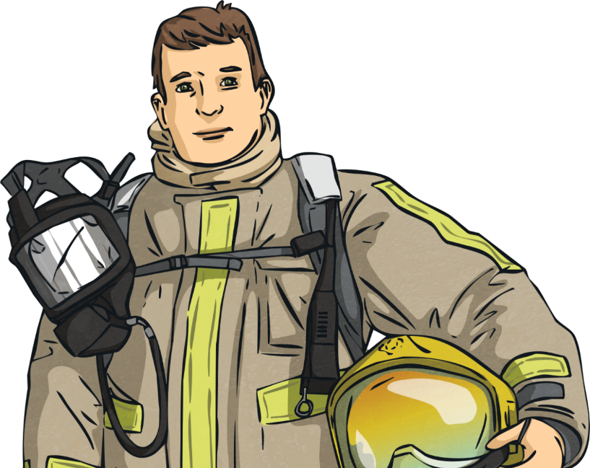
What is a County?
A county is a smaller area of the UK containing lots of towns and villages.
They are the top level of local government. They control the local area and the services within, such as education, transport, policing, fire & public safety, social care, libraries, and waste management.

Slide 6
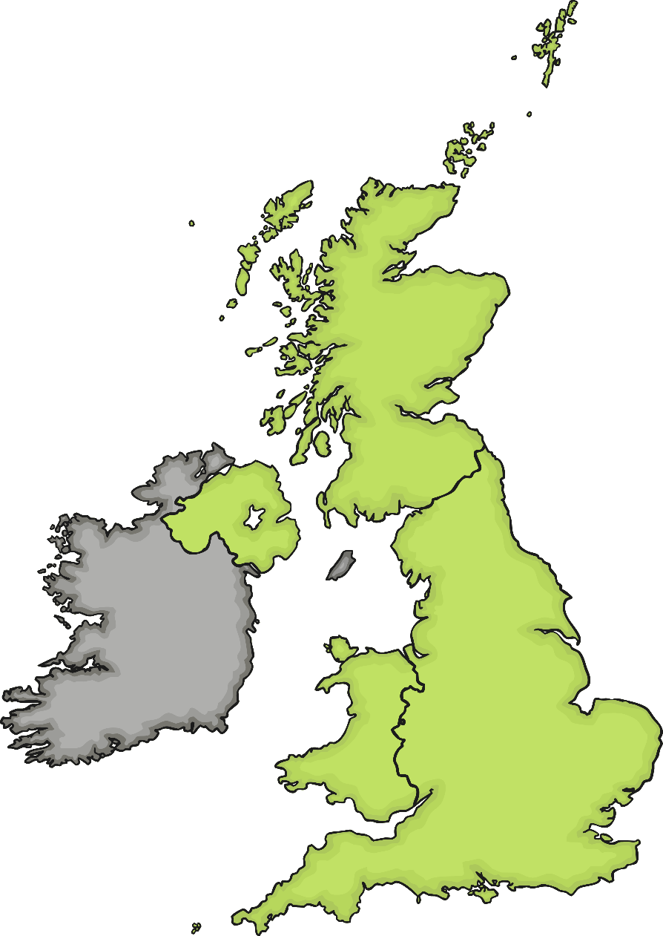
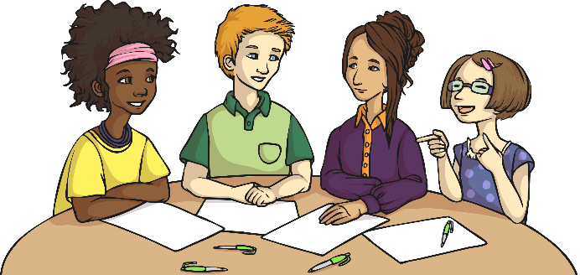
UK Counties
How many counties of the UK can you name?
?
?
Do you know where they are?
Can you name counties in England, Northern Ireland, Scotland and Wales?

Slide 7
Our County
Let’s find the part of the UK that we live in.
Can you find the county we are in?
?
Which counties are our neighbours?
?

Slide 8
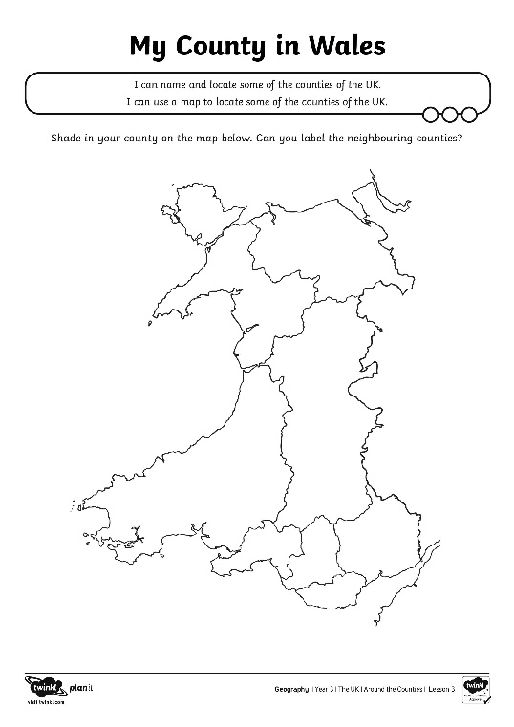
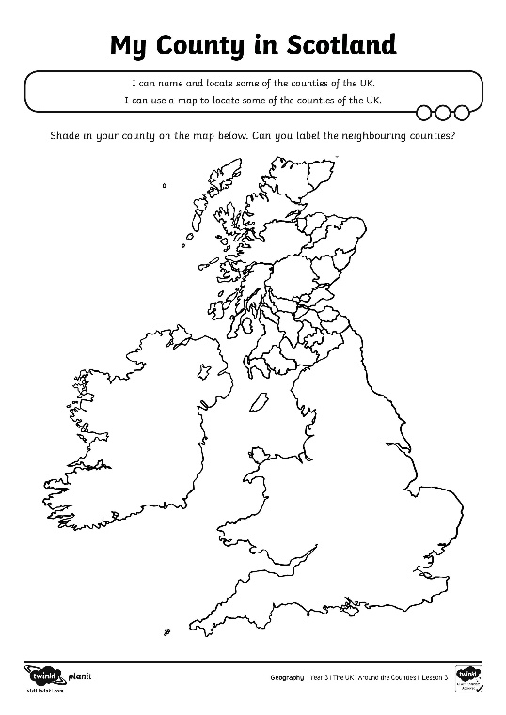
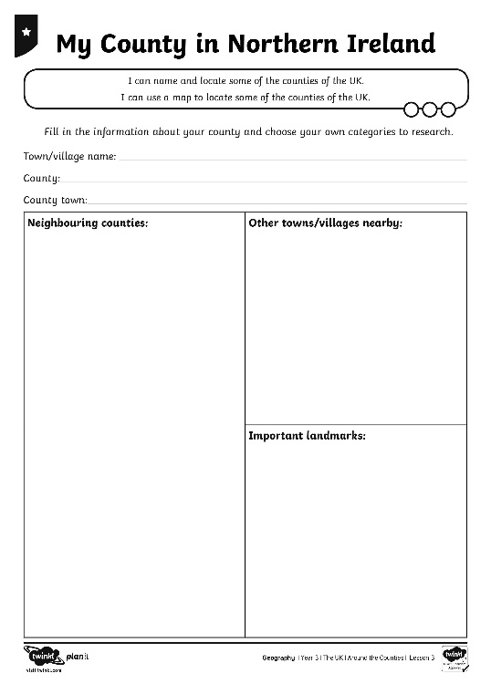
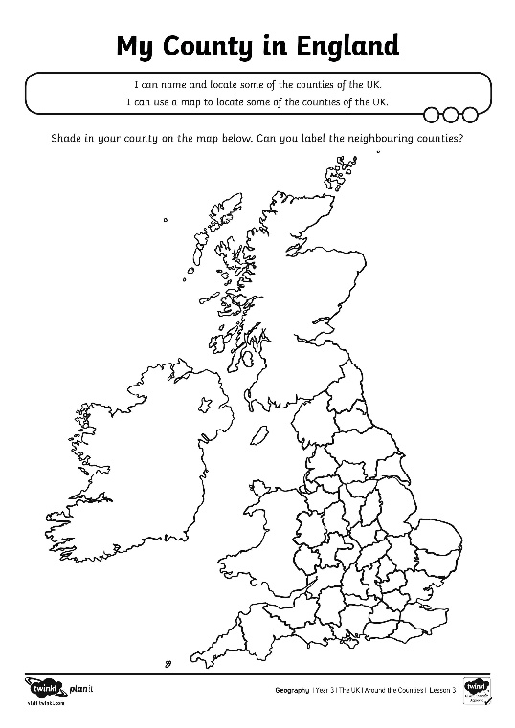
My County
Use the information leaflets and books to find out more about your county.
Make a fact file with the information you find out.

Slide 9
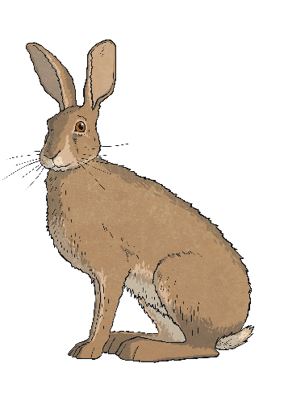
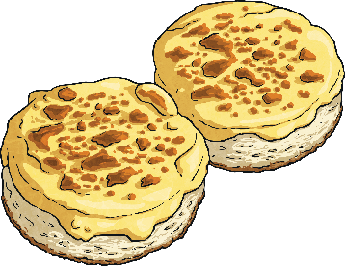
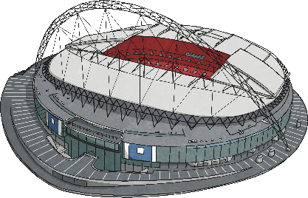
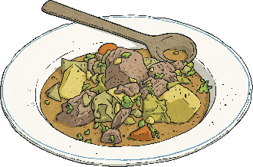

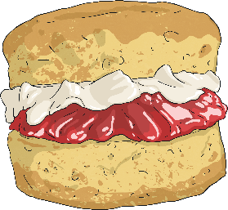

What Are We Famous For?
Let’s find out more about what our county is famous for.
What foods are associated with this area?
?
Which famous people grew up here?
?
Is there a special county day?
?
!
Don’t forget to add what you’ve found out to your fact files!

Slide 10
Aim
I can name and locate some of the counties of the UK.
I can use a map to locate some of the counties of the UK.
Success Criteria
I can explain what a county is.
I can name some counties local to my area.
I can find my county on a map.
I can identify some counties local to my area on a map.

