Slide 2
Aim
I can identify ways that London changed over time.
I can explain the importance of the Prime Meridian to London’s history.
Success Criteria
I can tell you who first settled in London.
I can describe some ways that London has changed since AD 43.
I can explain why London has changed since AD 43.
I can find London on world and UK maps.
I can identify the location of the Prime Meridian.
I can tell you why London was chosen to be the location of the Prime Meridian.

Slide 3







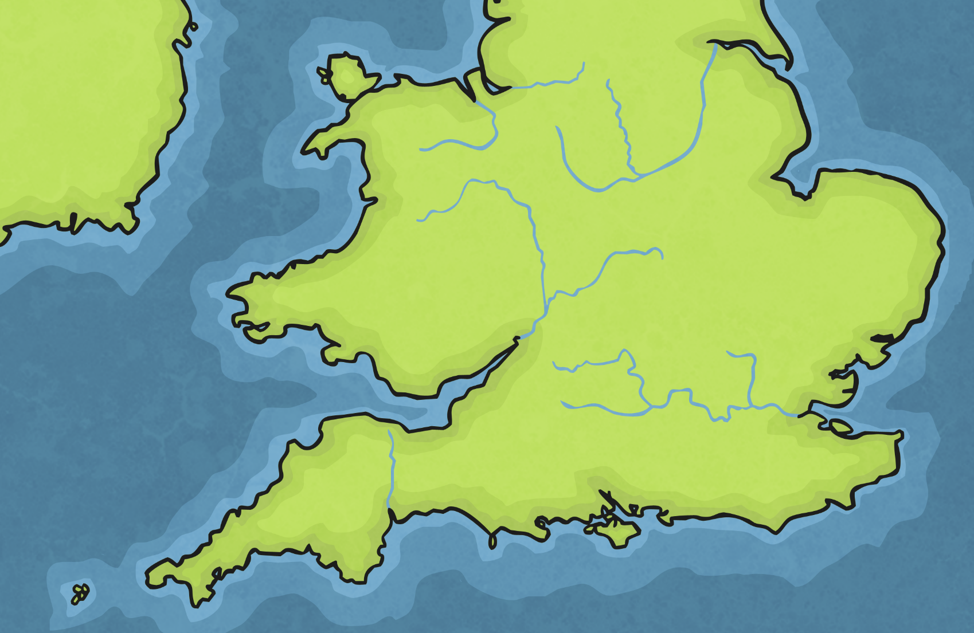
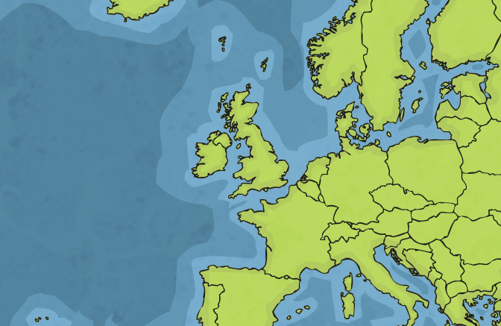
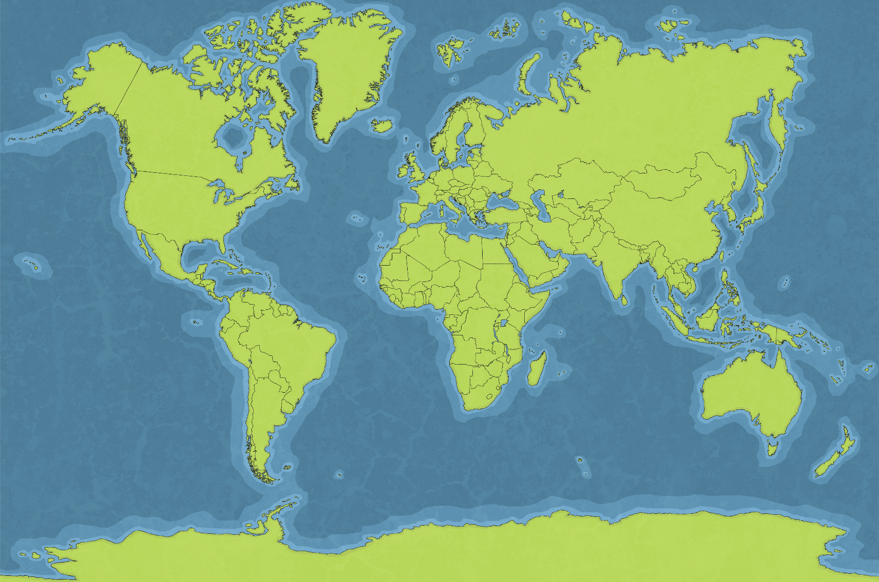
Where Is London?

Slide 4
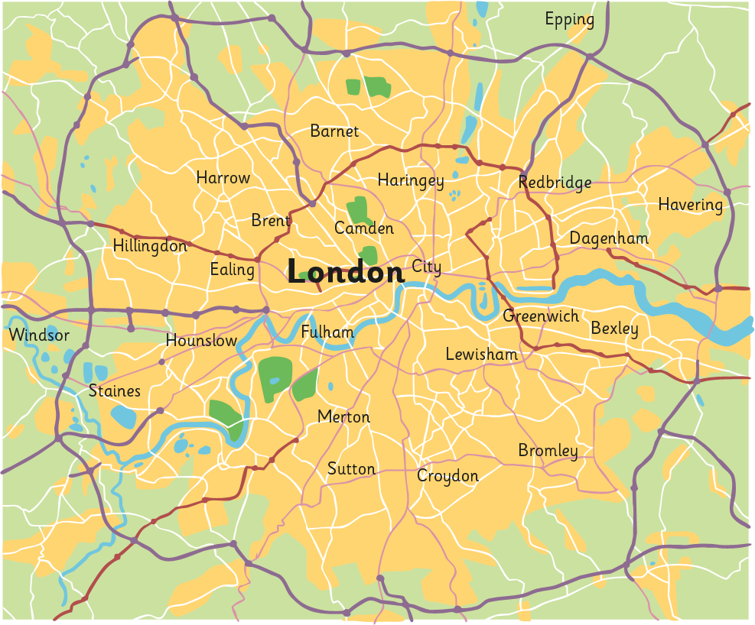
Where Is London?
M25
River Thames
Greater London
City of London

