Slide 1








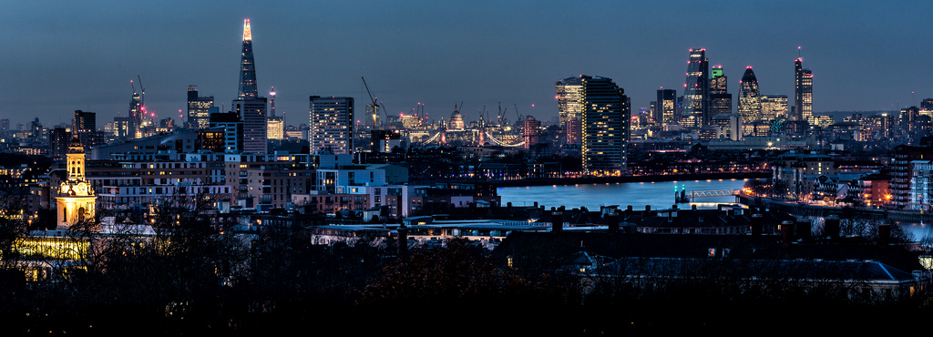
Who Built London?
?
How old do you think London is?
?
Has it always looked like this?
?
Who were the first people to live in London?
Photo courtesy of Davide D’Amico (@flickr.com) - granted under creative commons licence

Slide 2
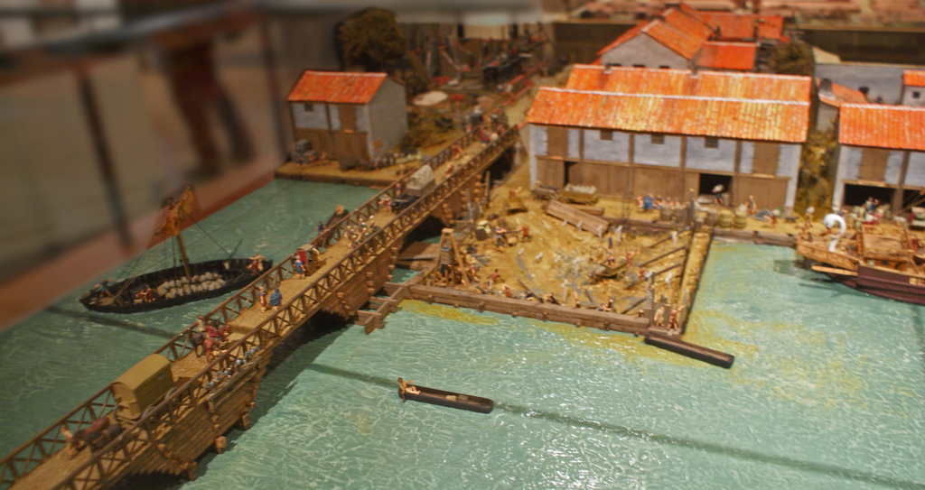
Who Built London?
The Romans invaded Britain in AD 43 and built a settlement called Londinium on the banks of the River Thames.
By AD100, Londinium was the new capital city of Britain and had a population of around 60 000 people!
This model from the Museum of London shows what the north side of the river might have looked like in around AD60.
Photo courtesy of Dick Penn (@flickr.com) - granted under creative commons licence

Slide 3
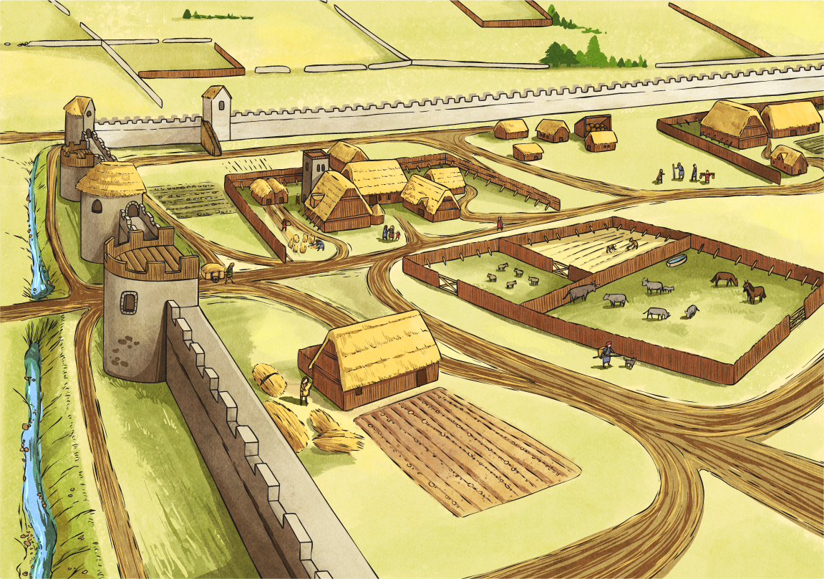


How Did London Change?
After the Romans left in AD 410, an Anglo-Saxon settlement called Lundenwic was built west of the Roman settlement, outside the Roman city walls.
In AD 800, Lundenwic was attacked by Vikings and renamed Lundenburgh.
The population was around 15 000.

Slide 4
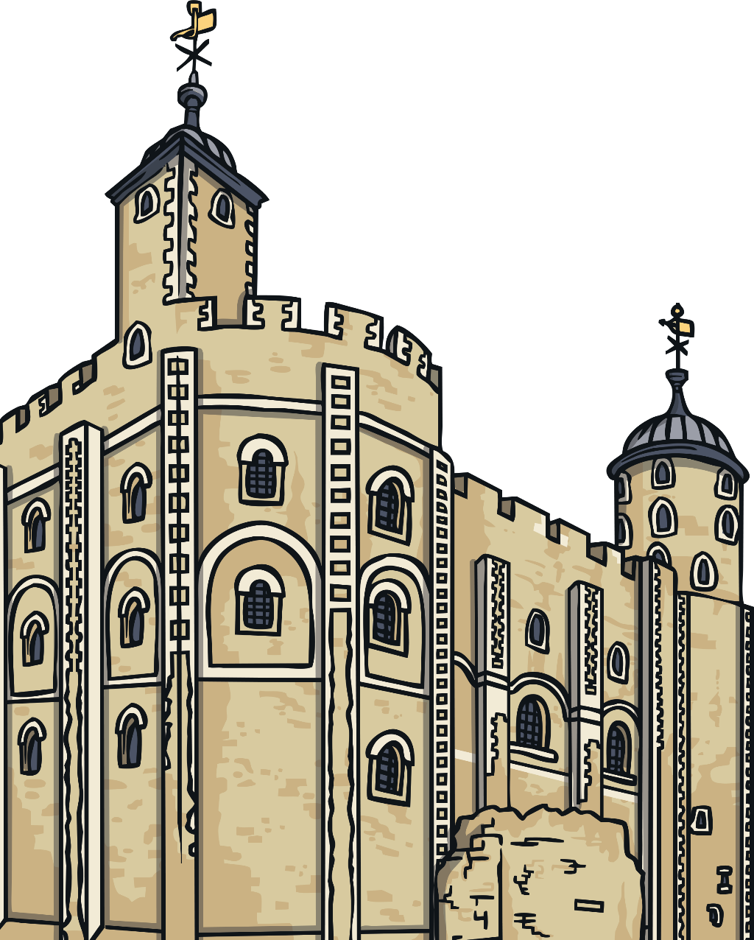
How Did London Change?
After the Norman Invasion of AD 1066, many forts were built, including the Tower of London.
In AD 1209, London Bridge was built to replace many smaller wooden bridges. It was the only bridge crossing the River Thames until AD 1739!
The population was around
80 000.

