Slide 1







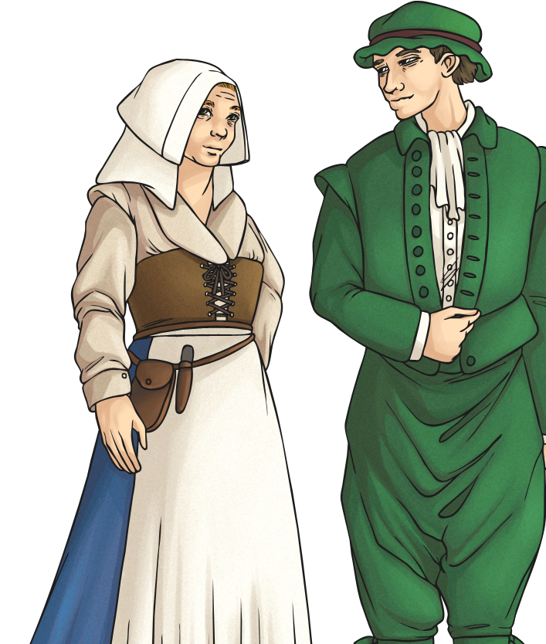

How Did London Change?
Between AD 1485 and AD 1603, the Tudors ruled England.
London was still quite small, but the River Thames provided an important trading link with Russia and the newly-discovered America.
Many trading companies developed.
Immigrants from other parts of the UK and around the world increased the population to 225 000.
Some of Queen Elizabeth I’s courtiers built country villas in the surrounding countryside of Essex and Surrey.

Slide 2
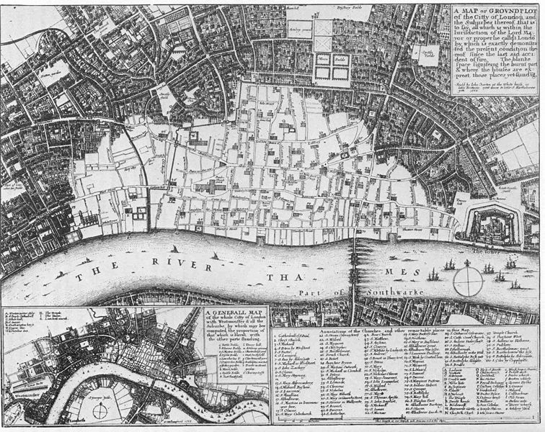
How Did London Change?
?
Can you remember what happened in London in AD 1666?
In the Great Fire of London, over 60% of the city was destroyed (shown in white on the map).

Slide 3
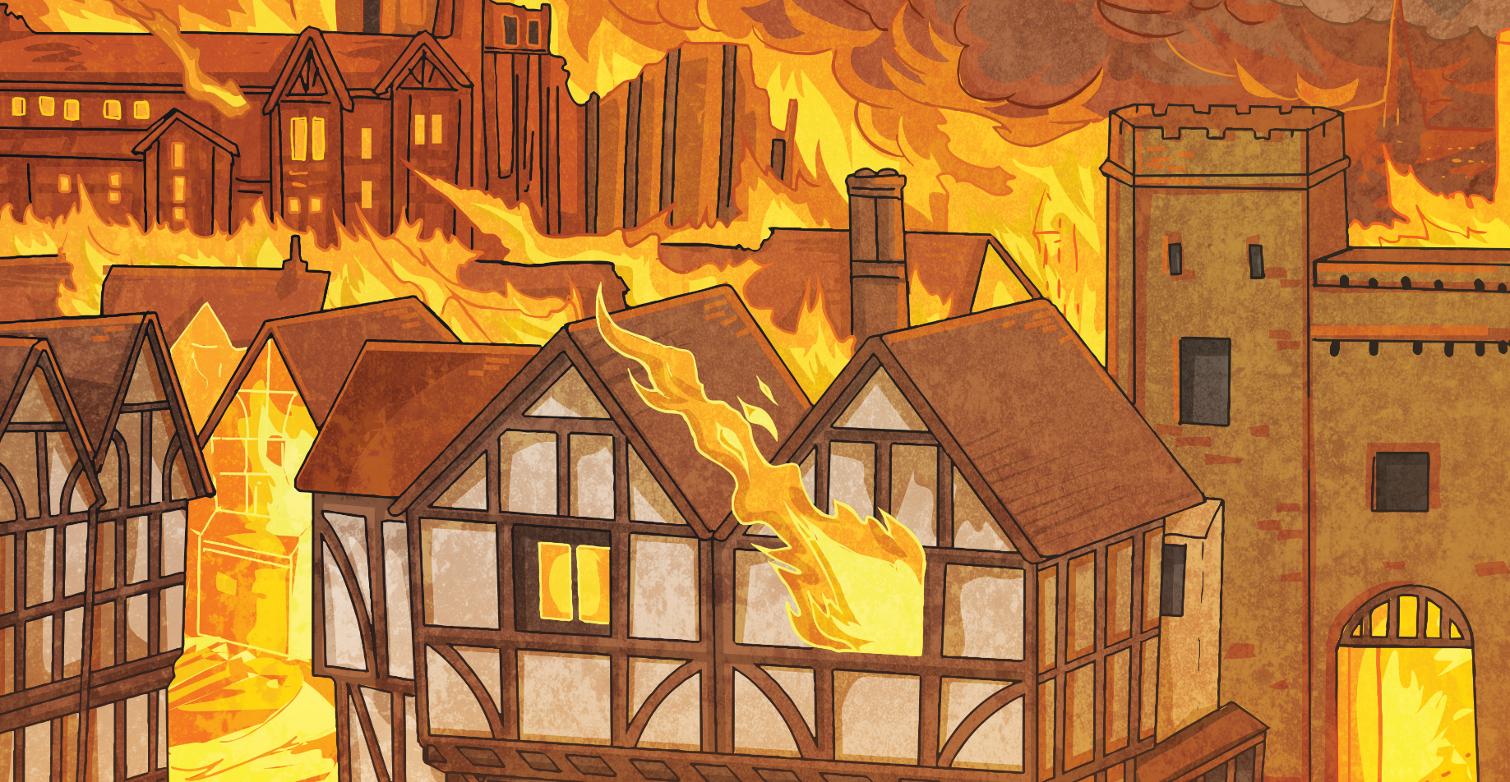

How Did London Change?
New houses were built to the west, close to The Royal Family’s new residence at St James’s Palace.

Slide 4
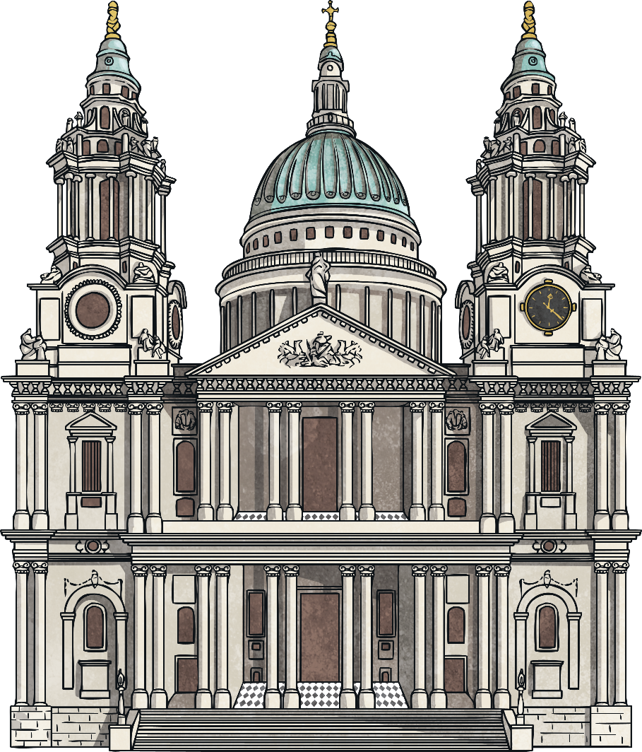
How Did London Change?
AD 1708 saw the completion of St Paul’s Cathedral.
In AD1762, King George III bought Buckingham House to be his new Royal Residence. The population of London was now 1 million.
By the Victorian period, London was the capital of the British Empire.
Trading and finance were becoming important industries.

