Slide 1






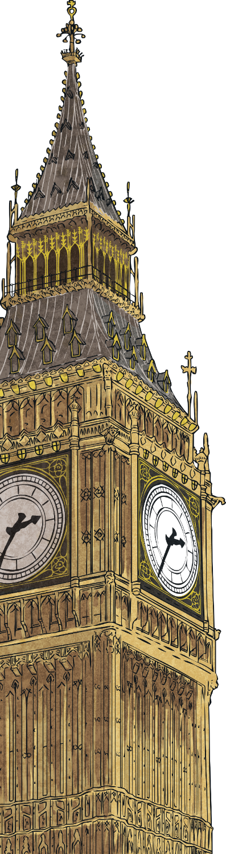

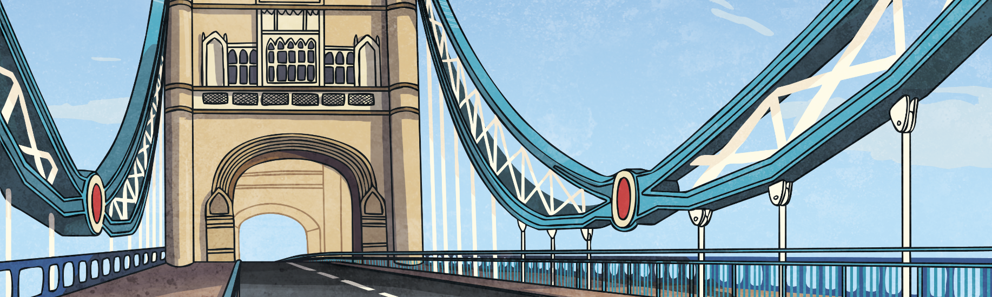
How Did London Change?
Immigrants moved to London and the population rose to 6.7 million.
London grew bigger as new areas of housing were built.
Railways linked London to other parts of the UK.
Landmarks such as Trafalgar Square, Big Ben, the Royal Albert Hall and Tower Bridge were built.

Slide 2
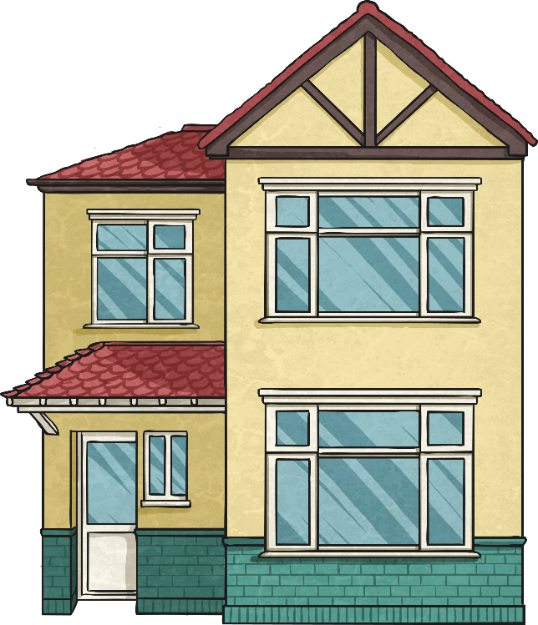
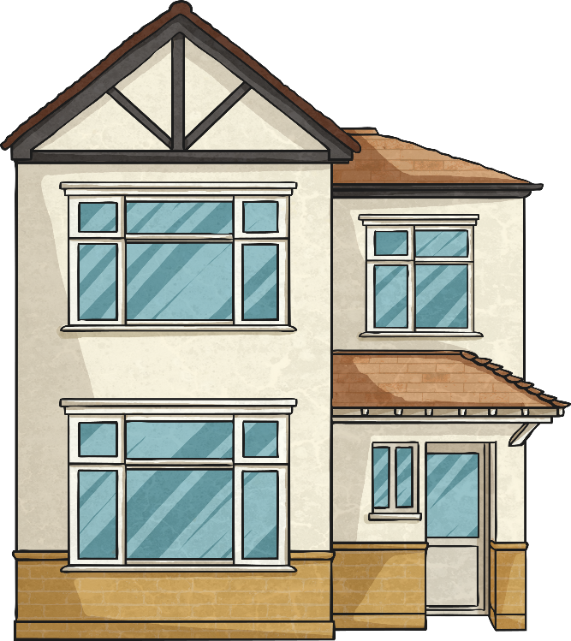
How Did London Change?
In the early 20th Century, London continued to grow.
People wanted bigger, more spacious homes. Semi-detached houses were built in new suburban areas outside London, leading the population to be nearly 9 million.
Landmarks such as Trafalgar Square, Big Ben, the Royal Albert Hall and Tower Bridge were built.

Slide 3
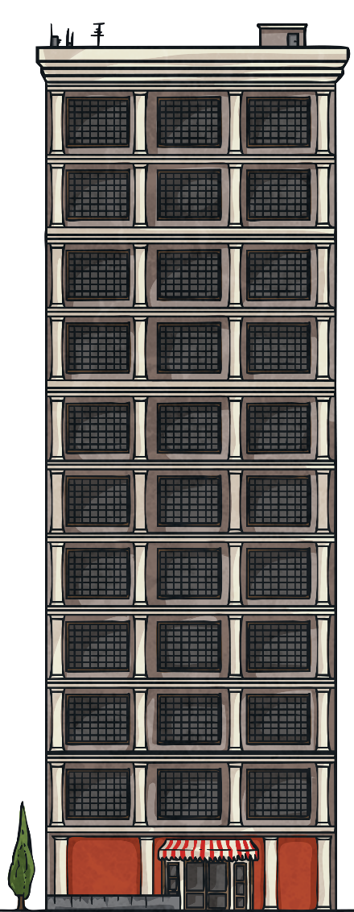
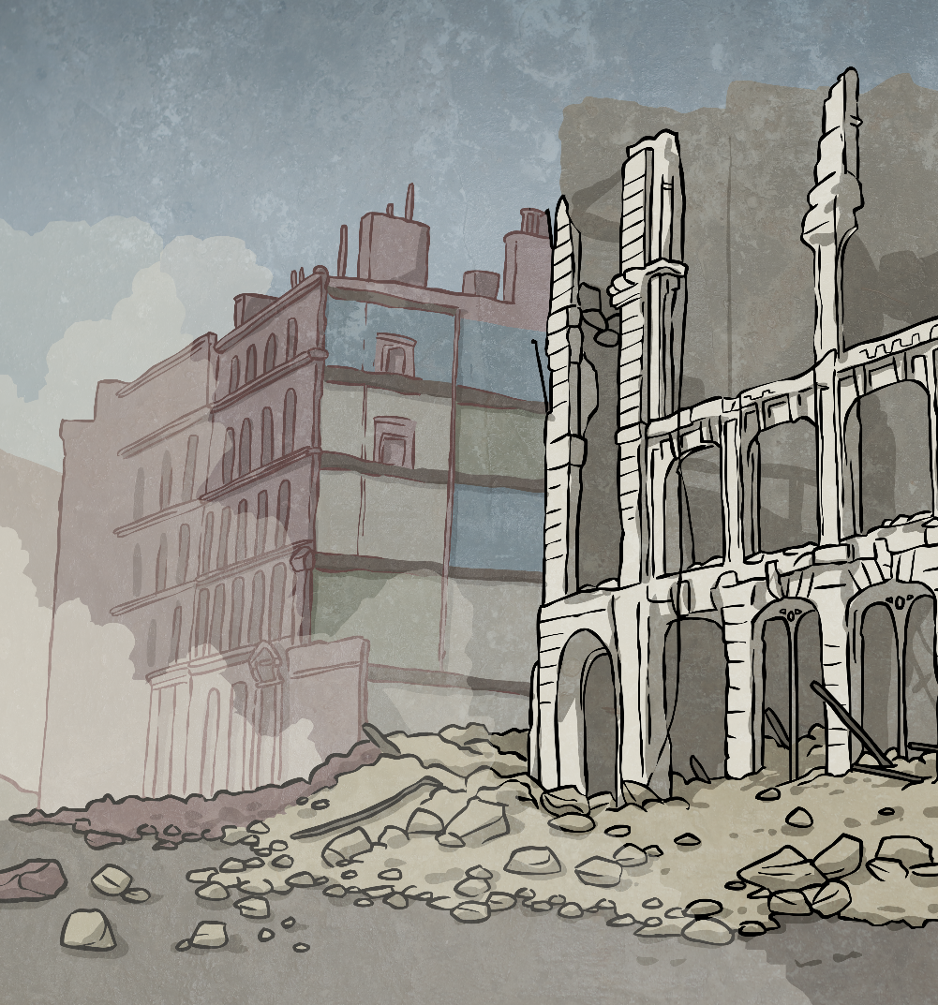
How Did London Change?
After the war ended, high-rise flats were built to replace the destroyed houses.
During the Second World War, areas of London were bombed and many houses and other buildings were destroyed.

Slide 4
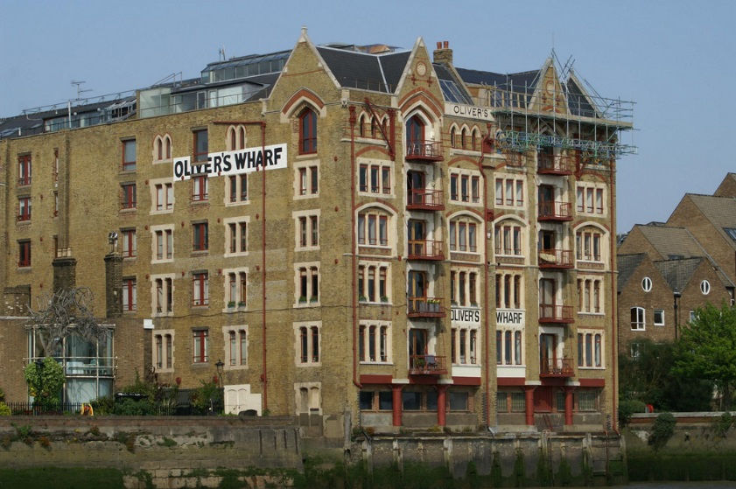
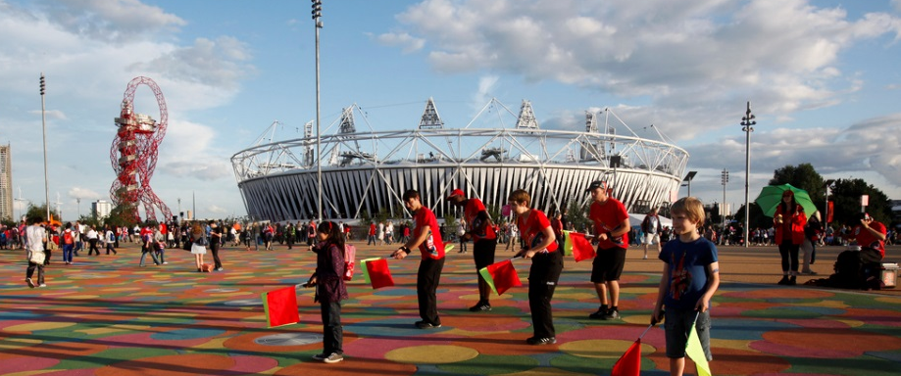
How Did London Change?
In the 1970s and 1980s, the docks that had once been a vital part of London’s trading links with other countries finally closed. Many of the Docklands buildings were converted into housing.
The Thames Barrier was built to protect London from tidal surges travelling up the River Thames.
The new millennium saw many building projects, including the Millennium Dome (now known as the O2 Arena), the Millennium Wheel (The London Eye) and the Queen Elizabeth Olympic Park for the London 2012 Olympic Games.
Photo courtesy of Dave Hamster, and The Department for Culture, Media and Sport (@flickr.com) - granted under creative commons licence

Slide 5
How Has London Grown?
AD 60 | AD 800 | AD 1200 | AD 1666 | AD 1900 | AD 1945 | AD 2012
The settlement is called Londinium. | The city of Lundenwic is attacked by Vikings. | The Tower of London is built. | Over 60 000 people died because of the Great Plague. | The population is over 6 million. | The population is almost 9 million. | London hosts the Summer Olympic Games.
The city has replaced Colchester as the capital of Britain. | The city is to the west of the old walled city. | London Bridge is built. | The city is renamed Lundenwic. | London is the capital of the British Empire. | Children have been evacuated to the countryside. | The Thames Barrier protects London from flooding.
The population is around 60 000. | The population is around 15 000. | The population is around 80 000. | 60% of the city has been destroyed by fire. | Trafalgar Square, Big Ben and Tower Bridge are built. | Many houses have been destroyed by the bombing in the Blitz. | The London Eye and 02 Arena are popular tourist attractions.
A wall has been built around the city. | The city is renamed Lundenburgh. | Stone is used for more buildings, including bridges. | The city of Lundenwic is attacked by Vikings. | Railways bring more people to the city. | Semi-detached houses are popular in the suburbs. | The Docks are no longer used for shipping, and are used for housing instead.

