Slide 1







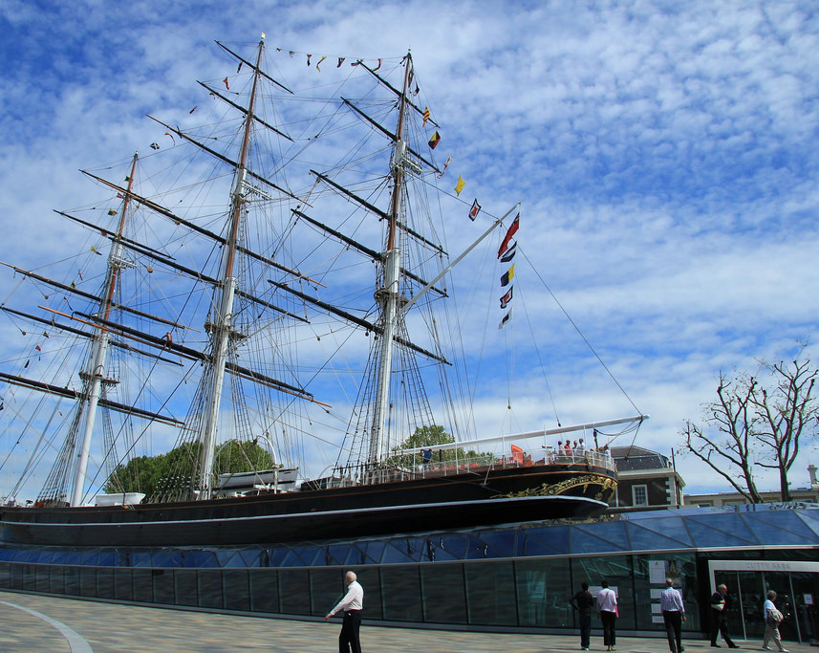
Why Was London So
Important in the Past?
Early settlers in Londinium and Lundenwic chose this site to build their homes as it was close to supplies of water, wood and food. The land was flat for farming.
From AD1485 until early in the 1900s, London was an important shipping and trading port, with large trading companies forming in the Docklands area.
From AD1800, London became an important city for finance and investment, linked to its trading and Empire.
Photo courtesy of Karen Roe (@flickr.com) - granted under creative commons licence

Slide 2
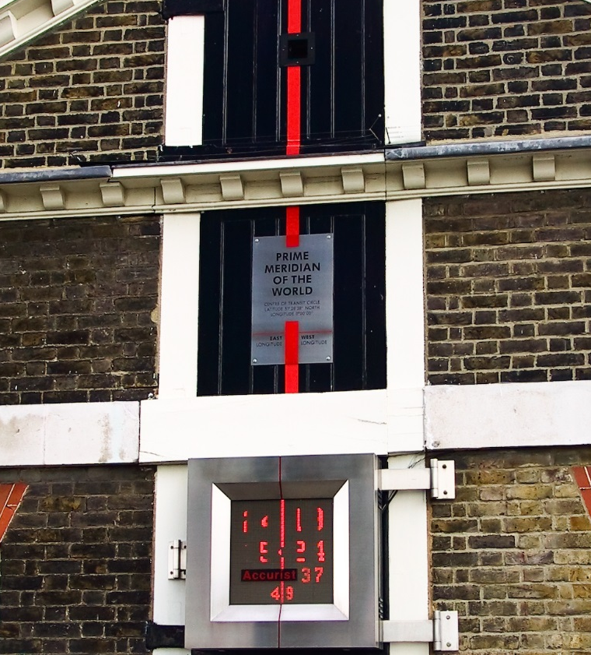
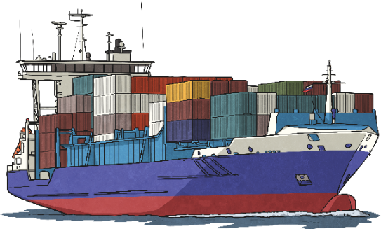
Why Was London So
Important in the Past?
The Prime Meridian is an imaginary line which divides the Earth into two hemispheres: the eastern hemisphere and the western hemisphere.
In 1884, the International Meridian Conference chose to make the line at 0° longitude run through the Royal Observatory in Greenwich, England.
The conference chose Greenwich because most of the world’s ships used this meridian already.
Photo courtesy of llamnudds (@flickr.com) - granted under creative commons licence

Slide 3
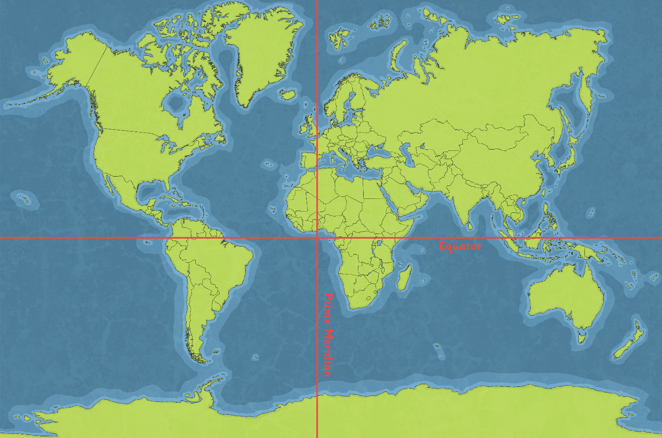
Why Was London So
Important in the Past?
Can you use the meridian lines to help you find London?

Slide 4
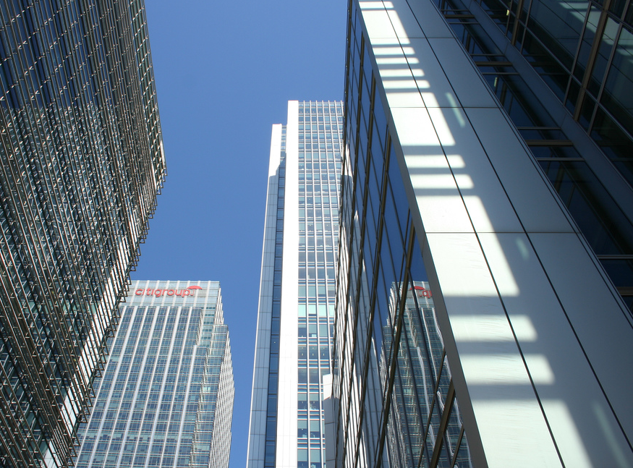
Is London Still
Important Today?
The FTSE Stock Exchange plays an important part in financial investments around the world.
It is still a major transport interchange. Heathrow Airport is used for passengers as well as freight.
Many global businesses are based in London.
?
Do you think London is still important today?
?
What is it famous for?
Photo courtesy of .Martin. (@flickr.com) - granted under creative commons licence

