Slide 1
Heartsmart
Lesson 4: Watch what you watch

Slide 2
LI: to learn ways to know what we should and shouldn’t watch

Slide 3
Our hearts are precious. How can we protect them?
Healthy eating
Good diet choices
Exercise
Not smoking or taking drugs
Did you think about:
watching what you what on TV?
Watching what you play on the games console?
Watching what you view on social media?

Slide 4

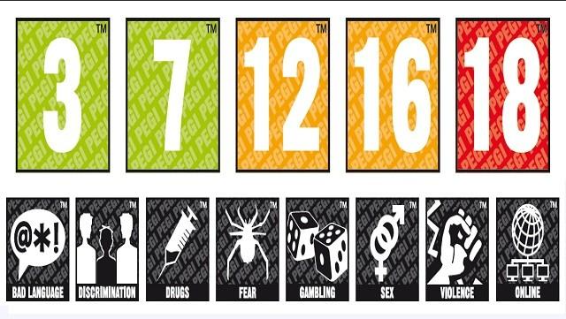
Being Heartsmart means we are careful about what we see and what we watch.
Do you recognise these?
Do you recognise these?

Slide 5
All films have a rating guide
So what do they mean?
U films are suitable for all viewers
PG film mean that a parent or guardian should agree to you viewing the film
12, 15 and 18 and R18 films should not be viewed by persons under that age due to content

Slide 6
Computer games also have ratings too
So what do they mean
The number tells us how old the person should be before they have access to the game because of its content.
Young hearts and minds are precious and developing. Some times things we watch can harm our development and give us false ideas about how to behave and the types of language to use.

Slide 7
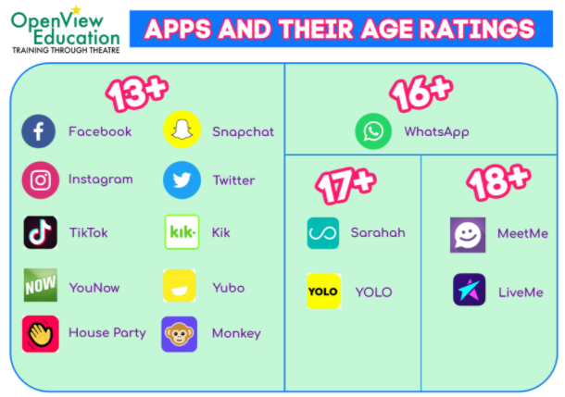
Social media is also given an age restriction
You should be 13, 16, 17 or 18 to have any of the following accounts:
I wonder how many of them you have and if your parents know you have them?

Slide 8



CEOP
CEOP (Child Exploitation and Online Protection) are the internet police.
If you are on any social media platform and you see something you do not like please report it to CEOP.
Their commonly used logos are here:

Slide 9
Your task: Using the worksheet provided, design a smart watch for children to wear that will alert them every time they see or watch something that isn’t good for them.

Slide 10
Consider: How many alerts do you think should be allowed everyday? What could your watch do if you did look at something it doesn’t like?

