Slide 1
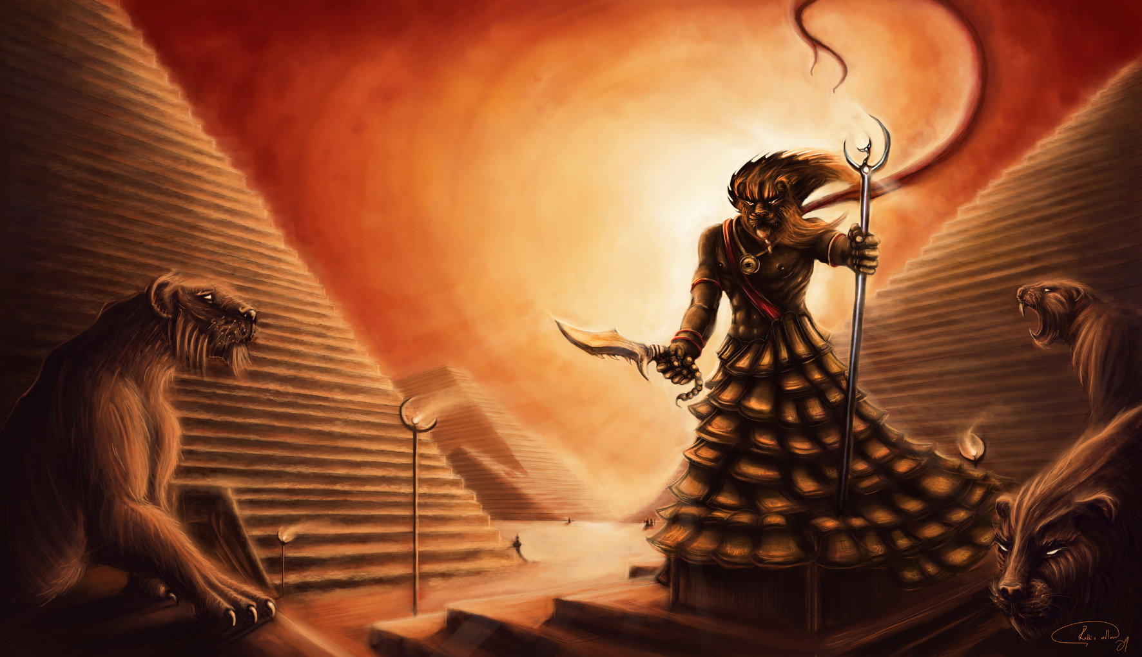
Egyptian Gods & Goddesses
The Egyptians worshipped a number of different Gods & Goddesses! Can you name any?

Slide 2
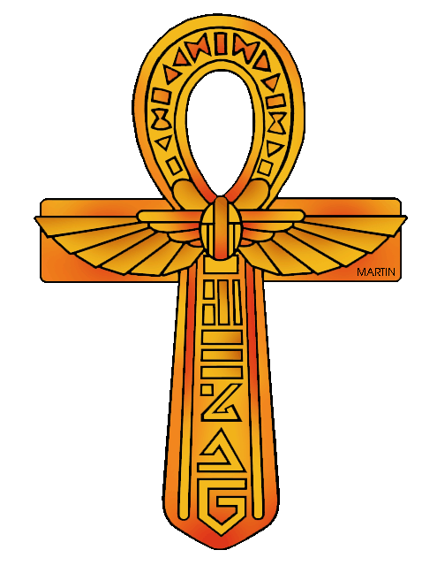
Ancient Egyptian Gods:
Religion was very important in Ancient Egypt.
Believed in a variety of Gods & Goddesses.
Each took a different form.
Alot took the form of different animals.
Animals represented certain things to people.
Depended on the area, temple or timeframe.
Each God or Goddess had an important role to Egyptians.

Slide 3
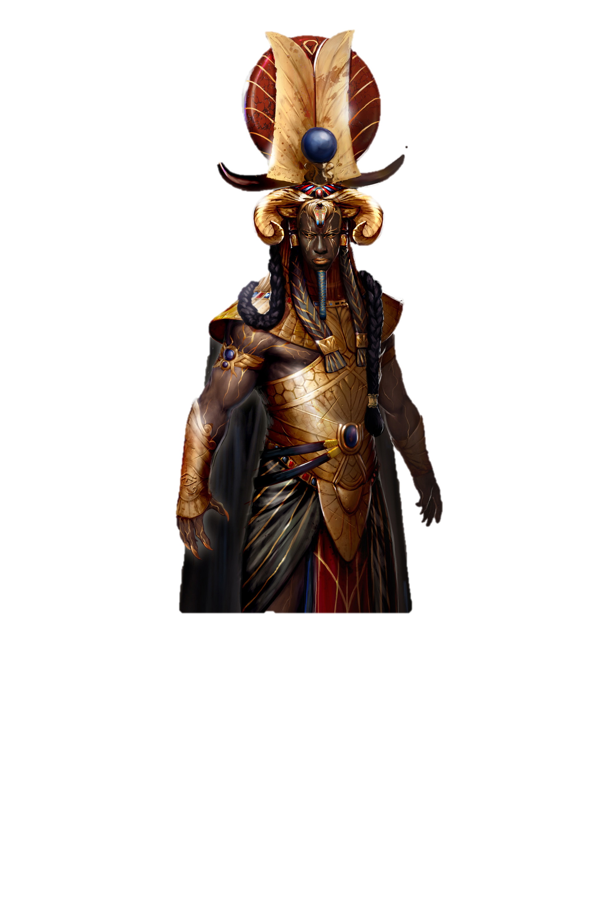
Atum - God of Creation
Atum was the first God.
Also God of the Setting Sun.
He is also known as the “father” of the Pharaohs.
He was self-created.
He wore a white & red crown.
Had a plaited beard called a Osird.
Pharaohs based their look upon him.
The Gods were all descendants of Atum.
Ra took over his role as the God of the Sun.

Slide 4
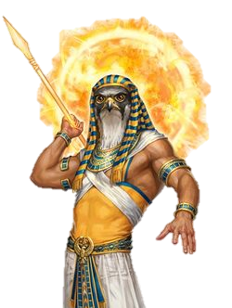
Ra - Lord of the Gods
Ra was the God of the Sun.
He was also the Lord of the Gods.
He has the body of a human & the head of a falcon.
Wears a sun disk crown circled by a sacred cobra.
Shown holding a sceptre called Ankh, the key of life.
He was linked a myth about the all-seeing Eye of Ra.
Pharaohs called themselves “sons of Ra”.

Slide 5
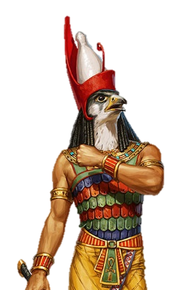
Horus - God of the Sky
Horus was the son of Isis & Osiris.
Looked similar to Ra.
Had the head of a hawk & wore a double crown.
Lost his eye during a fight with his uncle, Seth.
Became known as the Eye of Horus, an important Egyptian symbol.
Said to fight off evil, danger & disease.
Worshipped all over Egypt.
Pharaohs believed they were Horus in human form.

Slide 6
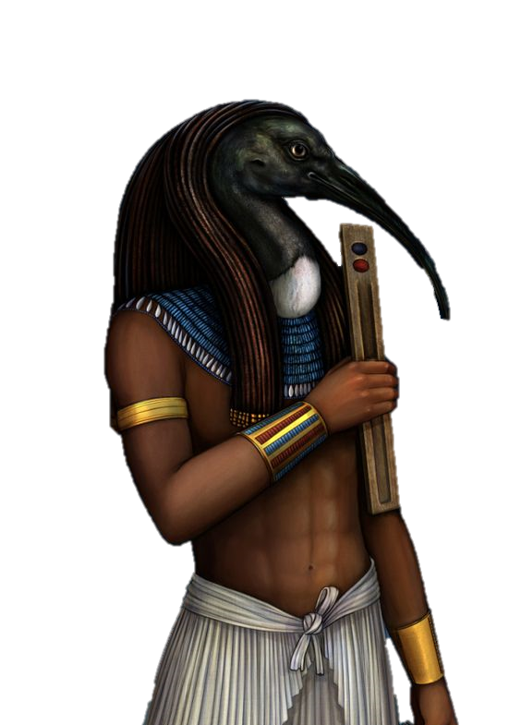
Thoth - God of Knowledge
Thoth also God of Wisdom & Hieroglyphs.
Created himself, had no parents.
Married to Ma’at, Goddess of Truth.
Gave advice to the Gods before battles.
He maintained the universe by settling arguments.
Had the head of an ibis - a long, slim bird.
His curved beak symbolises the moon.
Originally known as God of the Moon.
Said to be the creator of hieroglyphics.

Slide 7
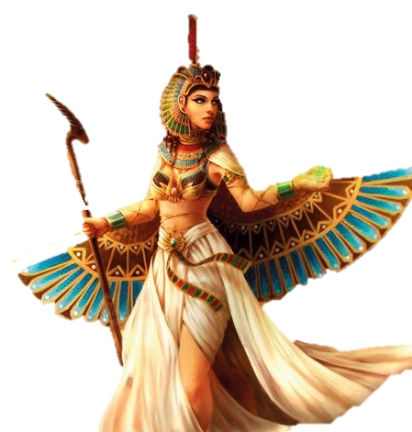
Ma’at - Goddess of Truth
Ma’at also Goddess of Justice & Harmony.
Wife of Thoth.
She judged the souls of the living & the dead.
Her symbol was an ostrich feather.
Helped her judge a persons goodness.
She is believed to have had wings.
Job was to stop the world falling into chaos.
Pharaohs had to promise to follow her & be fair leaders.

Slide 8
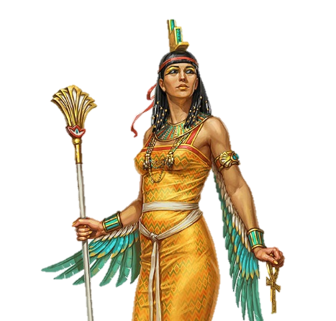
Isis - Goddess of Protection
Isis also the Goddess of Healing.
Wife of Osiris.
Mother of Horus.
Also known as Queen of the Goddesses.
Sometimes shown wearing a throne on her head.
Used her powers to help those in need.
After her husbands death she became Goddess of the dead.
She was considered the mother & protector of Pharaohs.

Slide 9
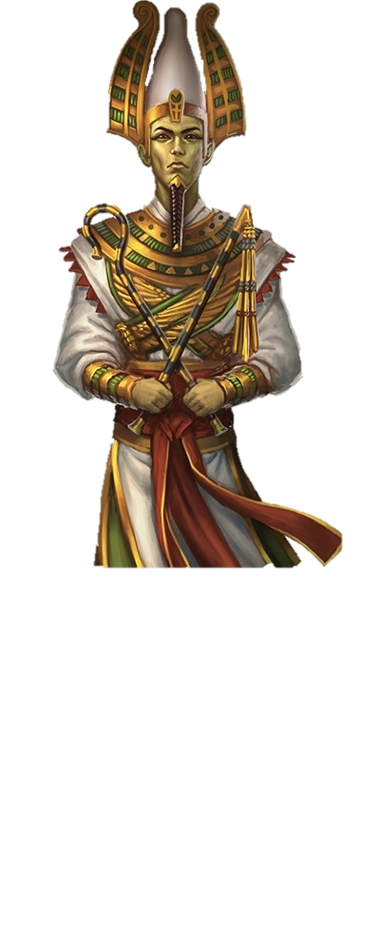
Osiris - God of Death
Osiris also God of the Underworld.
Husband of Isis.
Murdered by his brother, Set.
His sons were Horus & Anubis.
Often shown as having green skin.
Wore the white, linen wrapping of a mummy.
Wears a white crown with large feathers.
Loved by all Egyptians.
Pharaoh believed to become Osiris after their death.

Slide 10
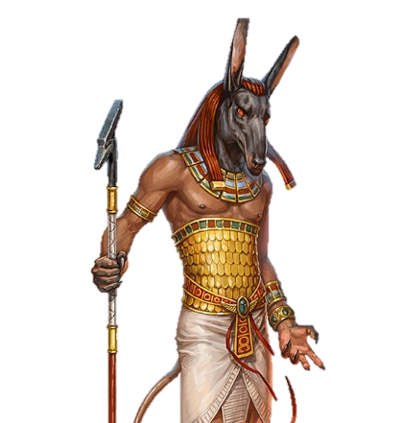
Set - God of Chaos
Set also the God of Darkness.
Had one of the largest & oldest cults in Egypt.
Had a human body & the head of an animal called a Seth.
Was an enemy of quite a few gods.
Egyptians associated the colour red with him.
Sometimes seen as a war God.
He murdered Osiris & was later beaten by Horus.

Slide 11
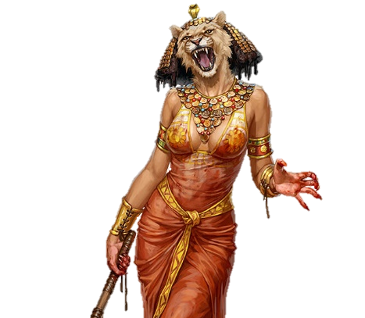
Sekhmet - Goddess of War
Sekhmet is also sometimes called the daughter of Ra.
Wife of Ptah, the God of Life.
Shown with the body of a woman & head of a lioness.
Wore a sun disk headdress similar to Ra.
Often called the “lady of terror”.
Known for her violence & power.
Loved war & went to battle with the king.
She loved blood & Egyptians made sacrifices to her.

Slide 12
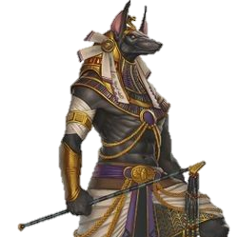
Anubis - God of the Dead
Anubis also God of Embalming.
Invented the mummification process.
Shown with the head of a jackal, tail of a lion & human body.
Sometimes wore a golden necklace.
Had dark black skin.
People would give their organs to Anubis as gifts.
Embalmed Osiris after his death.
Helped decide the fate of the dead.

Slide 13
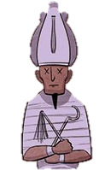
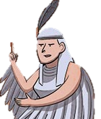
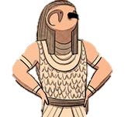
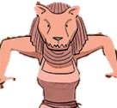
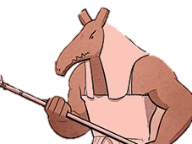
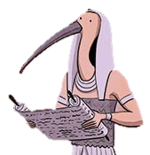
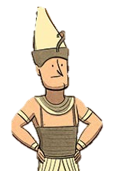
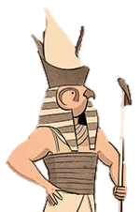
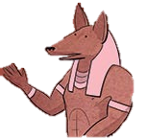
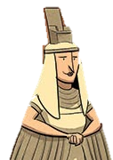
Can you name each of the Gods?
Osiris
Ma’at
Ra
Sekhmet
Set
Thoth
Atum
Anubis
Horus
Isis

