Slide 1
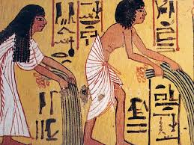
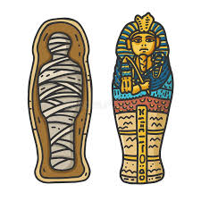


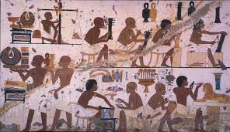
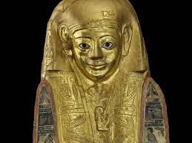
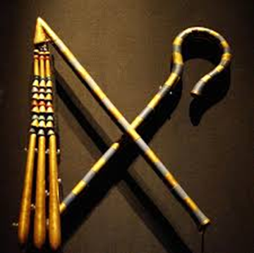
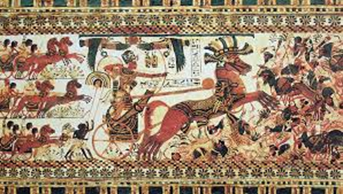
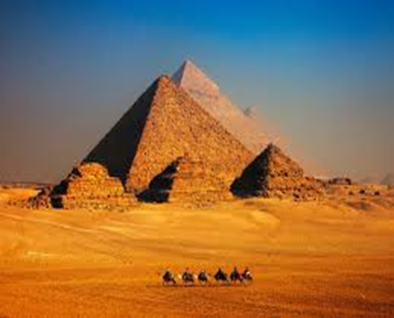
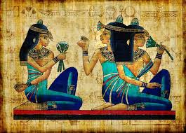
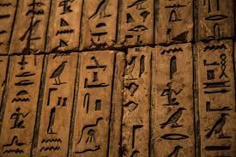
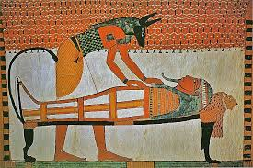
L.I: To understand the achievements of the pharaohs
What is a pharaoh and what did they do?
Notes:
Read LI to pupils. Click to move to next slide.

Slide 2

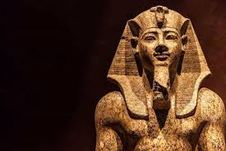

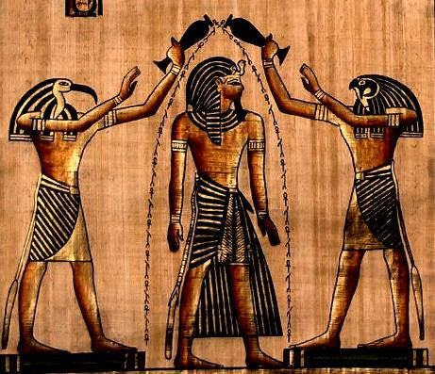
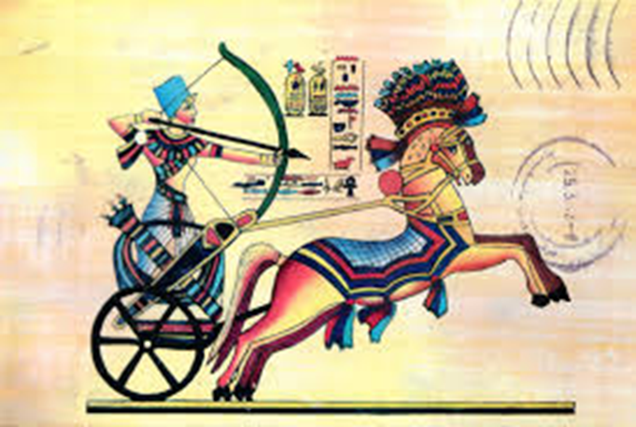
What do these pictures tell us about Pharaohs?
Crook and Flail: symbols of kingship.
Statues of Pharaohs
Pyramids as tombs
The pharaoh was considered a god by Egyptian people.
Pharaoh led the army into battle!
Notes:
Give pupils time to look at the image carefully. Ask questions such as: Can you see Egyptians hunting hippos?
Can you see an Egyptian getting water from the Nile?
Can you see a man in a reed boat selling things?
How are people travelling on the Nile?

Slide 3
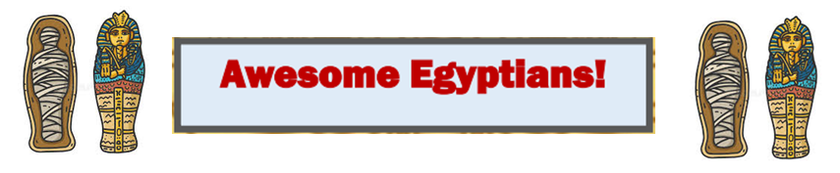
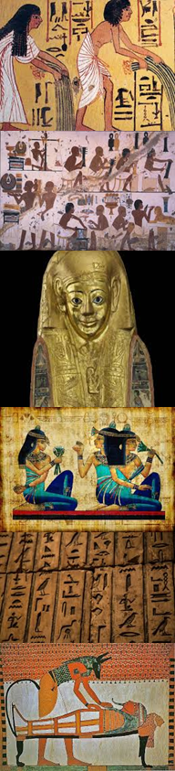
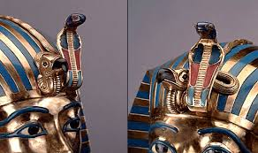
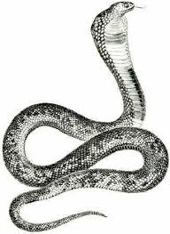
The Pharaohs of Ancient Egypt were leaders, kings and queens and all of the lands of the Nile belonged to them! The Pharaoh was often thought of as one of the gods. Only the Pharaoh was allowed to wear the cobra goddess. It was said that she would protect them by spitting flames at their enemies!
The cobra is a poisonous snake found in hot countries like Egypt.
The uraeus is a snake on the pharaoh’s crown. It is a symbol of Wadjet, the protector goddess of Egypt.
Notes:
Read through the details. Ask pupils to make a note of any useful words and facts. Check they have understood by allowing time for them to ask questions about new words or ideas.

Slide 4

The son of the current Pharaoh would inherit the title and would often go through training, so he could be a good leader.
As part of his training to become a future Pharaoh, a young prince learned to be an expert at driving a war chariot.

Slide 5
The name Pharaoh comes from a word meaning "great house" describing a palace or kingdom. The Pharaoh's wife, or Queen of Egypt, was also considered a powerful ruler. Sometimes women became the rulers and were called Pharaoh, but it was generally men.
Historians divide up the timeline of Ancient Egyptian history by the dynasties of the Pharaohs. A dynasty was when one family maintained power, handing down the throne to an heir.

Slide 6
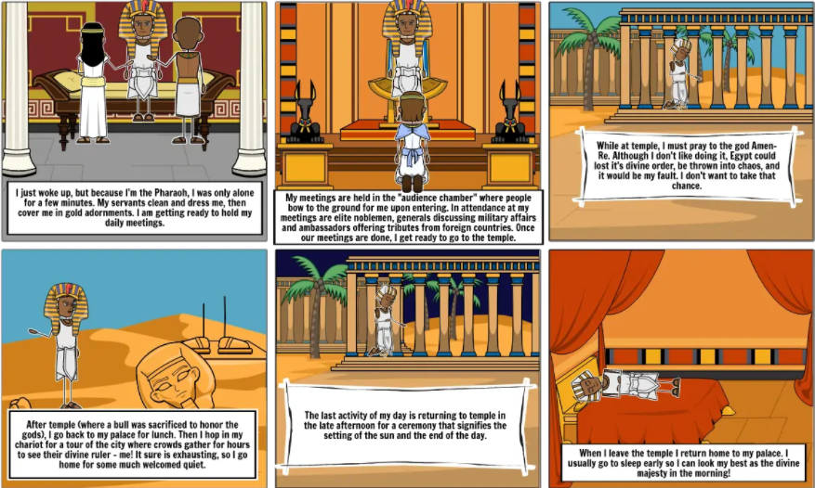

Slide 7
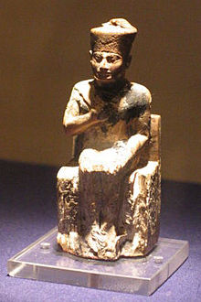
Khufu (reign 2589 ‒ 2566 BC)
Khufu (Cheops) was the builder of the Great Pyramid at GIZA which is one of the seven wonders of the world.
His own burial chamber was found to contain only an empty sarcophagus.
It is said that he was a cruel and dictatorial ruler but there is not enough evidence to be certain.
Why do you think Cheops’ tomb had no treasure?
Notes:
Read through the details. Ask pupils to make a note of any useful words and facts. Check they have understood by allowing time for them to ask questions about new words or ideas.

Slide 8
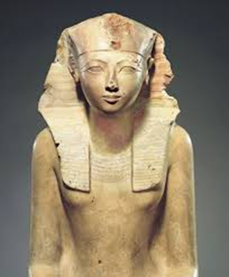
Hatshepsut(reign 1473–1458 BC) - A lady Pharaoh, Hatshepsut came to the throne because her son was still a baby, but she took on the power of Pharaoh. She also dressed like the Pharaoh to reinforce her power including the crown and ceremonial beard. Many consider her to be not only the greatest woman Pharaoh, but one of the greatest Pharaohs in the history of Egypt.
Why did Hatshepsut wear a false beard?
Notes:
Read through the details. Ask pupils to make a note of any useful words and facts. Check they have understood by allowing time for them to ask questions about new words or ideas.

Slide 9
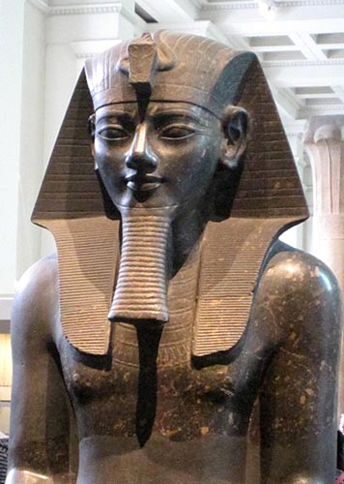
Amenhotep III (reign 1390–1352 BC)- Amenhotep III ruled for 39 years of great prosperity. He brought Egypt to its peak of power. During his rule the country was at peace and he was able to enlarge many cities and construct temples.
What do you think Amenhotep did to make sure there was peace with other countries and wealth came to Egypt?

Slide 10
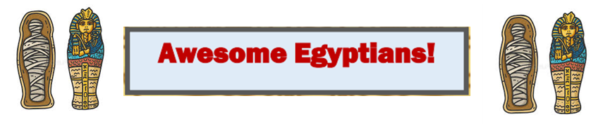
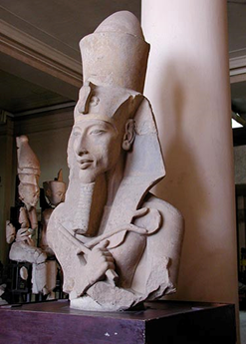
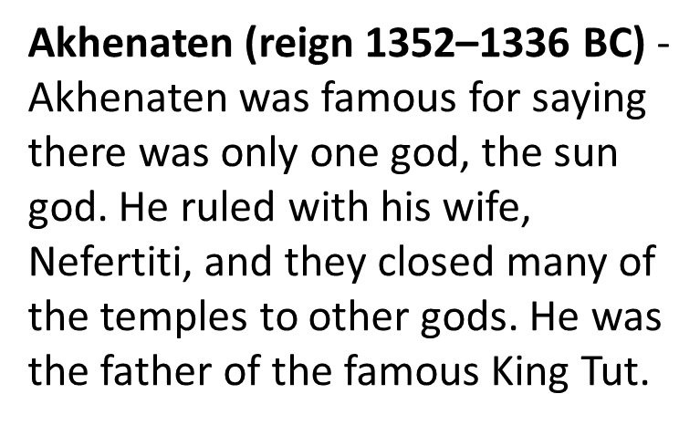
How do you think the priests of the old gods felt when Akhenaten closed their temples?

Slide 11
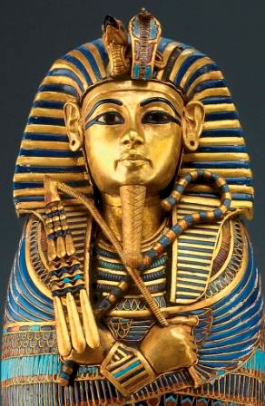
Tutankhamun (reign 1336–1327 BC)- Often called King Tut , Tutankhamun is famous because much of his tomb remained intact. He became Pharaoh at the age of 9. He tried to bring back the gods that his father had stopped worshipping. He only reigned for about 10 years and died at the young age of 20. Mystery still surrounds his death .
How could life be dangerous for a pharaoh?

Slide 12
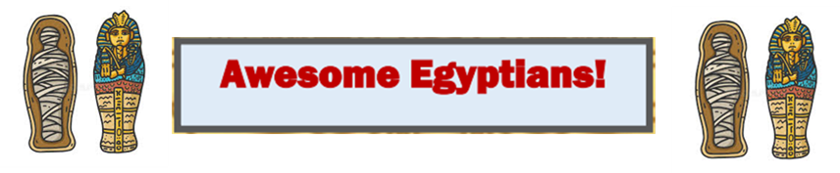
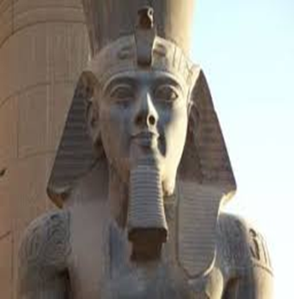
Ramses II(reign 1279–1213 BC) - Often called Ramses the Great, he ruled Egypt for 67 years. He is famous today because he built more statues and monuments than any other Pharaoh.
Why do you think it was important for a pharaoh to build monuments to the gods and themselves?

Slide 13
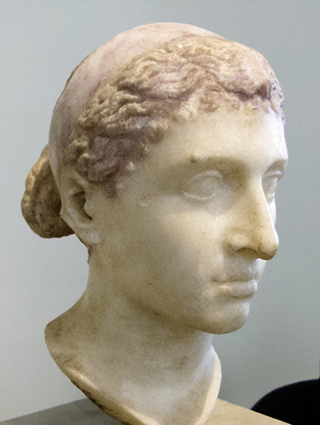
Cleopatra VII (51-30 BC)
Cleopatra VII is considered the last Pharaoh of Egypt. She was very intelligent and one of the few Queens who learned the Egyptian language. She maintained power by making alliances with famous Romans such as Mark Antony. She married him but he committed suicide after being defeated at the battle of Actium by his brother-in-law, Octavian and Cleopatra followed shortly after. Octavian killed Cleopatra’s son and made himself Pharaoh. The Egyptian pharaohs had come to an end! From 30BC, the Romans would rule.

Slide 14
Who do you think was the most powerful of the pharaohs and why?
Even though they were rich, what would’ve been the most difficult thing about being pharaoh do you think?

Slide 15
Make a timeline of the Egyptian Pharaohs from the presentation.
Show the dates they reigned and add 1-2 facts about them.
Draw a picture of each to go on the timeline if you like.

