Slide 1
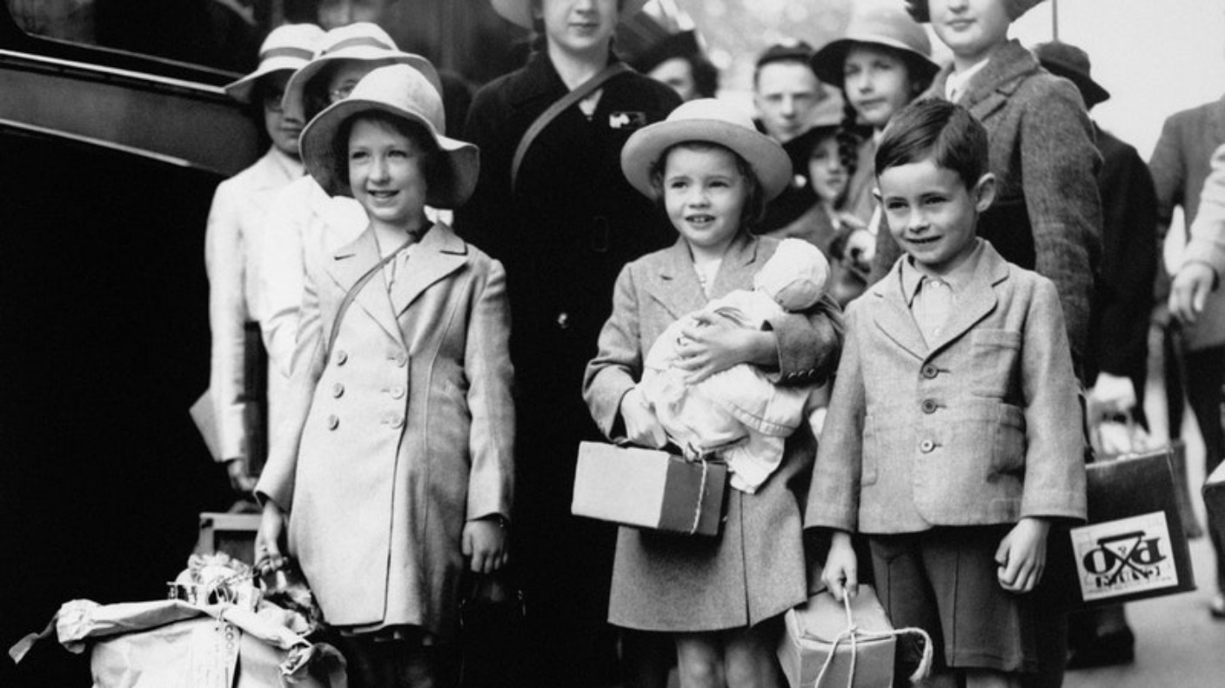
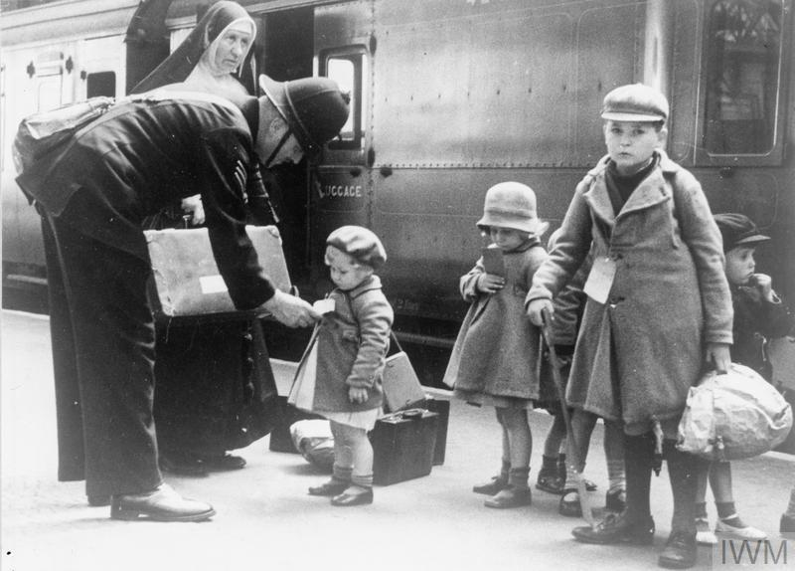
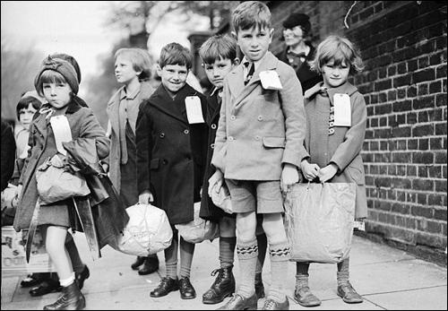
Evacuation in World War 2

Slide 2
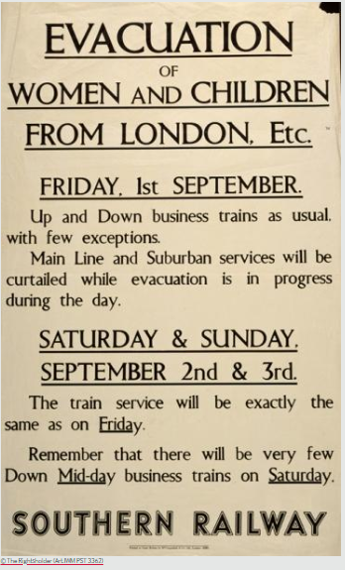
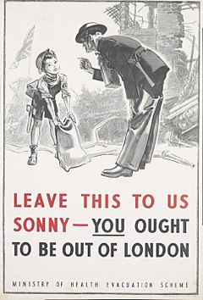
Before the start of WW2, the government predicted that German forces would try to bomb cities of Britain to cause civilian deaths. This prompted the government to evacuate children, mothers and infants and the infirm (google ‘infirm’ to find the meaning), from British towns and cities during the Second World War.
The first evacuation took place on 1st September 1939 – just a day before Germany invaded Poland and two days before Britain declared war. Over three day 1.5 million evacuees were sent to rural locations that were considered to be safe.
Why were rural places considered safer?

Slide 3
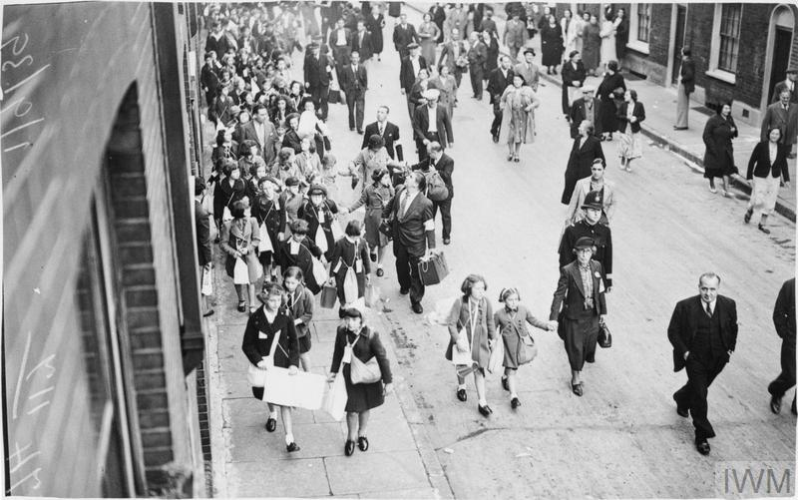
Evacuation was voluntary, but the fear of bombing, the closure of many urban schools and the organised transportation of school groups helped persuade families to send their children away to live with strangers.
Adults accompanying evacuees wore arm bands, which identifying them as volunteer marshals.

Slide 4
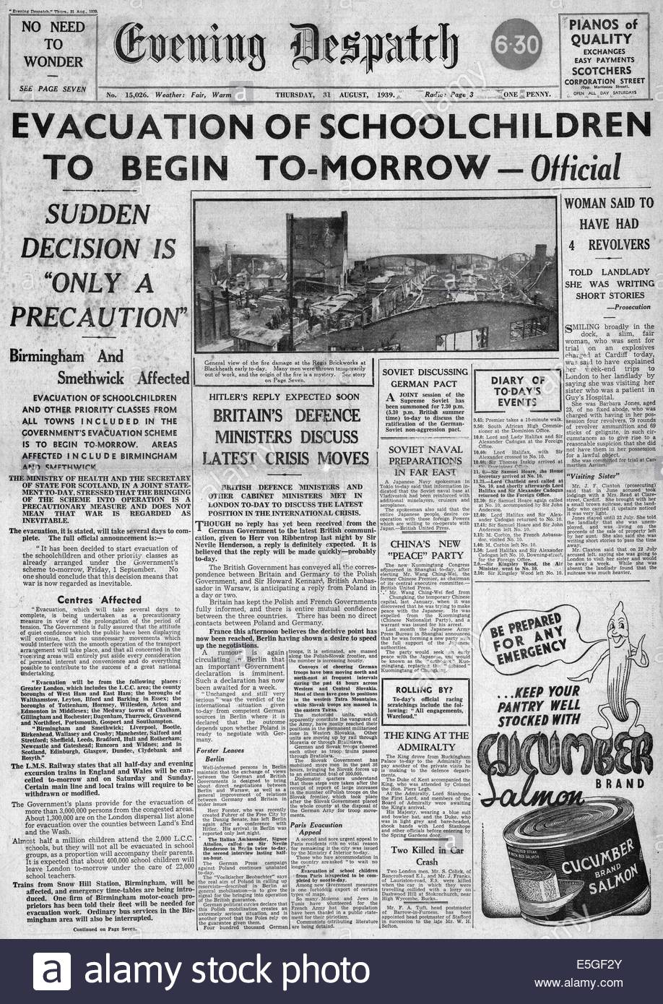
Imagine you are a child living in London in 1939 and you see this newspaper headline.
What are your thoughts, feelings and emotions at this time?
Are you excited about a new adventure?
Or frightened about the family you’ll leave behind?
‘EVACUATION OF SCHOOLCHILDREN TO BEGIN TO-MORROW’

Slide 5
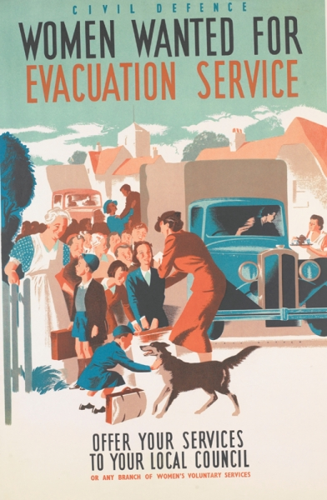
Evacuation (also known as operation Pied Piper) needed thousands of volunteers to be successful. Teachers, local authority officials, railway staff and 17,000 members of the Women’s Voluntary Service (WVS) were key to ensuring children were evacuated safely. The WVS looked after the tired, apprehensive evacuees at railway stations and provided refreshments in reception areas and billeting halls.
Volunteers were also needed in rural areas to take children in and look after them! Some children were evacuated to Canada or Australia!
Why do you think it was called ‘Operation Pied Piper’?

Slide 6
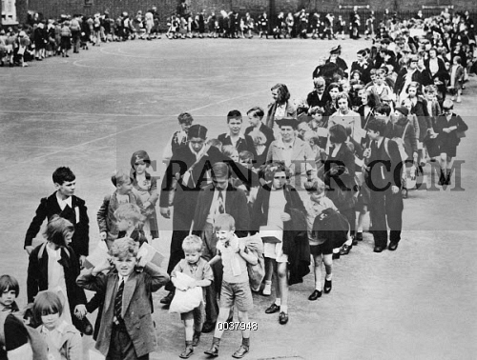
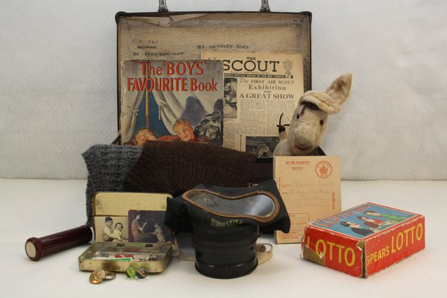
When evacuating all children had to wear an identity label and take their gas mask, ration book, identity card and food for the journey. Many children also took a suitcase containing clothes and personal items.
Some poorer children could not afford a suitcase so they carried their belongings in a haversack or tied them up in jute instead. Some very poor children did not take any personal belongings at all.
When they reached their destination, billeting officers were responsible for arranging for children to stay with host families. For many children this involved being selected out a line by their host. This was an upsetting experience for some children who felt unwanted or rejected.
What would you take in your suitcase if you were an evacuee?

Slide 7
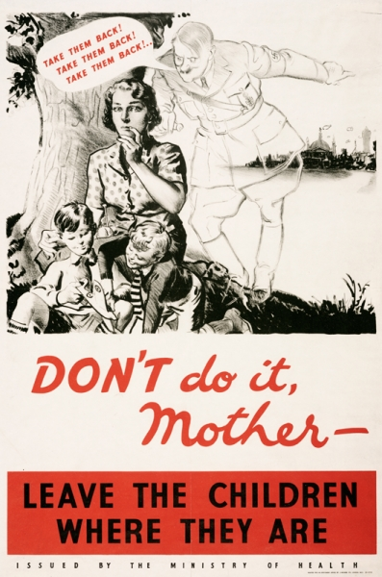
By the end of 1939, when the widely expected bombing raids on cities had failed to materialise, many parents whose children had been evacuated in September decided to bring them home again. By January 1940 almost half of the evacuees returned home. The government produced posters like this one, urging parents to leave evacuees where they were while the threat of bombing remained likely.

Slide 8
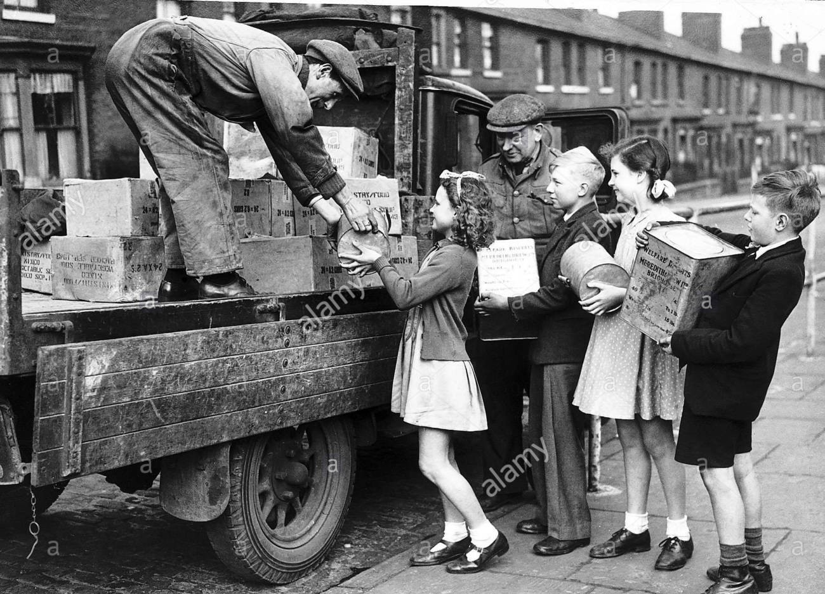
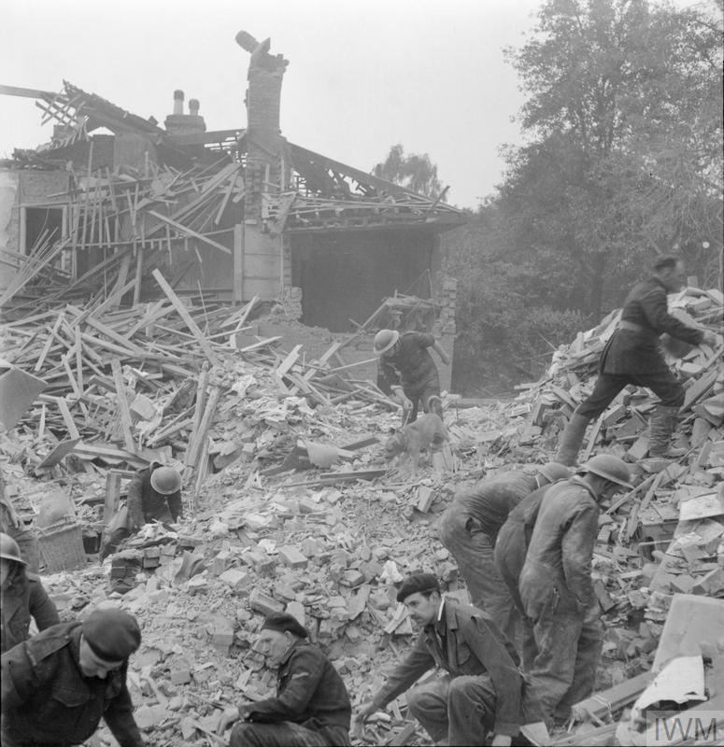
There were more waves of evacuations nationwide in 1940 – just before the Blitz in September. Again, evacuation was voluntary and many children remained in the cities to help, care for or support their families.
Yet another wave of evacuations happened in 1944 after German V-weapons attacks on cities in the east and south-east of England.
Over 3.5 million children were thought to be evacuated!

Slide 9
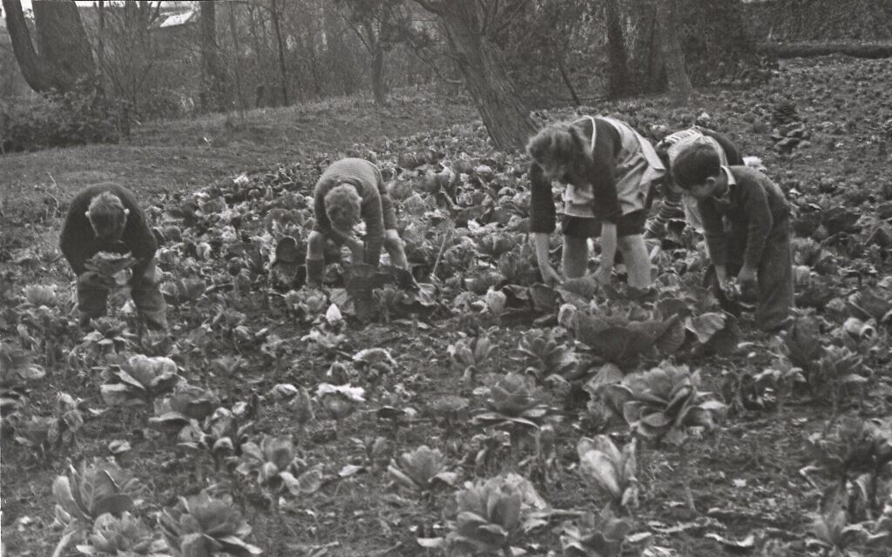
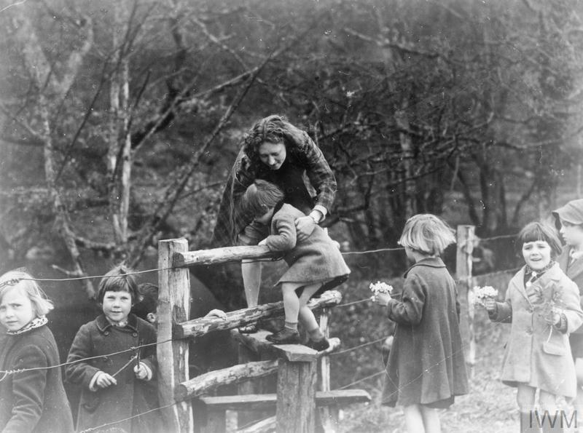
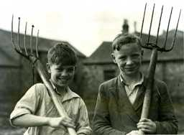
Evacuees and their hosts were often astonished to see how each other lived. Some evacuees flourished in their new surroundings. Others endured a miserable time away from home. Many evacuees from inner-city areas had never seen farm animals before or eaten vegetables.

Slide 10
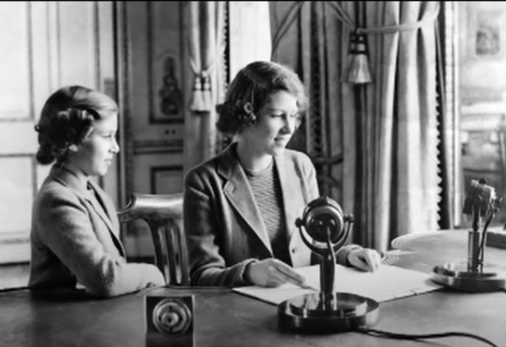
In 1940, Princess Elizabeth (now Queen Elizabeth) spoke on BBC Children’s Hour to reassure the children of the British Empire.
Press Ctrl and click the picture for the video
Queen Elizabeth was just 14 when she spoke to the British Empire on the radio!

Slide 11
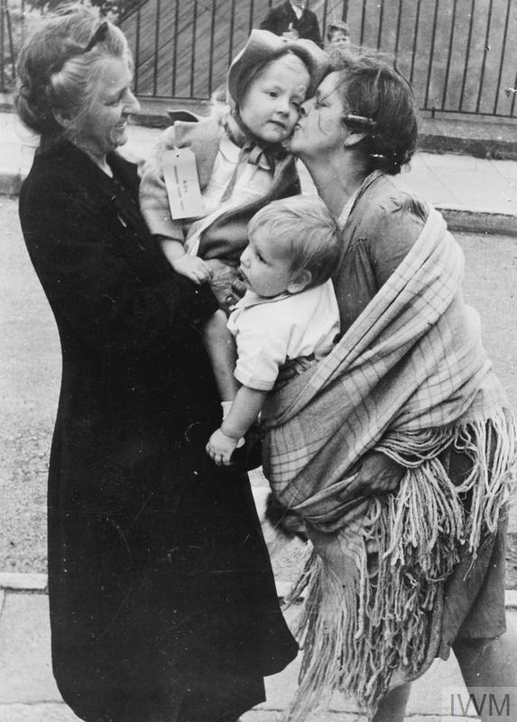
For some children, the end of the war in 1945 brought an end to a prolonged period of fear, confusion and separation. For others, it brought considerable upheaval as they returned to cities and families they barely remembered. But the government’s voluntary evacuation scheme was an enormous undertaking that saw millions of children sent to places of safety, away from the threat of German bombs.

Slide 12

UKS2 Kahoot!
There will be an UKS2 Kahoot on Tuesday 5th May 2020 at 3pm with questions focusing on all of the details in this Powerpoint – Evacuation WW2.
To enter the live quiz, go to https://kahoot.it/ where you will need to enter a game pin. The game pin will be released on the school website at 2:45pm on this page https://archbishop-courtenay-primary.secure-primarysite.net/history-1/ giving you 15 minutes to join the quiz. Don’t be late… and good luck!

