Slide 1

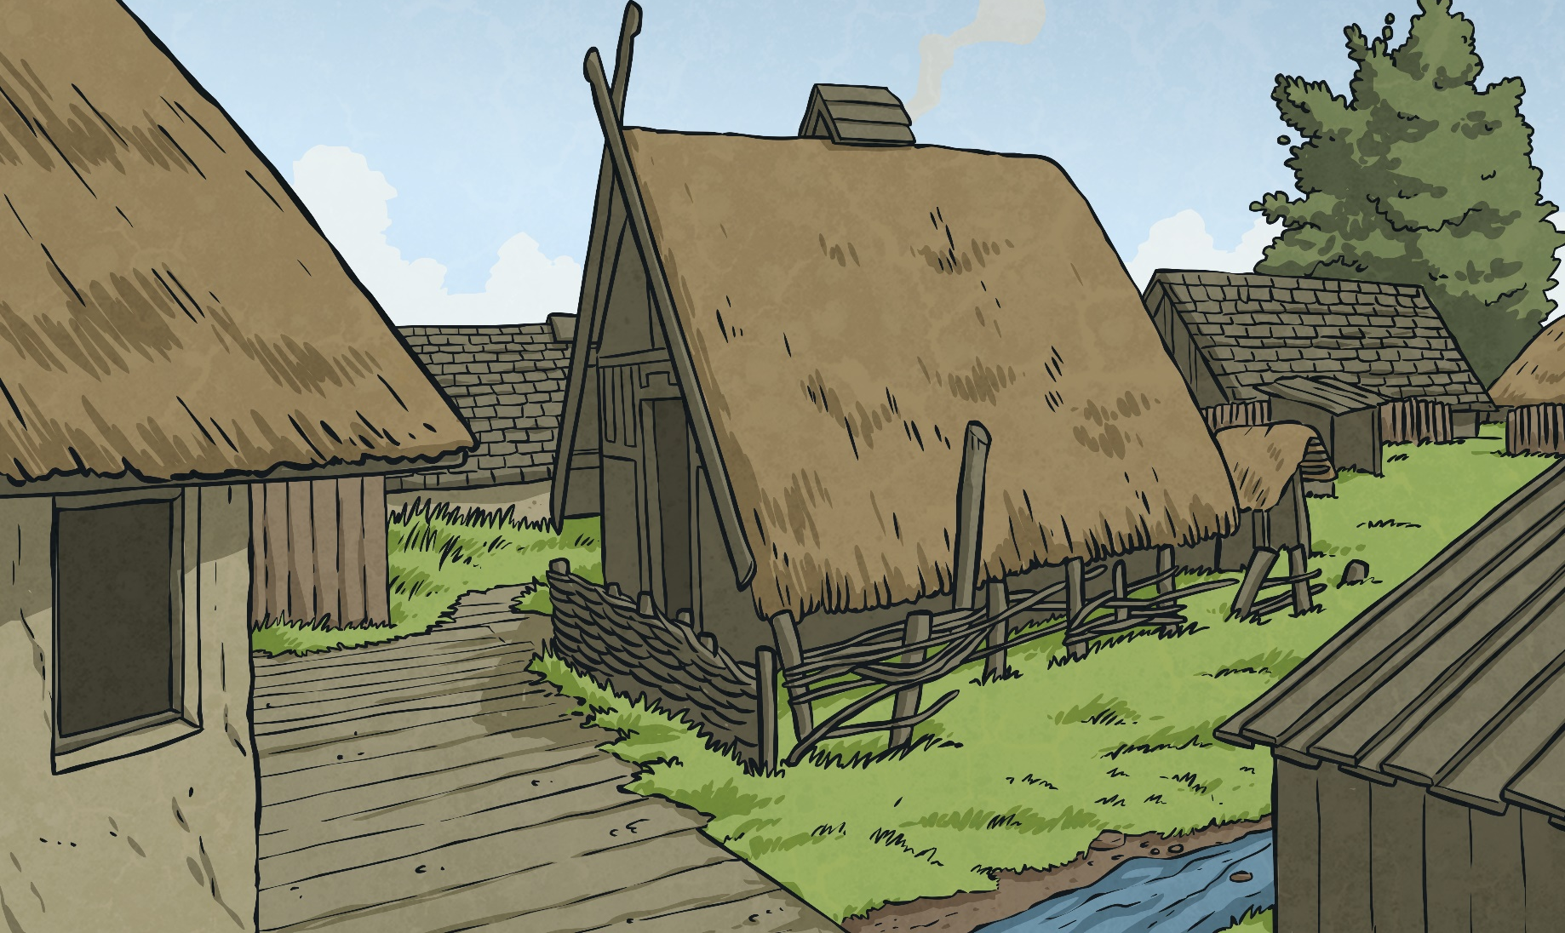
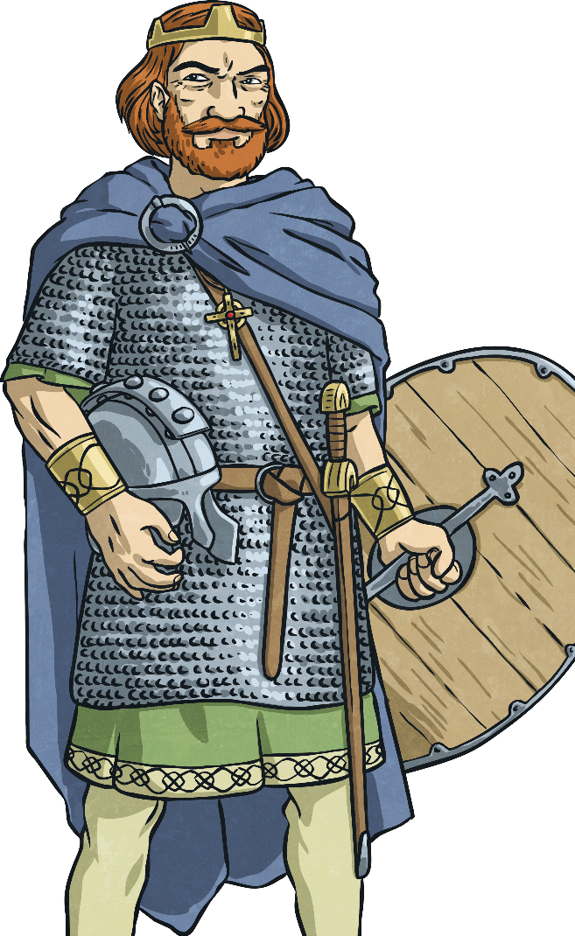
Viking Justice System
Just like their Anglo-Saxon neighbours, the Vikings in Britain also had their own laws and punishments.
The Vikings may have had a reputation for being
ruthless raiders, but their justice system was
fairly civilised.
Each Viking community had its own laws. These
were not written down, but were passed from
person to person and from parents to children by word of mouth. In each community their was a
law speaker. This person would remember all the
laws of that community. The disputes and punishments for breaking the laws were decided
by a Thing.

Slide 2
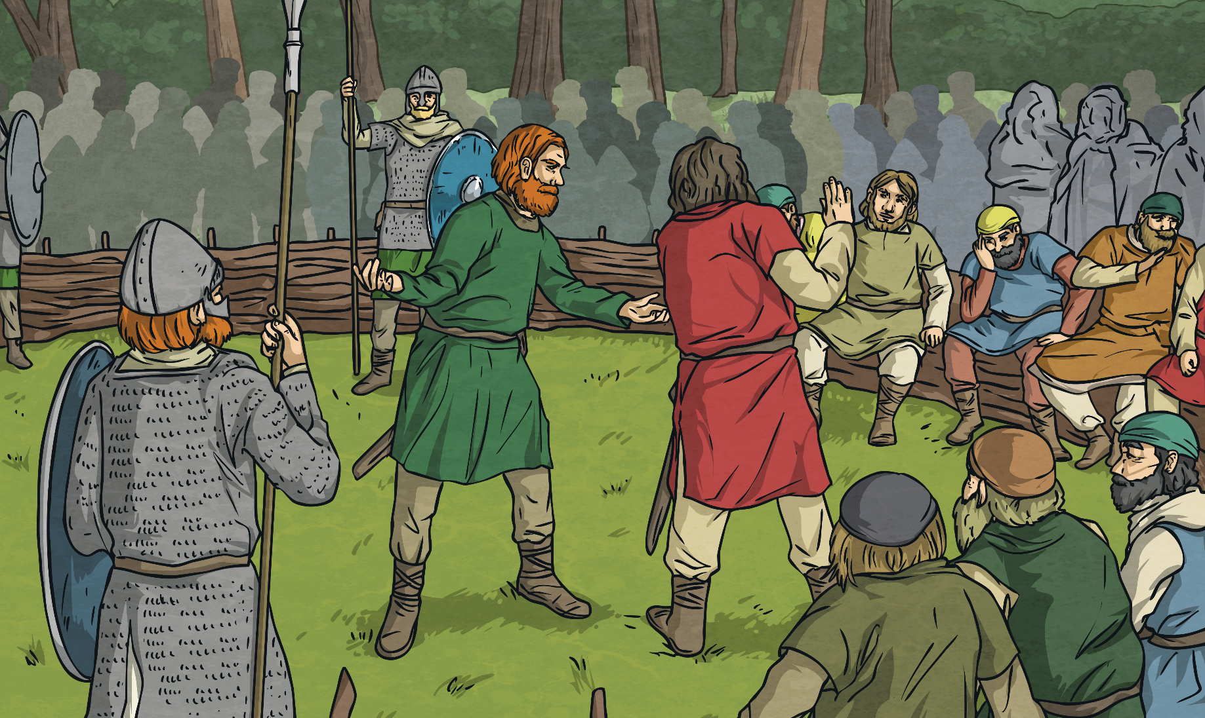
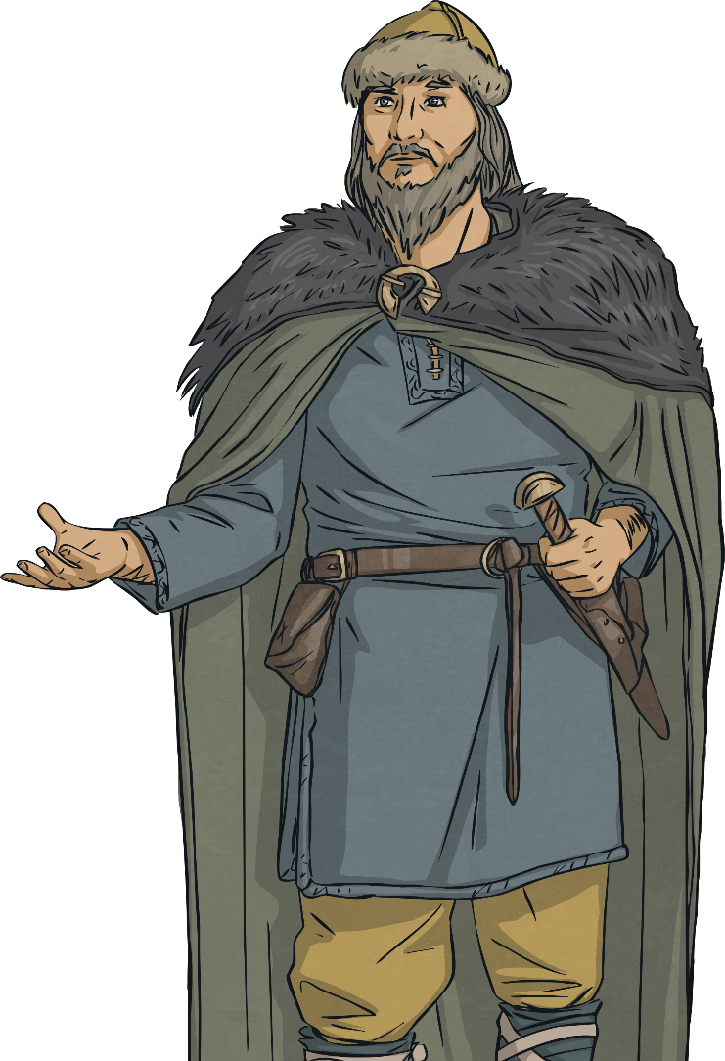
Viking Justice System
The Thing was a group made up of all the free
men and women (people who weren’t slaves) of
the community. They would meet to solve disputes
and punish people who broke the laws. The law
speaker would be at each Thing along with the
leader of the community, the chieftain.
Things were held in open places and sometimes
could last days. Everyone was allowed to say
what they thought at the Thing, but chieftain and
the law speaking would usually settle the disputes
based on what the laws said.

Slide 3
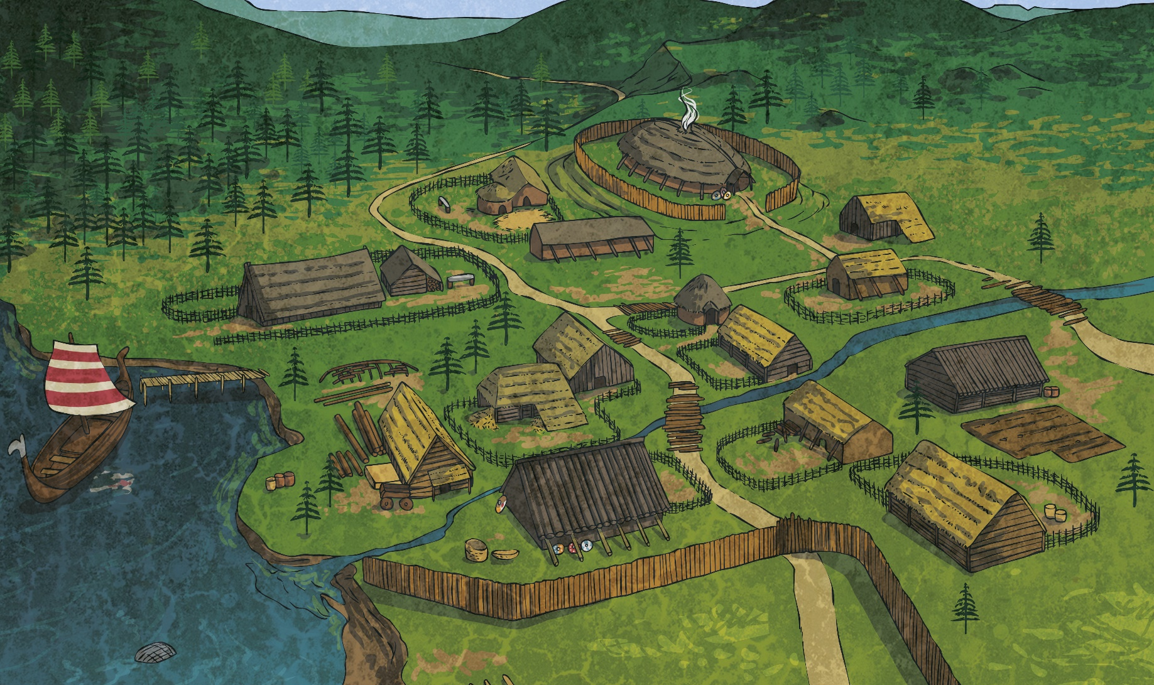
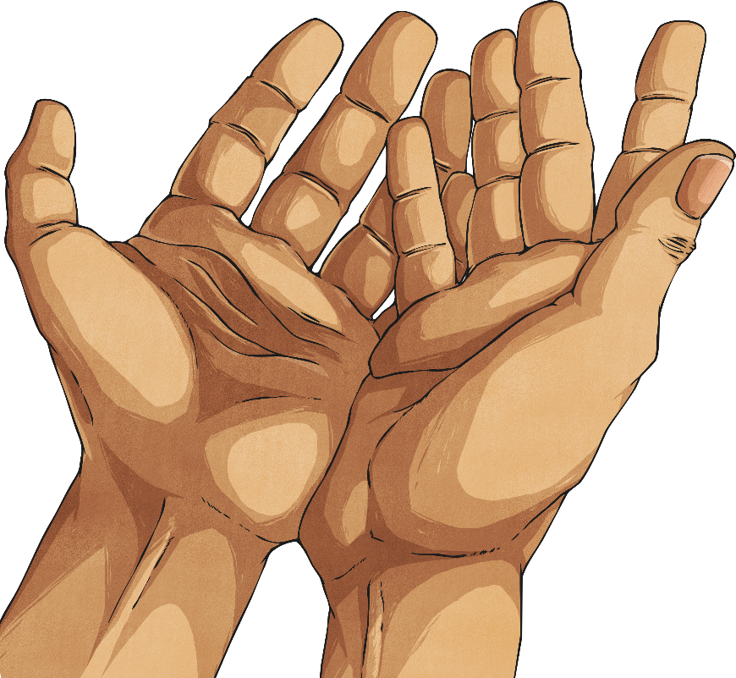
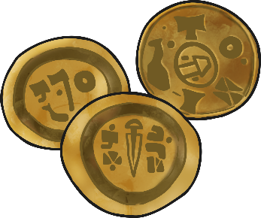
Viking Justice System
Anyone who was tried at the Thing
and found guilty could face one of
these punishments:
● A fine
● Being semi-outlawed (outlawed for
a short time)
● Being fully outlawed (outlawed
forever).

Slide 4

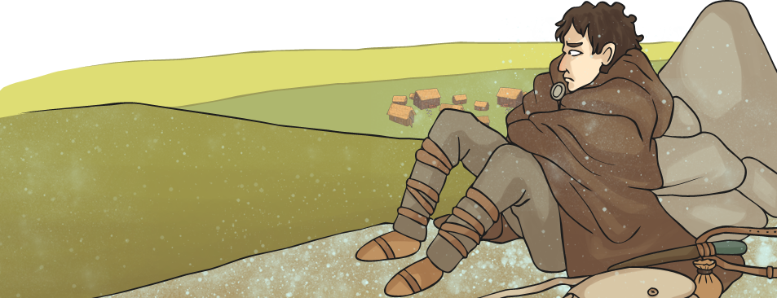
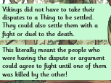
Viking Justice System
Being outlawed may sound like an easy punishment compared to the Anglo-Saxon punishments but if you were outlawed, all of your property was taken off you and you could no longer live in the community. No one was allowed to help you to find food, shelter or water. Worse than the loneliness, being outlawed also meant that anyone could kill you without
a reason!

Slide 5
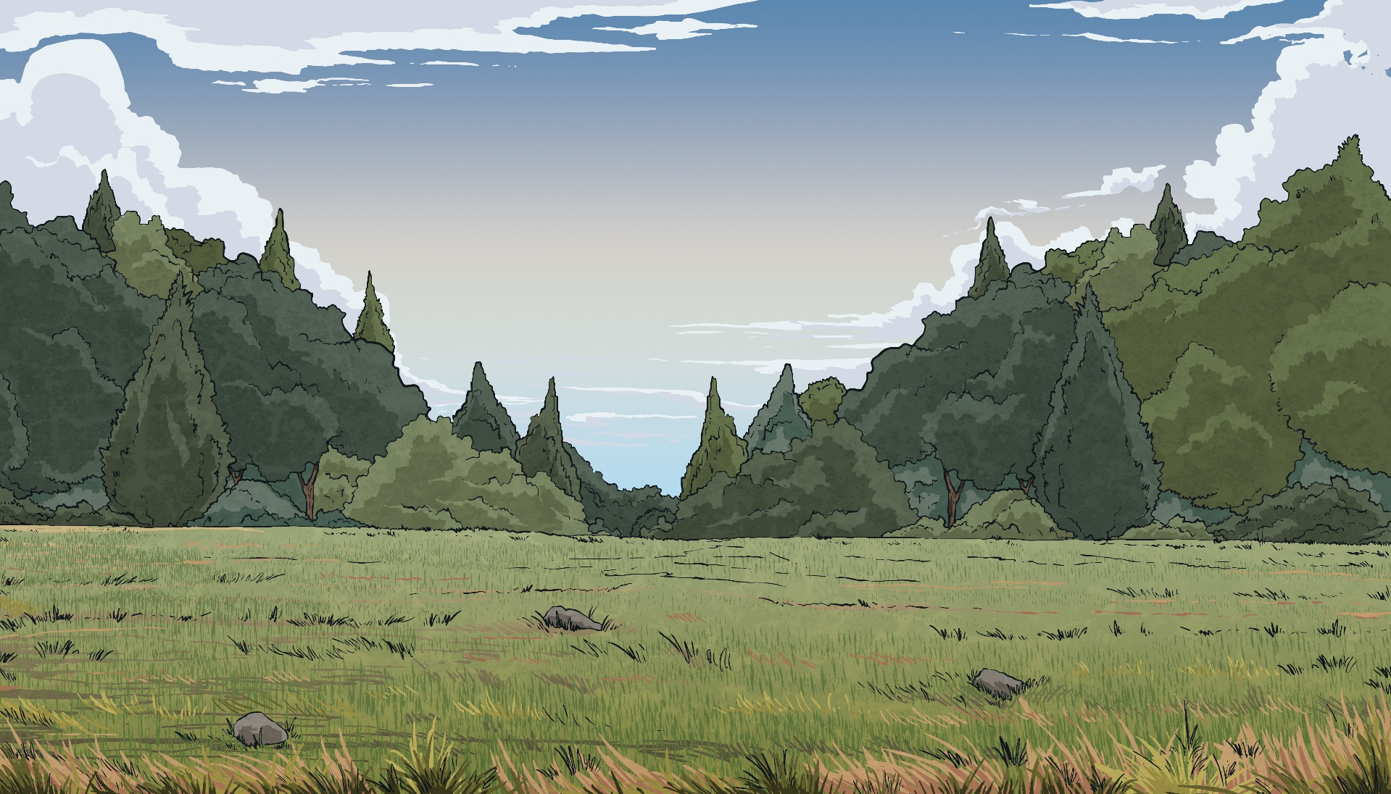
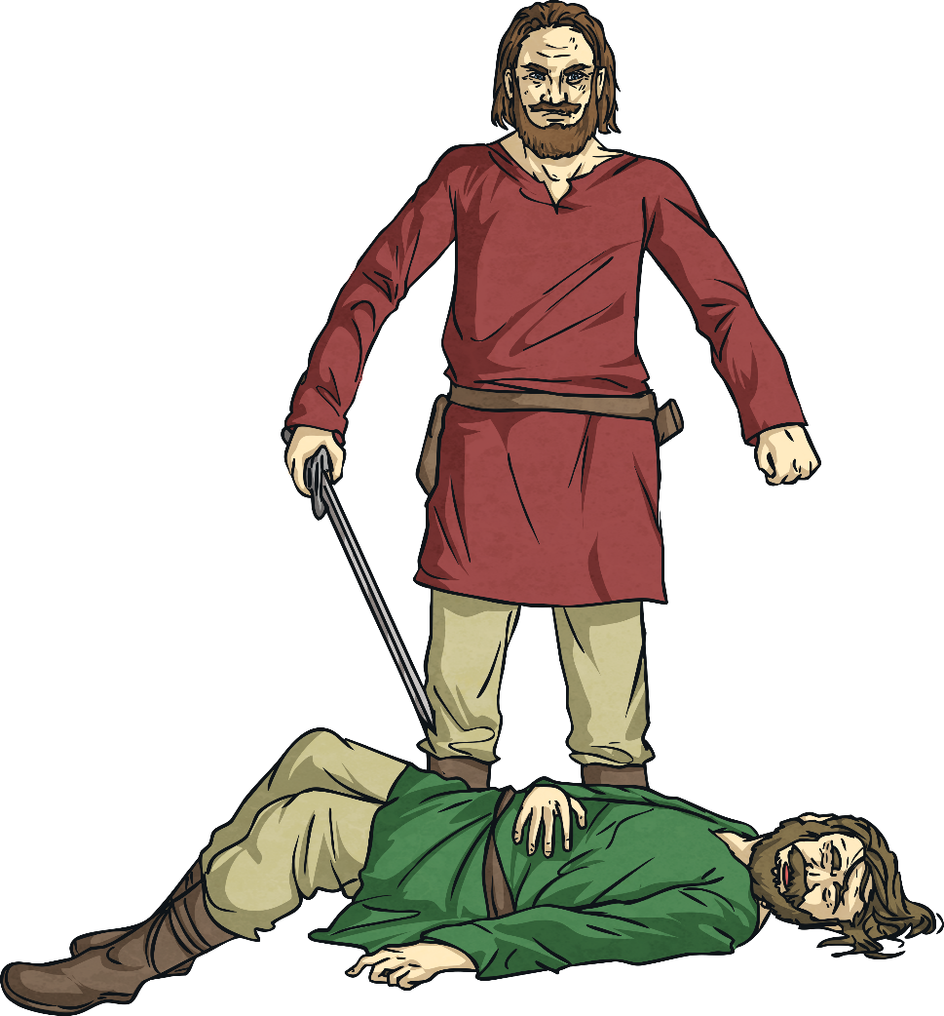
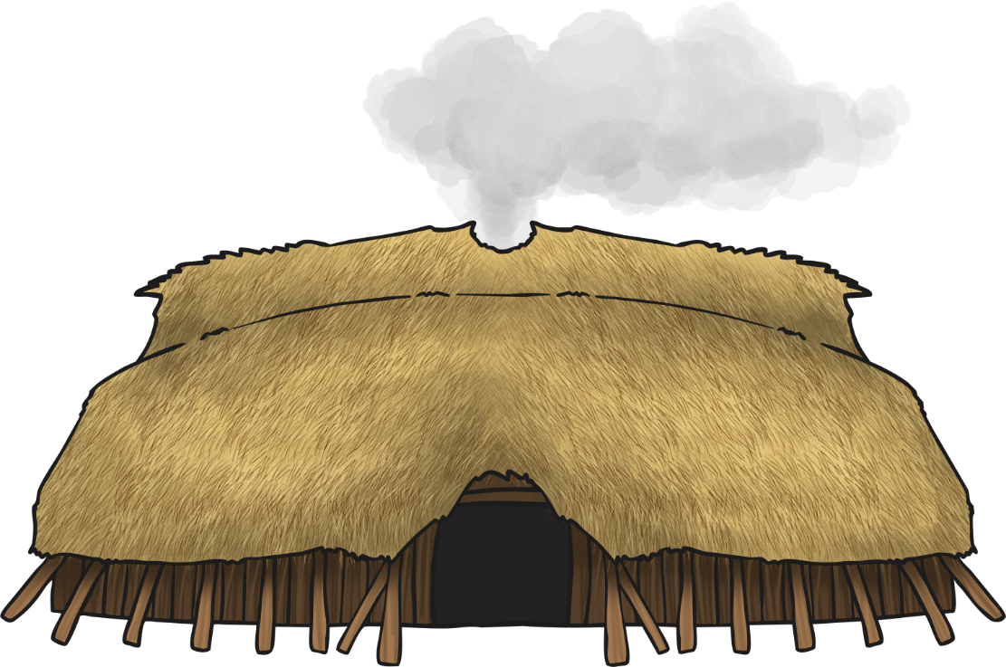
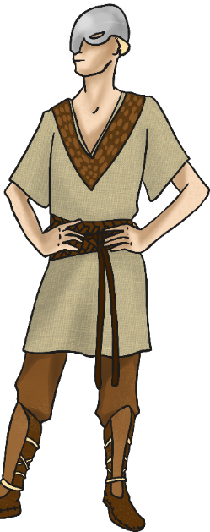
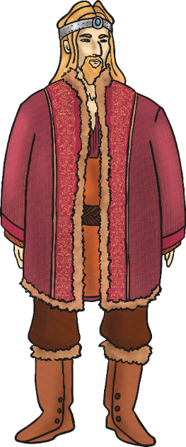
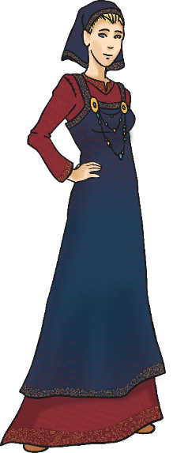
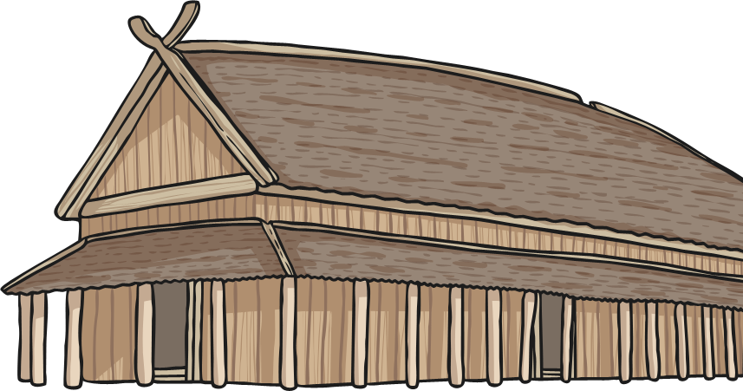
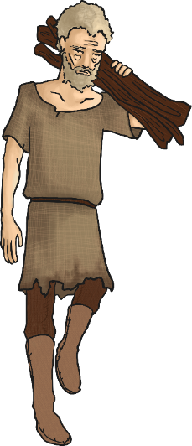
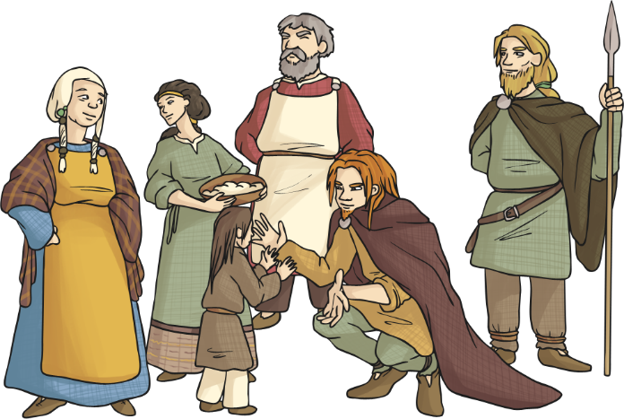
Viking Justice System
As a Viking, you could also take revenge on someone
who had killed a member of your family - as long as
you were open and honest about it.
This meant you would need to kill them in a
public place and give them chance to react.
You might have to pay your victims family a
fine, but you would not face any other
consequences.

