Slide 1




YOU ARE AWESOME

Slide 2
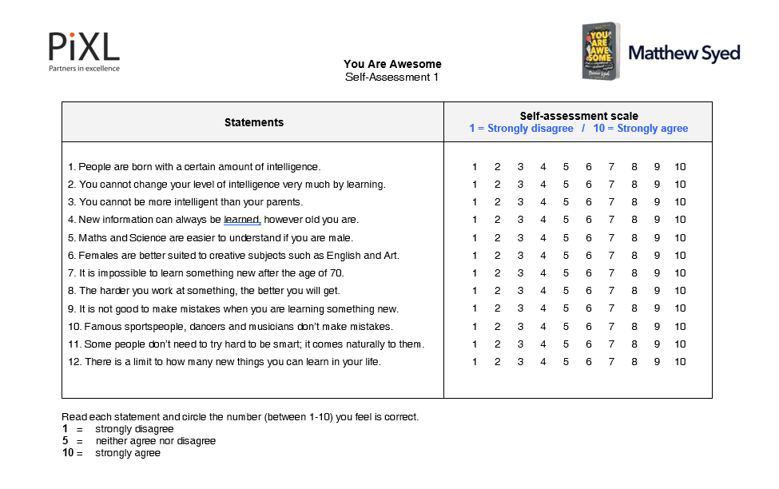
How much do you agree or disagree with each of these statements?

Slide 3

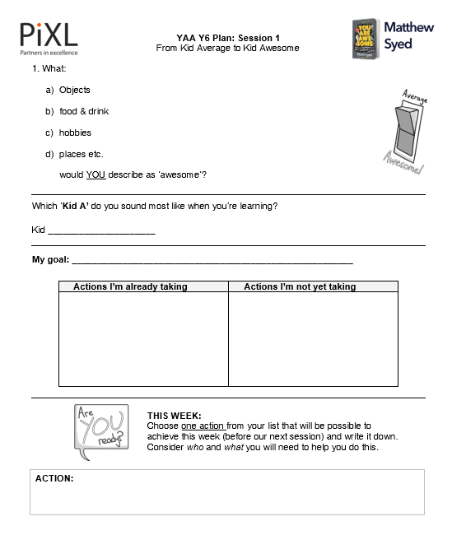
TODAY’S SESSION
YOU WILL NEED

Slide 4

Read Chapter 1 of ‘You Are Awesome’.

Slide 5


While Kid Average has decided he’s no good, given up completely and gone to bed, Kid Awesome is determined and sticks to it. Kid Awesome really wants to improve. Not just by a little bit, but as far as he can take things. Kid Awesome is set on becoming the best table-tennis player he can, and he realises that this all comes down to how often he can get in the garage to practise. He starts to love the game. So much so that he has even started thinking about asking his brother to help him practise.
page 22
Notes:
Page 138

Slide 6

What: a) objects b) people c) food & drink d) hobbies e) places etc. would YOU describe as ‘awesome’?

Slide 7
What does ‘awesome’ mean?
‘extremely impressive’
‘very good’
‘excellent’
‘amazing’
‘wonderful’
‘terrifying’
‘magnificent’
‘breathtaking’
‘astonishing’
‘fantastic’

Slide 8
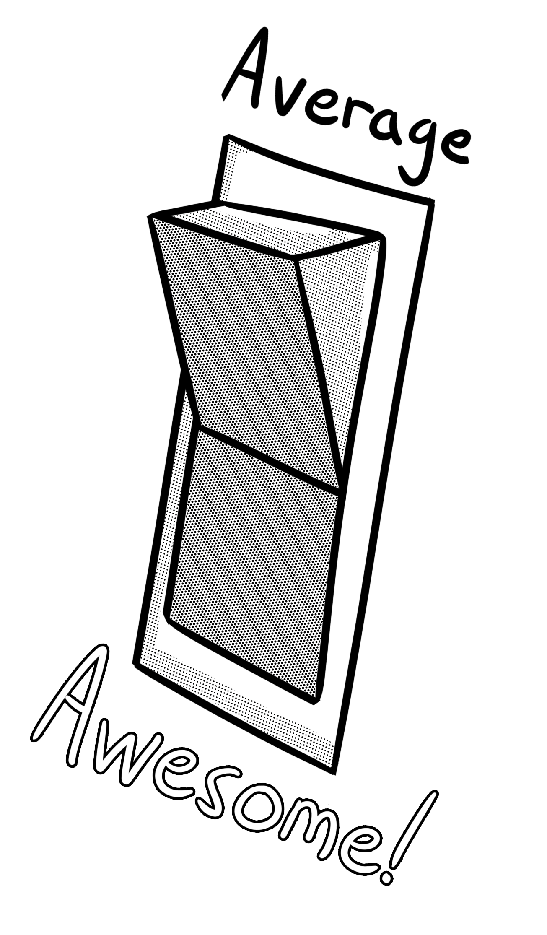
Things Kid Average might say:
Things Kid Awesome might say:

Slide 9
Do the words and phrases YOU say when you’re learning sound more like Kid Average or Kid Awesome?

Slide 10

Write down one goal you hope to achieve in your lifetime. This might be something you could achieve this week, perhaps later on this year, or a bigger dream to achieve at a later point in your life.

Slide 11
What are you doing (or could you be doing) NOW that might help you reach towards your goal?
Make a list of actions you need to take at this point to help you get there and sort them into ones you are already doing or not yet doing.

Slide 12

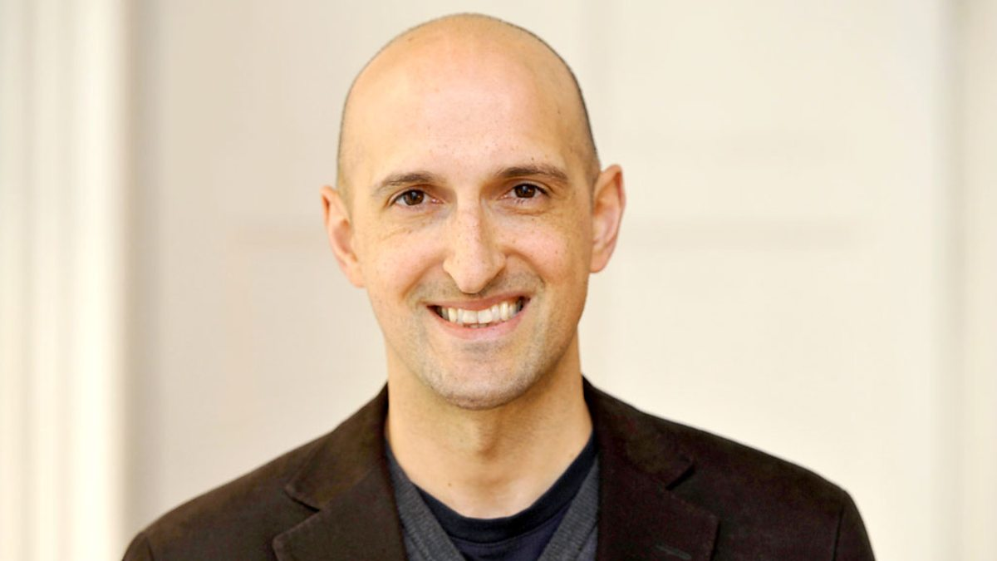
Matthew Syed

Slide 13

Choose one action from your list that will be possible to achieve this week (before our next session) and write it down. Consider who and what you will need to help you do this.

Slide 14

NEXT SESSION

Slide 15
YOU ARE AWESOME

Slide 16
© Year 2018 The PiXL Club Ltd and Author Matthew Syed. All rights reserved.
If this resource has been provided under The PiXL Club Ltd school membership agreement, it is strictly for the use of member schools for as long as they remain members of The PiXL Club. It may not be copied, sold, or transferred to a third party or used by the school after membership ceases. Until such time it may be freely used within the member school.
The Author Matthew Syed has the right to sell this teaching guide. It may not be copied, sold, or transferred to or by a third party. Matthew Syed takes full responsibility for all commercial activity thereof.
All opinions and contributions are those of the author. The contents of this resource are not connected with, or endorsed by, any other company, organisation or institution. Any additional images are from getty.co.uk , unless otherwise stated. 'You Are Awesome' illustrations copyright © Toby Triumph.
Endeavours have been made to trace and contact copyright owners. If there are any inadvertent omissions or errors in the acknowledgements or usage, this is unintended and PiXL will be remedy these on written notification.

