Slide 1
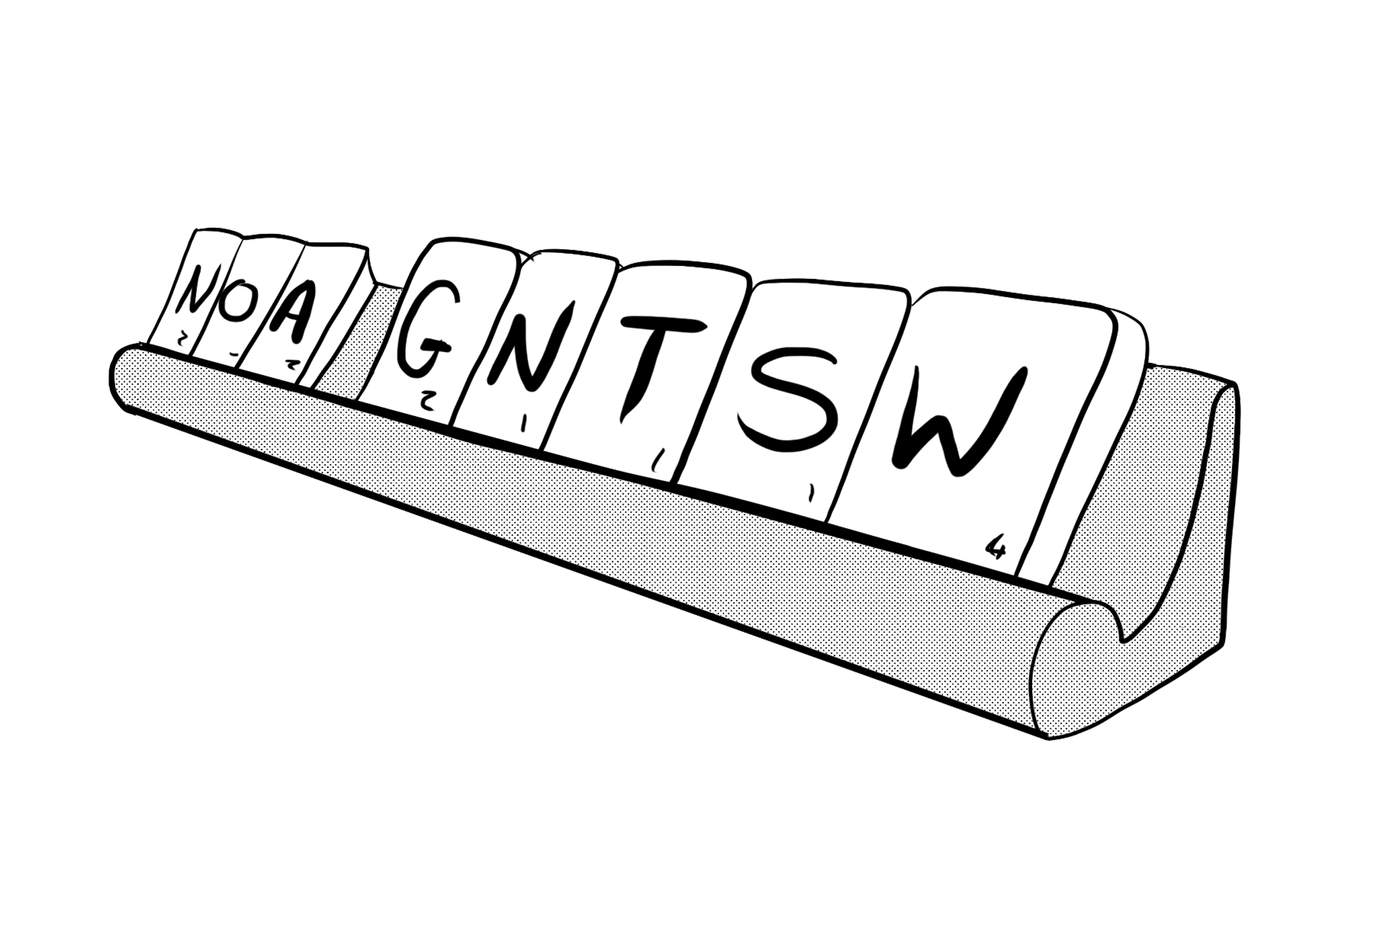


Newspaper: a daily or weekly publication containing news reports, features and opinion articles,
originally produced on printed sheets but increasingly available on-line.
Recount: to give an account of the details of an event or experience.
Origin: Mid-15th century: from the Anglo-French word reconter; meaning ‘re’- again, and ‘conter’ to relate.
Types of news recounts: reports of newsworthy events such as court hearings, crimes, protests, natural disasters.
Synonyms:
newspaper
paper
journal
media
recount
retell
relate
impart
outline
describe
news
report
dispatch
bulletin
Text features:
Introduction (who, what, where, when, why)
Some chronological order
Written in past tense
Includes important details
Quotes from witnesses and relevant authorities
Factual descriptions
Sequential conjunctions
Concluding statement or quote
Useful words:
residents
sources
according
eyewitness
anonymous
devastating
incensed
tragedy
wounded
injured
grievance
demonstrators
emergency
paramedics
catastrophe
lawcourt
lawyer
justice
guilty
innocent
conviction
announcement
survivors
casualty
Useful conjunctions:
when…
throughout…
ultimately…
immediately…
finally…
eventually…
without warning
during…
although…
despite…
suddenly…
Vocabulary: newspaper recounts
What are you reporting? Have you covered all the key information? Have you stuck to the facts and avoided your personal opinions?

Slide 2

To introduce your newspaper report, always state clearly and briefly what happened where, when and to whom. For example:
There was drama at … yesterday.
Huge crowds gathered ...
A driver was convicted …
Dozens of families were …
Fronted adverbial sentence openers:
In an unprecedented move …
Dramatically …
According to sources who wished to remain anonymous …
Turning to the accused …
Confronted with the devastation…
Waving banners and placards …
To conclude your writing:
A spokesperson for the victims said ….
Commenting at the scene, the local MP said ‘Lessons must be learnt.’
A representative of the campaign group said, ‘The fight continues.’
The search for survivors will resume at first light.
The case continues tomorrow.
Examples of this language used in context:
There was drama at Fanchester Crown Court yesterday when relatives of the victims in the case had to be removed by court officials.
Dozens of families were left homeless last night when a wildfire swept down the hillside and threatened their village.
Ultimately, the police were able to contain the demonstration and the protesters expressed their grievances peacefully.
According to eyewitnesses who wished to remain anonymous, the residents jostled the man as he tried to leave home for work.
Although it was a catastrophe for the community, villagers were full of praise for the professionalism of the paramedics.
In an unprecedented move, Justice Emma Shah ordered for the public gallery to be cleared at Bigly lawcourts yesterday.
Sentence frames: newspaper recounts

