Slide 1

Information Texts
What features did you see in the non-fiction texts?

Slide 2

A page Title
Tells the reader what the text is all about.

Slide 3

Headings and Subheadings
Main headings
Main headings give sections of text their own title.
Sub-headings
Sub-headings create even smaller sections of text with their own headings.

Slide 4

Opening Statement
The opening statement, or introductory paragraph, contains the most important information of the text.

Slide 5
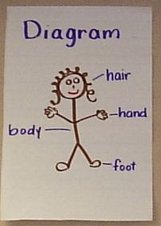
Diagram
A diagram is a labelled picture that shows the reader something important that was mentioned in the text. It may have a title and normally has a caption to state what the image shows. You may also see photographs used in this way.
A diagram to show body parts

Slide 6
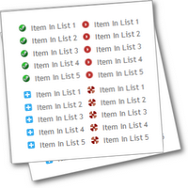
Bullet Points
Some of the text may be written using bullet points rather than full sentences.

Slide 7

Text Box
A text box highlights a section of information within a box.

Slide 8

Contents
A contents page helps the reader to see what topics are featured on each page. This helps you to navigate the book.

Slide 9
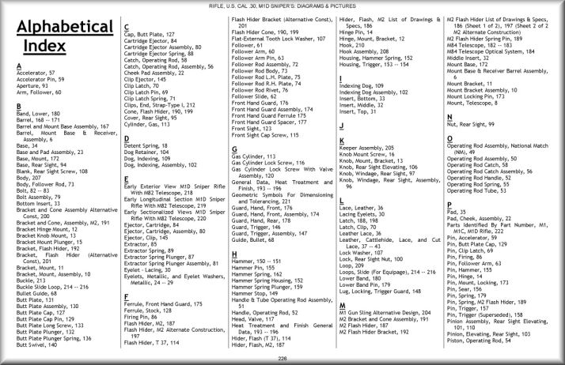
Index Page
Important words from within the book are listed in alphabetical order at the back. Each word has page numbers next to it, these show where you can find paragraphs that contain that word within the text. This helps you locate the information that you need.

Slide 10
Information Texts
What features could I include in my own information leaflet?
Page title
Headings and sub-headings
Paragraphs with a main introductory paragraph
Diagrams, pictures or photographs with captions
Bullet points
Text boxes
You won’t need to include a contents page or index because a leaflet isn’t a big as a book.

Slide 11

How could you organise the leaflet?
Text in paragraphs text in paragraphs text in paragraphs.
Text in paragraphs text in paragraphs. Text in paragraphs. Text in paragraphs. Text in paragraphs.
Text in paragraphs text in paragraphs. Text in paragraphs. Text in paragraphs text in paragraphs. Text in paragraphs. Text in paragraphs.
Heading
PAGE TITLE
Picture caption
Introductory
paragraph
Sub heading
Other text

Slide 12
Information Texts
What features could I include in my own information leaflet?
Page title
Headings and sub-headings
Paragraphs with a main introductory paragraph
Diagrams, pictures or photographs with captions
Bullet points
Text boxes
You won’t need to include a contents page or index because a leaflet isn’t a big as a book.

