Slide 1



YOU ARE AWESOME

Slide 2
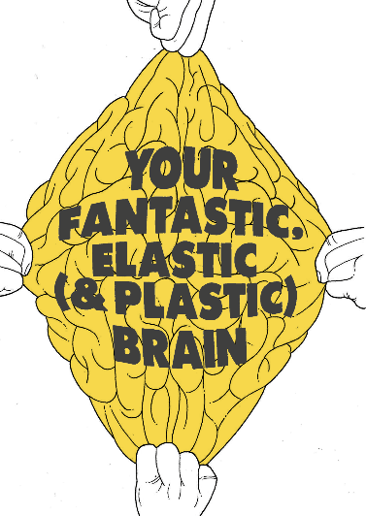
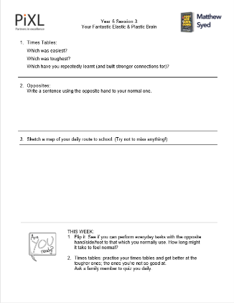


TODAY’S SESSION
YOU WILL NEED

Slide 3
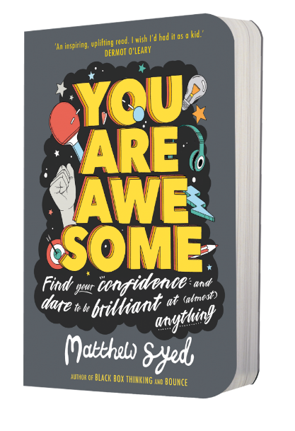
Read Chapter 3 of ‘You Are Awesome’.

Slide 4


This means we can shape up our brain just like we can shape up our body. Think of it as a mental muscle. If we put the brain through a fitness programme that helps to build neural pathways, we can mould it into something truly incredible. And the more we push ourselves, the more connections we make and the stronger they become. Scientists have a name for this. Wait for it… it’s called…
NEURO-PLASTICITY.
page 67
Notes:
Page 138

Slide 5
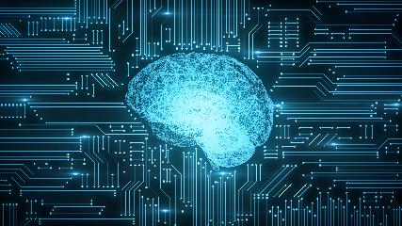
Neuroplasticity
the ability of the brain to change (and build stronger connections) throughout an individual's life

Slide 6
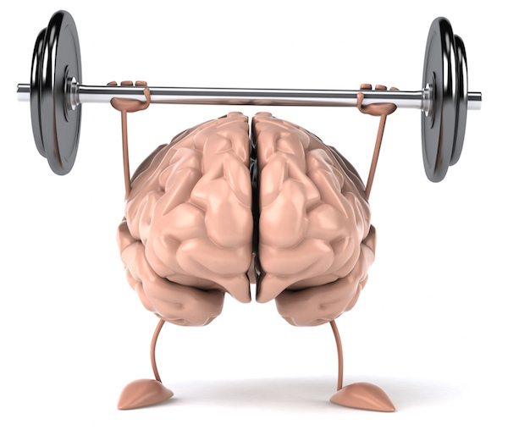

Slide 7
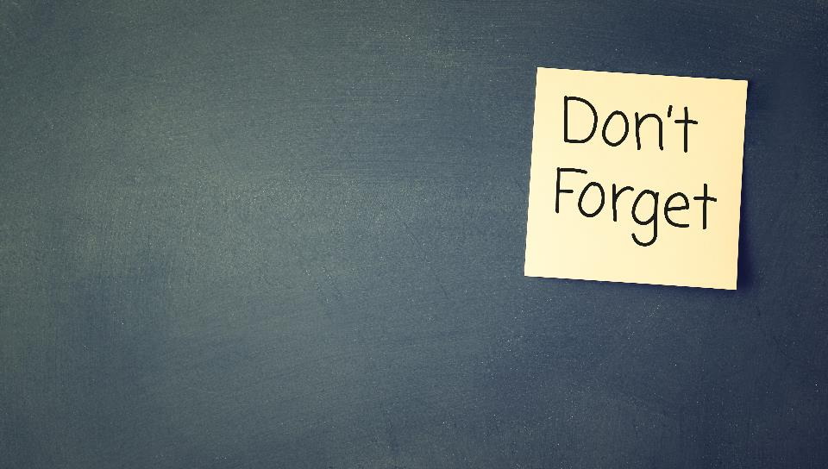
REMEMBER:
If you don’t repeatedly return to new information you learn, you’ll forget it!

Slide 8
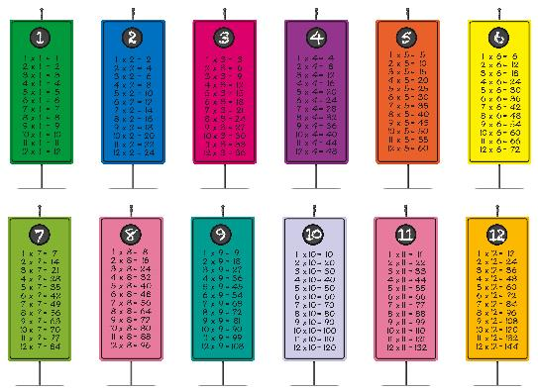
Try it:
a) 2x table
b) 5x table
c) 6x table
d) 9x table
e) 11x table
Which was easiest? Which was toughest? Which have you repeatedly learnt (and build stronger connections)?

Slide 9


Watch short trailer: The Knowledge
Notes:
https://www.youtube.com/watch?v=HEEe6U3dfZ8

Slide 10
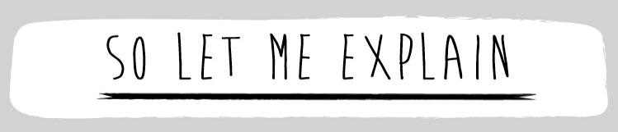
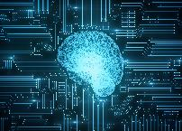
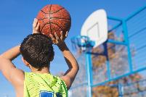
1. The tougher the practice, the more neural connections you build.
2. Keep practising – don’t stop.

Slide 11

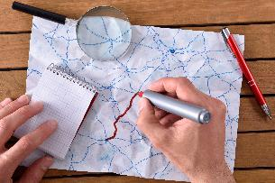
CHALLENGE TIME
Write a sentence with the opposite hand to usual.
Sketch a basic map of your daily route to school. Then, on the journey home later, find out if you missed any important steps out. If you did, these will be because the route is so automatic for you now that you stop having to think carefully about it now; you just follow the path. When we slow or stop those daily routes, we begin to forget them.

Slide 12
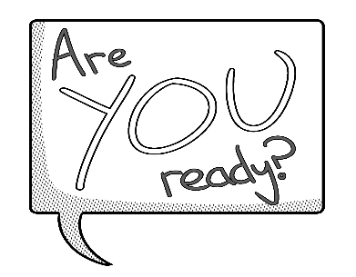
Flip it: See if you can perform everyday tasks with the opposite hand/side/foot to that which you normally use. How long might it take to feel normal?
Times tables: Practise your times tables and get better at the tougher ones, the ones you’re not so good at. Ask a family member to quiz you daily.

Slide 13
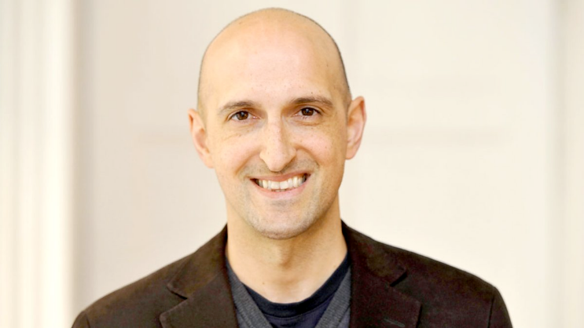
Matthew Syed

