Slide 1




YOU ARE AWESOME

Slide 2

LAST SESSION
Genius or what?

Slide 3

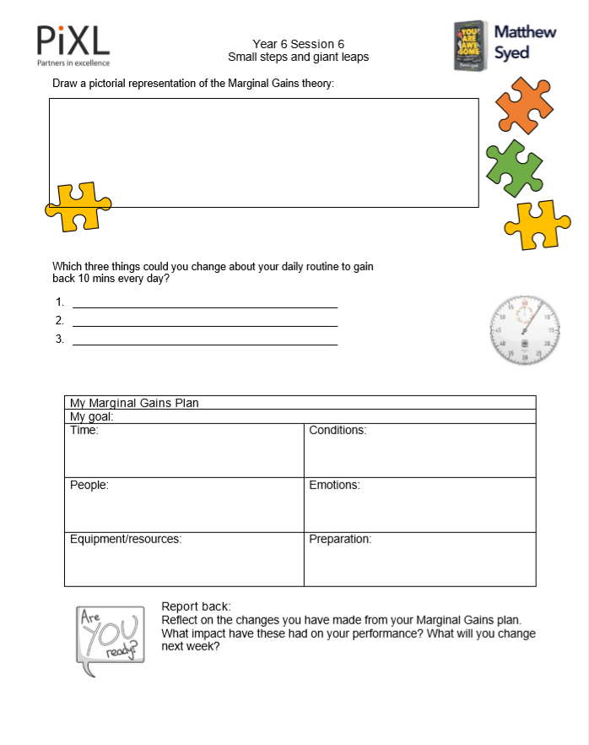
TODAY’S SESSION
YOU WILL NEED

Slide 4

Read Chapter 6 of ‘You Are Awesome’.

Slide 5

What setbacks did the GB women’s hockey team face?

Slide 6
GB women’s hockey team
How do you think they felt when their coach retired?
What do you think motivated them to keep going?
What did they do to help them on their journey to success?

Slide 7


Marginal Gains means breaking down a big goal into small parts and then improving each of them, delivering a huge improvement in overall performance when you put the parts back together. So the team got to work. They looked at every single thing that they were going to need to do to win big in Rio. In teeny tiny detail.
page 121
Notes:
Page 138

Slide 8
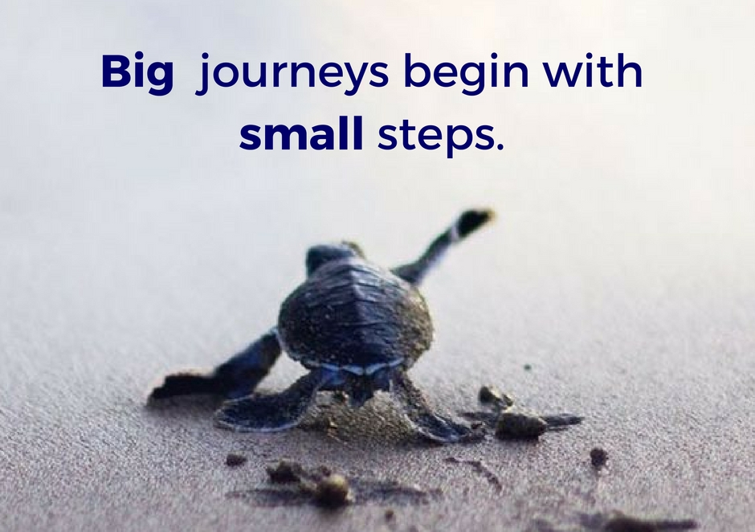
Explain the Marginal Gains theory to your partner.
Why do you think this has worked for so many sports teams, athletes and other successful figures?
Notes:
The following image is free to share and use commercially:
https://www.bing.com/images/search?view=detailV2&ccid=%2b6D3OC8l&id=AFF4A090F60B8F645040F07371207BA5F9835AEC&thid=OIP.-6D3OC8lFTn0Cq3zNIPNIAHaGN&mediaurl=http%3a%2f%2fwww.betergezond.be%2fwp-content%2fuploads%2f2017%2f05%2fPeppertalk-Big-journeys-begin-with-small-steps..jpg&exph=788&expw=940&q=big+journeys+begin+with+small+steps&simid=608049908292846963&selectedIndex=3&qft=+filterui%3alicense-L2_L3_L4&ajaxhist=0

Slide 9

10 minutes a day
5 school days a week
50 minutes a week
Four WHOLE extra lessons a month!
Break down your daily routine. Work out three changes that you could make which might gain you ten extra minutes every day.
1.
2.
3.
What will you use this extra time to improve?

Slide 10
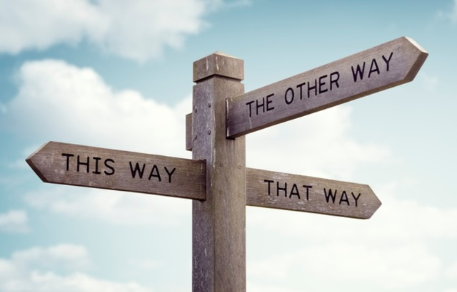
Implementing the theory
Where am I?
Where do I want to get to?
What do I need to do to get there?

Slide 11
My Marginal Gains Plan
My goal:
Time: | Conditions:
People: | Emotions:
Equipment/resources: | Preparation:

Slide 12

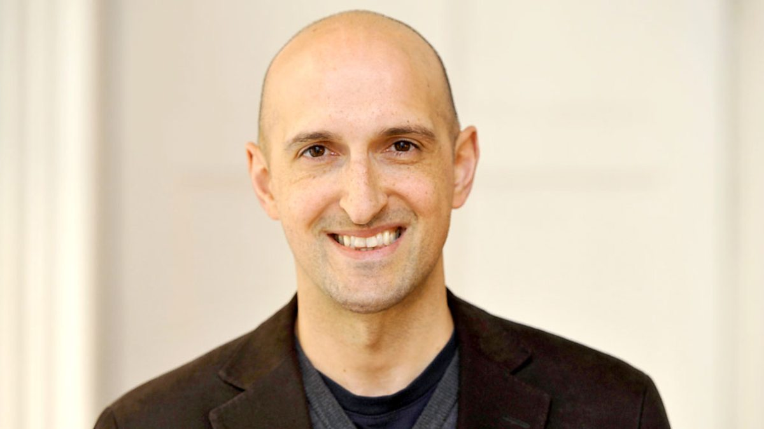
Matthew Syed

Slide 13

Report back
1. Which changes have you successfully implemented from your Marginal Gains Plan? 2. What impact have these had on your performance? 3. What do you still need to change?

Slide 14

NEXT SESSION

Slide 15
YOU ARE AWESOME

Slide 16
© Year 2018 The PiXL Club Ltd and Author Matthew Syed. All rights reserved.
If this resource has been provided under The PiXL Club Ltd school membership agreement, it is strictly for the use of member schools for as long as they remain members of The PiXL Club. It may not be copied, sold, or transferred to a third party or used by the school after membership ceases. Until such time it may be freely used within the member school.
The Author Matthew Syed has the right to sell this teaching guide. It may not be copied, sold, or transferred to or by a third party. Matthew Syed takes full responsibility for all commercial activity thereof.
All opinions and contributions are those of the author. The contents of this resource are not connected with, or endorsed by, any other company, organisation or institution. Any additional images are from getty.co.uk , unless otherwise stated. 'You Are Awesome' illustrations copyright © Toby Triumph.
Endeavours have been made to trace and contact copyright owners. If there are any inadvertent omissions or errors in the acknowledgements or usage, this is unintended and PiXL will be remedy these on written notification.

