Slide 1


Y1-2 Solving Word Problems
Addition and Subtraction
Commissioned by The PiXL Club Ltd. October 2019
This resource is strictly for the use of member schools for as long as they remain members of The PiXL Club. It may not be copied, sold nor transferred to a third party or used by the school after membership ceases. Until such time it may be freely used within the member school.
All opinions and contributions are those of the authors. The contents of this resource are not connected with nor endorsed by any other company, organisation or institution.
PiXL Club Ltd endeavour to trace and contact copyright owners. If there are any inadvertent omissions or errors in the acknowledgements or usage, this is unintended and PiXL will remedy these on written notification
© Copyright The PiXL Club Limited, 2019

Slide 2
Teacher guidance
Typically, pupils lack confidence tackling word problems, mainly because they involve several steps and a large amount of information to process. Barriers to successfully answering these may, of course, be the mathematical concepts being assessed, but the amount of reading, the challenging vocabulary, as well as identifying the correct operation/s to perform, is not to be underestimated.
This therapy begins by explaining a suggested teaching strategy for these question types. The intention of this strategy is to develop pupil confidence in tackling such questions through high-quality modelling. Using the teach, model and apply format, it will take pupils through this strategy with two modelled questions. Pupils will then have the opportunity to apply this independently.
The guidance notes under each slide explain each stage. It is assumed that Stage One, the teaching of the mathematical skill/concept involved, has been already taught.

Slide 3

The PiXL approach to solving word problems
Unlock the language
Unlock the numbers
Embed vocabulary
Number-free zones
Answer-free zones
Full problem
Teach the mathematical concept/skill being tested within the question
Stage 1 | Stage 2 | Stage 3 | Stage 4 | Stage 5

Slide 4
Model Question 1

Slide 5
Stage 2 - Vocabulary
There are 6 red balls and 7 yellow balls in a bag. How many balls are in the bag altogether?

Slide 6
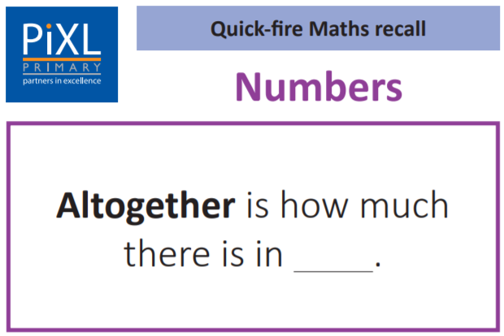
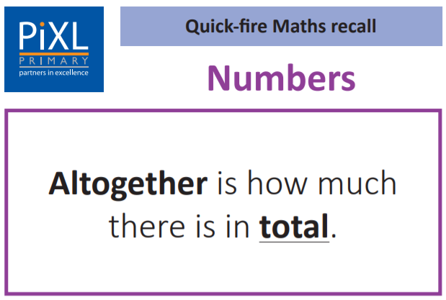
Stage 2 - Vocabulary
Turn to your partner and tell them what altogether means.

Slide 7
Stage 3 – Number Free Zone
There are 6 red balls and 7 yellow balls in a bag. How many balls are in the bag altogether?
1. Vocabulary - Write a definition for the following words:
a) ball b) altogether
2. Retrieval - What colour balls are there?
3. Inference – What is the question asking you to do? Summarise the problem.

Slide 8
Stage 4 – Answer Free Zone
There are 6 red balls and 7 yellow balls in a bag. How many balls are in the bag altogether?
Answer: 13 balls

Slide 9
Thinking Talk
There are 6 red balls and 7 yellow balls in a bag. How many balls are in the bag altogether?
Firstly, I need to understand that altogether means putting them together.
I will add 6 and 7.
6 + 7 = ?
By putting the balls together, I am adding.
Answer: 13 balls

Slide 10
Thinking Talk
There are 6 red balls and 7 yellow balls in a bag. How many balls are in the bag altogether?
I could also show this as a bar model.
? balls
Red 6
Yellow 7
Answer: 13 balls

Slide 11
Stage 5 – Your Turn
There are 8 red pencils and 6 blue pencils in the table pot. How many pencils are there altogether?
Answer: 14 pencils

Slide 12
Model Question 2

Slide 13
Stage 2 - Vocabulary
Class 2 have 28 pupils altogether. 11 of them wear coats at playtime. How many do not wear coats?

Slide 14
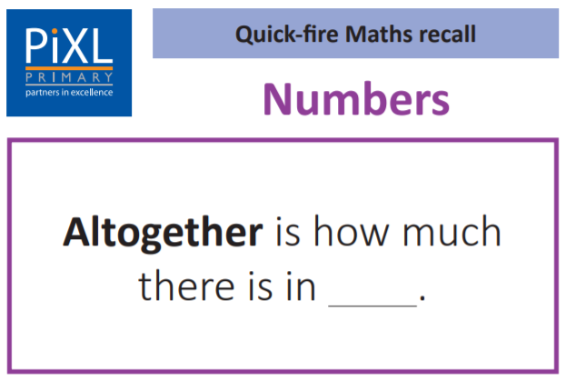
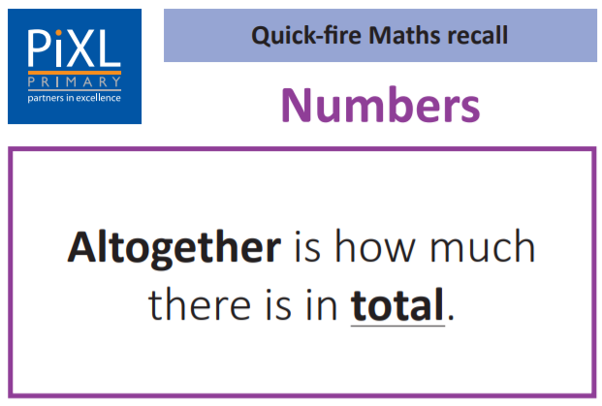
Stage 2 - Vocabulary
Turn to your partner and tell them what altogether means.
Can you put the word ‘altogether’ in a sentence of your own?

Slide 15
Stage 3 – Number Free Zone
Class 2 have 28 pupils altogether. 11 of them wear coats at playtime. How many do not wear coats?
1. Vocabulary - Write a definition for the following words:
a) pupils b) altogether
2. Retrieval - What is the class called?
3. Inference – What is the question asking you to do? Summarise the problem.

Slide 16
Stage 4 - Answer Free Zone
Class 2 have 28 pupils altogether. 11 of them wear coats at playtime. How many do not wear coats?
Answer: 17

Slide 17
Thinking Talk
Class 2 have 28 pupils altogether. 11 of them wear coats at playtime. How many do not wear coats?
Firstly, I need to start with all the pupils in the class.
So, I will do
28 – 11 =
I can quickly subtract 11 by subtracting 10 and then subtracting 1 more using a mental method.
I want to find out how many do not wear coats so I will take away the ones who do wear coats.
Answer: 17

Slide 18
Thinking Talk
Class 2 have 28 pupils altogether. 11 of them wear coats at playtime. How many do not wear coats?
I can show this as a bar model.
28 pupils
Wear coats
11
Do not wear coats
?
Answer: 17

Slide 19
Stage 5 – Your Turn
Class 1 have 26 pupils altogether. 14 of the pupils wear coats. How many pupils do not wear coats?
Answer: 12

Slide 20
Next Steps
To consolidate the language aspects of these problems, a suggestion is that the number free zone questions could form part of a guided reading session. Use Slide 7 as a model. A template can also be found in the Whole School Reading resources on inference (Slide 3).
Once pupils have developed greater confidence in tackling these word problems, they will then need to develop strategies when working independently. A suggestion is on the following slides.

Slide 21
Your Turn
Paul has 17 red hoops. He gives 8 hoops to Sarah. How many hoops does Paul have now?
15 children attend football club. 12 children go to hockey club. How many children go to football and hockey club altogether?

Slide 22
18 children attend dance club. 15 children go to art club. How many children go to dance and art club altogether?
Show Me Tasks
Tom has 19 pennies. He gives 12 pennies to Sam. How many pennies does Tom have now?
There were 86 pumpkins in a field. If 45 of them were picked, how many pumpkins were left in the field?

Slide 23

Solving word problems – steps to success
Take Two – read the question twice, once to get a general idea of context and vocabulary; the second to understand exactly what is being asked.
Underline/highlight key information (or eliminate information from your enquiries - like a detective!)
Give us a clue – look for key words to guide you to the operation needed, e.g. altogether suggests addition, share suggests division etc.
Summarise – in your head, summarise the question back to yourself, e.g. So, I’ve got to add the cost of 3 adults to the cost of a child, then subtract that from £50.00.

Slide 24

Solving word problems – steps to success
5. Estimate – round the numbers to give a rough idea of what the answer should be and jot it down.
6. Calculate – make sure you align digits carefully.
8. Read the question back – have you answered it?
9. Look at your original estimate – does your answer seem reasonable?

Slide 25
Apply
Further Number and Answer Free Zone questions can be found on PrimaryWise in the relevant year group areas.
These can be used to provide continued support in developing both the confidence to tackle, and strategies to solve, these problems.

