Slide 1


Y1-2 Solving Word Problems
Fractions
Commissioned by The PiXL Club Ltd.
October 2019
This resource is strictly for the use of member schools for as long as they remain members of The PiXL Club. It may not be copied, sold nor transferred to a third party or used by the school after membership ceases. Until such time it may be freely used within the member school.
All opinions and contributions are those of the authors. The contents of this resource are not connected with nor endorsed by any other company, organisation or institution.
PiXL Club Ltd endeavour to trace and contact copyright owners. If there are any inadvertent omissions or errors in the acknowledgements or usage, this is unintended and PiXL will remedy these on written notification.
© Copyright The PiXL Club Limited, 2019

Slide 2
Teacher guidance
Typically, pupils lack confidence tackling word problems, mainly because they involve several steps and a large amount of information to process. Barriers to successfully answering these may, of course, be the mathematical concepts being assessed, but the amount of reading, the challenging vocabulary, as well as identifying the correct operation/s to perform, is not to be underestimated.
This therapy begins by explaining a suggested teaching strategy for these question types. The intention of this strategy is to develop pupil confidence in tackling such questions through high-quality modelling. Using the teach, model and apply format, it will take pupils through this strategy with two modelled questions. Pupils will then have the opportunity to apply this independently.
The guidance notes under each slide explain each stage. It is assumed that Stage One, the teaching of the mathematical skill/concept involved, has been already taught.

Slide 3

The PiXL approach to solving word problems
Unlock the language
Unlock the numbers
Embed vocabulary
Number-free zones
Answer-free zones
Full problem
Teach the mathematical concept/skill being tested within the question
Stage 1 | Stage 2 | Stage 3 | Stage 4 | Stage 5

Slide 4
Model Question 1

Slide 5
Stage 2 - Vocabulary
Ben has some buttons. He gives half of them to Max. Max has 12 buttons. How many buttons does Ben have?

Slide 6

Stage 2 - Vocabulary
Synonym: _____________________
Antonym: _____________________
My definition: ____________________
_________________________________
_________________________________
Used in context: ___________________
_________________________________
______________________________
Word:
half
Picture:

Slide 7
Stage 3 – Number Free Zone
Ben has some buttons. He gives half of them to Max which is 12 buttons. How many buttons does Ben have left?
1. Vocabulary - Write the name of another fraction you know.
2. Retrieval – What is Ben sharing?
3. Inference – What is the question asking you to do? Summarise the problem.

Slide 8
Stage 4 – Answer Free Zone
Ben has some buttons. He gives half of them to Max which is 12 buttons. How many buttons does Ben have left?
Answer: 12 buttons

Slide 9
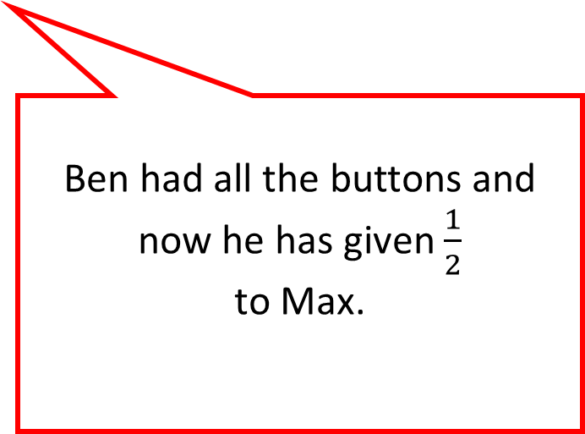
Thinking Talk
Ben has some buttons. He gives half of them to Max which is 12 buttons. How many buttons does Ben have left?
The children have some buttons.
Halves mean 2 equal pieces.
Ben had all the buttons and now he has given $\frac{1}{2}$
to Max.
Answer: 12 buttons

Slide 10
Thinking Talk
Ben has some buttons. He gives half of them to Max which is 12 buttons. How many buttons does Ben have left?
I could also show this with a picture.
Max
Ben
Max has 12 which is half the number Ben had. So Ben must have the other half.
Answer: 12 buttons

Slide 11
Stage 5 – Your Turn
Beth has some stones. She gives half of them to Seb. Seb has 14 stones. How many stones does Beth have?
Answer:14 stones

Slide 12
Model Question 2

Slide 13
Stage 2 - Vocabulary
Sam has some counters. She gives half of them to Max. She has 6 counters left. How many counters did Sam begin with?

Slide 14
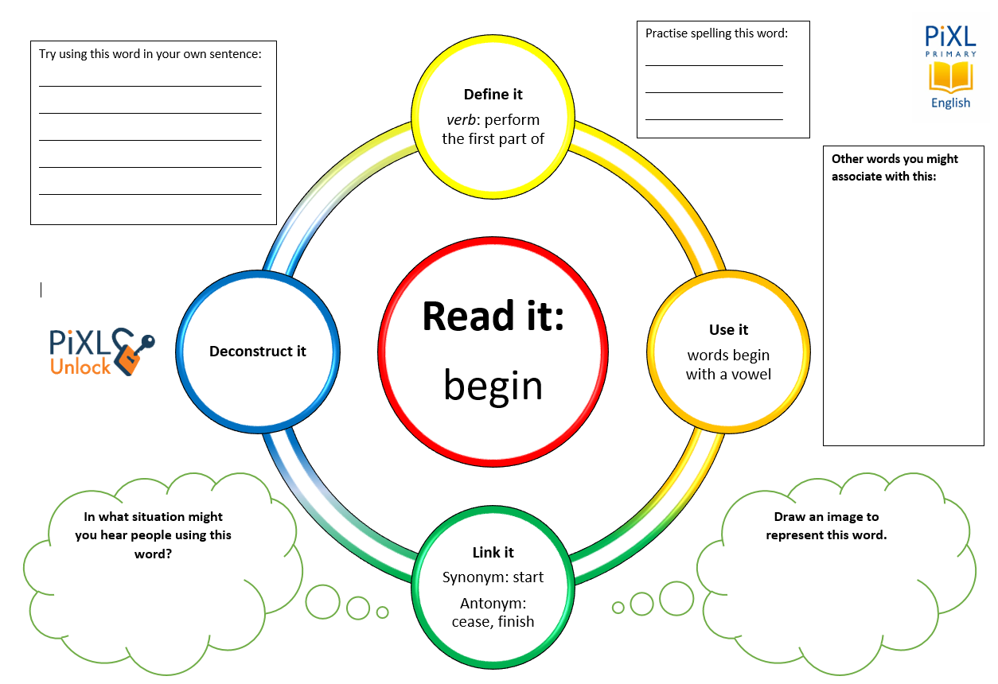
Stage 2 - Vocabulary
begin
counters
half

Slide 15
Stage 3 – Number Free Zone
Sam has some counters. She gives half of them to Max. She has 6 counters left. How many counters did Sam begin with?
1. Vocabulary – What is another word for ‘begin’?
2. Retrieval – Who starts with the counters?
3. Inference – What is the question asking you to do? Summarise the problem.

Slide 16
Stage 4 - Answer Free Zone
Sam has some counters. She gives half of them to Max. She has 6 counters left. How many counters did Sam begin with?
Answer: 12 counters

Slide 17
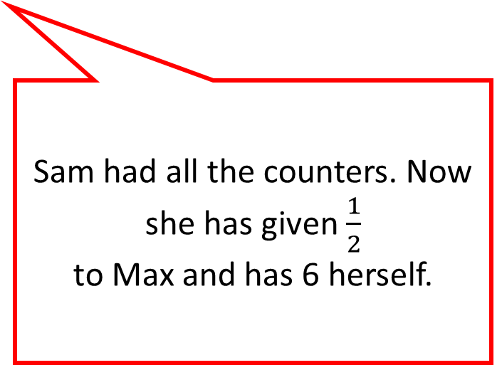
Thinking Talk
Sam has some counters. She gives half of them to Max. She has 6 counters left. How many counters did Sam begin with?
The children have some counters.
Halves mean 2 equal pieces.
Sam had all the counters. Now she has given $\frac{1}{2}$
to Max and has 6 herself.
Answer: 12 counters

Slide 18
Thinking Talk
Sam has some counters. She gives half of them to Max. She has 6 counters left. How many counters did Sam begin with?
I could also show this as a bar model.
Sam 6 | Max 6
Max has 6 which is half the number Sam had. So Sam must have the other half.
6 + 6 = 12
Answer: 12 counters

Slide 19
Stage 5 – Your Turn
Abdul has some conkers. He gives half of them to John which is 10 conkers. How many conkers did Abdul begin with?
Answer: 20 conkers

Slide 20
Your Turn
Paul had 20 grapes. He ate half of them. How many grapes did Paul eat?
Lucy had some grapes. She ate half of them. She had 12 grapes left. How many grapes did she start with?

Slide 21
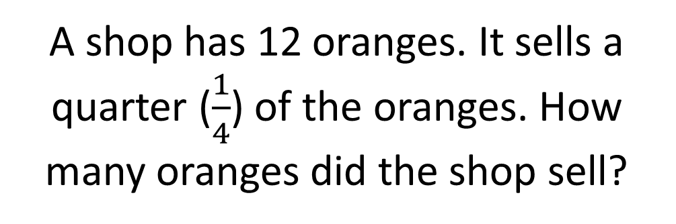
Show Me
A shop has 16 bottles of water. Half of them are put on the shelf. How many bottles were put on the shelf?
A shop has 6 magazines. It sells half of the magazines. How many magazines did the shop sell?
A shop has 12 oranges. It sells a quarter ($\frac{1}{4}$) of the oranges. How many oranges did the shop sell?

Slide 22
Next Steps
To consolidate the language aspects of these problems, a suggestion is that the number free zone questions could form part of a guided reading session. Use Slide 7 as a model. A template can also be found in the Whole School Reading resources on inference (Slide 3).
Once pupils have developed greater confidence in tackling these word problems, they will then need to develop strategies when working independently. A suggestion is on the following slides.

Slide 23

Solving word problems – steps to success
Take Two – read the question twice, once to get a general idea of context and vocabulary; the second to understand exactly what is being asked.
Underline/highlight key information (or eliminate information from your enquiries - like a detective!)
Give us a clue – look for key words to guide you to the operation needed, e.g. altogether suggests addition, share suggests division etc.
Summarise – in your head, summarise the question back to yourself, e.g. So, I’ve got to add the cost of 3 adults to the cost of a child, then subtract that from £50.00.

Slide 24

Solving word problems – steps to success
5. Estimate – round the numbers to give a rough idea of what the answer should be and jot it down.
6. Calculate – make sure you align digits carefully.
8. Read the question back – have you answered it?
9. Look at your original estimate – does your answer seem reasonable?

Slide 25
Apply
Further Number and Answer Free Zone questions can be found on PrimaryWise in the relevant year-group areas. These can be used to provide continued support in developing both the confidence to tackle, and strategies to solve, these problems.

