Slide 1


Y1-2 Solving Word Problems
Measurement
Commissioned by The PiXL Club Ltd.
October 2019
This resource is strictly for the use of member schools for as long as they remain members of The PiXL Club. It may not be copied, sold nor transferred to a third party or used by the school after membership ceases. Until such time it may be freely used within the member school.
All opinions and contributions are those of the authors. The contents of this resource are not connected with nor endorsed by any other company, organisation or institution.
PiXL Club Ltd endeavour to trace and contact copyright owners. If there are any inadvertent omissions or errors in the acknowledgements or usage, this is unintended and PiXL will remedy these on written notification.
© Copyright The PiXL Club Limited, 2019

Slide 2
Teacher guidance
Typically, pupils lack confidence tackling word problems, mainly because they involve several steps and a large amount of information to process. Barriers to successfully answering these may, of course, be the mathematical concepts being assessed, but the amount of reading, the challenging vocabulary, as well as identifying the correct operation/s to perform, is not to be underestimated.
This therapy begins by explaining a suggested teaching strategy for these question types. The intention of this strategy is to develop pupil confidence in tackling such questions through high-quality modelling. Using the teach, model and apply format, it will take pupils through this strategy with two modelled questions. Pupils will then have the opportunity to apply this independently.
The guidance notes under each slide explain each stage. It is assumed that Stage One, the teaching of the mathematical skill/concept involved, has been already taught.

Slide 3

The PiXL approach to solving word problems
Unlock the language
Unlock the numbers
Embed vocabulary
Number-free zones
Answer-free zones
Full problem
Teach the mathematical concept/skill being tested within the question
Stage 1 | Stage 2 | Stage 3 | Stage 4 | Stage 5

Slide 4
Model Question 1

Slide 5
Stage 2 - Vocabulary
Amy has a 50p coin. She is given a 20p coin and a 10p coin. What is the sum of her coins?

Slide 6
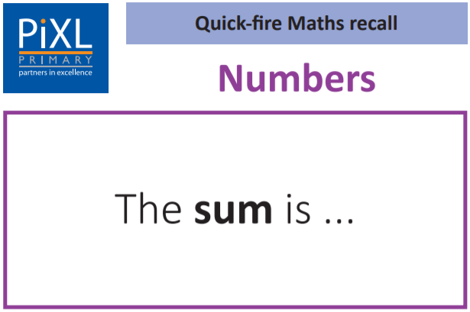
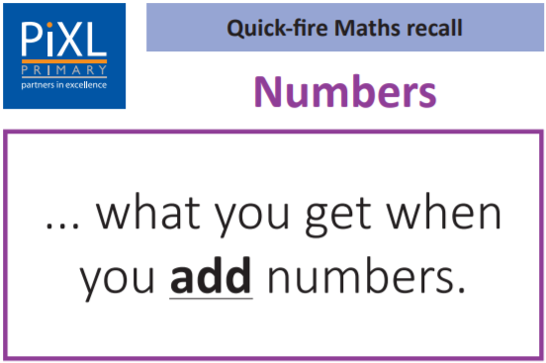
Stage 2 – Vocabulary

Slide 7
Stage 3 – Number Free Zone
Amy has a 50p coin. She is given a 20p coin and a 10p coin. What is the sum of her coins?
1. Vocabulary - Write a definition for the following words:
a) sum b) coin
2. Retrieval – What is the name of the person?
3. Inference – What is the question asking you to do? Summarise the problem.

Slide 8

Stage 4 – Answer Free Zone
Amy has a 50p coin. She is given a 20p coin and a 10p coin. What is the sum of her coins?
Answer: 80p

Slide 9
Thinking Talk
Amy has a 50p coin. She is given a 20p coin and a 10p coin. What is the sum of her coins?
Amy has 50p.
Next, I need to add the 10p.
She gets 20p more so I need to calculate
50p + 20p.
I know 5 + 2 = 7
so
50p + 20p = 70p
70p + 10p is the same as
70 + 10 = 80
so
70p + 10p = 80p
Answer: 80p

Slide 10
Thinking Talk
Amy has a 50p coin. She is given a 20p coin and a 10p coin. What is the sum of her coins?
I could also show this using a number line.
+ 20p
+ 10p
Answer: 80p
50p
70p
80p

Slide 11
Stage 5 – Your Turn
Robert has two 20p coins. He is given a 10p coin and a 5p coin. How much money does he have altogether?
Answer: 55p

Slide 12
Model Question 2

Slide 13
Stage 2 - Vocabulary
Seb grows a sunflower. The plant was 13cm tall. It grows 6cm taller. What is the total height of Seb’s sunflower?

Slide 14
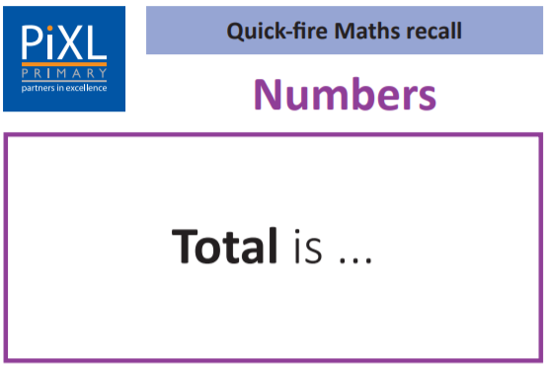
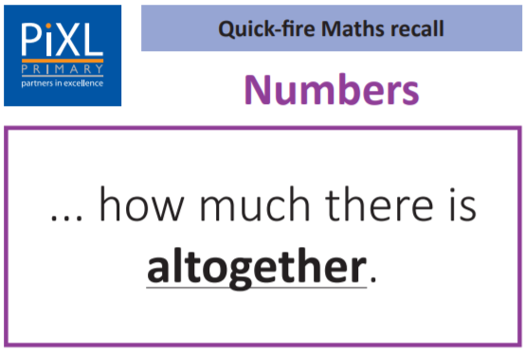
Stage 2 - Vocabulary

Slide 15
Stage 3 – Number Free Zone
Seb grows a sunflower. The plant was 13cm tall. It grows 6cm taller. What is the total height of Seb’s sunflower?
1. Vocabulary - Write a definition for the following words:
a) height b) taller
2. Retrieval – What happened to the sunflower?
3. Inference – What is the question asking you to do? Summarise the problem.

Slide 16
Stage 4 - Answer Free Zone
Seb grows a sunflower. The plant was 13cm tall. It grows 6cm taller. What is the total height of Seb’s sunflower?
Answer: 19cm

Slide 17
Thinking Talk
Seb grows a sunflower. The plant was 13cm tall. It grows 6cm taller. What is the total height of Seb’s sunflower?
Firstly, I need to know how tall the sunflower is.
13cm
If it increases, I need to add.
13cm + 6cm
Next, I need to look at what is happening to the sunflower. It is getting taller so the height is going to increase.
13cm + 6cm = 19cm
Answer: 19cm

Slide 18
Thinking Talk
Seb grows a sunflower. The plant was 13cm tall. It grows 6cm taller. What is the total height of Seb’s sunflower?
I can show this as a bar model.
?
13cm
6cm
Answer: 19cm

Slide 19
Stage 5 – Your Turn
Sita is making cookies. She has 100g of flour in a bag. She pours 40g into one bowl and 25g into a second bowl. How much flour is left in the bag?
Answer: 35g

Slide 20
Your Turn
Nico has a 20p coin and two 5p coins. He is given three 10p coins. How much money does Nico have now?
Helen is making cereal bars. She has 100g of oats in a bag. She pours 20g of oats into one bowl and 55g into a second bowl. What weight of oats is left in the bag?

Slide 21
Show Me
Ben has a 50p coin, a 10p coin and a 5p coin. He is given two 20p coins. How much money does Ben have now?
Anna grows a sunflower. The plant was 17cm tall. It grows 8cm taller. What is the total height of Anna’s sunflower?
Rashid is making flapjacks. He has 100g of oats in a bag. He pours 15g of oats into one bowl and 45g into a second bowl. What weight of oats is left in the bag?

Slide 22
Next Steps
To consolidate the language aspects of these problems, a suggestion is that the number free zone questions could form part of a guided reading session. Use Slide 7 as a model. A template can also be found in the Whole School Reading resources on inference (Slide 3).
Once pupils have developed greater confidence in tackling these word problems, they will then need to develop strategies when working independently. A suggestion is on the following slides.

Slide 23

Solving word problems – steps to success
Take Two – read the question twice, once to get a general idea of context and vocabulary; the second to understand exactly what is being asked.
Underline/highlight key information (or eliminate information from your enquiries - like a detective!)
Give us a clue – look for key words to guide you to the operation needed, e.g. altogether suggests addition, share suggests division etc.
Summarise – in your head, summarise the question back to yourself, e.g. So, I’ve got to add the cost of 3 adults to the cost of a child, then subtract that from £50.00.

Slide 24

Solving word problems – steps to success
5. Estimate – round the numbers to give a rough idea of what the answer should be and jot it down.
6. Calculate – make sure you align digits carefully.
8. Read the question back – have you answered it?
9. Look at your original estimate – does your answer seem reasonable?

Slide 25
Apply
Further Number and Answer Free Zone questions can be found on PrimaryWise in the relevant year-group areas. These can be used to provide continued support in developing both the confidence to tackle, and strategies to solve, these problems.

