Slide 1


Y1-2 Solving Word Problems
Multiplication and Division
Commissioned by The PiXL Club Ltd.
October 2019
This resource is strictly for the use of member schools for as long as they remain members of The PiXL Club. It may not be copied, sold nor transferred to a third party or used by the school after membership ceases. Until such time it may be freely used within the member school.
All opinions and contributions are those of the authors. The contents of this resource are not connected with nor endorsed by any other company, organisation or institution.
PiXL Club Ltd endeavour to trace and contact copyright owners. If there are any inadvertent omissions or errors in the acknowledgements or usage, this is unintended and PiXL will remedy these on written notification
© Copyright The PiXL Club Limited, 2019

Slide 2
Teacher guidance
Typically, pupils lack confidence tackling word problems, mainly because they involve several steps and a large amount of information to process. Barriers to successfully answering these may, of course, be the mathematical concepts being assessed, but the amount of reading, the challenging vocabulary, as well as identifying the correct operation/s to perform, is not to be underestimated.
This therapy begins by explaining a suggested teaching strategy for these question types. The intention of this strategy is to develop pupil confidence in tackling such questions through high-quality modelling. Using the teach, model and apply format, it will take pupils through this strategy with two modelled questions. Pupils will then have the opportunity to apply this independently.
The guidance notes under each slide explain each stage. It is assumed that Stage One, the teaching of the mathematical skill/concept involved, has been already taught.

Slide 3

The PiXL approach to solving word problems
Unlock the language
Unlock the numbers
Embed vocabulary
Number-free zones
Answer-free zones
Full problem
Teach the mathematical concept/skill being tested within the question
Stage 1 | Stage 2 | Stage 3 | Stage 4 | Stage 5

Slide 4
Model Question 1

Slide 5
Stage 2 - Vocabulary
A greengrocer has 30 apples and 5 baskets. He puts the same number of apples in each basket. How many apples go in each basket?

Slide 6

Stage 2 - Vocabulary
Synonym: _____________________
Antonym: _____________________
My definition: ____________________
_________________________________
_________________________________
Used in context: ___________________
_________________________________
______________________________
Word:
basket
Picture:

Slide 7
Stage 3 – Number Free Zone
A greengrocer has 30 apples and 5 baskets. He puts the same number of apples in each basket. How many apples go in each basket?
1. Vocabulary - Write a definition for the following words:
a) greengrocer b) same
2. Retrieval – What does a greengrocer sell?
3. Inference – What is the question asking you to do? Summarise the problem.

Slide 8
Stage 4 – Answer Free Zone
A greengrocer has 30 apples and 5 baskets. He puts the same number of apples in each basket. How many apples go in each basket?
Answer: 6 apples

Slide 9
Thinking Talk
A greengrocer has 30 apples and 5 baskets. He puts the same number of apples in each basket. How many apples go in each basket?
I will do 30 ÷ 5
There are 30 apples.
I can count in 5s
5, 10, 15, 20, 25, 30
I share the apples out and put them in the baskets.
Answer: 6 apples

Slide 10
Thinking Talk
A greengrocer has 30 apples and 5 baskets. He puts the same number of apples in each basket. How many apples go in each basket?
I could also show this using a picture.
Answer: 6 apples

Slide 11
Stage 5 – Your Turn
The PE teacher has 15 tennis balls and 5 buckets. She puts the same number of tennis balls in each bucket. How many tennis balls are in each bucket?
Answer: 3 tennis balls

Slide 12
Model Question 2

Slide 13
Stage 2 - Vocabulary
Paul, Tom and Holly are playing a game. They each have 2 counters. How many counters are there altogether?

Slide 14
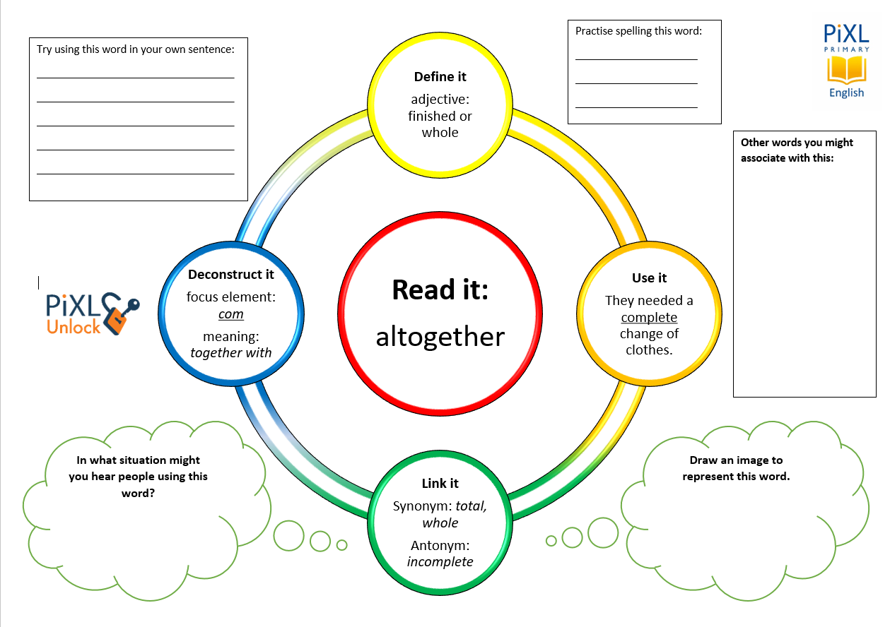
Stage 2 - Vocabulary
altogether
counters
each

Slide 15
Stage 3 – Number Free Zone
Paul, Tom and Holly are playing a game. They each have 2 counters. How many counters are there altogether?
1. Vocabulary - Write a definition for the following words:
a) counters b) each
2. Retrieval – What are the children doing?
3. Inference – What is the question asking you to do? Summarise the problem.

Slide 16
Stage 4 - Answer Free Zone
Paul, Tom and Holly are playing a game. They each have 2 counters. How many counters are there altogether?
Answer: 6 counters

Slide 17
Thinking Talk
Paul, Tom and Holly are playing a game. They each have 2 counters. How many counters are there altogether?
I need to draw a picture for this question.
Paul Tom Holly
Answer: 6 counters

Slide 18
Thinking Talk
Paul, Tom and Holly are playing a game. They each have 2 counters. How many counters are there altogether?
Paul Tom Holly
I can count in 2s.
2, 4, 6
Answer: 6 counters

Slide 19
Stage 5 – Your Turn
Amy, Alex and Sam are colouring. They each have 10 pencils. How many pencils are there altogether?
Answer: 30 pencils

Slide 20
3 friends are playing a game. They each have 5 counters. How many counters are there altogether?
Show me
Holly has 6 pairs of shoes. How many shoes does she have altogether?
Mrs Brown has 10 ice poles. She shares them between 5 children. How many ice poles will each child get?

Slide 21
Your Turn
Alex has 5 toy cars. Lucy has six times that number. How many toy cars are there altogether?
5 children in Class 2 share their slices of apple. There were 35 slices of apple altogether. How many slices does each child get?

Slide 22
Next Steps
To consolidate the language aspects of these problems, a suggestion is that the number free zone questions could form part of a guided reading session. Use Slide 7 as a model. A template can also be found in the Whole School Reading resources on inference (Slide 3).
Once pupils have developed greater confidence in tackling these word problems, they will then need to develop strategies when working independently. A suggestion is on the following slides.

Slide 23

Solving word problems – steps to success
Take Two – read the question twice, once to get a general idea of context and vocabulary; the second to understand exactly what is being asked.
Underline/highlight key information (or eliminate information from your enquiries - like a detective!)
Give us a clue – look for key words to guide you to the operation needed, e.g. altogether suggests addition, share suggests division etc.
Summarise – in your head, summarise the question back to yourself, e.g. So, I’ve got to add the cost of 3 adults to the cost of a child, then subtract that from £50.00.

Slide 24

Solving word problems – steps to success
5. Estimate – round the numbers to give a rough idea of what the answer should be and jot it down.
6. Calculate – make sure you align digits carefully.
8. Read the question back – have you answered it?
9. Look at your original estimate – does your answer seem reasonable?

Slide 25
Apply
Further Number and Answer Free Zone questions can be found on PrimaryWise in the relevant year-group areas. These can be used to provide continued support in developing both the confidence to tackle, and strategies to solve, these problems.

