Slide 1



LIFE/work balance
We have started a #LIFEworkbalance campaign and we need your help to complete our LIFE/work balance survey.
We hope to publish the results soon, so please give 15 minutes of your time to help us get a true picture of school life.
Want to be a part of this campaign? Take the survey on our website and share it with your colleagues!
© Classroom Secrets Limited 2019

Slide 2
Year 2 – Spring Block 2 – Statistics – Interpret Pictograms (1-1)
About This Resource:
This PowerPoint has been designed to support your teaching of this small step. It includes a starter activity and an example of each question from the Varied Fluency and Reasoning and Problem Solving resources also provided in this pack. You can choose to work through all examples provided or a selection of them depending on the needs of your class.
National Curriculum Objectives:
Mathematics Year 2: (2S1) Interpret and construct simple pictograms, tally charts, block diagrams and simple tables
More Year 2 Statistics resources
Did you like this resource? Don’t forget to review it on our website.
© Classroom Secrets Limited 2018

Slide 3
Year 2 – Spring Block 2 – Statistics
Step 3: Interpret Pictograms (1-1)
© Classroom Secrets Limited 2018

Slide 4




Introduction
 | = 1
Brown
Blue
Green
Other
Use the numbers in the tally chart to finish the pictogram.
Eye colour | Number
Brown
Blue
Green
Other
What number should be in the bottom row of the tally chart? Use the pictogram to find out.
© Classroom Secrets Limited 2018

Slide 5
Introduction
 | = 1
Brown
Blue
Green
Other
Use the numbers in the tally chart to finish the pictogram.
Eye colour | Number
Brown
Blue
Green
Other
What number should be in the bottom row of the tally chart? Use the pictogram to find out.
© Classroom Secrets Limited 2018

Slide 6
Varied Fluency 1
Tick the statements that are correct.
= 1 vote
Yoghurt
Strawberry
Peach
Banana
A. The least popular yoghurt was banana.
B. 3 more people liked peach than banana.
C. 25 people were asked in total.
© Classroom Secrets Limited 2018

Slide 7
Varied Fluency 1
Tick the statements that are correct.
= 1 vote
Yoghurt
Strawberry
Peach
Banana
A. The least popular yoghurt was banana. |  | ✓
B. 3 more people liked peach than banana. |  | ✓
C. 25 people were asked in total.
© Classroom Secrets Limited 2018

Slide 8
Varied Fluency 2
Jason recorded the reptiles he saw at the reptile house.
Answer the questions using Jason’s pictogram.
Reptiles
Snake
Lizard
Tortoise
Turtle
= 1 creature
A. Which creature was the most common?
B. How many snakes were there?
C. How many more turtles were there than tortoise?
© Classroom Secrets Limited 2018

Slide 9
Varied Fluency 2
Jason recorded the reptiles he saw at the reptile house.
Answer the questions using Jason’s pictogram.
Reptiles
Snake
Lizard
Tortoise
Turtle
= 1 creature
A. Which creature was the most common? |  | Lizard
B. How many snakes were there? |  |  | 7
C. How many more turtles were there than tortoises? |  |  | 2
© Classroom Secrets Limited 2018

Slide 10
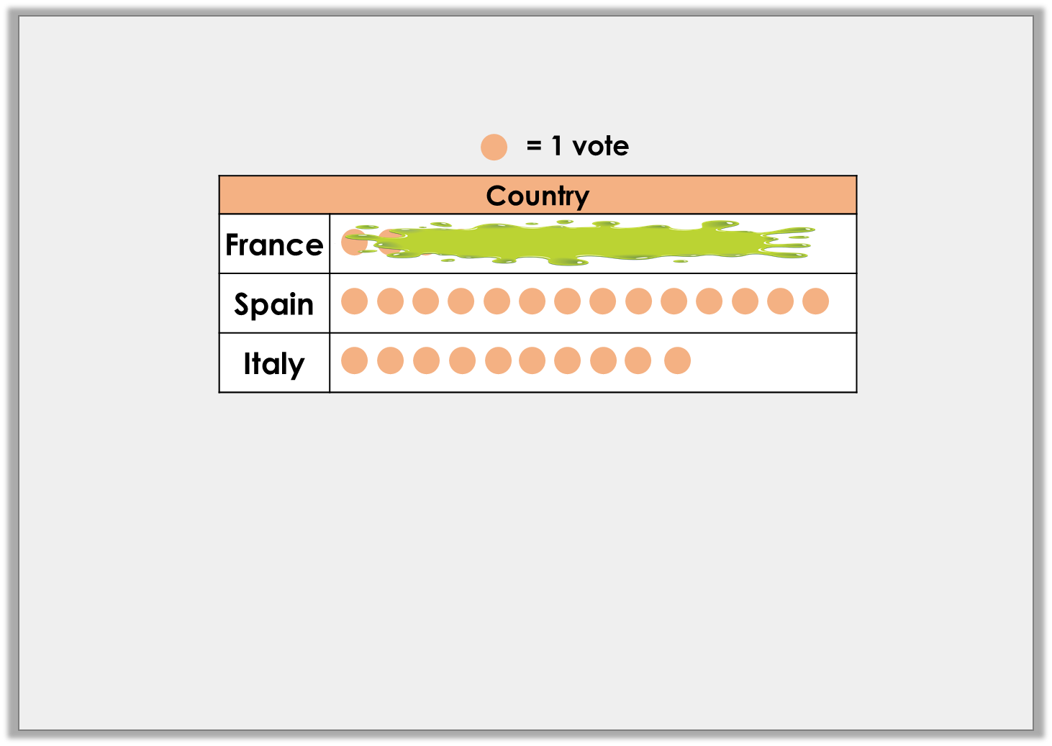
Problem Solving 1
Freddy has spilt on his pictogram.
Use the clues to work out how many people have been to France.
More people have been to France than Italy.
Fewer people have been to France than Spain.
© Classroom Secrets Limited 2018

Slide 11
Problem Solving 1
Freddy has spilt on his pictogram.
Use the clues to work out how many people have been to France.
More people have been to France than Italy.
Fewer people have been to France than Spain.
11, 12 or 13
© Classroom Secrets Limited 2018

Slide 12
Reasoning 1
True or false?
19 children would like to play the flute or the trumpet.
33 children were asked in total.
Explain your answers.
= 1 vote
Instrument
Piano
Trumpet
Flute
© Classroom Secrets Limited 2018

Slide 13
Reasoning 1
True or false?
19 children would like to play the flute or the trumpet.
33 children were asked in total.
Explain your answers.
A is false because…
B is true because…
= 1 vote
Instrument
Piano
Trumpet
Flute
© Classroom Secrets Limited 2018

Slide 14
Reasoning 1
True or false?
19 children would like to play the flute or the trumpet.
33 children were asked in total.
Explain your answers.
A is false because 11 want to play the trumpet and 7 want to play the flute. 11 + 7 = 18.
B is true because there are 33 symbols on the pictogram in total.
= 1 vote
Instrument
Piano
Trumpet
Flute
© Classroom Secrets Limited 2018

Slide 15
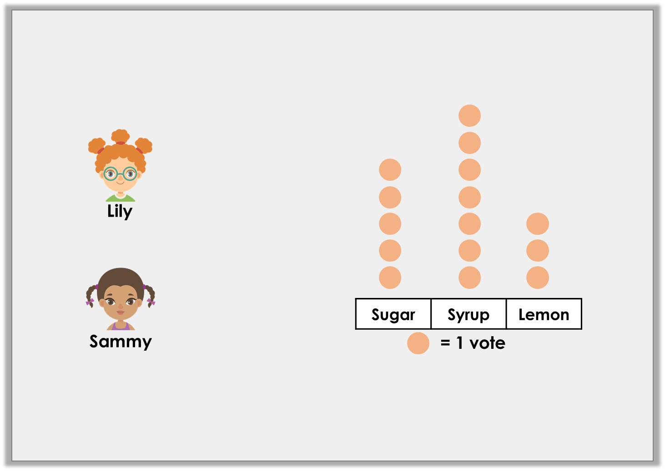
Reasoning 2
Who is correct? Explain your answer.
8 like sugar or lemon on their pancakes.
9 like sugar or lemon on their pancakes.
© Classroom Secrets Limited 2018

Slide 16
Reasoning 2
Who is correct? Explain your answer.
Lily is correct because…
8 like sugar or lemon on their pancakes.
9 like sugar or lemon on their pancakes.
© Classroom Secrets Limited 2018

Slide 17
Reasoning 2
Who is correct? Explain your answer.
Lily is correct because 5 like sugar and 3 like lemon. 5 + 3 = 8
8 like sugar or lemon on their pancakes.
9 like sugar or lemon on their pancakes.
© Classroom Secrets Limited 2018

