Slide 1


Year 2 – Spring Block 2 – Statistics – Interpret Pictograms (2, 5 and 10)
About This Resource:
This PowerPoint has been designed to support your teaching of this small step. It includes a starter activity and an example of each question from the Varied Fluency and Reasoning and Problem Solving resources also provided in this pack. You can choose to work through all examples provided or a selection of them depending on the needs of your class.
National Curriculum Objectives:
Mathematics Year 2: (2S1) Interpret and construct simple pictograms, tally charts, block diagrams and simple tables
Mathematics Year 2: (2S2a) Ask and answer simple questions by counting the number of objects in each category and sorting the categories by quantity
Mathematics Year 2: (2S2b) Ask and answer questions about totalling and comparing categorical data
More Year 2 Statistics resources.
Did you like this resource? Don’t forget to review it on our website.
© Classroom Secrets Limited 2018

Slide 2
Year 2 – Spring Block 2 – Statistics
Step 5:Interpret Pictograms (2, 5 and 10)
© Classroom Secrets Limited 2018

Slide 3
Introduction
Calculate the value of each shape.
 | + |  | + |  | + |  | = | 20
 |  | + |  | + |  | = |  | 6
 | + |  | + |  | + |  | = | 40
 | = |  |  |  | = |  |  |  | =
© Classroom Secrets Limited 2018

Slide 4
Introduction
Calculate the value of each shape.
 | + |  | + |  | + |  | = | 20
 |  | + |  | + |  | = |  | 6
 | + |  | + |  | + |  | = | 40
 | = | 5 |  |  | = | 2 |  |  | = | 10
© Classroom Secrets Limited 2018

Slide 5
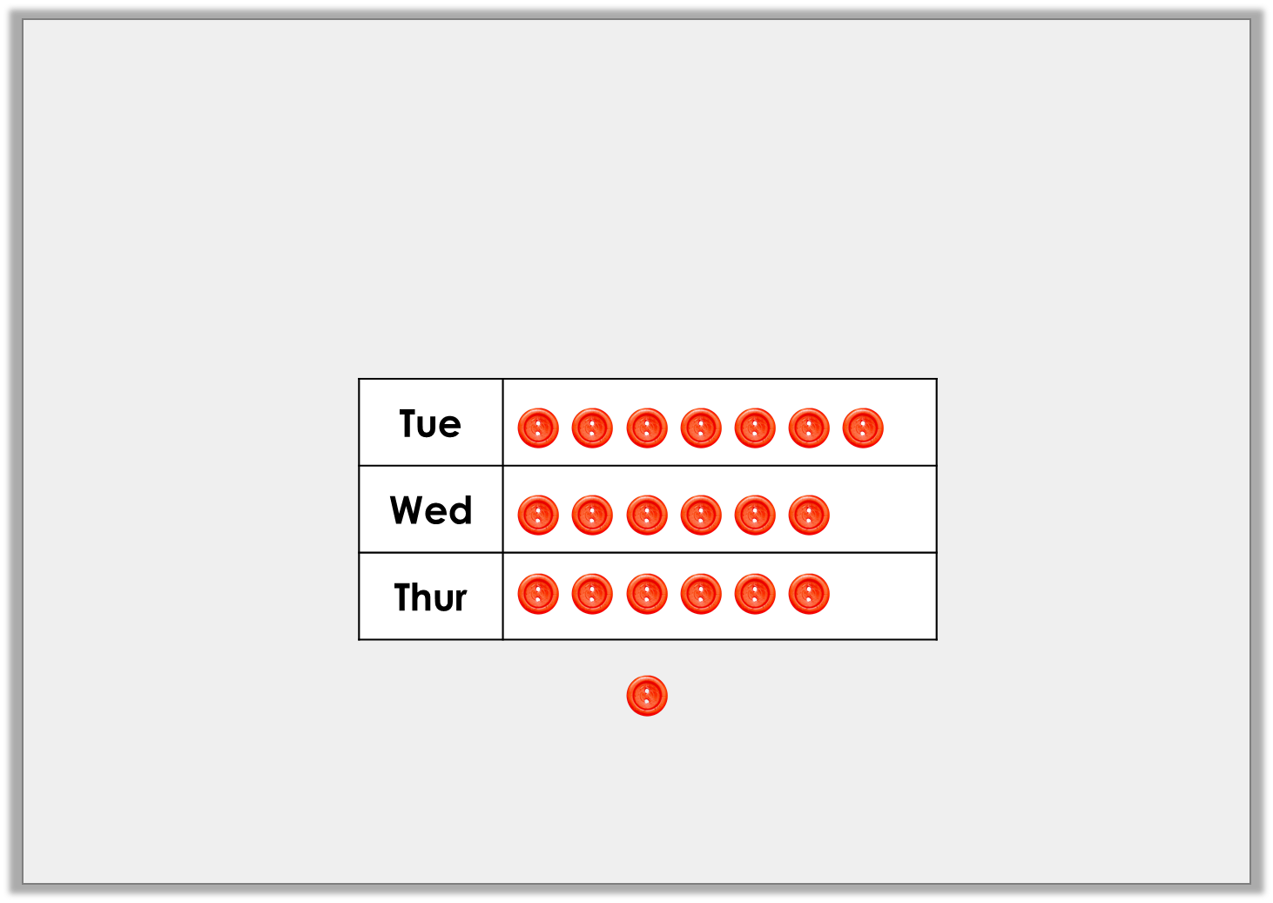
Varied Fluency 1
How many buttons were sold in the sewing shop on Tuesday?
Circle the correct answer.
55
90
11
35 |  | 7 |  | 14
= | 2
© Classroom Secrets Limited 2018

Slide 6
Varied Fluency 1
How many buttons were sold in the sewing shop on Tuesday?
Circle the correct answer.
55
90
11
35 |  | 7 |  | 14
= | 2
© Classroom Secrets Limited 2018

Slide 7

Varied Fluency 2
Tick the statements that are correct.
A. 95 chose the most popular vegetable.
B. 40 more people chose peas than broccoli.
C. Only 3 people chose broccoli.
Carrots
Peas
Broccoli
= | 10
© Classroom Secrets Limited 2018

Slide 8
Varied Fluency 2
Tick the statements that are correct.
A. 95 chose the most popular vegetable. | ✓
B. 40 more people chose peas than broccoli. | ✓
C. Only 3 people chose broccoli.
Carrots
Peas
Broccoli
= | 10
© Classroom Secrets Limited 2018

Slide 9
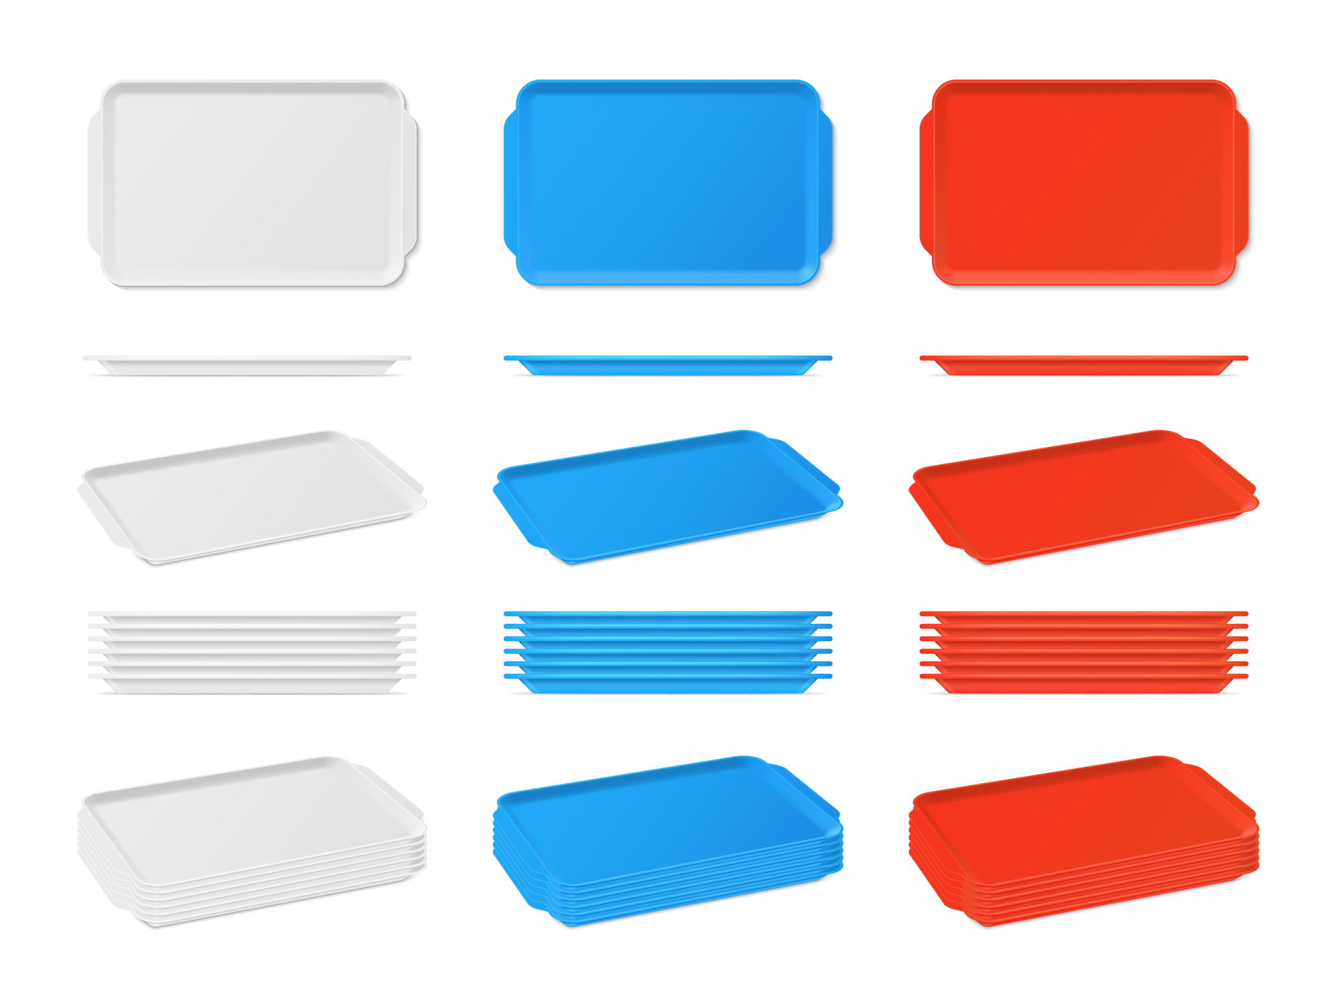
Varied Fluency 3
Complete the statements below.
A. On Monday, |  | school dinners were eaten.
B. There were |  | more eaten on Monday than Tuesday.
Monday | Tuesday | Wednesday | Thursday
= | 10
© Classroom Secrets Limited 2018

Slide 10
Varied Fluency 3
Complete the statements below.
A. On Monday, | 65 | school dinners were eaten.
B. There were | 15 | more eaten on Monday than Tuesday.
Monday | Tuesday | Wednesday | Thursday
= | 10
© Classroom Secrets Limited 2018

Slide 11


Reasoning 1
Afifa counted the children in each class in Year 2.
Is she correct? Explain why.
Class 1
Class 2
Class 3
I counted 21 children in Class 3 so the value of a circle is 2.
© Classroom Secrets Limited 2018

Slide 12
Reasoning 1
Afifa counted the children in each class in Year 2.
Is she correct? Explain why.
Afifa is correct because…
Class 1
Class 2
Class 3
I counted 21 children in Class 3 so the value of a circle is 2.
© Classroom Secrets Limited 2018

Slide 13
Reasoning 1
Afifa counted the children in each class in Year 2.
Is she correct? Explain why.
Afifa is correct because…
Various possible answers, for example: If each whole circle is worth 2, 10 whole circles and a half circle would give a total value of 21.
Class 1
Class 2
Class 3
I counted 21 children in Class 3 so the value of a circle is 2.
© Classroom Secrets Limited 2018

Slide 14
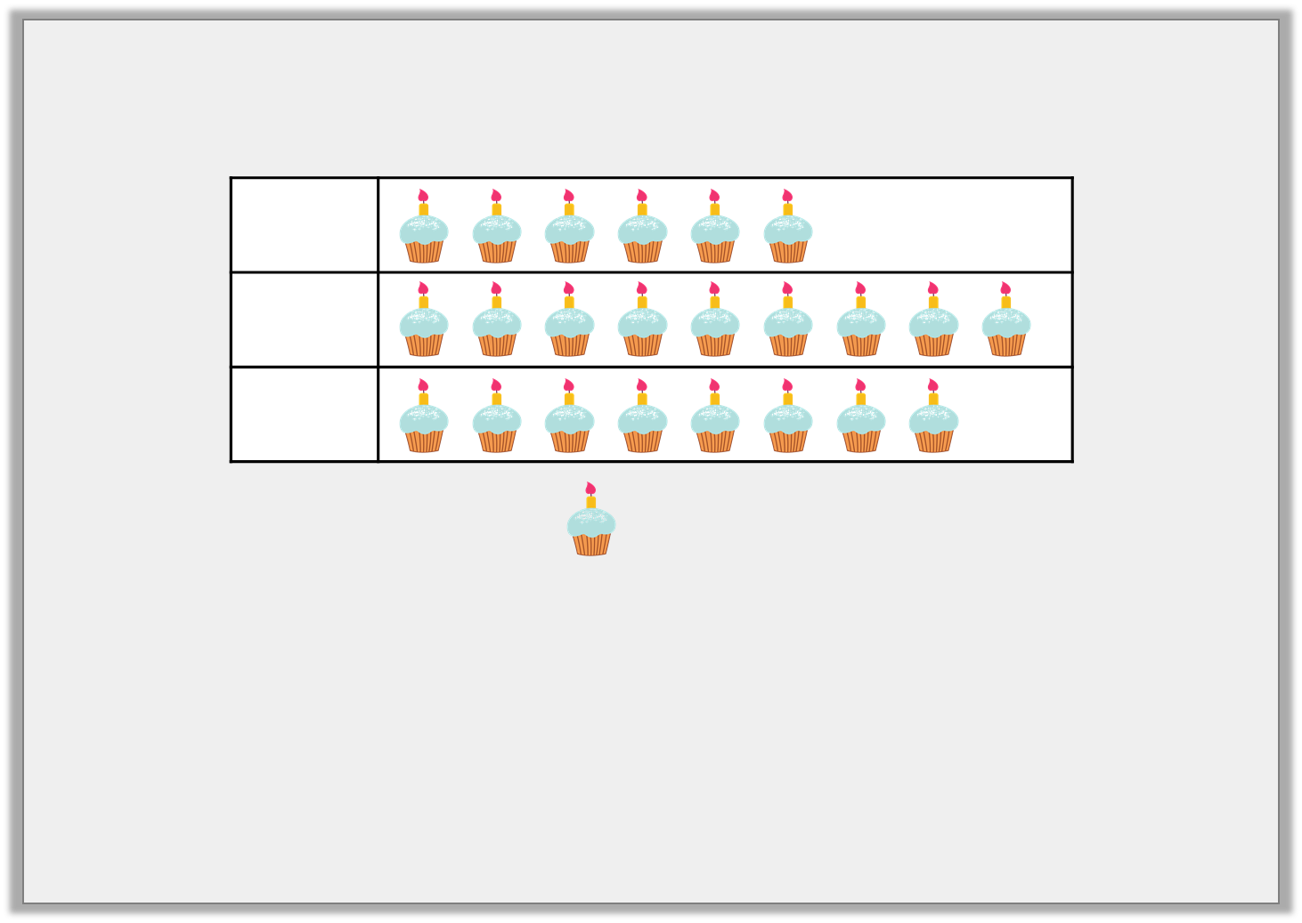
Problem Solving 1
Use the clues to complete the pictogram.
= | 5
There were more birthdays in June than March.
There were 30 birthdays in March.
There were 5 more birthdays in April than June.
© Classroom Secrets Limited 2018

Slide 15
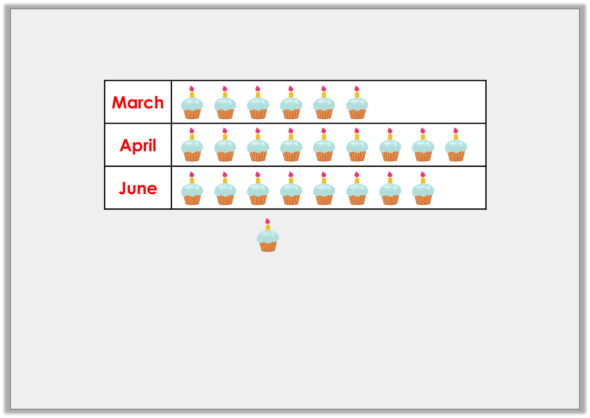
Problem Solving 1
Use the clues to complete the pictogram.
= | 5
There were more birthdays in June than March.
There were 30 birthdays in March.
There were 5 more birthdays in April than June.
© Classroom Secrets Limited 2018

Slide 16
Reasoning 2
True or false?
Kara has most team points but only beat
Lewis by 10 points.
Prove it.
Kara
Bella
Lewis
= 10
© Classroom Secrets Limited 2018

Slide 17
Reasoning 2
True or false?
Kara has most team points but only beat
Lewis by 10 points.
Prove it.
This is false because…
Kara
Bella
Lewis
= 10
© Classroom Secrets Limited 2018

Slide 18
Reasoning 2
True or false?
Kara has most team points but only beat
Lewis by 10 points.
Prove it.
This is false because…
Various answers, for example: Kara has 100 team points but Lewis has 85 team points so Kara has 15 more team points than Lewis.
Kara
Bella
Lewis
= 10
© Classroom Secrets Limited 2018

