Slide 1



LIFE/work balance
We have started a #LIFEworkbalance campaign and we need your help to complete our LIFE/work balance survey.
We hope to publish the results soon, so please give 15 minutes of your time to help us get a true picture of school life.
Want to be a part of this campaign? Take the survey on our website and share it with your colleagues!
© Classroom Secrets Limited 2020

Slide 2
Year 3 – Spring Block 2 – Money – Adding Money
About This Resource:
This PowerPoint has been designed to support your teaching of this small step. It includes a starter activity and an example of each question from the Varied Fluency and Reasoning and Problem Solving resources also provided in this pack. You can choose to work through all examples provided or a selection of them depending on the needs of your class.
National Curriculum Objectives:
Mathematics Year 3 (3M9a) Add and subtract amounts of money to give change, using both £ and p in practical contexts
More Year 3 Money resources.
Did you like this resource? Don’t forget to review it on our website.
© Classroom Secrets Limited 2019

Slide 3
Year 3 – Spring Block 2 – Money
Step 3: Adding Money
© Classroom Secrets Limited 2019

Slide 4
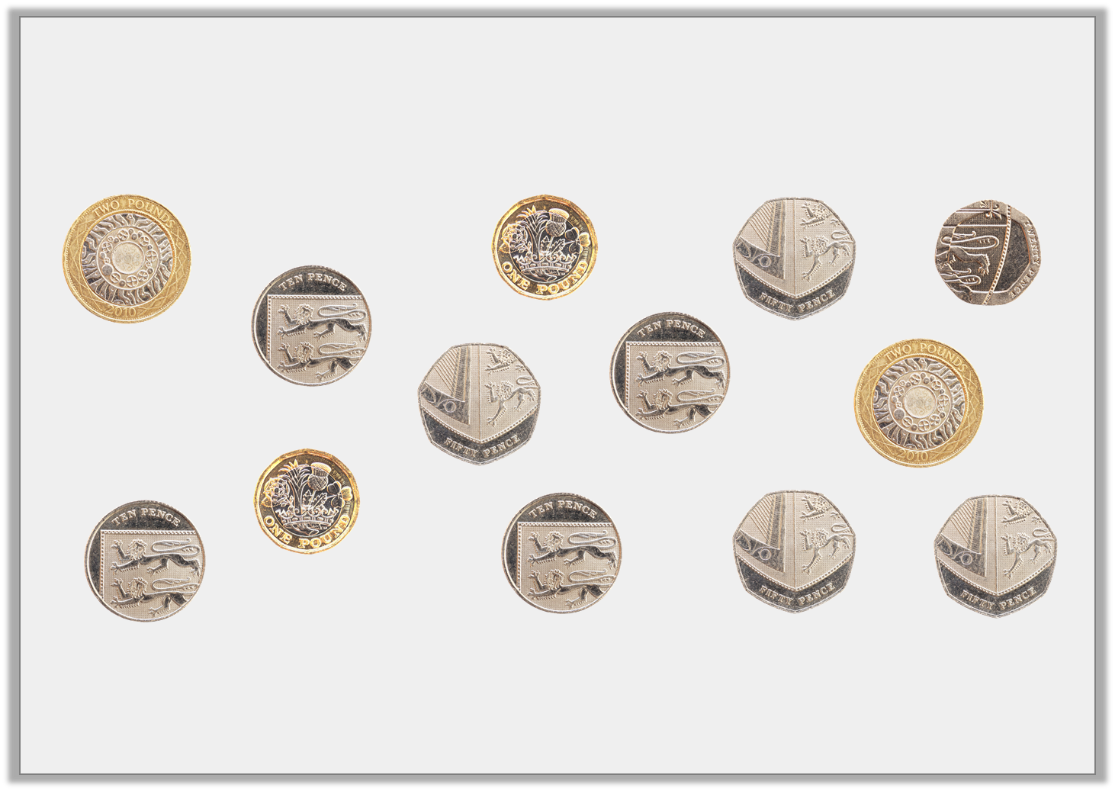
Introduction
How many different ways can you make a total of £4 and 50p using the coins shown below?
© Classroom Secrets Limited 2019

Slide 5
Introduction
How many different ways can you make a total of £4 and 50p using the coins shown below?
Various answers, for example:
A. £2 + £2 + 50p; B. £2 + £1 + £1 + 50p; C. £2 + 50p + 50p + 50p + 50p + 20p + 10p + 10p + 10p
© Classroom Secrets Limited 2019

Slide 6
Varied Fluency 1
Complete the addition represented on this number line.
£5 and 35p | + |  | =
65p
£2 and 85p
£5 and 35p
© Classroom Secrets Limited 2019

Slide 7
Varied Fluency 1
Complete the addition represented on this number line.
£5 and 35p | + | £3 and 50p | = | £8 and 85p
65p
£2 and 85p
£5 and 35p
£6
£8 and 85p
© Classroom Secrets Limited 2019

Slide 8
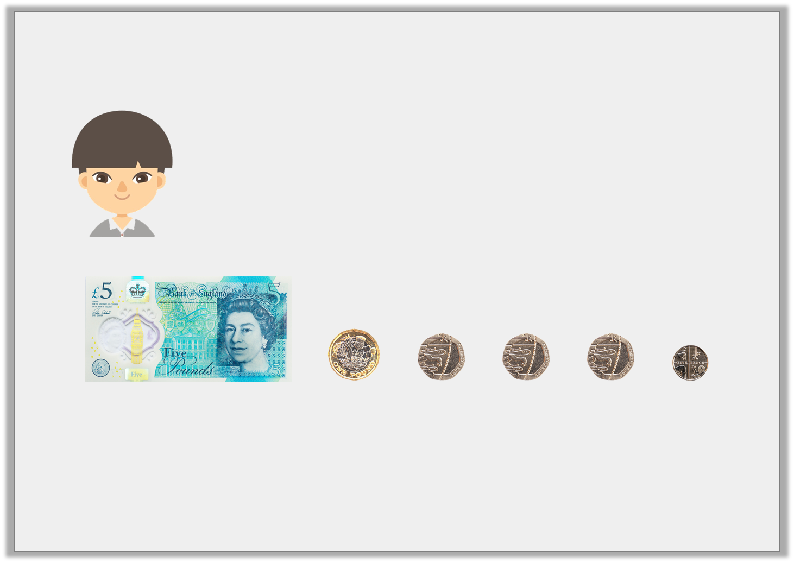
Varied Fluency 2
Jilani says,
His friend gives him £1 and 90p more.
How much does he have altogether?
This is how much money I have in my pocket.
© Classroom Secrets Limited 2019

Slide 9
Varied Fluency 2
Jilani says,
His friend gives him £1 and 90p more.
How much does he have altogether?
£6 and 65p + £1 and 90p = £8 and 55p
This is how much money I have in my pocket.
© Classroom Secrets Limited 2019

Slide 10
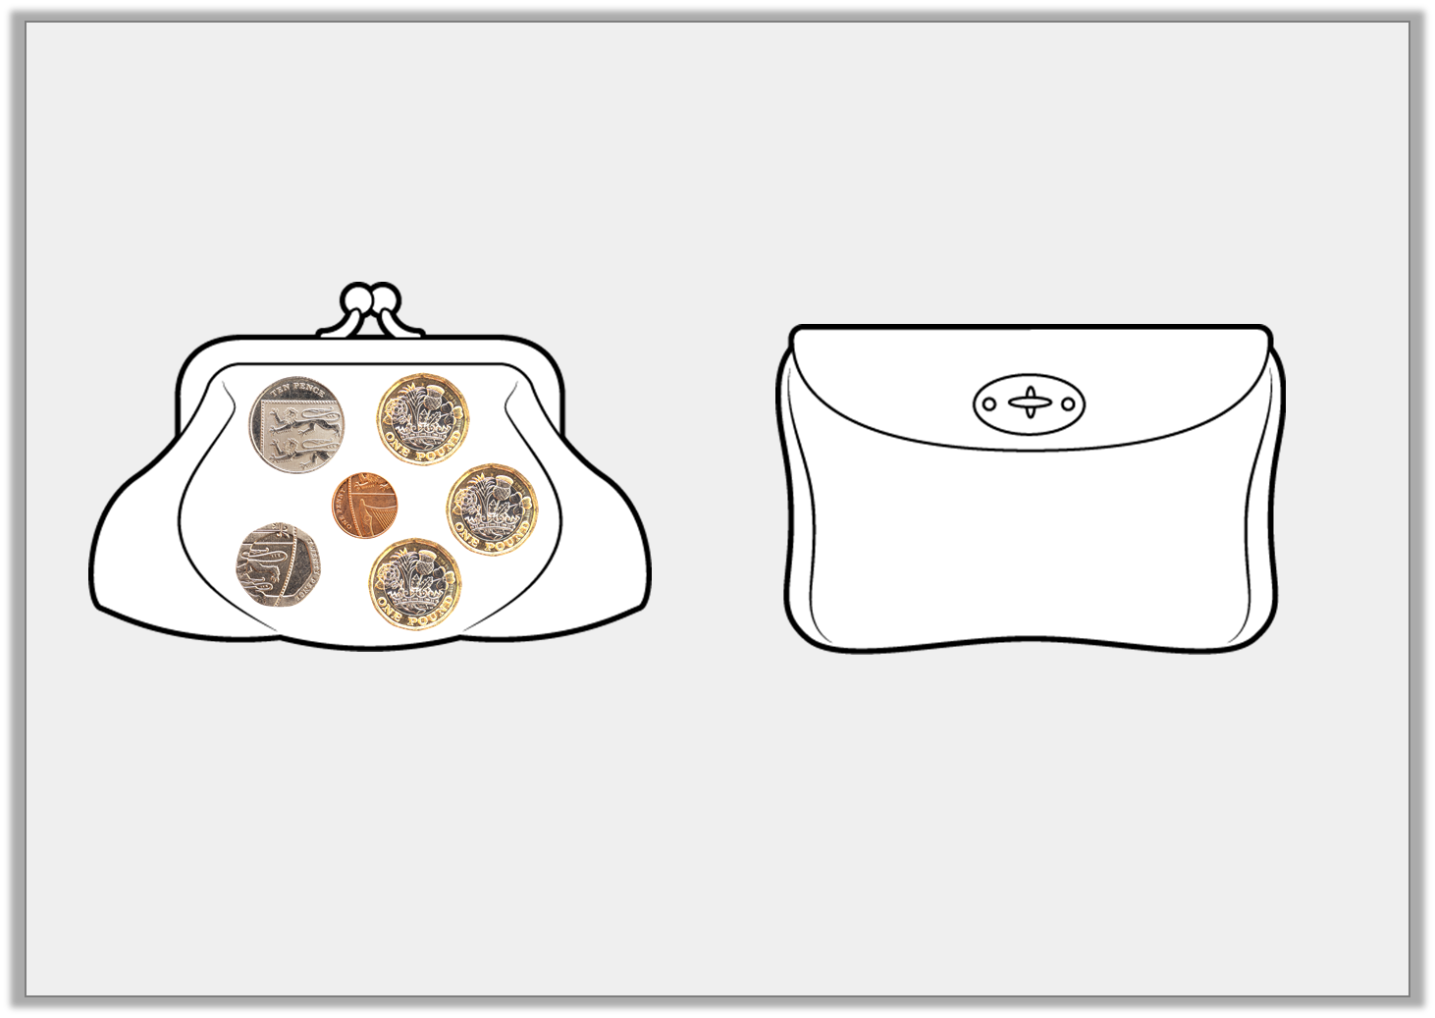
Varied Fluency 3
Find the total amount of money in these two purses.
Show your calculation.
Purse 1:
Purse 2:
+
£5 and 99p
© Classroom Secrets Limited 2019

Slide 11
Varied Fluency 3
Find the total amount of money in these two purses.
Show your calculation.
£3 and 31p + £5 and 99p = £9 and 30p
Purse 1:
Purse 2:
+
£5 and 99p
£3 and 31p | + | £5 and 99p
© Classroom Secrets Limited 2019

Slide 12
Varied Fluency 4
Complete these additions.
A. £2 and 85p | + | £4 and 35p | =
B. £5 and 22p | + | £3 and 34p | =
© Classroom Secrets Limited 2019

Slide 13
Varied Fluency 4
Complete these additions.
A. £2 and 85p | + | £4 and 35p | = | £7 and 20p
B. £5 and 22p | + | £3 and 34p | = | £8 and 56p
© Classroom Secrets Limited 2019

Slide 14
Problem Solving 1
Add any two amounts shown below, together to make a total more than £9.
Find three possibilities.
£7 and 15p
£1 and 70p
£2 and 20p
£4 and 60p
£3 and 65p
£1 and 30p
© Classroom Secrets Limited 2019

Slide 15
Problem Solving 1
Add any two amounts shown below, together to make a total more than £9.
Find three possibilities.
Various answers, for example:
£7 and 15p + £2 and 20p = £9 and 35p,
£7 and 15p + 365p = £10 and 80p
£4 and 60p + £7 and 15p = £11 and 75p.
£7 and 15p
£1 and 70p
£2 and 20p
£4 and 60p
£3 and 65p
£1 and 30p
© Classroom Secrets Limited 2019

Slide 16

Problem Solving 2
Geraint has made £8 and 60p below by adding two amounts of money together.
Help Geraint find two other ways of making £8 and 60p by adding two amounts together, using 1 note and 6 coins in total.
£5 and 35p + £3 and 25p = £8 and 60p
I used 1 note and 12 coins in total.
© Classroom Secrets Limited 2019

Slide 17
Problem Solving 2
Geraint has made £8 and 60p below by adding two amounts of money together.
Help Geraint find two other ways of making £8 and 60p by adding two amounts together, using 1 note and 6 coins in total.
Various answers, for example:
£6 and 55p (made up of: one £5 note + three 50p coins + one 5p coin) + £2 and 5p (made up of: one £2 coin + one 5p coin) = £8 and 60p
£6 and 10p (made up of: one £5 note + one £1 coin + one 10p coin) + £2 and 50p (made up of: one £2 coin + two 20p coins + one 10p coin) = £8 and 60p.
£5 and 35p + £3 and 25p = £8 and 60p
I used 1 note and 12 coins in total.
© Classroom Secrets Limited 2019

Slide 18
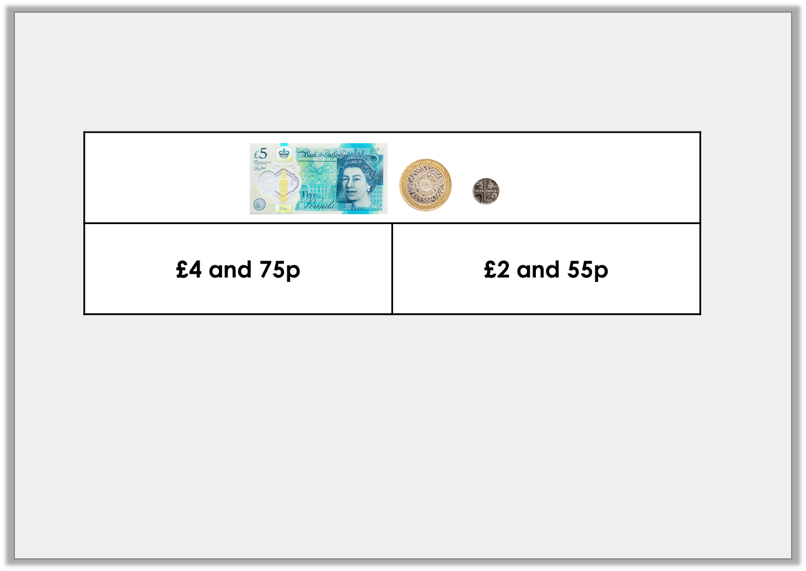
Reasoning 1
Sanjay has used this bar model to represent an addition.
He thinks he has lost two different silver coins.
Do you agree? Explain your reasoning.
© Classroom Secrets Limited 2019

Slide 19
Reasoning 1
Sanjay has used this bar model to represent an addition.
He thinks he has lost two different silver coins.
Do you agree? Explain your reasoning.
Yes, this is possible because…
© Classroom Secrets Limited 2019

Slide 20
Reasoning 1
Sanjay has used this bar model to represent an addition.
He thinks he has lost two different silver coins.
Do you agree? Explain your reasoning.
Yes, this is possible because the difference is 25p which can be made with two different silver coins (20p and 5p).
© Classroom Secrets Limited 2019

