Slide 1
15/12/2020
L.I: To use the 8 times tables

Slide 3
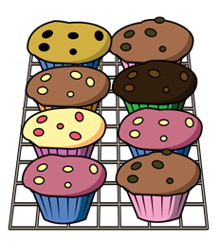

1) How many cakes?
2) Write a multiplication equation to represent the apples.
3) Complete the number track.
8 | 16 | 24 |  |  | 48 |  | 64 |  | 80 |  | 96

Slide 5

8
16
24
32
40
48
56
64
72
80
88
96
8
16
24
32
40
48
56
64
72
80
88
96

Slide 6
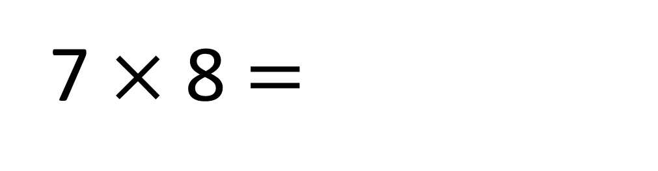
40
80
7 $×$ 8 $=$
56

Slide 7
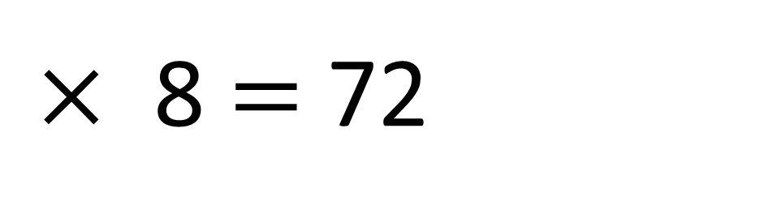
40
80
9
$×$ 8 $=$ 72

Slide 8
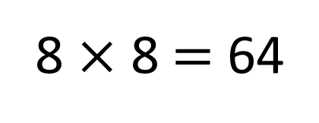
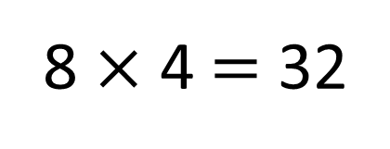
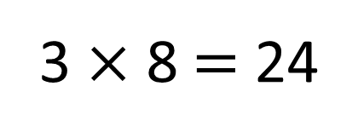
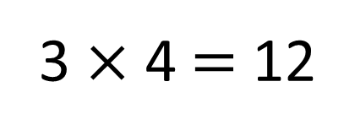
4 | 8 | 12 | 16 | 20 | 24 | 28 | 32 | 36 | 40 | 44 | 48
8 | 16 | 24 | 32 | 40 | 48 | 56 | 64 | 72 | 80 | 88 | 96
3 × 4 $=$ 12
8 × 4 $=$ 32
3 × 8 $=$ 24
8 × 8 $=$ 64

Slide 9






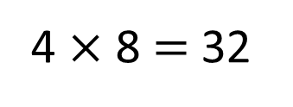
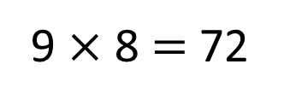
Alex and Rosie are playing a game.
32
72
4 $×$ 8 $=$ 32
9 $×$ 8 $=$ 72

Slide 10

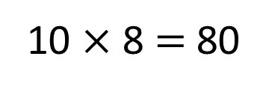
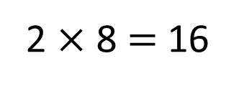
Alex and Rosie are playing a game.
32
72
80
16
2 $×$ 8 $=$ 16
10 $×$ 8 $=$ 80

Slide 11
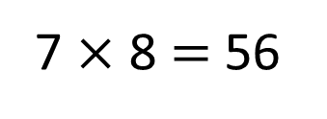
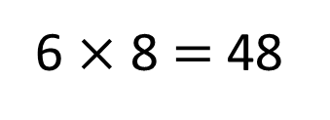
Alex and Rosie are playing a game.
32
72
80
16
R
A
32
96
48
56
R
40
48
64
24
7 $×$ 8 $=$ 56
6 $×$ 8 $=$ 48

Slide 12
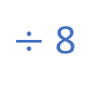
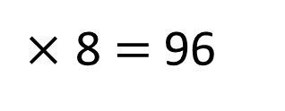
What number did Alex roll?
32
72
80
16
A
R
A
32
96
48
56
R
40
48
64
24
12
$×$ 8 $=$ 96
$÷$ 8

Slide 13



12
16
20
18
Multiples of 3
Multiples of 4
?
24 48
Multiples of 8
?
Have a think

Slide 14

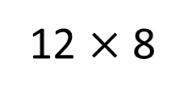
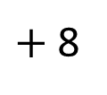
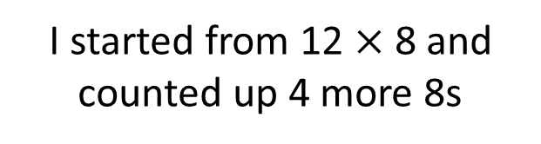
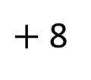
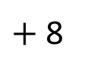
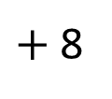
What is 16 $×$ 8?
Have a think
I started from 12 $×$ 8 and counted up 4 more 8s
12 $×$ 8
$+$ 8
$+$ 8
$+$ 8
$+$ 8
0
96
104
112
120
128

Slide 15

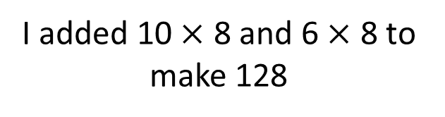
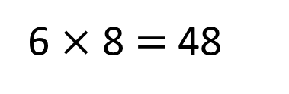
What is 16 $×$ 8?
I added 10 $×$ 8 and 6 $×$ 8 to make 128
128
80 | 48
10 $×$ 8 $=$ 80
6 $×$ 8 $=$ 48

Slide 16

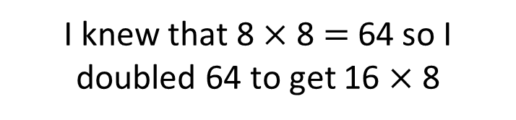
What is 16 $×$ 8?
I knew that 8 $×$ 8 $=$64 so I doubled 64 to get 16 $×$ 8
64
60
4
double 60
double 4
120
8

Slide 17
Have a go at the questions on the worksheet

