Slide 1



LIFE/work balance
We have started a #LIFEworkbalance campaign and we need your help to complete our LIFE/work balance survey.
We hope to publish the results soon, so please give 15 minutes of your time to help us get a true picture of school life.
Want to be a part of this campaign? Take the survey on our website and share it with your colleagues!
© Classroom Secrets Limited 2020

Slide 2
Year 3 – Spring Block 2 – Money – Giving Change
About This Resource:
This PowerPoint has been designed to support your teaching of this small step. It includes a starter activity and an example of each question from the Varied Fluency and Reasoning and Problem Solving resources also provided in this pack. You can choose to work through all examples provided or a selection of them depending on the needs of your class.
National Curriculum Objectives:
Mathematics Year 3 (3M9a) Add and subtract amounts of money to give change, using both £ and p in practical contexts
More Year 3 Money resources.
Did you like this resource? Don’t forget to review it on our website.
© Classroom Secrets Limited 2019

Slide 3
Year 3 – Spring Block 2 – Money
Step 5: Giving Change
© Classroom Secrets Limited 2019

Slide 4
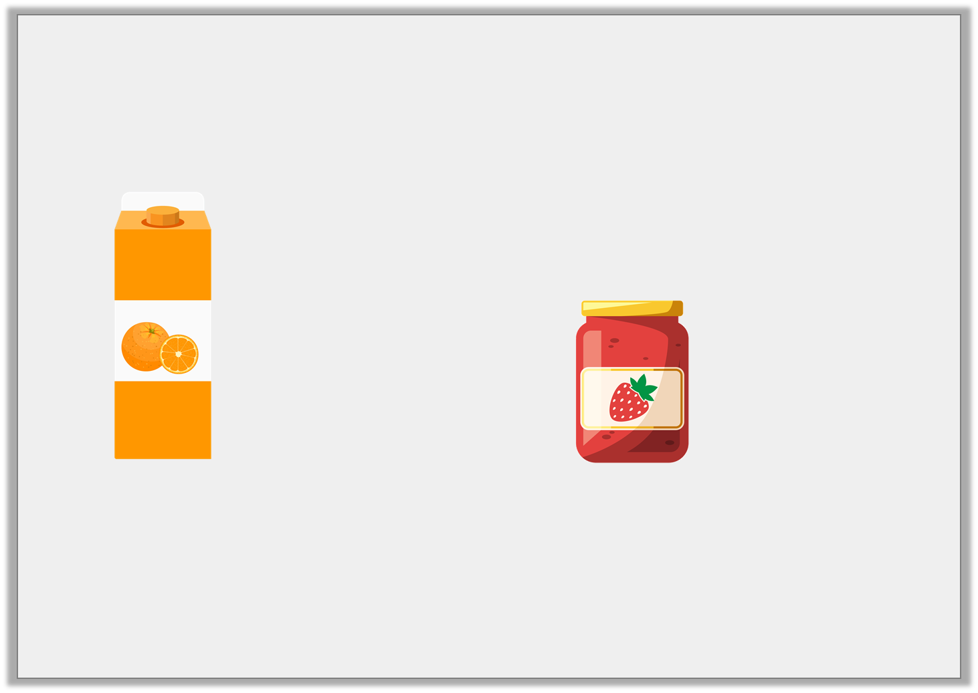
Introduction
Choose the nearest whole pounds for the change you would receive if you bought the jam and the orange juice and paid with a £10 note.
£2 and 69p
£3 and 45p
A. | B. | C.
£6 | £4 | £8
© Classroom Secrets Limited 2019

Slide 5
Introduction
Choose the nearest whole pounds for the change you would receive if you bought the jam and the orange juice and paid with a £10 note.
£2 and 69p
£3 and 45p
A. | B. | C.
£6 | £4 | £8
© Classroom Secrets Limited 2019

Slide 6
Varied Fluency 1
Alice buys a book for £7 and 68p. She pays with a £10 note.
Complete the number line to work out her change.
?
?
?
£7 and 68p
£7 and 70p
£8
£10
© Classroom Secrets Limited 2019

Slide 7
Varied Fluency 1
Alice buys a book for £7 and 68p. She pays with a £10 note.
Complete the number line to work out her change.
The change will be £2 and 32p.
£2
2p
30p
£7 and 68p
£7 and 70p
£8
£10
© Classroom Secrets Limited 2019

Slide 8
Varied Fluency 2
Sophie goes swimming. It costs £3 and 75p.
She pays with a £5 note.
What will her change be?
£5
£3 and 75p | ?
© Classroom Secrets Limited 2019

Slide 9
Varied Fluency 2
Sophie goes swimming. It costs £3 and 75p.
She pays with a £5 note.
What will her change be?
Her change will be £1 and 25p.
£5
£3 and 75p | £1 and 25p
© Classroom Secrets Limited 2019

Slide 10
Varied Fluency 3
Joe buys an ice cream for 87p. He pays with a £2 coin.
Calculate his change.
£2
?
87p
© Classroom Secrets Limited 2019

Slide 11
Varied Fluency 3
Joe buys an ice cream for 87p. He pays with a £2 coin.
Calculate his change.
His change will be £1 and 13p.
£2
£1 and 13p
87p
© Classroom Secrets Limited 2019

Slide 12

Varied Fluency 4
If you buy the ball, what will your change be
if you pay with a £10 note?
£3 and 65p
© Classroom Secrets Limited 2019

Slide 13
Varied Fluency 4
If you buy the ball, what will your change be
if you pay with a £10 note?
His change will be £6 and 35p.
£3 and 65p
© Classroom Secrets Limited 2019

Slide 14
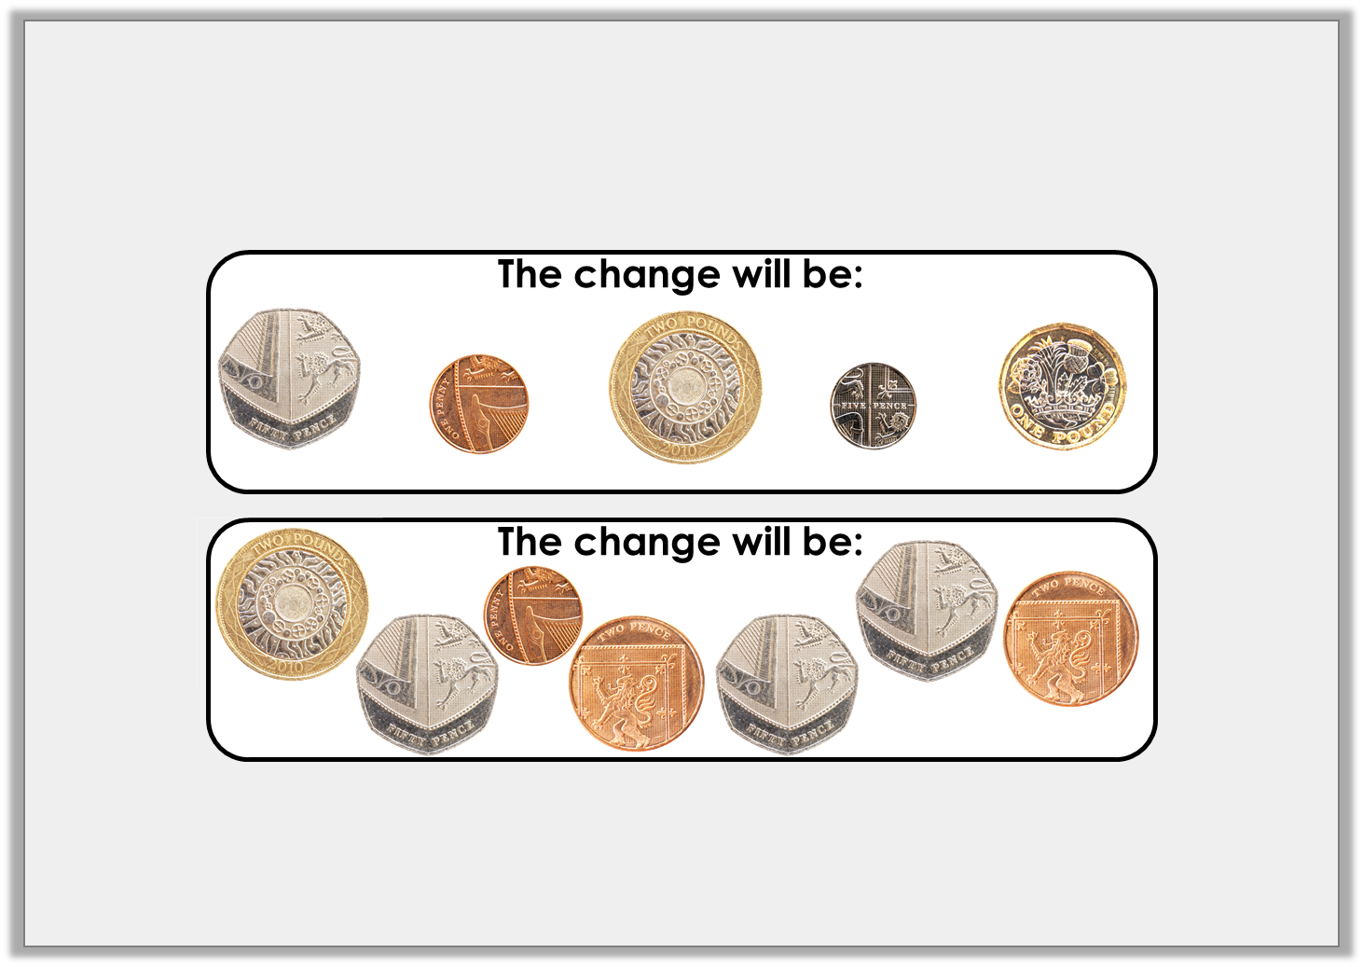
Reasoning 1
Andrew buys a chocolate bar which costs £1 and 44p.
He gives the shop keeper a £5 note.
Which is correct? Prove it.
A.
B.
© Classroom Secrets Limited 2019

Slide 15
Reasoning 1
Andrew buys a chocolate bar which costs £1 and 44p.
He gives the shop keeper a £5 note.
Which is correct? Prove it.
A is correct because...
A.
B.
© Classroom Secrets Limited 2019

Slide 16
Reasoning 1
Andrew buys a chocolate bar which costs £1 and 44p.
He gives the shop keeper a £5 note.
Which is correct? Prove it.
A is correct because £5 – £1 and 44p = £3 and 56p change.
A.
B.
© Classroom Secrets Limited 2019

Slide 17

Problem Solving 1
Matt bought an ice cream. He paid with a £2 coin.
In his change he got three different silver coins.
How much could the ice cream cost?
Show your working.
?
£2
© Classroom Secrets Limited 2019

Slide 18
Problem Solving 1
Matt bought an ice cream. He paid with a £2 coin.
In his change he got three different silver coins.
How much could the ice cream cost?
Show your working.
Various answers, for example: The ice cream cost £1 and 25p.
£1 and 25p
50p
5p
20p
£1 and 25p
£1 and 30p
£1 and 50p
£2
© Classroom Secrets Limited 2019

Slide 19

Problem Solving 2
Veronica bought some building blocks. She paid with a £10 note.
Which coins might she get in her change? Give 3 possible answers.
£3 and 52p
£10
£3 and 52p | ?
© Classroom Secrets Limited 2019

Slide 20
Problem Solving 2
Veronica bought some building blocks. She paid with a £10 note.
Which coins might she get in her change? Give 3 possible answers.
Various answers, for example:
£2 + £2 + £2 + 10p + 10p + 10p + 10p + 5p + 2p + 1p = £6 and 48p
£2 + £2 + £1 + £1 + 20p + 20p + 2p + 2p + 2p + 2p = £6 and 48p
£2 + £2 + £1 + 50p + 50p + 20p + 10p + 10p + 5p + 1p + 1p + 1p = £6 and 48p
£3 and 52p
£10
£3 and 52p | £6 and 48p
© Classroom Secrets Limited 2019

