Slide 1


Y5-6 Solving Word Problems
Addition and Subtraction
Commissioned by The PiXL Club Ltd.
October 2019
This resource is strictly for the use of member schools for as long as they remain members of The PiXL Club. It may not be copied, sold nor transferred to a third party or used by the school after membership ceases. Until such time it may be freely used within the member school.
All opinions and contributions are those of the authors. The contents of this resource are not connected with nor endorsed by any other company, organisation or institution.
PiXL Club Ltd endeavour to trace and contact copyright owners. If there are any inadvertent omissions or errors in the acknowledgements or usage, this is unintended and PiXL will remedy these on written notification
© Copyright The PiXL Club Limited, 2019

Slide 2
Teacher guidance
Typically, pupils lack confidence tackling word problems, mainly because they involve several steps and a large amount of information to process. Barriers to successfully answering these may, of course, be the mathematical concepts being assessed, but the amount of reading, the challenging vocabulary, as well as identifying the correct operation/s to perform, is not to be underestimated.
This therapy begins by explaining a suggested teaching strategy for these question types. The intention of this strategy is to develop pupil confidence in tackling such questions through high-quality modelling. Using the teach, model and apply format, it will take pupils through this strategy with two modelled questions. Pupils will then have the opportunity to apply this independently.
The guidance notes under each slide explain each stage. It is assumed that Stage One, the teaching of the mathematical skill/concept involved, has been already taught.

Slide 3

The PiXL approach to solving word problems
Unlock the language
Unlock the numbers
Embed vocabulary
Number-free zones
Answer-free zones
Full problem
Teach the mathematical concept/skill being tested within the question
Stage 1 | Stage 2 | Stage 3 | Stage 4 | Stage 5

Slide 4
Model Question 1

Slide 5
Stage 2 - Vocabulary
15,740 car show tickets were sold in advance of the show. Another 8,497 were sold on the day of the show. 652 people did not attend the car show. How many people were at the show altogether?

Slide 6

Stage 2 - Vocabulary
Synonym: _____________________
Antonym: _____________________
My definition: ____________________
_________________________________
_________________________________
Used in context: ___________________
_________________________________
______________________________
Word:
advance
Picture:

Slide 7
Stage 3 – Number Free Zone
15,740 car show tickets were sold in advance of the show. Another 8,497 were sold on the day of the show. 652 people did not attend the car show. How many people were at the show altogether?
1. Vocabulary - Write a definition for the following words:
a) another b) attend
2. Retrieval – What type of show is it?
3. Inference – What is the question asking you to do? Summarise the problem.

Slide 8
Stage 4 – Answer Free Zone
15,740 car show tickets were sold in advance of the show. Another 8,497 were sold on the day of the show. 652 people did not attend the car show. How many people were at the show altogether?
Answer: 23,585

Slide 9
Thinking Talk
15,740 car show tickets were sold in advance of the show. Another 8,497 were sold on the day of the show. 652 people did not attend the car show. How many people were at the show altogether?
Firstly, I need to find out how many tickets were sold altogether.
The second step is to subtract the 652 people that did not attend.
To do this, I need to subtract 652 from the total number of tickets that were sold (the answer to the previous calculation).
To do this, I need to add two amounts together using the column method. So, I will add 8,497 to 15,740. I know that 16,000 + 8,000 = 24,000 so the actual answer will be close to this.
Answer: 23,585

Slide 10
Thinking Talk
15,740 car show tickets were sold in advance of the show. Another 8,497 were sold on the day of the show. 652 people did not attend the car show. How many people were at the show altogether?
I could show this as two column method calculations.
15740 + 8497 24237 | 24237 - 652 23585
From this, I can see that the number of people who did attend the car show is 23,585.
Answer: 23,585

Slide 11
Stage 5 – Your Turn
21,357 car show tickets were sold in advance of the show. Another 6,254 were sold on the day of the show. 1,035 people did not attend the car show. How many people were at the show altogether?
Answer: 26,576

Slide 12
Model Question 2

Slide 13
Stage 2 - Vocabulary
At the start of February, there were 2,548 flowers in the florist. During February, 7,652 more flowers were delivered, 5,418 flowers were used in orders and 763 flowers had wilted and were disposed of. How many flowers were left in the shop at the end of February?

Slide 14
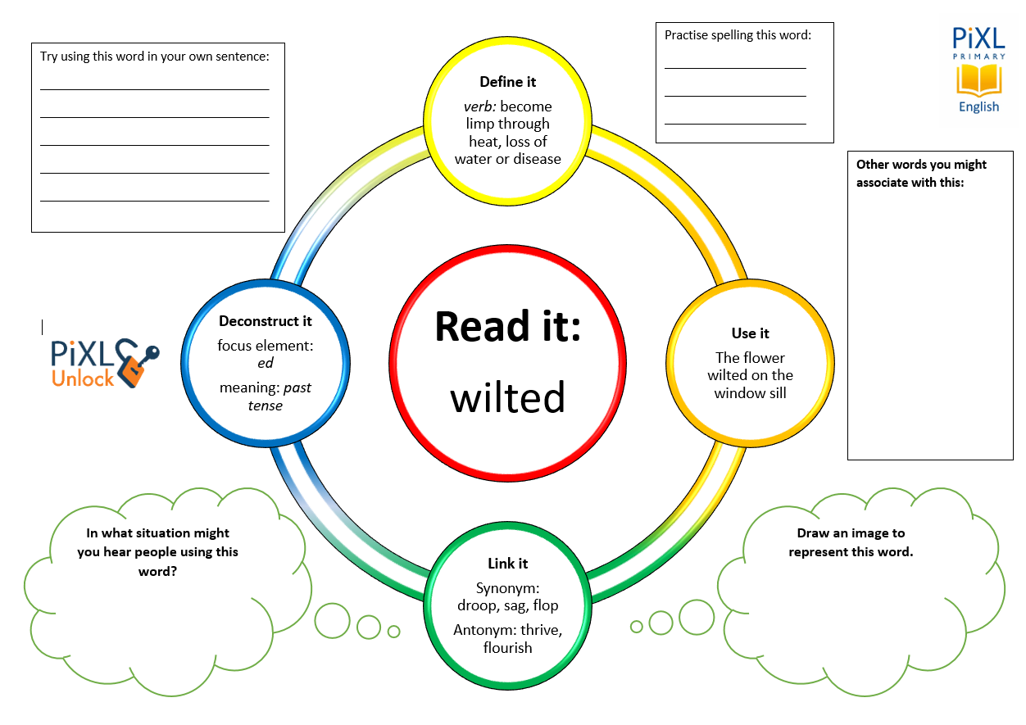
Stage 2 - Vocabulary
florist
delivered
wilted
disposed

Slide 15
Stage 3 – Number Free Zone
At the start of February, there were 2,548 flowers in the florist. During February, 7,652 more flowers were delivered, 5,418 flowers were used in orders and 763 flowers had wilted and were disposed of. How many flowers were left in the shop at the end of February?
1. Vocabulary - Write a definition for the following words:
a) disposed b) florist
2. Retrieval – What happened to the wilted flowers?
3. Inference – What is the question asking you to do? Summarise the problem.

Slide 16
Stage 4 - Answer Free Zone
At the start of February, there were 2,548 flowers in the florist. During February, 7,652 more flowers were delivered, 5,418 flowers were used in orders and 763 flowers had wilted and were disposed of. How many flowers were left in the shop at the end of February?
Answer: 4,019

Slide 17
Thinking Talk
At the start of February, there were 2,548 flowers in the florist. During February, 7,652 more flowers were delivered, 5,418 flowers were used in orders and 763 flowers had wilted and were disposed of. How many flowers were left in the shop at the end of February?
Firstly, I need to find out how many flowers were in the florist altogether after the delivery.
For the next step, I need to use that answer so I must ensure it is accurate.
To do this, I will have to add together the flowers that were already in the shop and the number that were delivered. So, I will add 7,652 to 2,548.
If 5,418 flowers were used in orders, I must subtract those from the total amount of flowers.
Answer: 4,019

Slide 18
Thinking Talk
At the start of February, there were 2,548 flowers in the florist. During February, 7,652 more flowers were delivered, 5,418 flowers were used in orders and 763 flowers had wilted and were disposed of. How many flowers were left in the shop at the end of February?
So, I need to do 2,548 + 7,652 = 10,200
Then
10,200 - 5,418 = 4,782
To do this, I must subtract 763 from the remaining flowers which was 4,782.
I then need to remember that there were other flowers that were not still in the shop.
4,782 – 763 = 4,019
Answer: 4,019

Slide 19
Stage 5 – Your Turn
At the start of February, there were 3,067 flowers in the florist. During February, 4,211 more flowers were delivered, 5,935 flowers were used in orders and 826 flowers had wilted and were disposed of. How many flowers were left in the shop at the end of February?
Answer: 517

Slide 20
Next Steps
To consolidate the language aspects of these problems, a suggestion is that the number free zone questions could form part of a guided reading session. Use Slide 7 as a model. A template can also be found in the Whole School Reading resources on inference (Slide 3).
Once pupils have developed greater confidence in tackling these word problems, they will then need to develop strategies when working independently. A suggestion is on the following slides.

Slide 21
Your Turn
A school has 345 rubbers. 2,390 more were ordered for the year. If throughout the year 1,245 were used, how many rubbers would be available for the next school year?
A theme park has 13,575 visitors on Saturday. On Sunday, 4,249 visitors entered the park. On Saturday, 2,356 people left early. On Sunday, 753 people left early. How many people stayed until closing on Saturday and Sunday altogether?

Slide 22

Solving word problems – steps to success
Take Two – read the question twice, once to get a general idea of context and vocabulary; the second to understand exactly what is being asked.
Underline/highlight key information (or eliminate information from your enquiries - like a detective!)
Give us a clue – look for key words to guide you to the operation needed, e.g. altogether suggests addition, share suggests division etc.
Summarise – in your head, summarise the question back to yourself, e.g. So, I’ve got to add the cost of 3 adults to the cost of a child, then subtract that from £50.00.

Slide 23

Solving word problems – steps to success
5. Estimate – round the numbers to give a rough idea of what the answer should be and jot it down.
6. Calculate – make sure you align digits carefully.
8. Read the question back – have you answered it?
9. Look at your original estimate – does your answer seem reasonable?

Slide 24
Apply
Further Number and Answer Free Zone questions can be found on PrimaryWise in the relevant year group areas.
These can be used to provide continued support in developing both the confidence to tackle, and strategies to solve, these problems.

