Slide 1


Y5-6 Solving Word Problems
Fractions
Commissioned by The PiXL Club Ltd.
October 2019
This resource is strictly for the use of member schools for as long as they remain members of The PiXL Club. It may not be copied, sold nor transferred to a third party or used by the school after membership ceases. Until such time it may be freely used within the member school.
All opinions and contributions are those of the authors. The contents of this resource are not connected with nor endorsed by any other company, organisation or institution.
PiXL Club Ltd endeavour to trace and contact copyright owners. If there are any inadvertent omissions or errors in the acknowledgements or usage, this is unintended and PiXL will remedy these on written notification.
© Copyright The PiXL Club Limited, 2019

Slide 2
Teacher guidance
Typically, pupils lack confidence tackling word problems, mainly because they involve several steps and a large amount of information to process. Barriers to successfully answering these may, of course, be the mathematical concepts being assessed, but the amount of reading, the challenging vocabulary, as well as identifying the correct operation/s to perform, is not to be underestimated.
This therapy begins by explaining a suggested teaching strategy for these question types. The intention of this strategy is to develop pupil confidence in tackling such questions through high-quality modelling. Using the teach, model and apply format, it will take pupils through this strategy with two modelled questions. Pupils will then have the opportunity to apply this independently.
The guidance notes under each slide explain each stage. It is assumed that Stage One, the teaching of the mathematical skill/concept involved, has been already taught.

Slide 3

The PiXL approach to solving word problems
Unlock the language
Unlock the numbers
Embed vocabulary
Number-free zones
Answer-free zones
Full problem
Teach the mathematical concept/skill being tested within the question
Stage 1 | Stage 2 | Stage 3 | Stage 4 | Stage 5

Slide 4
Model Question 1

Slide 5
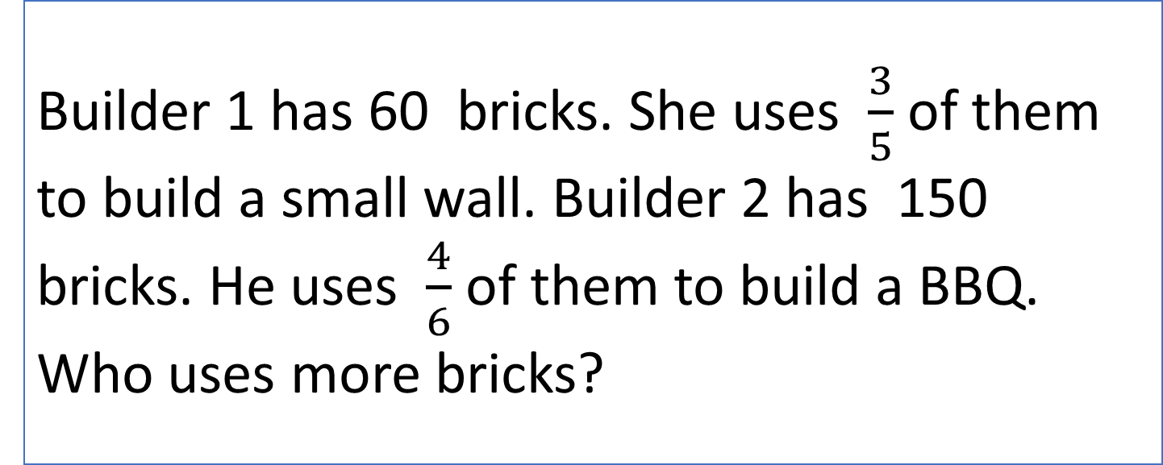
Stage 2 - Vocabulary
Builder 1 has 60 bricks. She uses $\frac{3}{5}$ of them to build a small wall. Builder 2 has 150 bricks. He uses $\frac{4}{6}$ of them to build a BBQ. Who uses more bricks?

Slide 6

Stage 2 - Vocabulary
Synonym: _____________________
Antonym: _____________________
My definition: ____________________
_________________________________
_________________________________
Used in context: ___________________
_________________________________
______________________________
Word:
fraction
Picture:

Slide 7
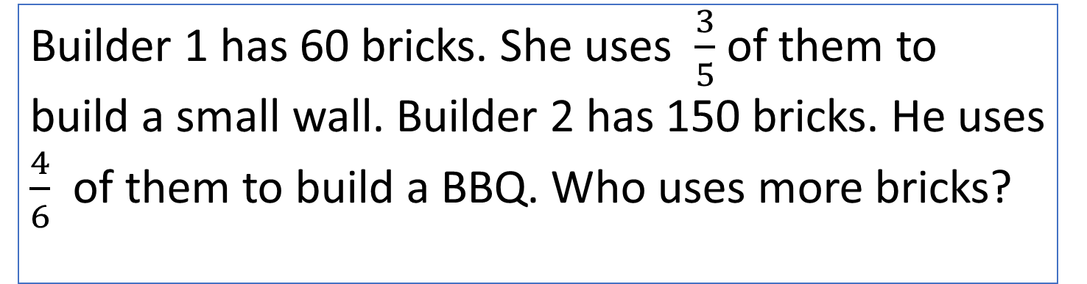
Stage 3 – Number Free Zone
Builder 1 has 60 bricks. She uses $\frac{3}{5}$ of them to build a small wall. Builder 2 has 150 bricks. He uses $\frac{4}{6}$ of them to build a BBQ. Who uses more bricks?
1. Vocabulary - Write a definition for the following words:
a) more b) builder
2. Retrieval – What is being built with the bricks?
3. Inference – What is the question asking you to do? Summarise the problem.

Slide 8
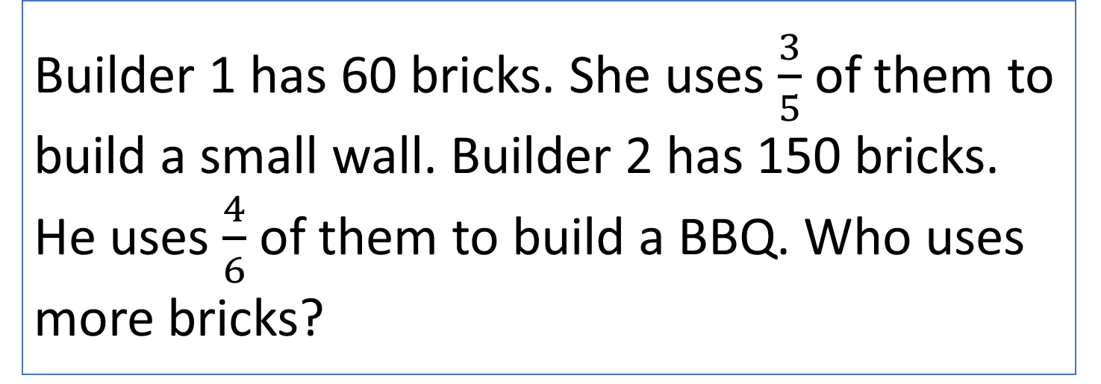
Stage 4 – Answer Free Zone
Builder 1 has 60 bricks. She uses $\frac{3}{5}$ of them to build a small wall. Builder 2 has 150 bricks. He uses $\frac{4}{6}$ of them to build a BBQ. Who uses more bricks?
Answer: Builder 2

Slide 9
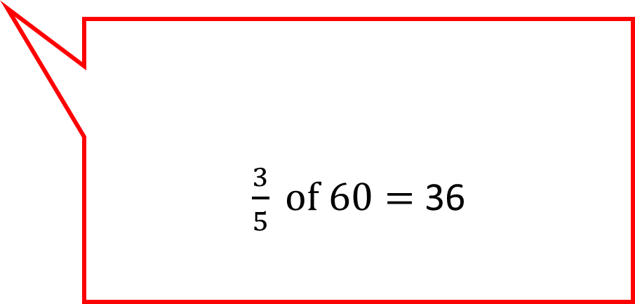
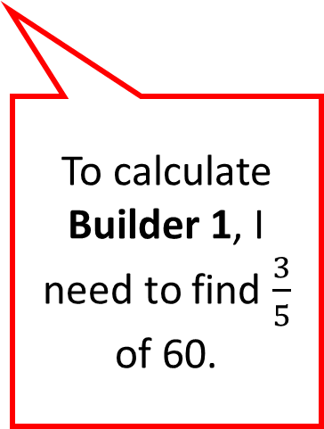
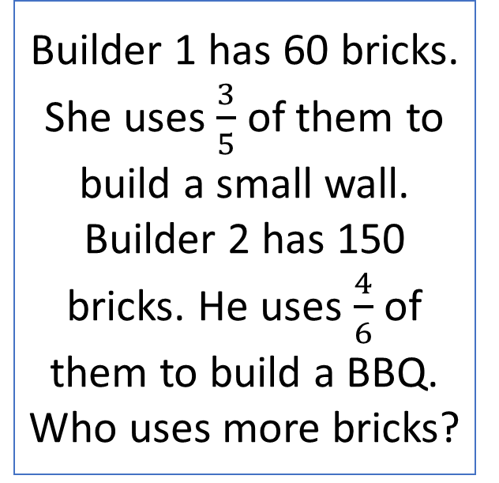
Thinking Talk
Builder 1 has 60 bricks. She uses $\frac{3}{5}$ of them to build a small wall. Builder 2 has 150 bricks. He uses $\frac{4}{6}$ of them to build a BBQ. Who uses more bricks?
To work out who uses most bricks, I need to work out how many bricks each builder uses.
60
$\frac{3}{5} of 60=$36
To calculate Builder 1, I need to find $\frac{3}{5}$ of 60.
12
12
12
12
12
Answer: Builder 2

Slide 10
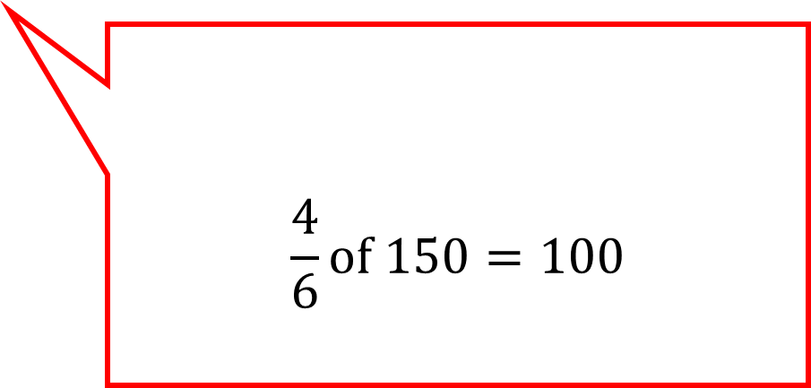
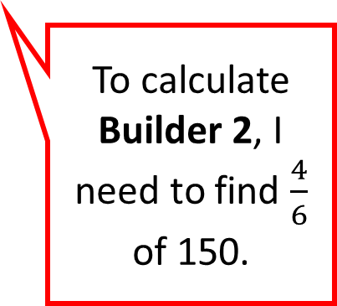
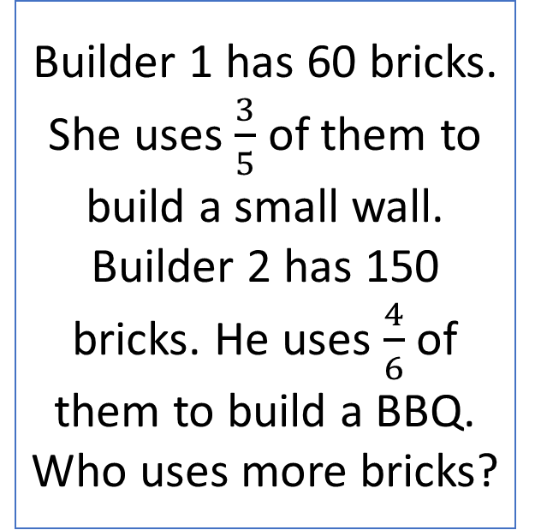
Thinking Talk
Builder 1 has 60 bricks. She uses $\frac{3}{5}$ of them to build a small wall. Builder 2 has 150 bricks. He uses $\frac{4}{6}$ of them to build a BBQ. Who uses more bricks?
$$\frac{4}{6}of 150=100$$
To calculate Builder 2, I need to find $\frac{4}{6}$ of 150.
25
25
25
25
25
25
100 > 36 so Builder 2 used the most bricks.
Answer: Builder 2

Slide 11
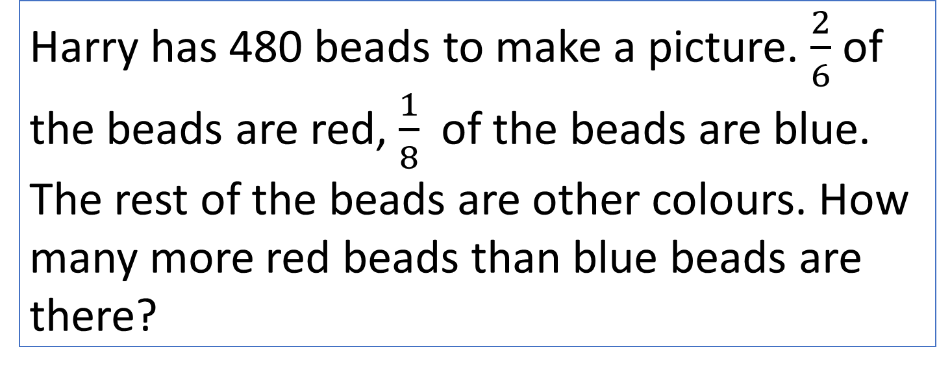
Stage 5 – Your Turn
Harry has 480 beads to make a picture. $\frac{2}{6}$ of the beads are red, $\frac{1}{8}$ of the beads are blue. The rest of the beads are other colours. How many more red beads than blue beads are there?
Answer: 100

Slide 12
Model Question 2

Slide 13
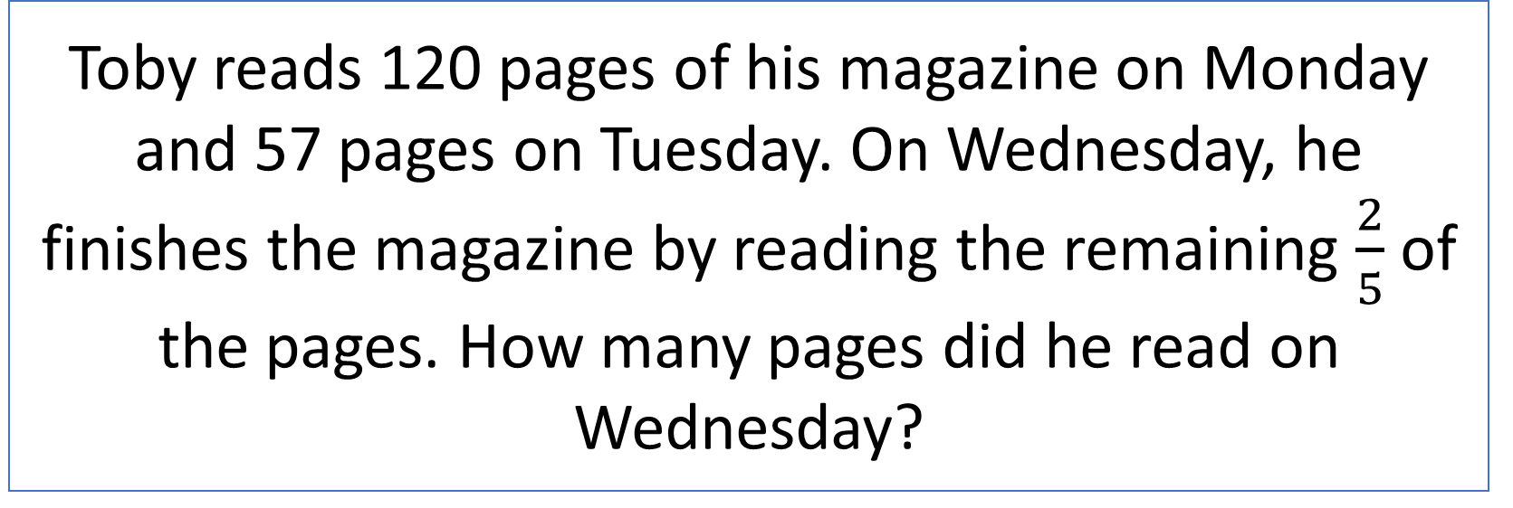
Stage 2 - Vocabulary
Toby reads 120 pages of his magazine on Monday and 57 pages on Tuesday. On Wednesday, he finishes the magazine by reading the remaining $\frac{2}{5}$ of the pages. How many pages did he read on Wednesday?

Slide 14
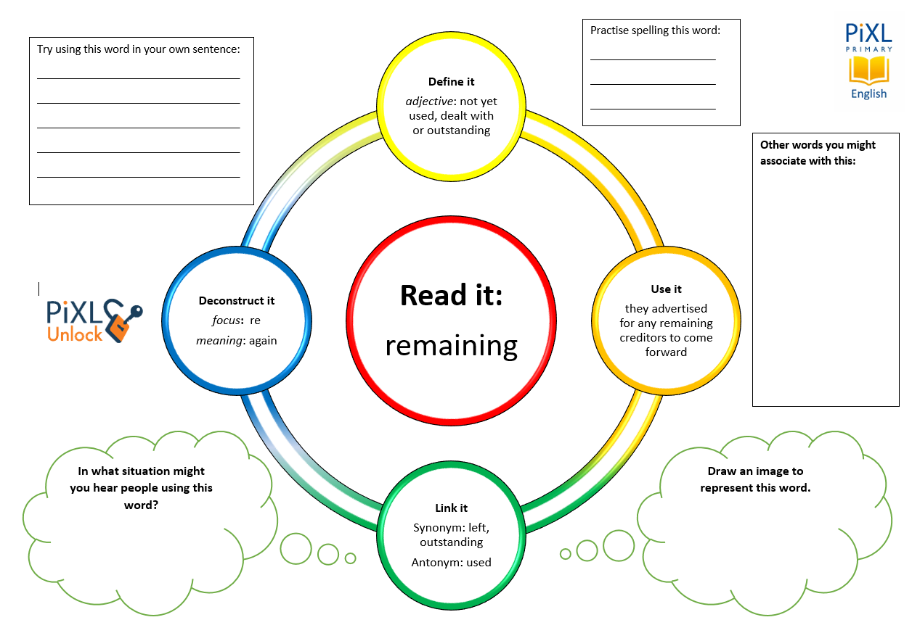
Stage 2 - Vocabulary
remaining
finish

Slide 15

Stage 3 – Number Free Zone
Toby reads 120 pages of his magazine on Monday and 57 pages on Tuesday. On Wednesday, he finishes the magazine by reading the remaining $\frac{2}{5}$ of the pages. How many pages did he read on Wednesday?
1. Vocabulary - Write a definition for the following words:
a) remaining b) magazine
2. Retrieval – How many days does it take for Toby to read his magazine?
3. Inference – What is the question asking you to do? Summarise the problem.

Slide 16

Stage 4 - Answer Free Zone
Toby reads 120 pages of his magazine on Monday and 57 pages on Tuesday. On Wednesday, he finishes the magazine by reading the remaining $\frac{2}{5}$ of the pages. How many pages did he read on Wednesday?
Answer: 118 pages

Slide 17
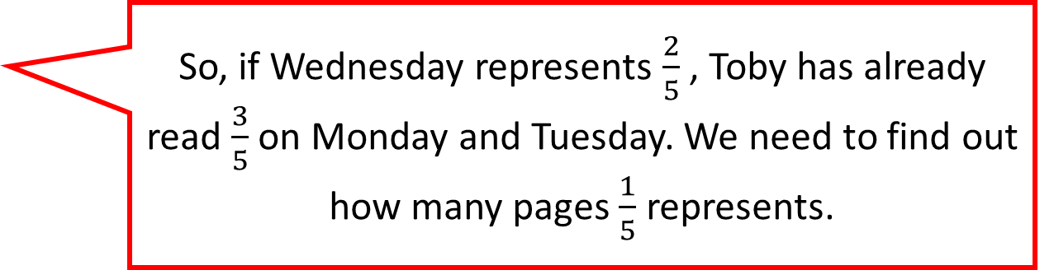
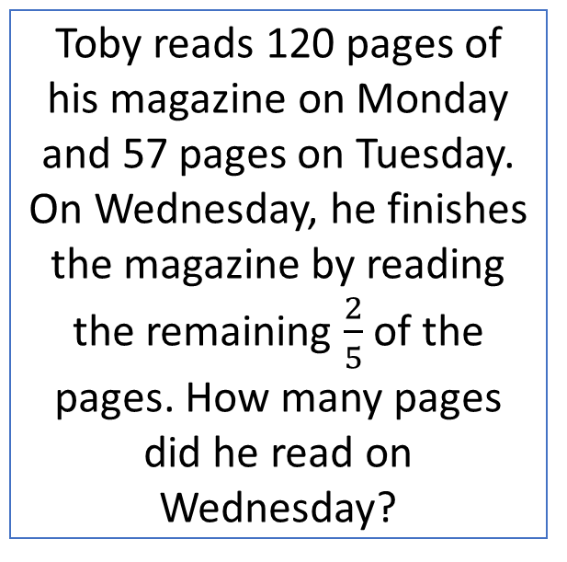
Thinking Talk
Toby reads 120 pages of his magazine on Monday and 57 pages on Tuesday. On Wednesday, he finishes the magazine by reading the remaining $\frac{2}{5}$ of the pages. How many pages did he read on Wednesday?
To begin with, I will draw a bar model.
Mon + Tues
Wed
So, if Wednesday represents $\frac{2}{5}$ , Toby has already read $\frac{3}{5}$ on Monday and Tuesday. We need to find out how many pages $\frac{1}{5}$ represents.
Answer: 118 pages

Slide 18
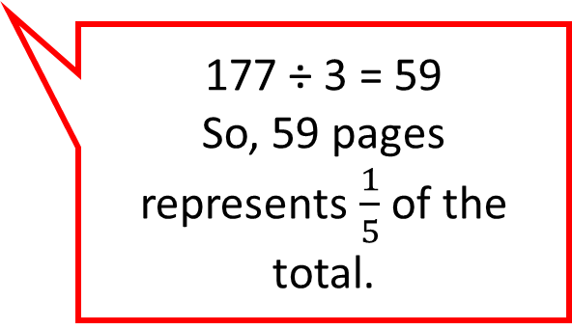
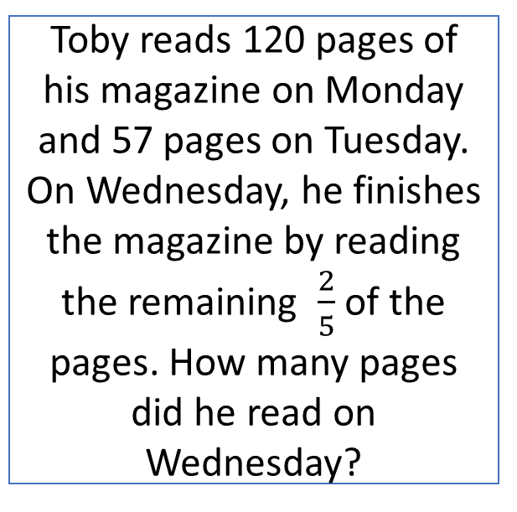
Thinking Talk
Toby reads 120 pages of his magazine on Monday and 57 pages on Tuesday. On Wednesday, he finishes the magazine by reading the remaining $\frac{2}{5}$ of the pages. How many pages did he read on Wednesday?
177
Mon + Tues
Wed
177 ÷ 3 = 59
So, 59 pages represents $\frac{1}{5}$ of the total.
59 + 59 = 118 pages read on Wednesday.
Answer: 118 pages

Slide 19
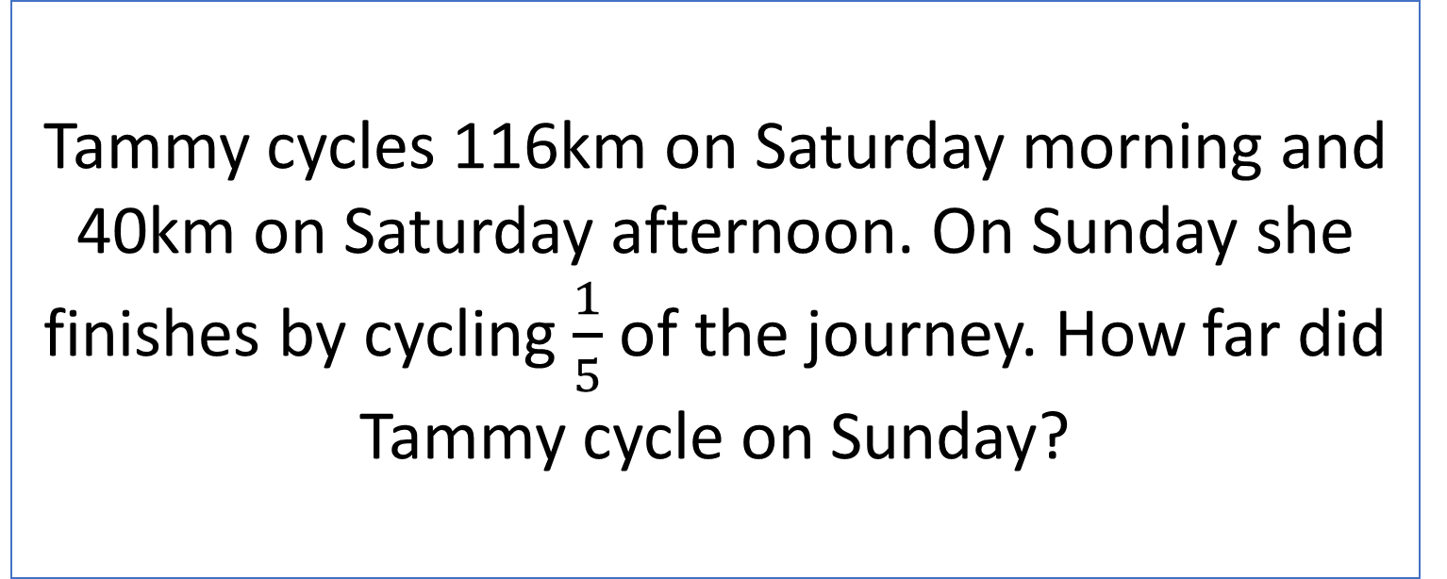
Stage 5 – Your Turn
Tammy cycles 116km on Saturday morning and 40km on Saturday afternoon. On Sunday she finishes by cycling $\frac{1}{5}$ of the journey. How far did Tammy cycle on Sunday?
Answer: 39km

Slide 20
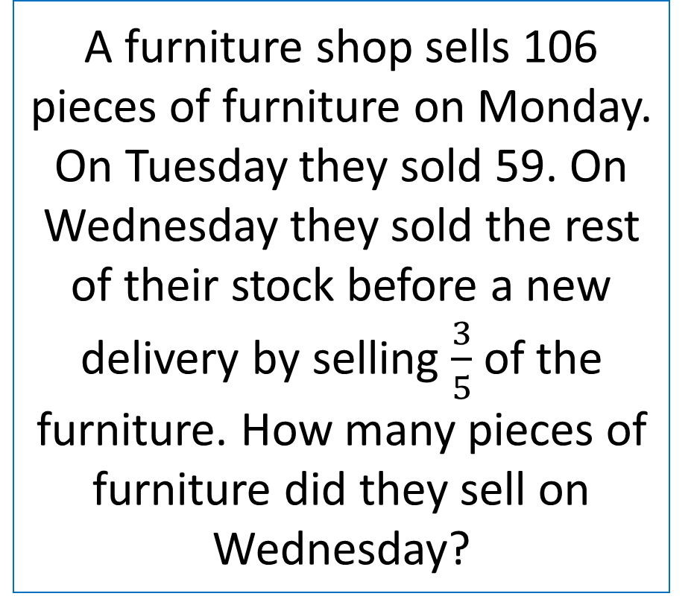
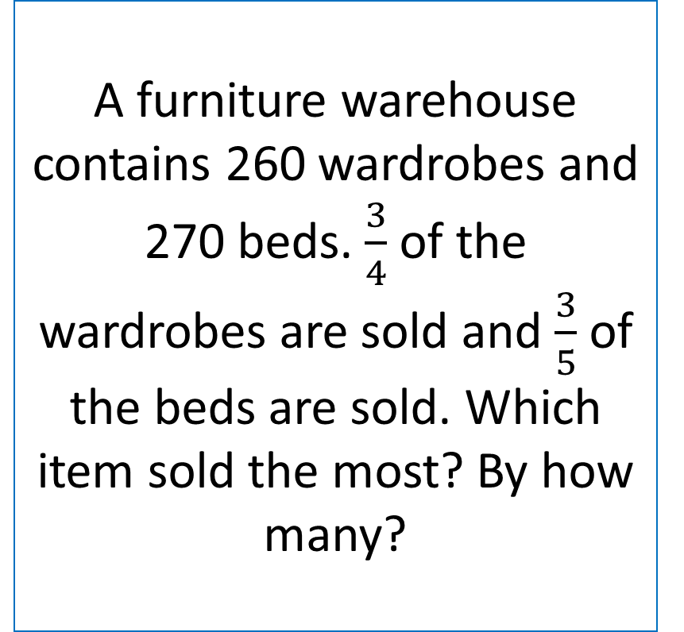
Your Turn
A furniture warehouse contains 260 wardrobes and 270 beds. $\frac{3}{4}$ of the wardrobes are sold and $\frac{3}{5}$ of the beds are sold. Which item sold the most? By how many?
A furniture shop sells 106 pieces of furniture on Monday. On Tuesday they sold 59. On Wednesday they sold the rest of their stock before a new delivery by selling $\frac{3}{5}$ of the furniture. How many pieces of furniture did they sell on Wednesday?

Slide 21
Next Steps
To consolidate the language aspects of these problems, a suggestion is that the number free zone questions could form part of a guided reading session. Use Slide 7 as a model. A template can also be found in the Whole School Reading resources on inference (Slide 3).
Once pupils have developed greater confidence in tackling these word problems, they will then need to develop strategies when working independently. A suggestion is on the following slides.

Slide 22

Solving word problems – steps to success
Take Two – read the question twice, once to get a general idea of context and vocabulary; the second to understand exactly what is being asked.
Underline/highlight key information (or eliminate information from your enquiries - like a detective!)
Give us a clue – look for key words to guide you to the operation needed, e.g. altogether suggests addition, share suggests division etc.
Summarise – in your head, summarise the question back to yourself, e.g. So, I’ve got to add the cost of 3 adults to the cost of a child, then subtract that from £50.00.

Slide 23

Solving word problems – steps to success
5. Estimate – round the numbers to give a rough idea of what the answer should be and jot it down.
6. Calculate – make sure you align digits carefully.
8. Read the question back – have you answered it?
9. Look at your original estimate – does your answer seem reasonable?

Slide 24
Apply
Further Number and Answer Free Zone questions can be found on PrimaryWise in the relevant year-group areas. These can be used to provide continued support in developing both the confidence to tackle, and strategies to solve, these problems.

