Slide 1


Y5-6 Solving Word Problems
Measurement
Commissioned by The PiXL Club Ltd.
October 2019
This resource is strictly for the use of member schools for as long as they remain members of The PiXL Club. It may not be copied, sold nor transferred to a third party or used by the school after membership ceases. Until such time it may be freely used within the member school.
All opinions and contributions are those of the authors. The contents of this resource are not connected with nor endorsed by any other company, organisation or institution.
PiXL Club Ltd endeavour to trace and contact copyright owners. If there are any inadvertent omissions or errors in the acknowledgements or usage, this is unintended and PiXL will remedy these on written notification.
© Copyright The PiXL Club Limited, 2019

Slide 2
Teacher guidance
Typically, pupils lack confidence tackling word problems, mainly because they involve several steps and a large amount of information to process. Barriers to successfully answering these may, of course, be the mathematical concepts being assessed, but the amount of reading, the challenging vocabulary, as well as identifying the correct operation/s to perform, is not to be underestimated.
This therapy begins by explaining a suggested teaching strategy for these question types. The intention of this strategy is to develop pupil confidence in tackling such questions through high-quality modelling. Using the teach, model and apply format, it will take pupils through this strategy with two modelled questions. Pupils will then have the opportunity to apply this independently.
The guidance notes under each slide explain each stage. It is assumed that Stage One, the teaching of the mathematical skill/concept involved, has been already taught.

Slide 3

The PiXL approach to solving word problems
Unlock the language
Unlock the numbers
Embed vocabulary
Number-free zones
Answer-free zones
Full problem
Teach the mathematical concept/skill being tested within the question
Stage 1 | Stage 2 | Stage 3 | Stage 4 | Stage 5

Slide 4
Model Question 1

Slide 5
Stage 2 - Vocabulary
A shop sells 1 litre of lemon squash for £1.50 and 1 litre of orange squash for £1.80. Jacob purchases 1500ml of lemon squash and ½ litre of orange squash. How much change does he get from £10 ?

Slide 6

Stage 2 - Vocabulary
Synonym: _____________________
Antonym: _____________________
My definition: ____________________
_________________________________
_________________________________
Used in context: ___________________
_________________________________
______________________________
Word:
purchase
Picture:

Slide 7
Stage 3 – Number Free Zone
A shop sells 1 litre of lemon squash for £1.50 and 1 litre of orange squash for £1.80. Jacob purchases 1500ml of lemon squash and ½ litre of orange squash. How much change does he get from £10?
1. Vocabulary - Write a definition for the following words:
a) sell b) change
2. Retrieval – What did Jacob purchase from the shop?
3. Inference – What is the question asking you to do? Summarise the problem.

Slide 8
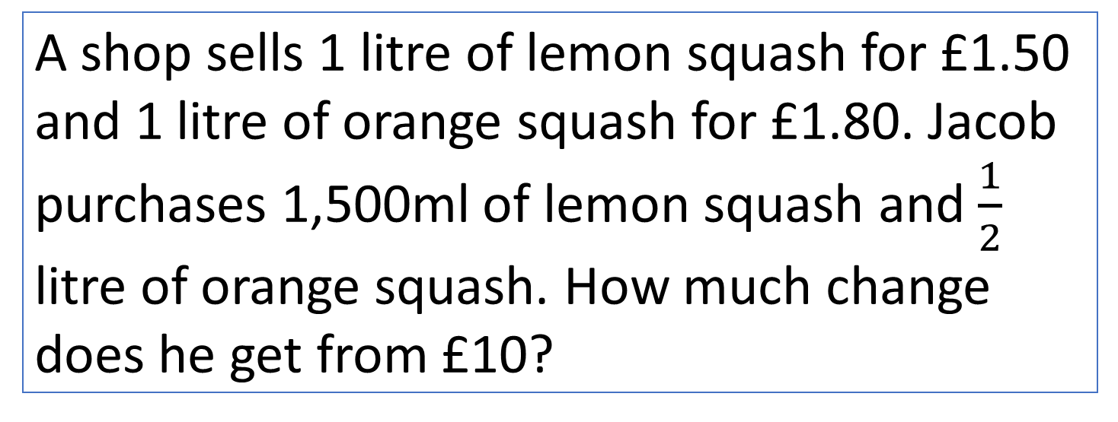
Stage 4 – Answer Free Zone
A shop sells 1 litre of lemon squash for £1.50 and 1 litre of orange squash for £1.80. Jacob purchases 1,500ml of lemon squash and $\frac{1}{2}$
litre of orange squash. How much change does he get from £10?
Answer: £6.85

Slide 9
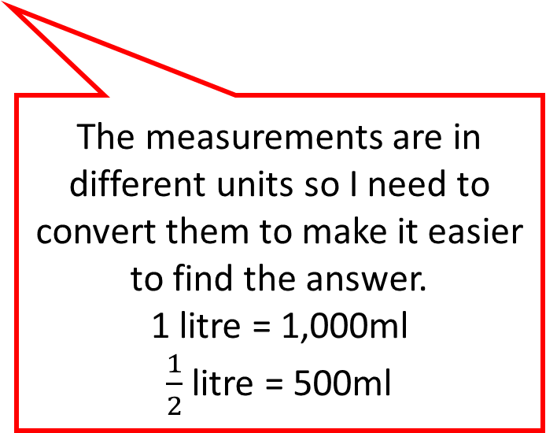
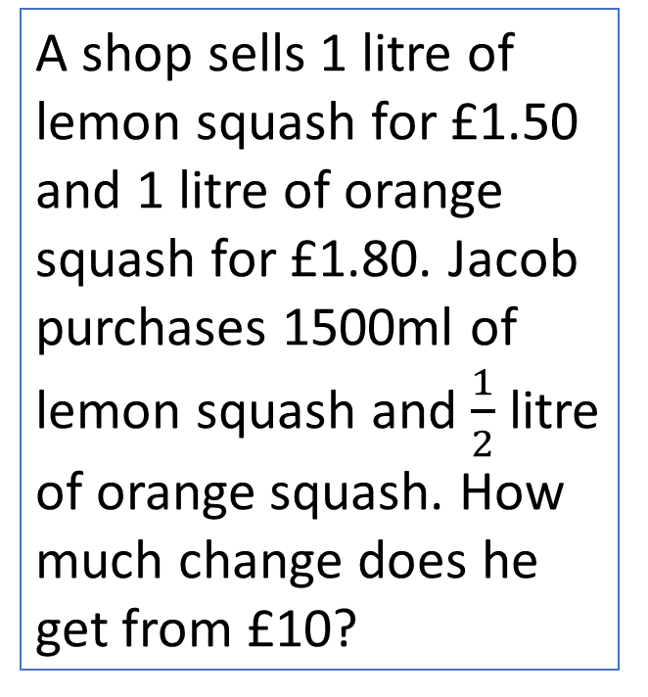
Thinking Talk
A shop sells 1 litre of lemon squash for £1.50 and 1 litre of orange squash for £1.80. Jacob purchases 1500ml of lemon squash and $\frac{1}{2}$ litre of orange squash. How much change does he get from £10?
Firstly, I can see that Jacob buys some lemon squash and orange squash.
I will start by working out how much the lemon squash will cost to buy.
Lemon Squash
1,000ml = £1.50
500ml = £0.75
So, the total cost for lemon squash is £2.25
The measurements are in different units so I need to convert them to make it easier to find the answer.
1 litre = 1,000ml
$\frac{1}{2}$ litre = 500ml
Answer: £6.85

Slide 10
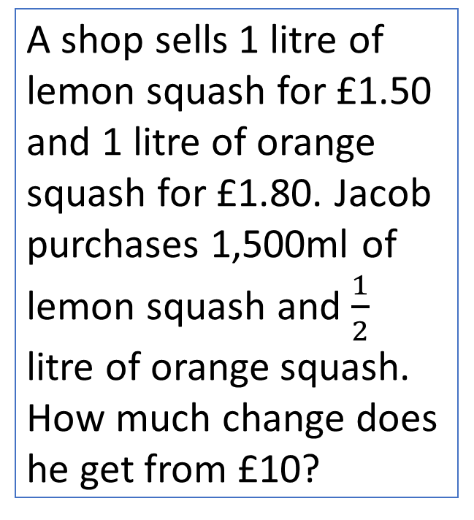
Thinking Talk
A shop sells 1 litre of lemon squash for £1.50 and 1 litre of orange squash for £1.80. Jacob purchases 1,500ml of lemon squash and $\frac{1}{2}$
litre of orange squash. How much change does he get from £10?
Jacob spends
£2.25 + £0.90. I can do this mentally using rounding and adjusting.
£2.25 + £1.00 = £3.25
£3.25 – 10p = £3.15
Orange Squash
1,000ml = £1.80
500ml = £0.90
Total cost for orange squash is £0.90
To find the change, I need to subtract £3.15 from £10. I can also do this mentally.
£10 - £3.00 = £7.00
£7.00 - £0.15 = £6.85
Answer: £6.85

Slide 11
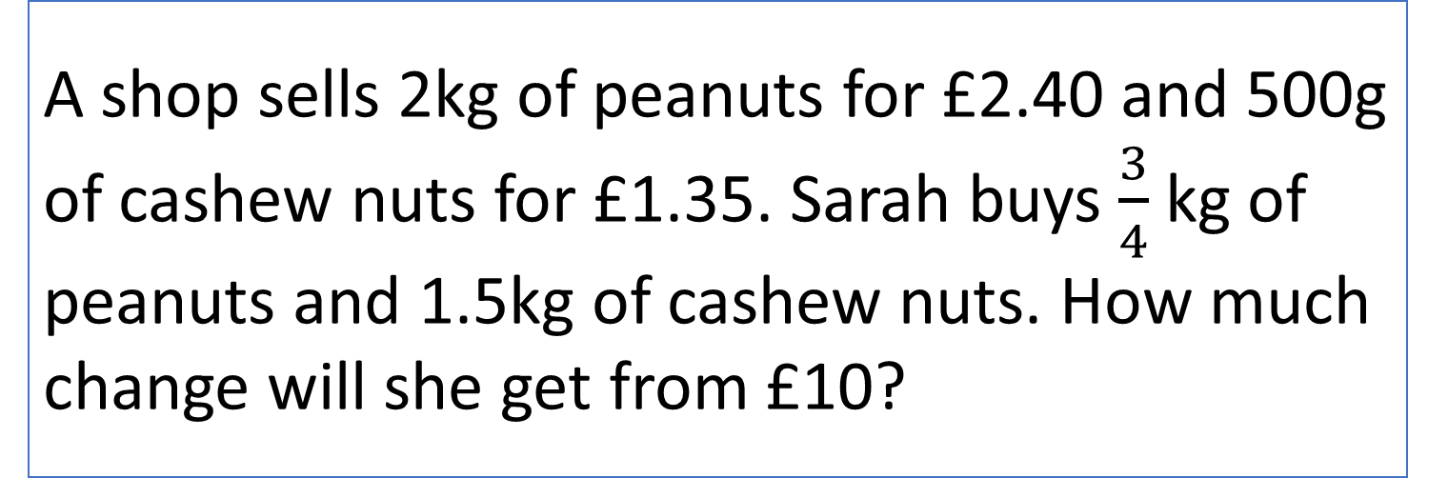
Stage 5 – Your Turn
A shop sells 2kg of peanuts for £2.40 and 500g of cashew nuts for £1.35. Sarah buys $\frac{3}{4}$ kg of peanuts and 1.5kg of cashew nuts. How much change will she get from £10?
Answer: £5.05

Slide 12
Model Question 2

Slide 13
Stage 2 - Vocabulary
Henry went to the cinema to watch a film that started at 4:45pm. The film finished at 7:10pm.What was the duration of the film? Write your answer in hours and minutes.

Slide 14
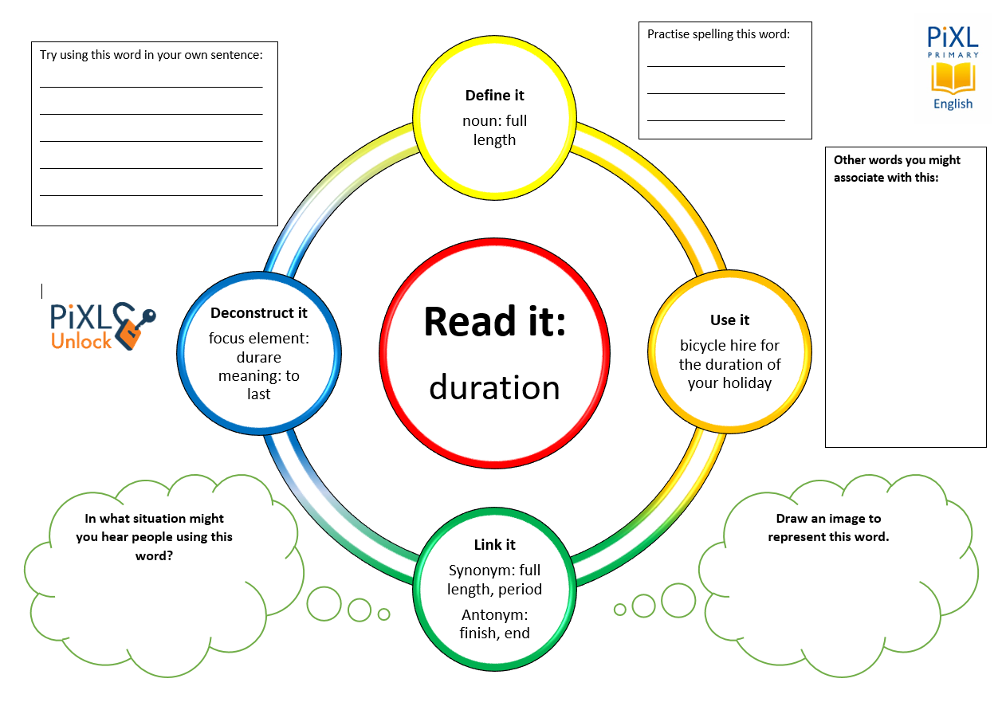
Stage 2 - Vocabulary
started
finished
hours

Slide 15
Stage 3 – Number Free Zone
Henry went to the cinema to watch a film that started at 4:45pm. The film finished at 7:10pm. What was the duration of the film? Write your answer in hours.
1. Vocabulary - Write a definition for the following words:
a) finished b) started
2. Retrieval – In what unit do you need to write the answer?
3. Inference – What is the question asking you to do? Summarise the problem.

Slide 16
Stage 4 - Answer Free Zone
Henry went to the cinema to watch a film that started at 4:45pm. The film finished at 7:10pm. What was the duration of the film? Write your answer in hours.
Answer: 2 hours and 25 minutes

Slide 17
Thinking Talk
Henry went to the cinema to watch a film that started at 4:45pm. The film finished at 7:10pm.What was the duration of the film? Write your answer in hours.
Firstly, I need to realise that this is a time duration question.
To find time duration, I need to count the interval between the two times.
The starting time is 4:45pm and it finishes at 7:10pm. If I count on from 4:45 to 5:00, that is fifteen minutes. Then I could add two hours to get to 7:00. Finally, I have the last ten minutes to add. The total time is 2 hours and 25 minutes.
Answer: 2 hours and 25 minutes

Slide 18
Thinking Talk
Henry went to the cinema to watch a film that started at 4:45pm. The film finished at 7:10pm.What was the duration of the film? Write your answer in hours.
The easiest way to show this, and be very accurate with the timings, is on a time line.
15 mins
2 hours
10 mins
4:45
5:00
7:00
7:10
Answer: 2 hours and 25 minutes

Slide 19
Stage 5 – Your Turn
Kelly arrived at the bus stop at 15:15. The buses stop at 42 minutes past the hour. How long will Kelly have to wait for the bus to arrive? Write your answer in minutes.
Answer: 27 minutes

Slide 20
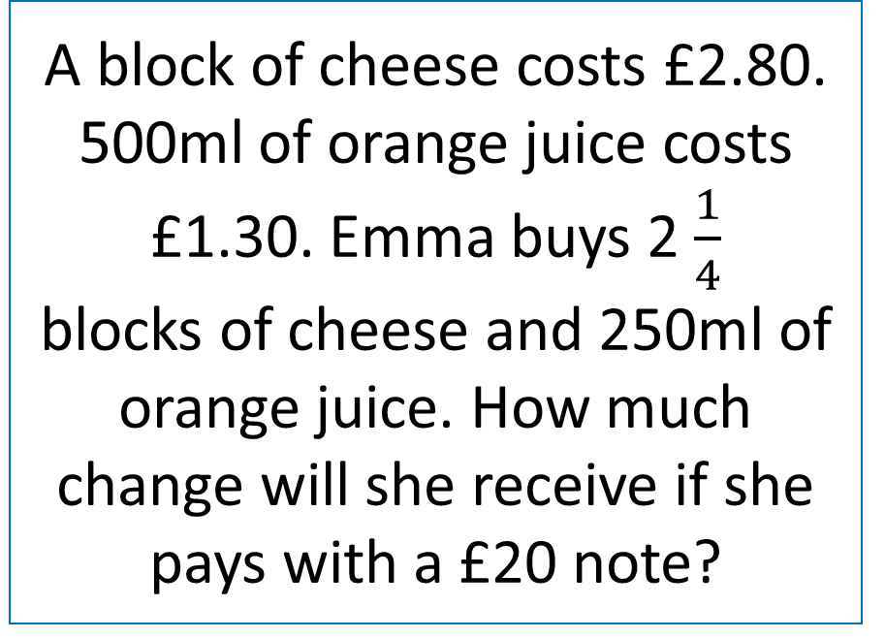
Your Turn
A film starts at 6:26pm. It lasts 145 minutes. What time will the film finish?
A block of cheese costs £2.80. 500ml of orange juice costs £1.30. Emma buys 2 $\frac{1}{4}$
blocks of cheese and 250ml of orange juice. How much change will she receive if she pays with a £20 note?

Slide 21

Solving word problems – steps to success
Take Two – read the question twice, once to get a general idea of context and vocabulary; the second to understand exactly what is being asked.
Underline/highlight key information (or eliminate information from your enquiries - like a detective!)
Give us a clue – look for key words to guide you to the operation needed, e.g. altogether suggests addition, share suggests division etc.
Summarise – in your head, summarise the question back to yourself, e.g. So, I’ve got to add the cost of 3 adults to the cost of a child, then subtract that from £50.00.

Slide 22

Solving word problems – steps to success
5. Estimate – round the numbers to give a rough idea of what the answer should be and jot it down.
6. Calculate – make sure you align digits carefully.
8. Read the question back – have you answered it?
9. Look at your original estimate – does your answer seem reasonable?

Slide 23
Next Steps
To consolidate the language aspects of these problems, a suggestion is that the number free zone questions could form part of a guided reading session. Use Slide 7 as a model. A template can also be found in the Whole School Reading resources on inference (Slide 3).
Once pupils have developed greater confidence in tackling these word problems, they will then need to develop strategies when working independently. A suggestion is on the following slides.

Slide 24
Apply
Further Number and Answer Free Zone questions can be found on PrimaryWise in the relevant year-group areas. These can be used to provide continued support in developing both the confidence to tackle, and strategies to solve, these problems.

