Slide 1


Y5-6 Solving Word Problems
Multiplication and Division
Commissioned by The PiXL Club Ltd.
October 2019
This resource is strictly for the use of member schools for as long as they remain members of The PiXL Club. It may not be copied, sold nor transferred to a third party or used by the school after membership ceases. Until such time it may be freely used within the member school.
All opinions and contributions are those of the authors. The contents of this resource are not connected with nor endorsed by any other company, organisation or institution.
PiXL Club Ltd endeavour to trace and contact copyright owners. If there are any inadvertent omissions or errors in the acknowledgements or usage, this is unintended and PiXL will remedy these on written notification.
© Copyright The PiXL Club Limited, 2019

Slide 2
Teacher guidance
Typically, pupils lack confidence tackling word problems, mainly because they involve several steps and a large amount of information to process. Barriers to successfully answering these may, of course, be the mathematical concepts being assessed, but the amount of reading, the challenging vocabulary, as well as identifying the correct operation/s to perform, is not to be underestimated.
This therapy begins by explaining a suggested teaching strategy for these question types. The intention of this strategy is to develop pupil confidence in tackling such questions through high-quality modelling. Using the teach, model and apply format, it will take pupils through this strategy with two modelled questions. Pupils will then have the opportunity to apply this independently.
The guidance notes under each slide explain each stage. It is assumed that Stage One, the teaching of the mathematical skill/concept involved, has been already taught.

Slide 3

The PiXL approach to solving word problems
Unlock the language
Unlock the numbers
Embed vocabulary
Number-free zones
Answer-free zones
Full problem
Teach the mathematical concept/skill being tested within the question
Stage 1 | Stage 2 | Stage 3 | Stage 4 | Stage 5

Slide 4
Model Question 1

Slide 5
Stage 2 - Vocabulary
A case contains bags of marbles. There are 24 marbles in a bag. There are 6 bags in a case. How many marbles are in a case?

Slide 6

Stage 2 - Vocabulary
Synonym: _____________________
Antonym: _____________________
My definition: ____________________
_________________________________
_________________________________
Used in context: ___________________
_________________________________
______________________________
Word:
case
Picture:

Slide 7
Stage 3 – Number Free Zone
A case contains bags of marbles. There are 24 marbles in a bag. There are 6 bags in a case. How many marbles are in a case?
1. Vocabulary - Write a definition for the following words:
a) contains b) case
2. Retrieval – What are the bags of marbles in?
3. Inference – What is the question asking you to do? Summarise the problem.

Slide 8
Stage 4 – Answer Free Zone
A case contains bags of marbles. There are 24 marbles in a bag. There are 6 bags in a case. How many marbles are in a case?
Answer: 144 marbles

Slide 9
Thinking Talk
A case contains bags of marbles. There are 24 marbles in a bag. There are 6 bags in a case. How many marbles are in a case?
I will multiply 24 by 6.
Firstly, I need to start with 24 marbles in a bag.
24 x 6 = 144
Then I note that there are 6 bags that all contain 24 marbles.
Answer: 144 marbles

Slide 10
Thinking Talk
A case contains bags of marbles. There are 24 marbles in a bag. There are 6 bags in a case. How many marbles are in a case?
I could also show this as a bar model.
?
24
Answer: 144 marbles

Slide 11
Stage 5 – Your Turn
A box holds trays of bananas. There are 8 bananas in each bunch. There are 13 bunches in each tray. How many bananas are in a tray?
Answer: 104 bananas

Slide 12
Model Question 2

Slide 13
Stage 2 - Vocabulary
Notebooks are packaged in fours. One pack costs £3.24. How much does each notebook cost?

Slide 14
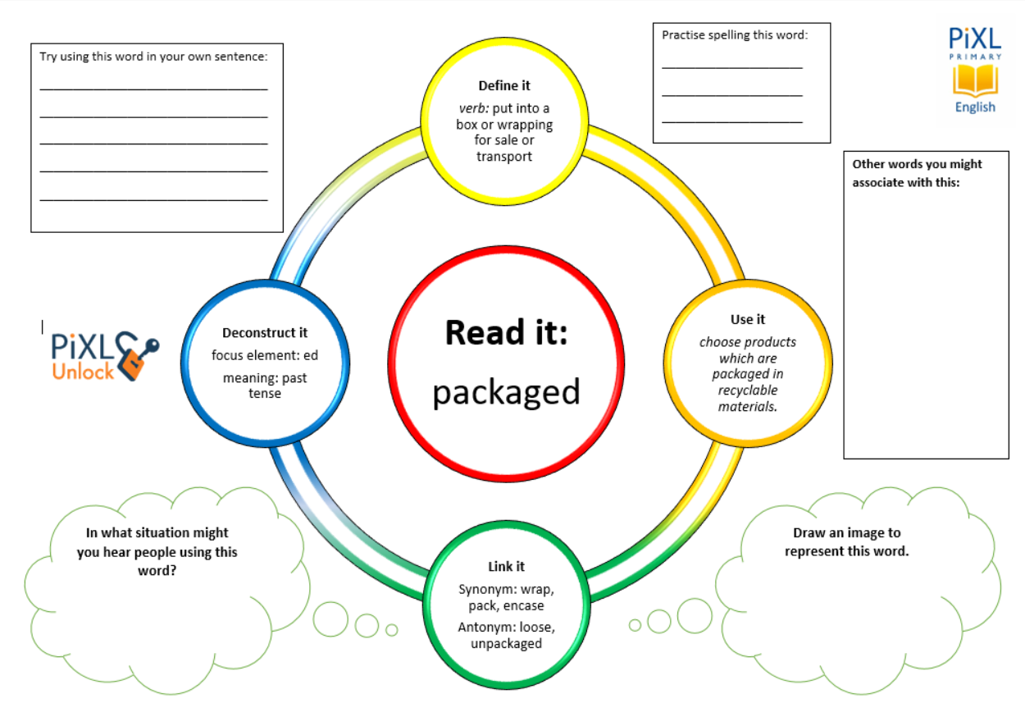
Stage 2 - Vocabulary
packaged
cost
pack

Slide 15
Stage 3 – Number Free Zone
Notebooks are packaged in fours. One pack costs £3.24. How much does each notebook cost?
1. Vocabulary - Write a definition for the following words:
a) packaged b) pack
2. Retrieval – What is in the pack?
3. Inference – What is the question asking you to do? Summarise the problem.

Slide 16
Stage 4 - Answer Free Zone
Notebooks are packaged in fours. One pack costs £3.24. How much does each notebook cost?
Answer: £0.81

Slide 17
Thinking Talk
Notebooks are packaged in fours. One pack costs £3.24. How much does each notebook cost?
Firstly, I will find it easier to divide the money if it is in pence.
I need to share 324p between 4 notebooks.
To do this, I would use short division.
8 1
4 3 2 4
To do this, I will convert £3.24 by multiplying by 100.
3.24 x 100 = 324p
Answer: £0.81

Slide 18
Thinking Talk
Notebooks are packaged in fours. One pack costs £3.24. How much does each notebook cost?
I could also show this as a bar model.
£3.24
£0.81
Answer: £0.81

Slide 19
Stage 5 – Your Turn
6 oranges are put in a net. Each net costs £4.32. How much does each orange cost?
Answer: £0.72

Slide 20
Your Turn
Ping pong balls are sorted in trays of 16. There are 113 trays in each stack. How may ping pong balls are there altogether?
Dry cat food comes in 1.8kg boxes. Stuart feeds his cat 72g of food everyday. How many days will the food last?

Slide 21
Next Steps
To consolidate the language aspects of these problems, a suggestion is that the number free zone questions could form part of a guided reading session. Use Slide 7 as a model. A template can also be found in the Whole School Reading resources on inference (Slide 3).
Once pupils have developed greater confidence in tackling these word problems, they will then need to develop strategies when working independently. A suggestion is on the following slides.

Slide 22

Solving word problems – steps to success
Take Two – read the question twice, once to get a general idea of context and vocabulary; the second to understand exactly what is being asked.
Underline/highlight key information (or eliminate information from your enquiries - like a detective!)
Give us a clue – look for key words to guide you to the operation needed, e.g. altogether suggests addition, share suggests division etc.
Summarise – in your head, summarise the question back to yourself, e.g. So, I’ve got to add the cost of 3 adults to the cost of a child, then subtract that from £50.00.

Slide 23

Solving word problems – steps to success
5. Estimate – round the numbers to give a rough idea of what the answer should be and jot it down.
6. Calculate – make sure you align digits carefully.
8. Read the question back – have you answered it?
9. Look at your original estimate – does your answer seem reasonable?

Slide 24
Apply
Further Number and Answer Free Zone questions can be found on PrimaryWise in the relevant year group areas.
These can be used to provide continued support in developing both the confidence to tackle, and strategies to solve, these problems.

