Slide 1



LIFE/work balance
We have started a #LIFEworkbalance campaign and we need your help to complete our LIFE/work balance survey.
We hope to publish the results soon, so please give 15 minutes of your time to help us get a true picture of school life.
Want to be a part of this campaign? Take the survey on our website and share it with your colleagues!
© Classroom Secrets Limited 2019

Slide 2
Year 3 – Spring Block 1 – Multiplication and Division – Multiply 2 Digits by 1 Digit 1
About This Resource:
This PowerPoint has been designed to support your teaching of this small step. It includes a starter activity and an example of each question from the Varied Fluency and Reasoning and Problem Solving resources also provided in this pack. You can choose to work through all examples provided or a selection of them depending on the needs of your class.
National Curriculum Objectives:
Mathematics Year 3: (3C6) Recall and use multiplication and division facts for the 3, 4 and 8 multiplication tables
Mathematics Year 3: (3C7) Write and calculate mathematical statements for multiplication and division using the multiplication tables that they know, including for two-digit numbers times one-digit numbers, using mental and progressing to formal written methods
Mathematics Year 3: (3C8) Solve problems, including missing number problems, involving multiplication and division, including positive integer scaling problems and correspondence problems in which n objects are connected to m objects
More Year 3 Multiplication and Division resources.
Did you like this resource? Don’t forget to review it on our website.
© Classroom Secrets Limited 2018

Slide 3
Year 3 – Spring Block 1 – Multiplication and Division
Step 3: Multiply 2 Digits by 1 Digit 1
© Classroom Secrets Limited 2018

Slide 4
Introduction
Match the multiplication to the repeated addition.
10 + 10 + 10
12 x 3
9 + 9 + 9 + 9 + 9
10 x 3
12 + 12 + 12
2 x 4
2 + 2 + 2 + 2
5 x 9
© Classroom Secrets Limited 2018

Slide 5
Introduction
Match the multiplication to the repeated addition.
10 + 10 + 10
12 x 3
9 + 9 + 9 + 9 + 9
10 x 3
12 + 12 + 12
2 x 4
2 + 2 + 2 + 2
5 x 9
© Classroom Secrets Limited 2018

Slide 6
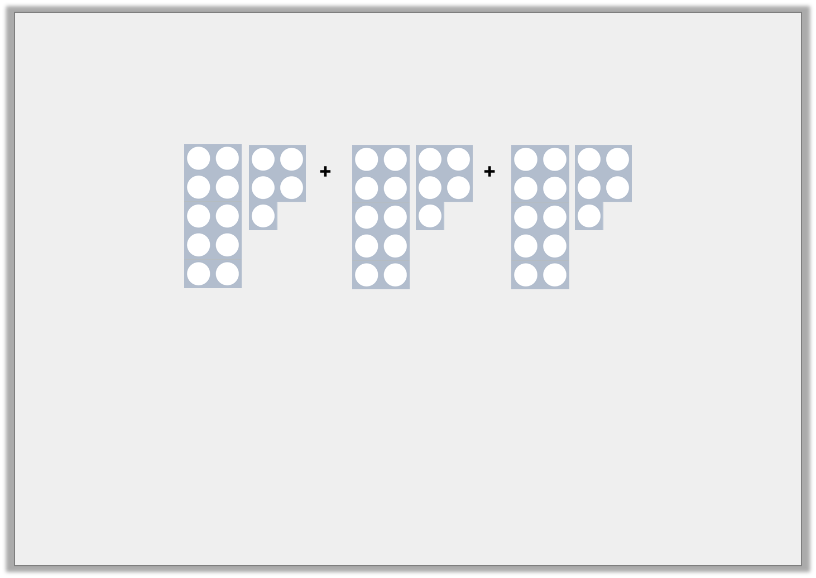
Varied Fluency 1
Complete these calculations.
 | + |  | + |  | =
 | x |  | =
© Classroom Secrets Limited 2018

Slide 7
Varied Fluency 1
Complete these calculations.
15 | + | 15 | + | 15 | = | 45
15 | x | 3 | = | 45
© Classroom Secrets Limited 2018

Slide 8
Varied Fluency 2
Complete the calculation.
T | O
 | x | 4 | =
© Classroom Secrets Limited 2018

Slide 9
Varied Fluency 2
Complete the calculation.
T | O
21 | x | 4 | = | 84
© Classroom Secrets Limited 2018

Slide 10
Varied Fluency 3
True or false? 24 x 2 = 48
48
 | T | O
 | 2 | 4
x |  | 2
1
1
10
1
10
1
1
1
10
1
10
1
© Classroom Secrets Limited 2018

Slide 11
Varied Fluency 3
True or false? 24 x 2 = 48
True
48
 | T | O
 | 2 | 4
x |  | 2
 | 4 | 8
1
1
10
1
10
1
1
1
10
1
10
1
© Classroom Secrets Limited 2018

Slide 12
Varied Fluency 4
Using the numbers below complete the calculation.
32 | 99 | 42 | 69 | 96
 | x | 3 | =
T | O
© Classroom Secrets Limited 2018

Slide 13
Varied Fluency 4
Using the numbers below complete the calculation.
32 | 99 | 42 | 69 | 96
32 | x | 3 | = | 96
T | O
© Classroom Secrets Limited 2018

Slide 14

Reasoning 1
Blake and Brooke have solved the following multiplications.
Are they correct?
Explain how you know, using a place value grid to show your working.
 | T | O
 | 3 | 0
x |  | 3
 | 9 | 0
 | T | O
 | 3 | 1
x |  | 2
 | 5 | 3
Blake
Brooke
© Classroom Secrets Limited 2018

Slide 15
Reasoning 1
Blake and Brooke have solved the following multiplications.
Are they correct?
Explain how you know, using a place value grid to show your working.
 | T | O
 | 3 | 0
x |  | 3
 | 9 | 0
 | T | O
 | 3 | 1
x |  | 2
 | 5 | 3
Blake
Brooke
Blake is correct. Brooke is incorrect because…
© Classroom Secrets Limited 2018

Slide 16
Reasoning 1
Blake and Brooke have solved the following multiplications.
Are they correct?
Explain how you know, using a place value grid to show your working.
 | T | O
 | 3 | 0
x |  | 3
 | 9 | 0
 | T | O
 | 3 | 1
x |  | 2
 | 5 | 3
Blake
Brooke
Blake is correct. Brooke is incorrect because she has added the numbers together instead of multiplying them. 31 x 2 = 62.
© Classroom Secrets Limited 2018

Slide 17

Reasoning 2
Rehan is thinking of a number.
What is Rehan’s number?
Explain how you know.
I multiplied a number by 3. The answer was 36.
© Classroom Secrets Limited 2018

Slide 18
Reasoning 2
Rehan is thinking of a number.
What is Rehan’s number?
Explain how you know.
I multiplied a number by 3. The answer was 36.
Rehan’s number is 12 because…
© Classroom Secrets Limited 2018

Slide 19
Reasoning 2
Rehan is thinking of a number.
What is Rehan’s number?
Explain how you know.
I multiplied a number by 3. The answer was 36.
Rehan’s number is 12 because 3 x 12 = 36.
© Classroom Secrets Limited 2018

Slide 20
Problem Solving 1
Create and solve a calculation using the digit cards below.
 | T | O
 |  | 3
x
 | 3
9
1
3
© Classroom Secrets Limited 2018

Slide 21
Problem Solving 1
Create and solve a calculation using the digit cards below.
 | T | O
 |  | 3
x
 | 3
1
3
9
9
1
3
© Classroom Secrets Limited 2018

