Slide 1



LIFE/work balance
We have started a #LIFEworkbalance campaign and we need your help to complete our LIFE/work balance survey.
We hope to publish the results soon, so please give 15 minutes of your time to help us get a true picture of school life.
Want to be a part of this campaign? Take the survey on our website and share it with your colleagues!
© Classroom Secrets Limited 2019

Slide 2
Year 4 – Autumn Block 4 – Multiplication and Division – Multiply and Divide by 7
About This Resource:
This PowerPoint has been designed to support your teaching of this small step. It includes a starter activity and an example of each question from the Varied Fluency and Reasoning and Problem Solving resources also provided in this pack. You can choose to work through all examples provided or a selection of them depending on the needs of your class.
National Curriculum Objectives:
Mathematics Year 4: (4N1) Count in multiples of 6, 7, 9, 25 and 1000
Mathematics Year 4: (4C6a) Recall multiplication and division facts for multiplication tables up to 12 × 12
More Year 4 Multiplication and Division resources.
Did you like this resource? Don’t forget to review it on our website.
© Classroom Secrets Limited 2018

Slide 3
Year 4 – Autumn Block 4 – Multiplication and Division
Step 11: Multiply and Divide by 7
© Classroom Secrets Limited 2018

Slide 4
Introduction
Highlight all the multiples of 7 in the hundred square below.
1 | 2 | 3 | 4 | 5 | 6 | 7 | 8 | 9 | 10
11 | 12 | 13 | 14 | 15 | 16 | 17 | 18 | 19 | 20
21 | 22 | 23 | 24 | 25 | 26 | 27 | 28 | 29 | 30
31 | 32 | 33 | 34 | 35 | 36 | 37 | 38 | 39 | 40
41 | 42 | 43 | 44 | 45 | 46 | 47 | 48 | 49 | 50
51 | 52 | 53 | 54 | 55 | 56 | 57 | 58 | 59 | 60
61 | 62 | 63 | 64 | 65 | 66 | 67 | 68 | 69 | 70
71 | 72 | 73 | 74 | 75 | 76 | 77 | 78 | 79 | 80
81 | 82 | 83 | 84 | 85 | 86 | 87 | 88 | 89 | 90
91 | 92 | 93 | 94 | 95 | 96 | 97 | 98 | 99 | 100
© Classroom Secrets Limited 2018

Slide 5
Introduction
Highlight all the multiples of 7 in the hundred square below.
1 | 2 | 3 | 4 | 5 | 6 | 7 | 8 | 9 | 10
11 | 12 | 13 | 14 | 15 | 16 | 17 | 18 | 19 | 20
21 | 22 | 23 | 24 | 25 | 26 | 27 | 28 | 29 | 30
31 | 32 | 33 | 34 | 35 | 36 | 37 | 38 | 39 | 40
41 | 42 | 43 | 44 | 45 | 46 | 47 | 48 | 49 | 50
51 | 52 | 53 | 54 | 55 | 56 | 57 | 58 | 59 | 60
61 | 62 | 63 | 64 | 65 | 66 | 67 | 68 | 69 | 70
71 | 72 | 73 | 74 | 75 | 76 | 77 | 78 | 79 | 80
81 | 82 | 83 | 84 | 85 | 86 | 87 | 88 | 89 | 90
91 | 92 | 93 | 94 | 95 | 96 | 97 | 98 | 99 | 100
© Classroom Secrets Limited 2018

Slide 6
Varied Fluency 1
Create 2 calculations using the digit cards and symbol.
8
4
7
56
÷
7 | 14 | 21 | 28 | 35 | 42 | 49 | 56 | 63 | 70 | 77 | 84
© Classroom Secrets Limited 2018

Slide 7
Varied Fluency 1
Create 2 calculations using the digit cards and symbol.
56 ÷ 7 = 8; 56 ÷ 8 = 7
8
4
7
56
÷
7 | 14 | 21 | 28 | 35 | 42 | 49 | 56 | 63 | 70 | 77 | 84
© Classroom Secrets Limited 2018

Slide 8
Varied Fluency 2
Complete the statement below.
63
÷
7
=
?
© Classroom Secrets Limited 2018

Slide 9
Varied Fluency 2
Complete the statement below.
63
÷
7
=
9
© Classroom Secrets Limited 2018

Slide 10
Varied Fluency 3
Complete the part-whole model below.
3 x 7
8 x 7
© Classroom Secrets Limited 2018

Slide 11
Varied Fluency 3
Complete the part-whole model below.
77
21
56
© Classroom Secrets Limited 2018

Slide 12
Reasoning 1
Which is the odd one out? Prove it.
42 ÷ 6 = 7
56 ÷ 8 = 7
7 x 6 = 42
7 x 8 = 56
48 ÷ 7 = 7
© Classroom Secrets Limited 2018

Slide 13
Reasoning 1
Which is the odd one out? Prove it.
48 ÷ 7 = 7 is the odd one out because...
42 ÷ 6 = 7
56 ÷ 8 = 7
7 x 6 = 42
7 x 8 = 56
48 ÷ 7 = 7
© Classroom Secrets Limited 2018

Slide 14
Reasoning 1
Which is the odd one out? Prove it.
48 ÷ 7 = 7 is the odd one out because 48 is not a multiple 7 so the calculation is incorrect.
42 ÷ 6 = 7
56 ÷ 8 = 7
7 x 6 = 42
7 x 8 = 56
48 ÷ 7 = 7
© Classroom Secrets Limited 2018

Slide 15
Problem Solving 1
Travel through the maze using only multiples of 7.
6 | 27 | 7 | 42 | 29
35 | 84 | 70 | 46 | 34
32 | 52 | 49 | 70 | 42
28 | 14 | 22 | 82 | 90
12 | 5 | 13 | 36 | 107
Start
Finish
7 | 7 | 7 | 7 | 7 | 7 | 7 | 7 | 7 | 7 | 7 | 7
© Classroom Secrets Limited 2018

Slide 16
Problem Solving 1
Travel through the maze using only multiples of 7.
6 | 27 | 7 | 42 | 29
35 | 84 | 70 | 46 | 34
32 | 52 | 49 | 70 | 42
28 | 14 | 22 | 82 | 26
12 | 5 | 13 | 36 | 21
Start
Finish
7 | 7 | 7 | 7 | 7 | 7 | 7 | 7 | 7 | 7 | 7 | 7
© Classroom Secrets Limited 2018

Slide 17
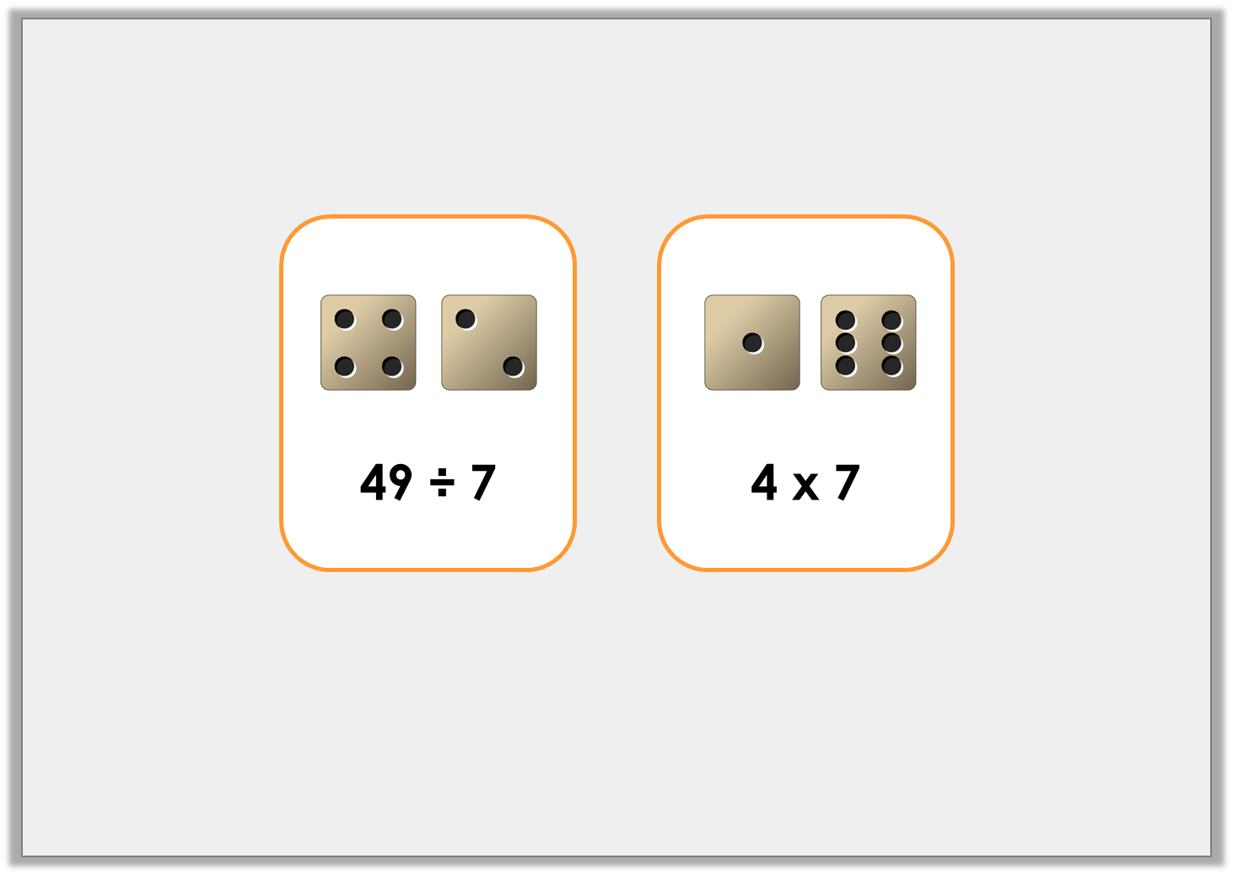
Problem Solving 2
Write a word problem for each of the following calculations.
Now solve your word problems.
© Classroom Secrets Limited 2018

Slide 18
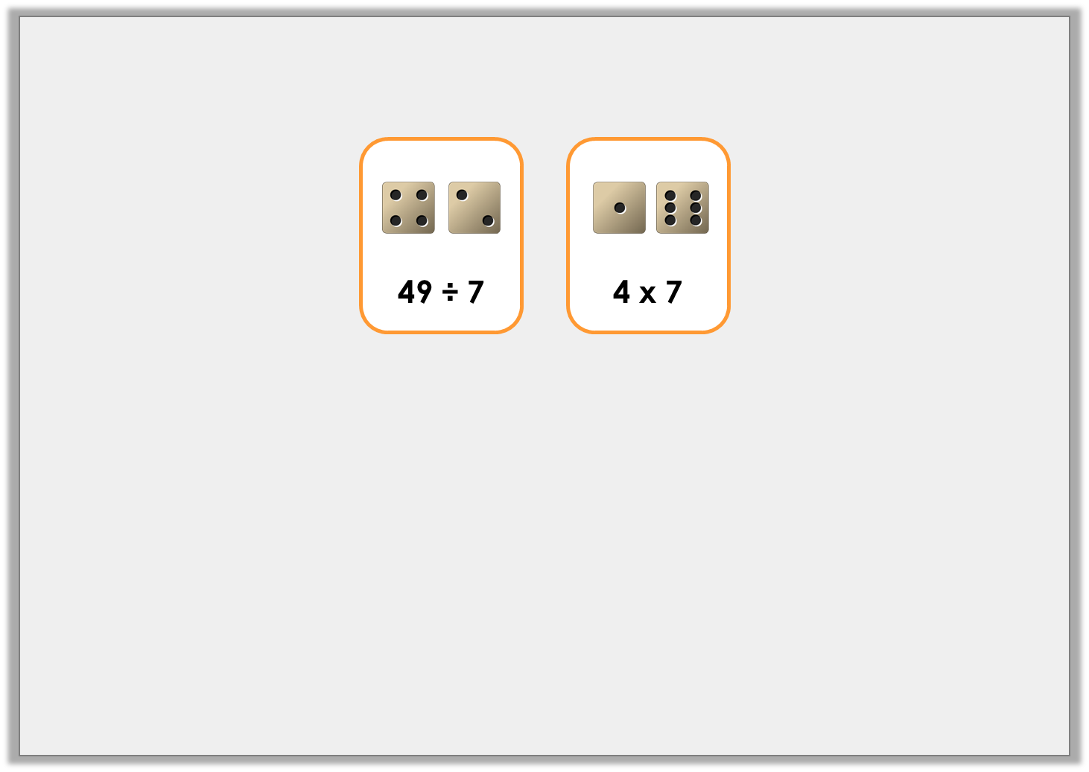
Problem Solving 2
Write a word problem for each of the following calculations.
Now solve your word problems.
Gino has 49 treats for his fish. He has 7 fish. How many treats do they each get?
49 ÷ 7 = 7
They get 7 treats each.
There are 4 muffins in a box and I have 7 boxes. How many are there altogether?
4 x 7 = 28
There are 28 muffins altogether.
© Classroom Secrets Limited 2018

